Slide 1


Heritage Under Pressure:
Exploring Climate Science and Culture
www.planet-pulse.eu

Slide 2
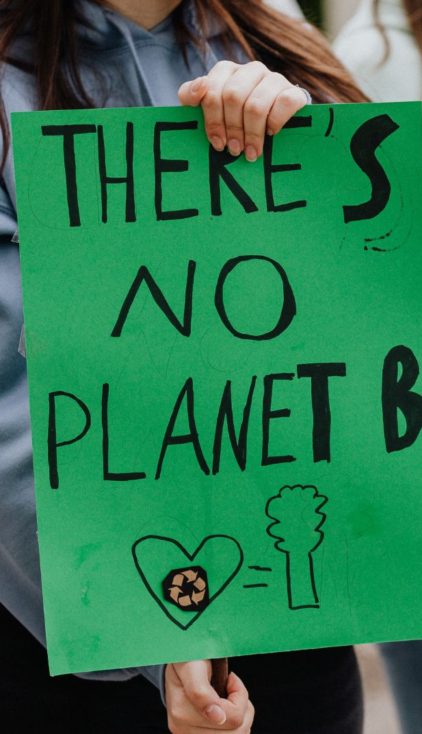
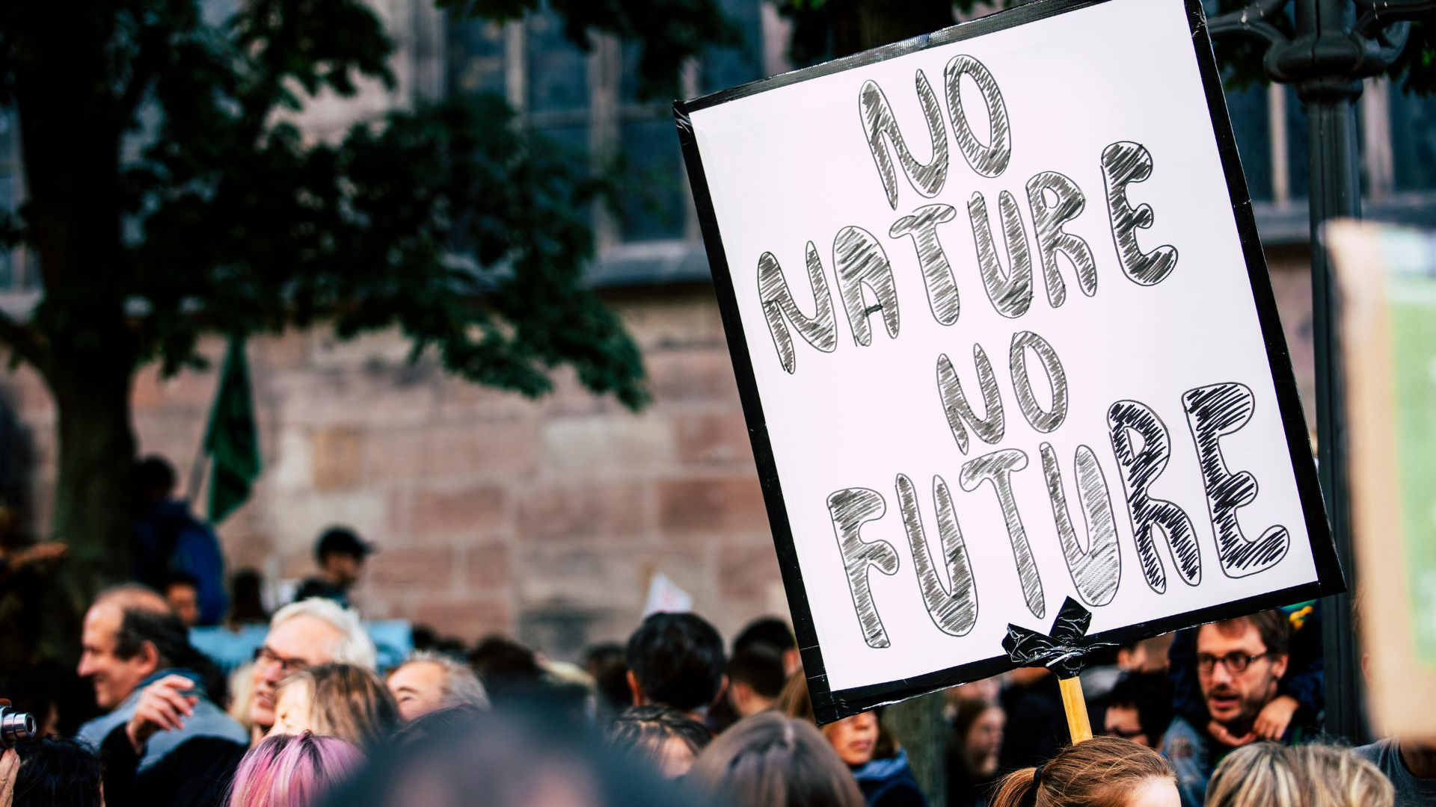
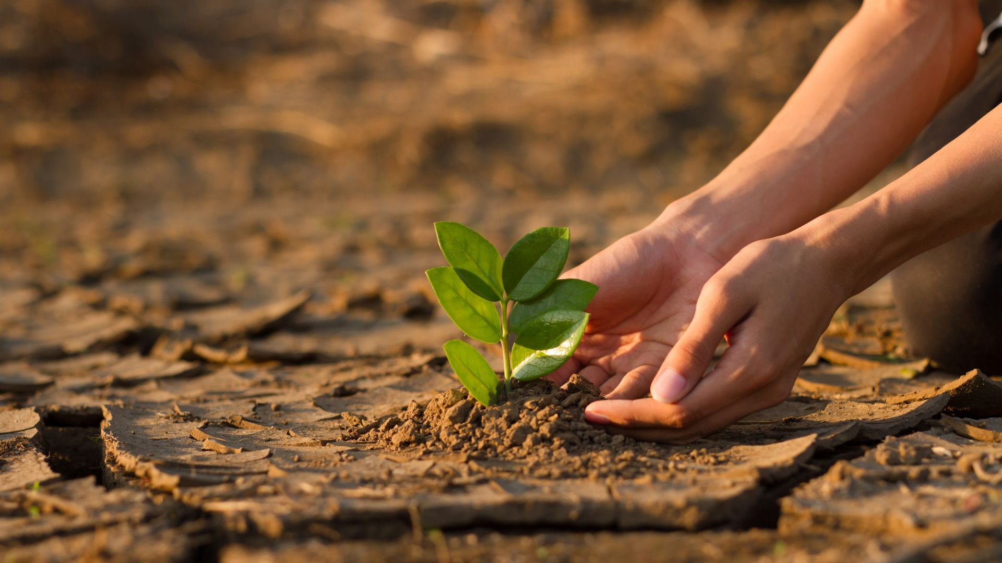
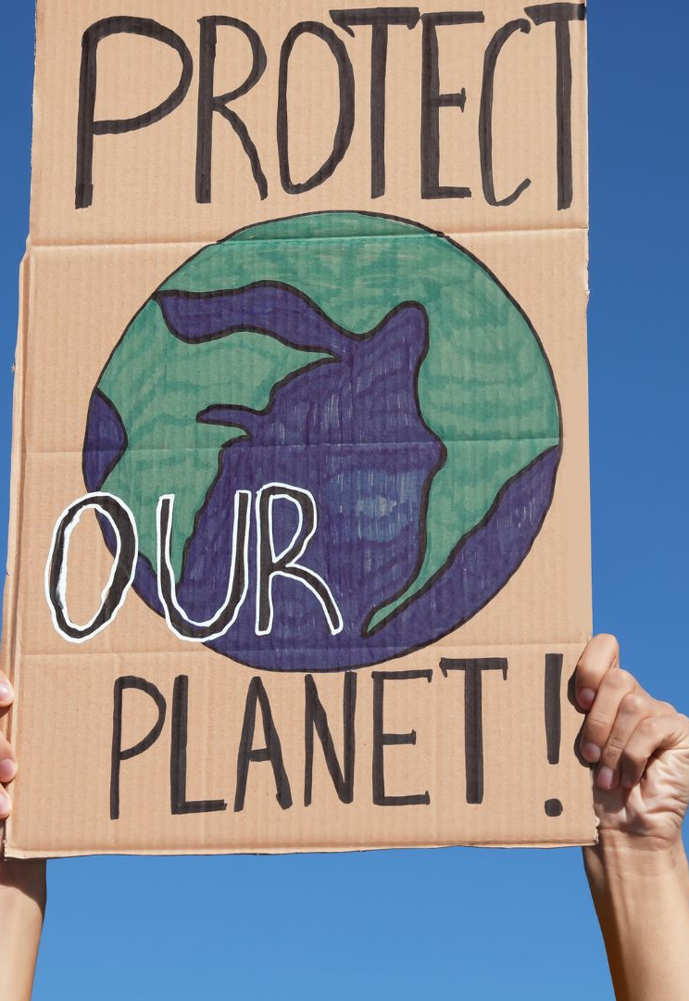
01
03
Climate Science & Heritage Basics (Short Factsheet)
TRY — Group Activity: “Heritage Under Pressure”
CONTENTS
00
02
Introduction & Learning Goals
THINK — Discussion Questions

Slide 3

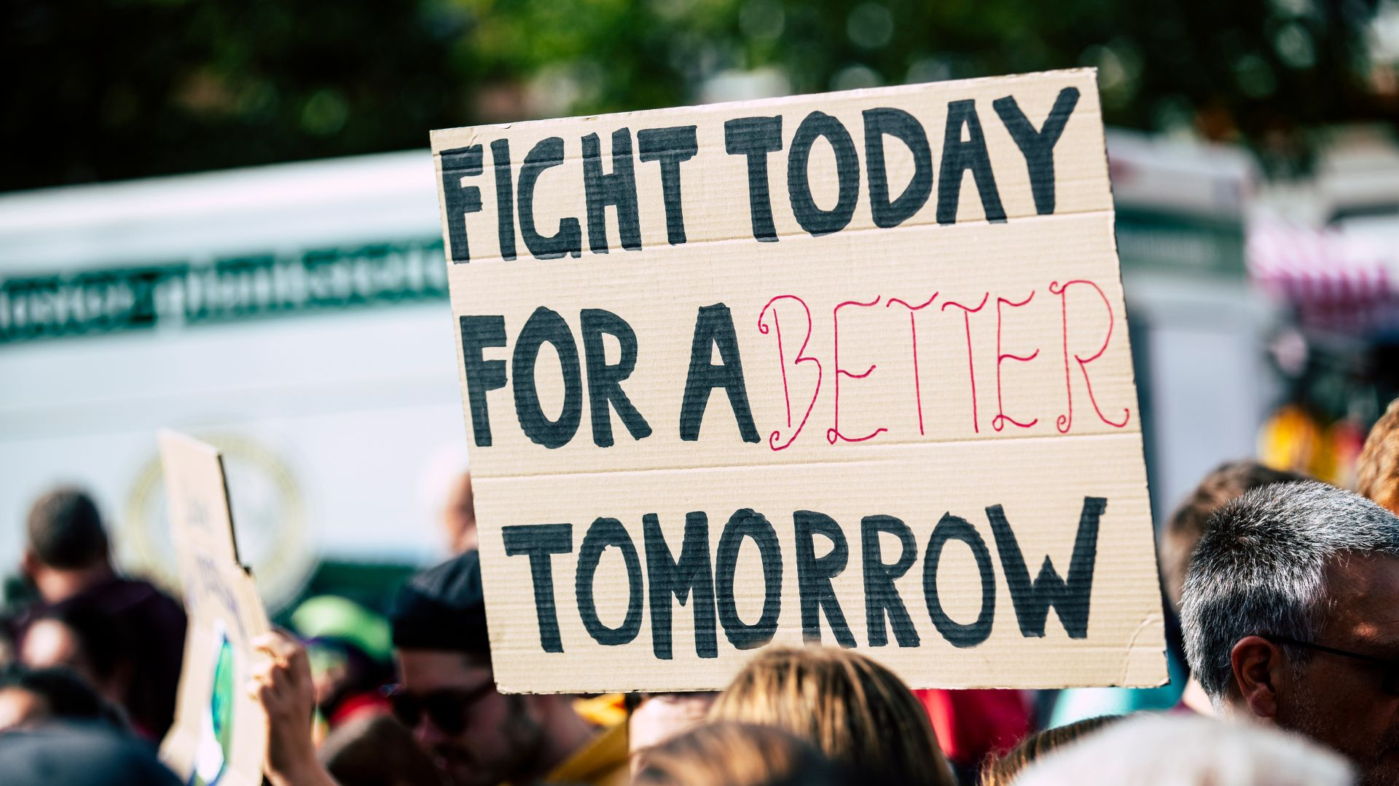
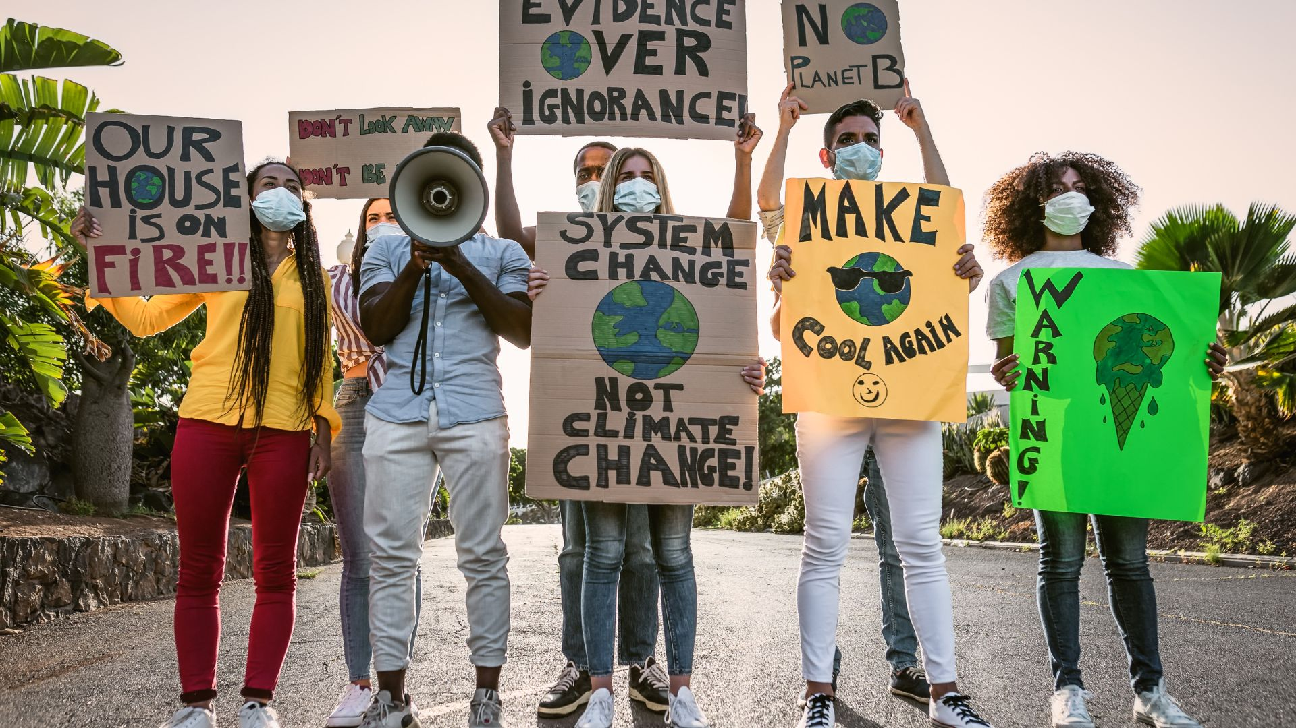
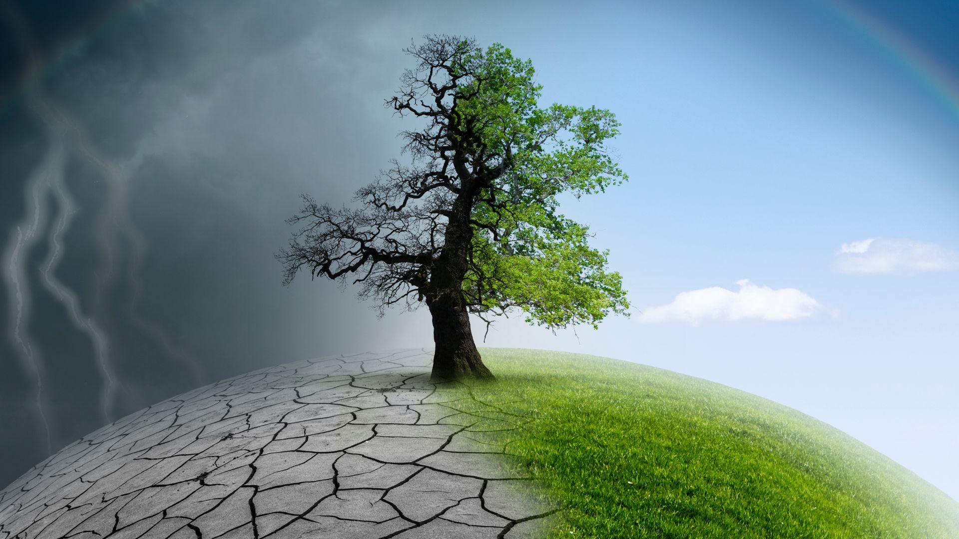
04
06
CONNECT — Climate Science in Local Heritage
Key Takeaways
CONTENTS
05
07
REFLECT — Making Meaning
Explore More — Read, Watch & Listen

Slide 4
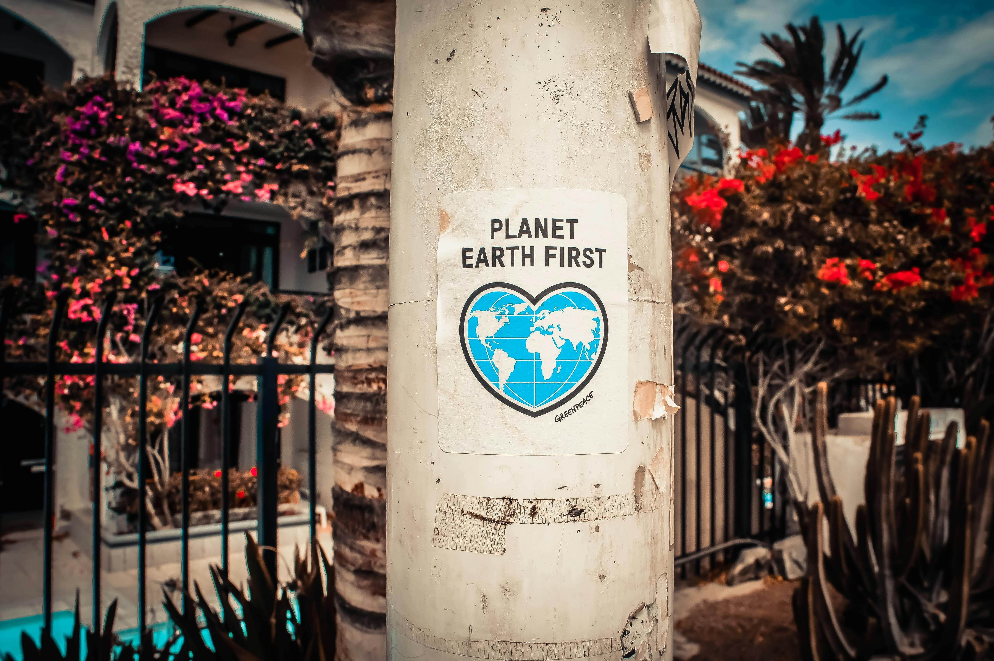
00
INTRODUCTION

Slide 5
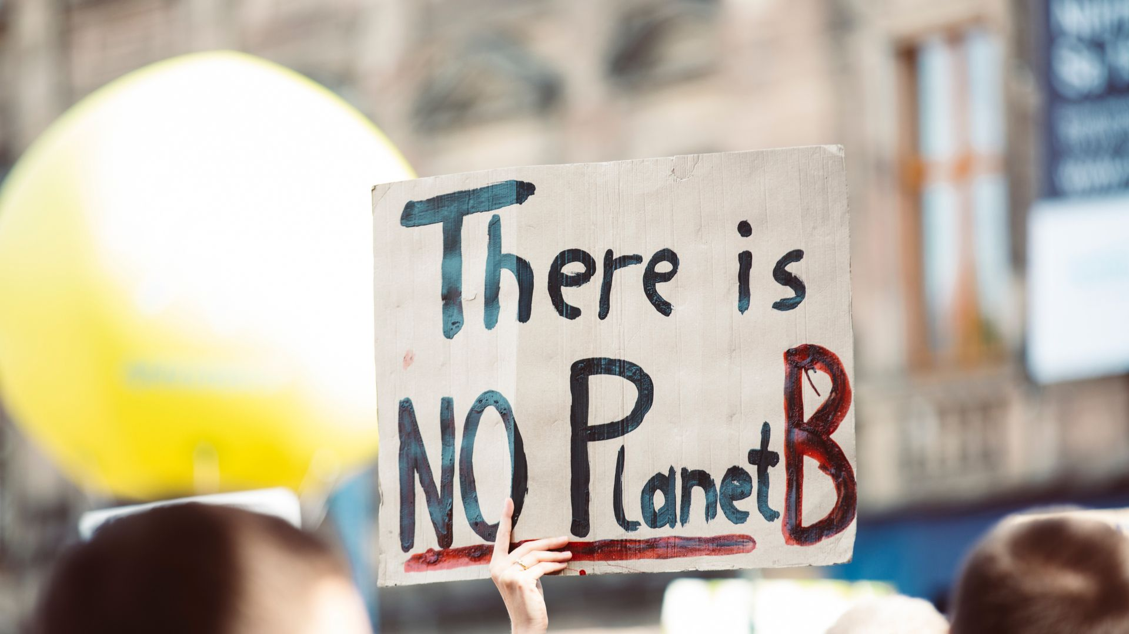
00
INTRODUCTION
Climate change is not only about rising temperatures and shifting weather patterns — it also affects the places, traditions, and cultural landscapes that communities value.
Historic buildings, museums, archaeological sites, traditional crafts, foodways, festivals, and living heritage all face new pressures from extreme weather, sea-level rise, changing seasons, and environmental shifts.
This guide helps groups explore how climate science connects to cultural heritage and what it means for identity, memory, and community well-being.

Slide 6
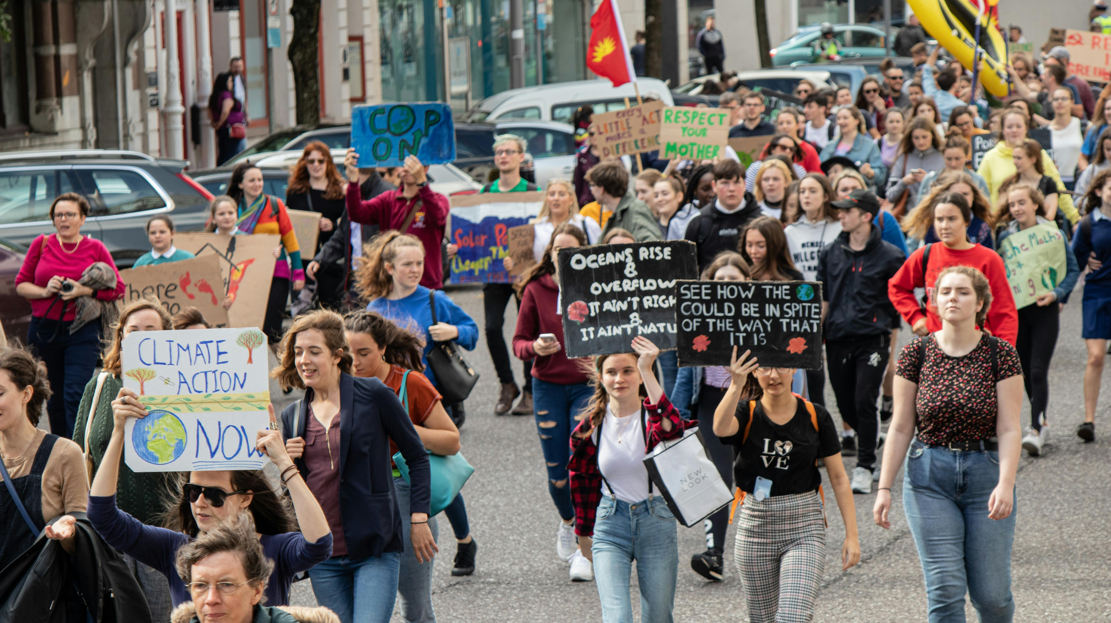
INTRODUCTION - Learning Goals
By participating in this activity, groups will:
Understand basic climate science concepts relevant to heritage protection
Explore how climate impacts affect cultural landscapes and identities
Discuss examples of threatened heritage locally and globally
Reflect on personal connections to heritage and climate
Brainstorm ways science, culture, and community action can come together

Slide 7
01
Climate Science &
Heritage Basics
(Short Factsheet)

Slide 8
How Climate Change Affects Cultural Heritage
Climate processes impact heritage through:
Extreme weather — storms, heatwaves, heavy rainfall
Gradual processes — erosion, sea-level rise, flooding
Temperature and humidity changes — affecting wood, stone, metals, textiles
Wildfires and drought — risk to landscapes, rural architecture, agricultural traditions
Biodiversity shifts — impacting traditional food systems, seasonal festivals, and local crafts
01
Climate Science &
Heritage Basics

Slide 9
Why Climate Science Matters for Heritage
Climate science helps communities:
Predict which areas or sites are most vulnerable
Understand physical processes (erosion, humidity changes, freeze–thaw cycles)
Develop adaptation strategies for buildings and cultural landscapes
Protect traditional knowledge connected to climate-sensitive environments
01
Climate Science &
Heritage Basics

Slide 10
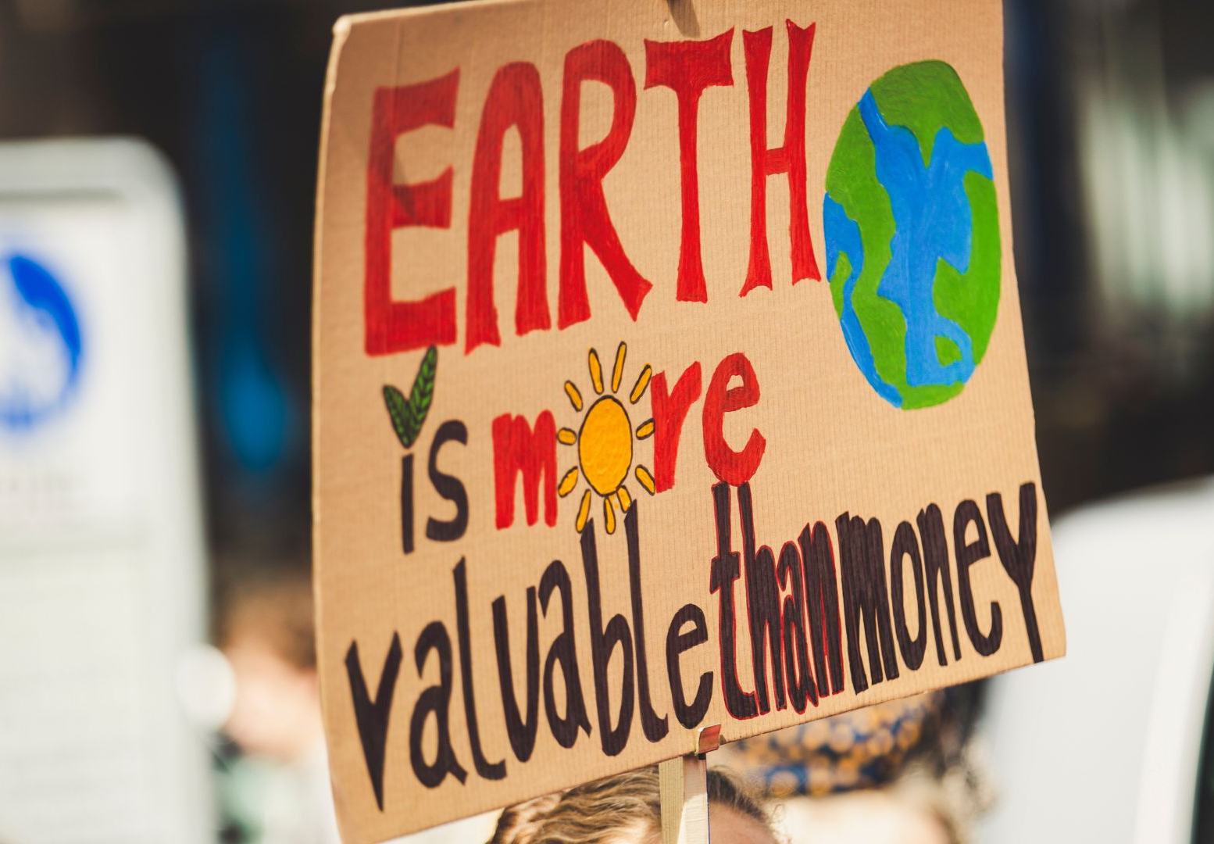
02
THINK —
Discussion Questions

Slide 11
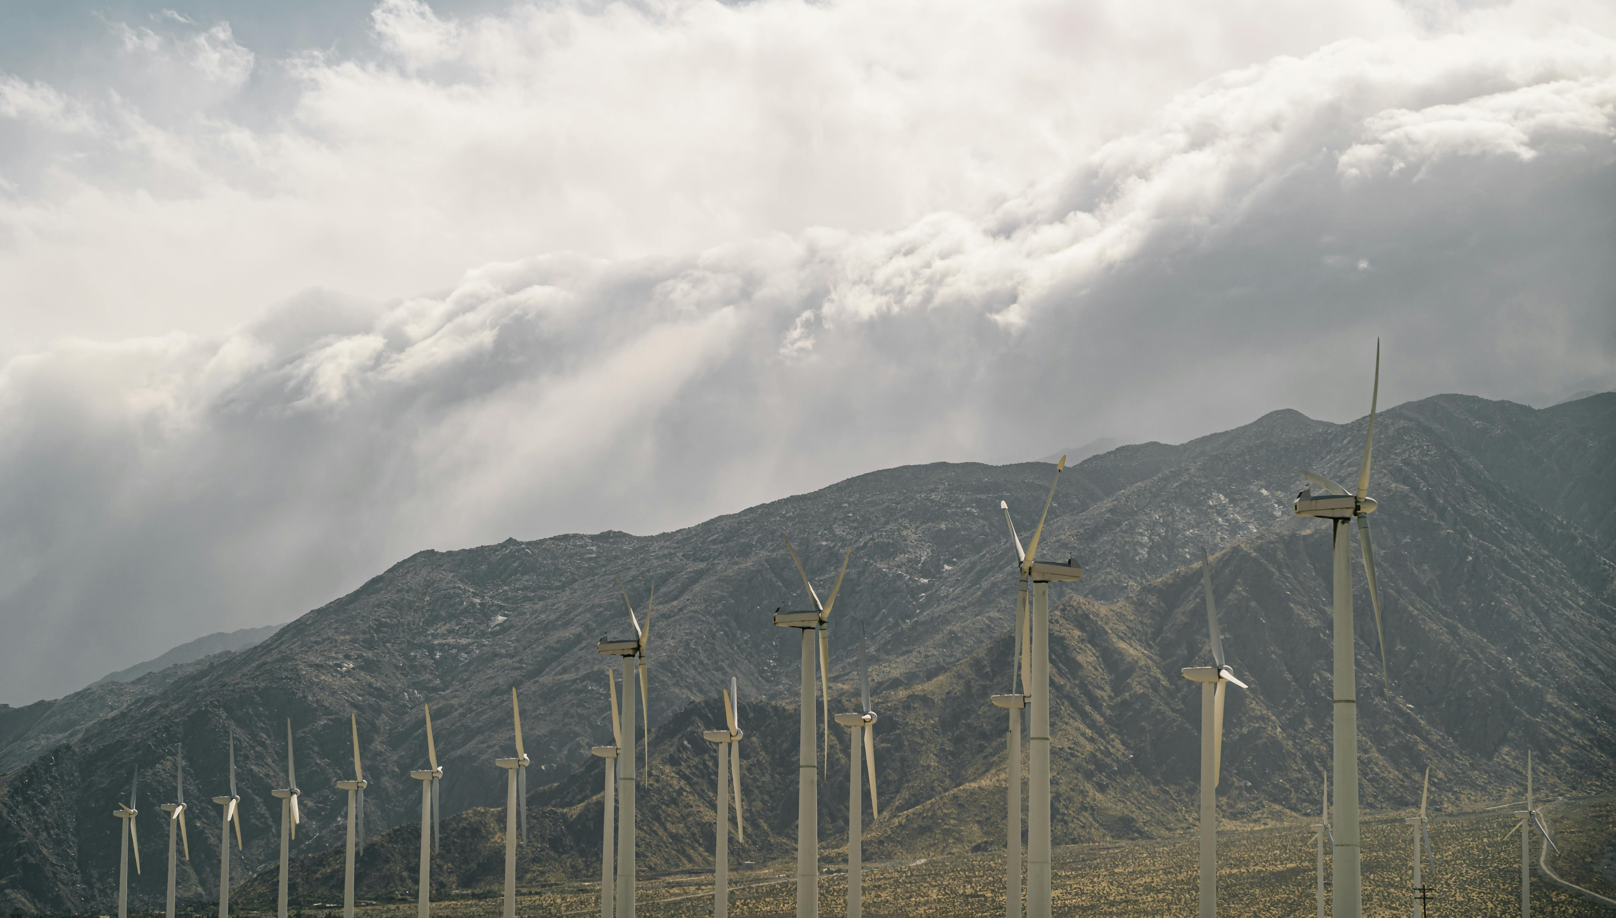
Understanding the Science
Que. 1: Which climate impacts (heat, storms, heavy rain, drought) are becoming more noticeable where you live?
Que. 2: How might these environmental changes affect buildings, landscapes, or traditions in your region?
02
THINK — Discussion Questions
Connecting Science and Culture
Que. 3: Can you think of a cultural site, festival, craft, or tradition that depends on stable weather or seasons?
Que. 4: What heritage elements — local or global — do you think are most at risk from climate change?

Slide 12
Critical Thinking
Que. 5: Why is it important to combine scientific knowledge with cultural understanding when planning climate action?
Que. 6: How might technology and traditional knowledge work together to protect heritage?
02
THINK — Discussion Questions

Slide 13
03
TRY — Group Activity
“Heritage Under Pressure”

Slide 14
Step 1 — Choose a Heritage Element
Groups pick one heritage element to explore.
Examples:
A local historical building or monument
A traditional craft or skill (e.g., lace-making, woodworking, pottery)
A cultural landscape (terraced fields, mining areas, vineyards)
A festival or seasonal tradition
A museum or archive
03
TRY — Group Activity: “Heritage Under Pressure”

Slide 15
Step 2 — Identify Climate Risks
Using simple climate science reasoning, discuss:
How might heat, humidity, storms, or drought affect this heritage?
Are materials (wood, stone, textiles) sensitive to climate factors?
For traditions: do they depend on a specific season, crop, ecosystem, or species?
03
TRY — Group Activity: “Heritage Under Pressure”

Slide 16
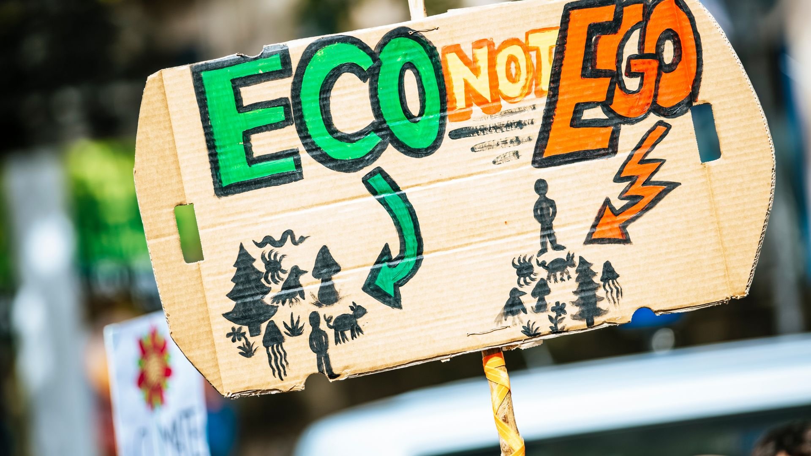
Step 3 — Visual Mapping
On a large sheet of paper (or whiteboard), groups create a simple diagram:
Heritage Element → Climate Impact → Consequence → Possible Solutions
Example:
Old mining settlement → Heavy rainfall → Slope erosion → Reinforced drainage + monitoring
03
TRY — Group Activity: “Heritage Under Pressure”

Slide 17
Step 4 — Share Out
Each group shares:
Why they chose the heritage element
The most important climate risk they identified
One idea for protecting it
03
TRY — Group Activity: “Heritage Under Pressure”

Slide 18
04
CONNECT-
Climate Science in Local Heritage

Slide 19
Option A: Observation Walk (Outdoor or Virtual)
If possible, take a walk around a cultural site or historic street.
Observe:
Visible weather-related damage (cracks, moisture marks, erosion)
Materials sensitive to climate (wooden doors, stone facades, traditional roofs)
Water flow and drainage
Shade vs. sun exposure
Discuss:
“How might future climate changes affect these features?”
04
CONNECT — Climate Science in Local Heritage

Slide 20
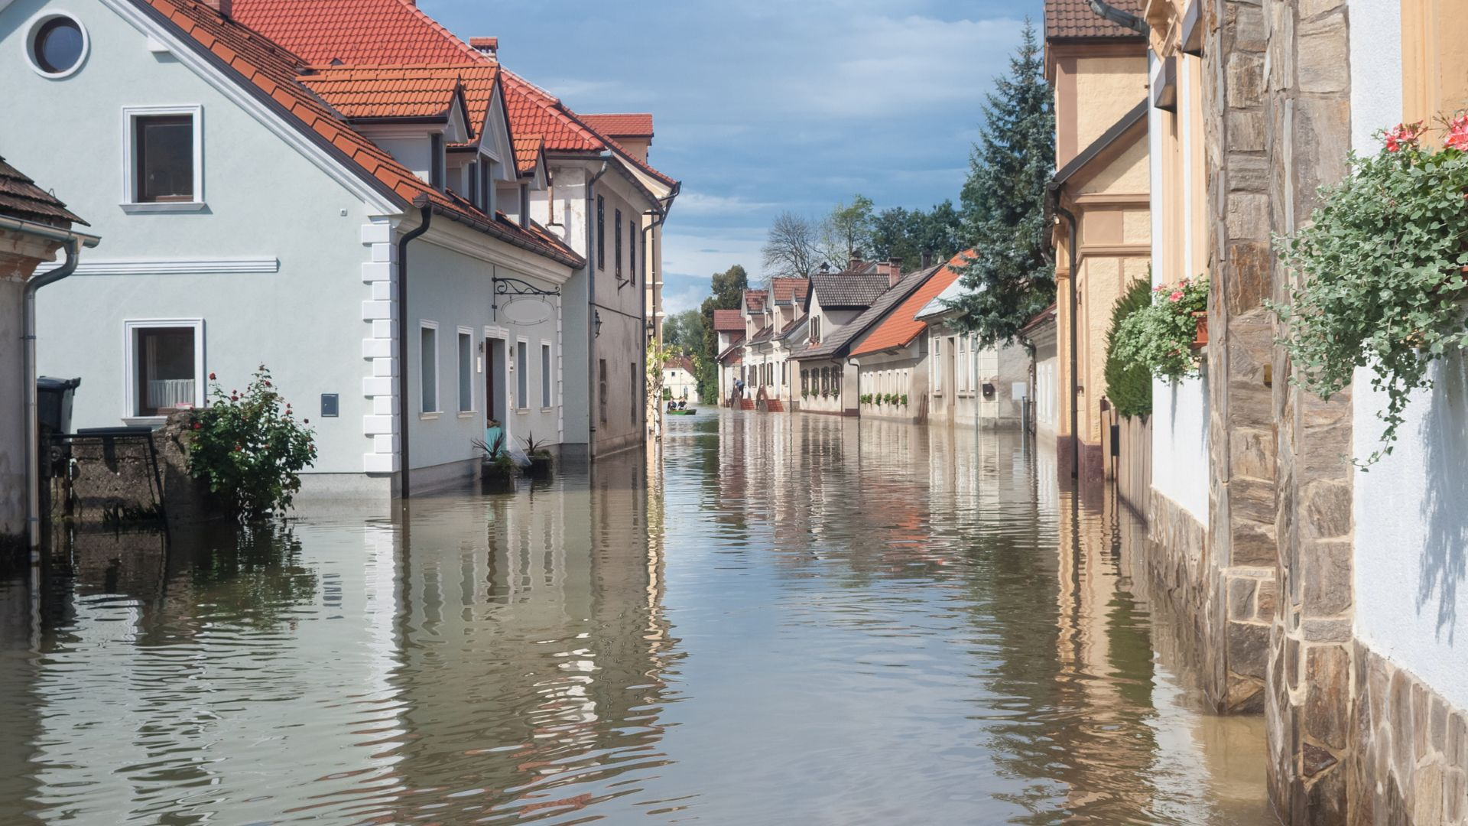
Option B: Photo Analysis (Indoor)
Provide images of cultural heritage sites experiencing climate impacts (flooded towns, cracked walls, wildfire damage, coastal erosion).
Groups identify scientific processes behind the damage.
04
CONNECT — Climate Science in Local Heritage

Slide 21
05
REFLECT —
Making Meaning

Slide 22
REFLECT — Making Meaning
What part of today’s discussion surprised you most?
How does connecting climate science with cultural heritage change the way you think about climate change?
Which heritage element would you most want to protect — and why?
What role can communities play in safeguarding both the environment and cultural identity?
05
REFLECT — Making Meaning

Slide 23
06
Key Takeaways

Slide 24
Key Takeaways
Climate science provides essential insights for protecting cultural heritage.
Cultural heritage — both material and intangible — is vulnerable to climate impacts.
Scientific knowledge + community knowledge creates stronger strategies for resilience.
Heritage protection strengthens local identity, belonging, and continuity.
Everyone has a role in connecting cultural memory with sustainable futures.
06
Key Takeaways

Slide 25
07
Explore More
Read, Watch & Listen

Slide 26
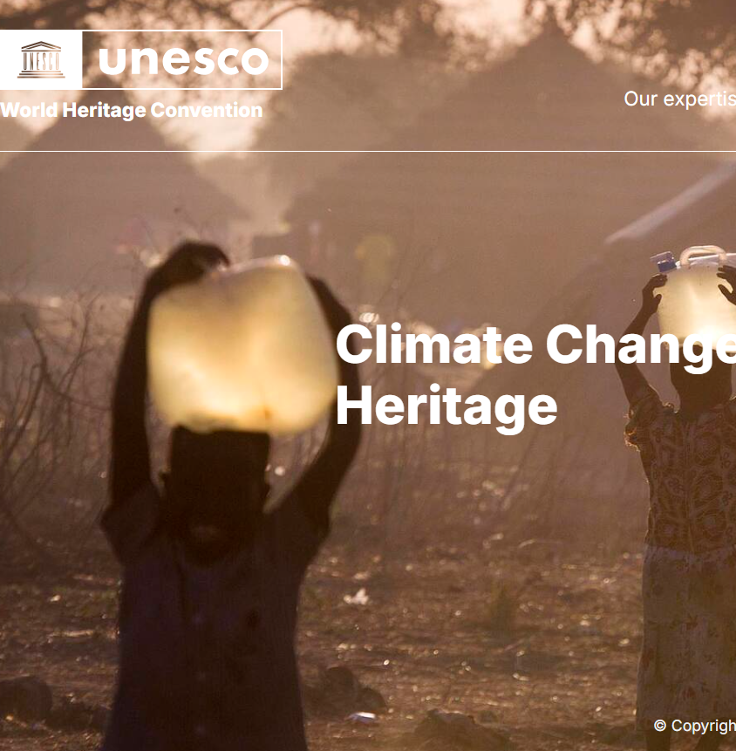
07
Read
UNESCO – Climate Change and World Heritage
Portal describes how climate change threatens World Heritage sites (glaciers, coral reefs, historic cities, etc.) while also highlighting how these sites can help with climate mitigation (e.g., forests absorbing CO₂).
https://whc.unesco.org/en/climatechange/

Slide 27
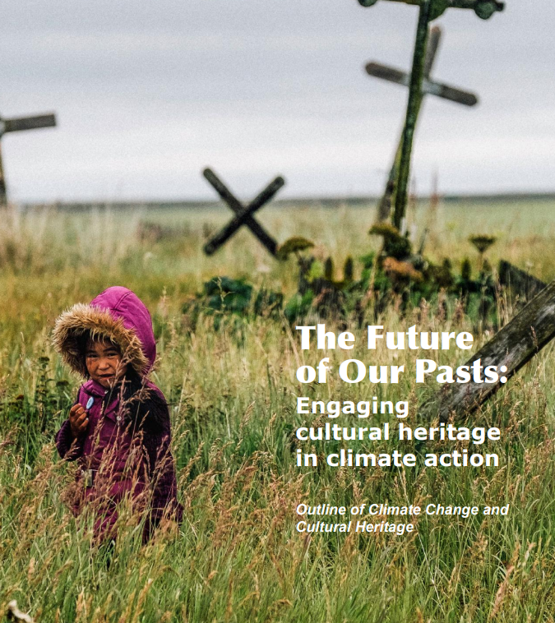

07
Read
ICOMOS – Future of Our Pasts: climate report on heritage
Report argues that cultural heritage must be actively integrated into climate policy, showing both how heritage is at risk from climate change and how it can contribute to climate resilience, adaptation, and mitigation.
https://civvih.icomos.org/wp-content/uploads/Future-of-Our-Pasts-Report-min.pdf

Slide 28
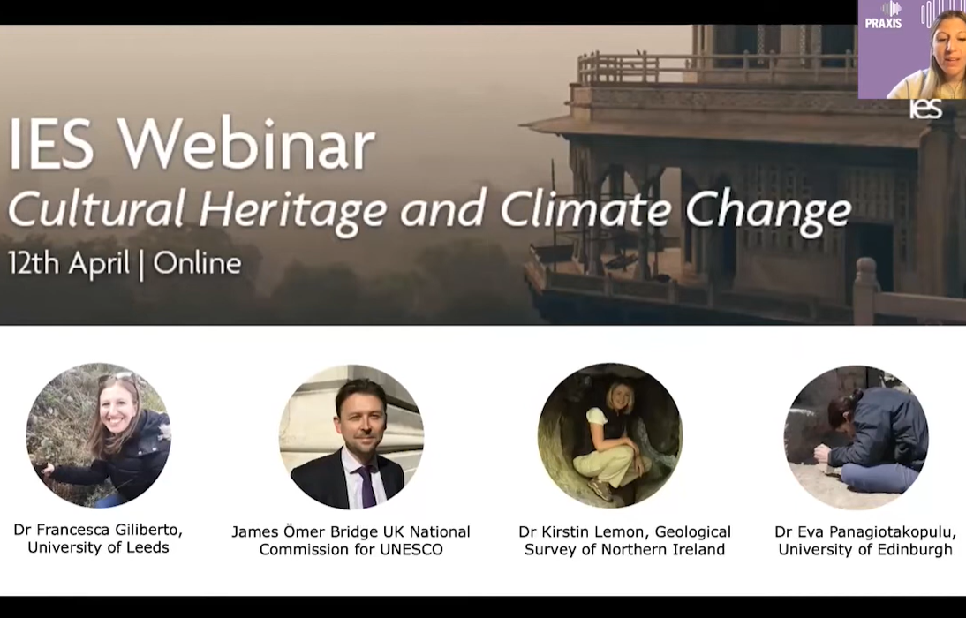

07
Watch
Webinar - Cultural Heritage and Climate Change
Video discusses how climate change impacts both tangible and intangible cultural heritage, and explores how heritage can serve as a resource for adaptation and mitigation
https://www.youtube.com/watch?v=Eoi-333nHVg

Slide 29
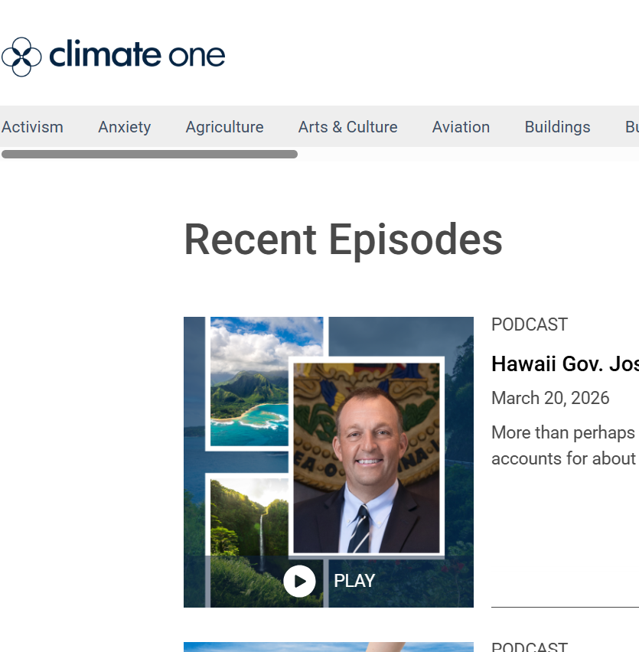

07
Listen
Climate One – podcast
Climate One brings together thought leaders, policymakers, activists, and Indigenous voices to explore how climate change affects communities, culture, and heritage.
https://www.climateone.org/listen-watch/podcasts

Slide 30
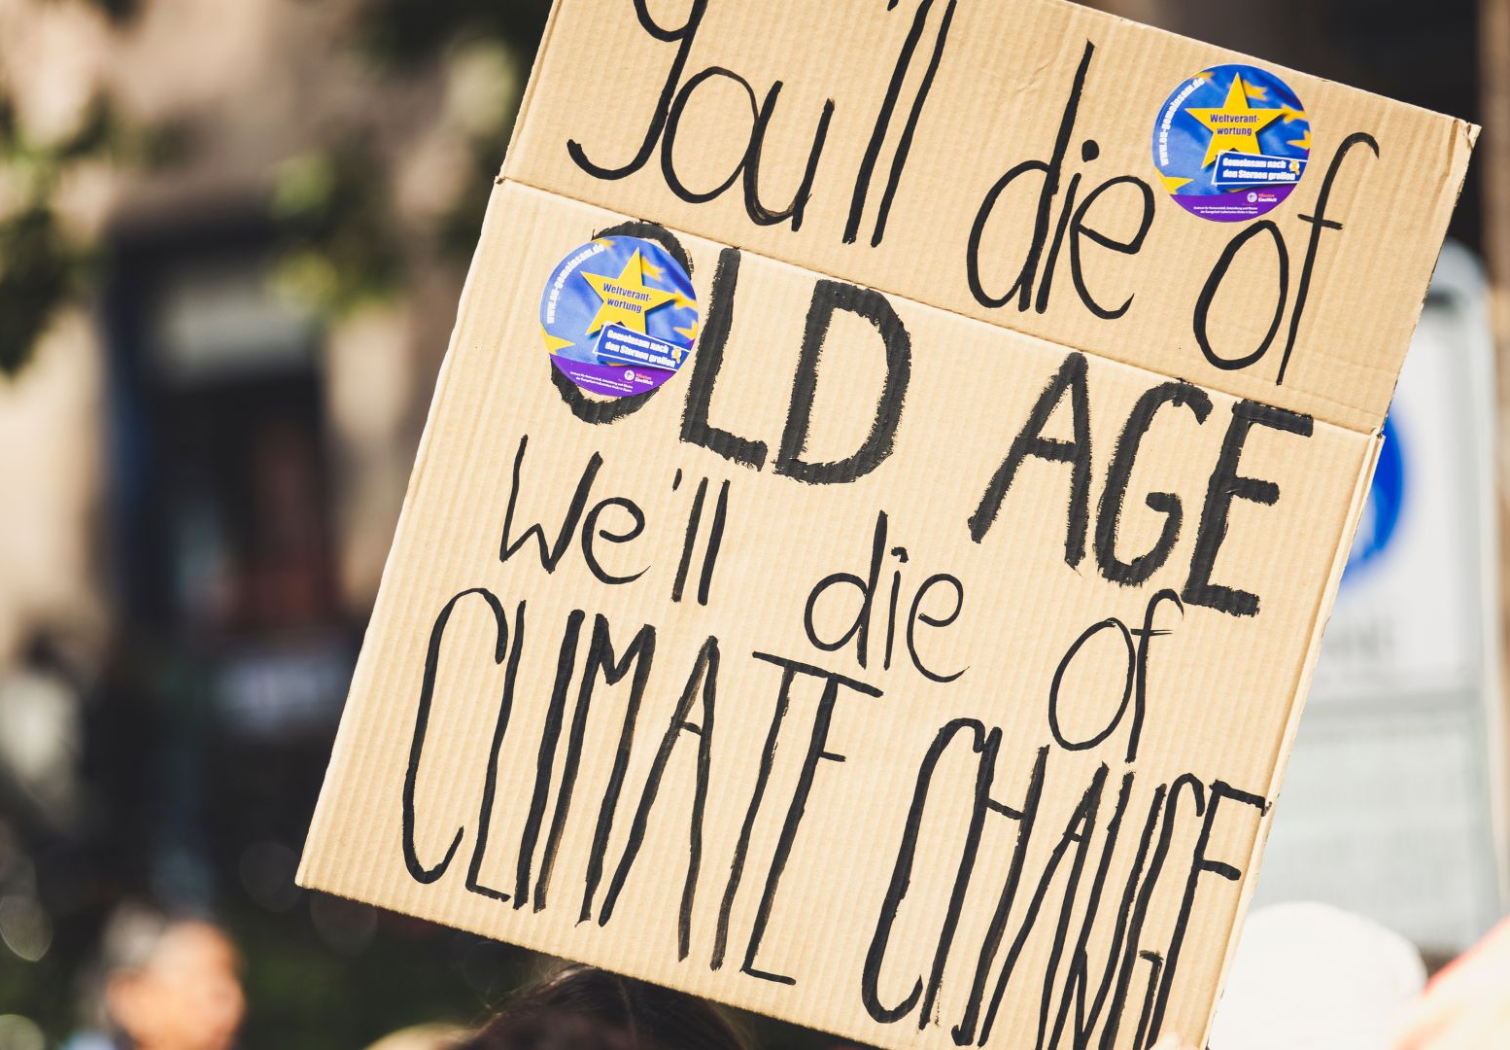
Toolkit
Feeling anxious about climate change is completely normal. Many young people describe climate change as one of the biggest worries in their lives.
This toolkit is here to show that those feelings matter, and that they can also be turned into strength. By exploring books, blogs, videos, and podcasts, you’ll see how others are coping with climate anxiety — and how you can too.
Read/Watch/Listen/Write/Act

Slide 31
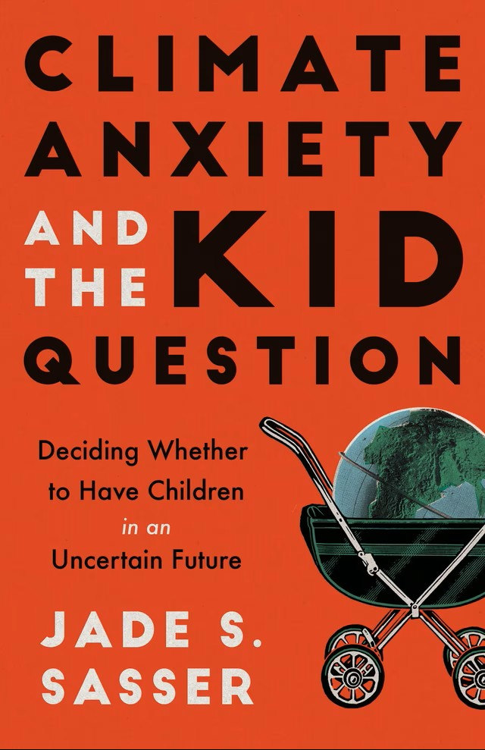

Toolkit
Climate Anxiety – Read/Watch/Listen/Write/Act
READ
Book – Climate Anxiety and the Kid Question
This book looks at how climate anxiety can affect decisions about the future, such as whether to have children. It’s a sensitive topic but one that reflects the depth of climate worries today. Reading it can help you reflect on how climate change shapes long-term life choices.
Link
Blog – From Climate Anxiety to Climate Action (National Wildlife Federation)
This blog explains how climate change affects young people emotionally and offers tips to cope. It’s written with a practical approach, helping you channel anxiety into small but meaningful actions.
Link

Slide 32
Toolkit
Climate Anxiety – Read/Watch/Listen/Write/Act
READ
Article – Helping Young People Turn Climate Anxiety into Climate Action
Here, youth activists share how they deal with climate anxiety by getting involved in collective action. It shows that when you work with others, feelings of helplessness can ease.
Link
Factsheet – How to Handle Climate Anxiety (SpunOut.ie)
This short resource offers straightforward advice from experts and young people on how to cope when climate worries feel overwhelming. It includes practical suggestions you can try right away, like journaling, mindfulness, or talking with a peer.
Link

Slide 33

Toolkit
Climate Anxiety – Read/Watch/Listen/Write/Act
READ
Article – Climate Emotions (Trinity College Dublin)
This article explains different climate emotions you may experience — such as sadness, guilt, or frustration — and how they can affect your mental health. It encourages you to acknowledge these feelings instead of ignoring them.
Link
Book – Healing Through Words (Rupi Kaur)
This book of guided writing exercises is not climate-focused, but it’s a great way to process heavy emotions. The creative prompts can help you work through fear and anxiety while building resilience.
Link

Slide 34
Toolkit
Climate Anxiety – Read/Watch/Listen/Write/Act
READ
Survey – Young People’s Climate Anxiety (Nature, 2021)
A global study of 10,000 young people showed that most feel climate anxiety, and many feel betrayed by political inaction. It’s powerful evidence that you’re not alone — millions of others share these emotions.
Link
WATCH
TED Talk – Katharina Van Bronswijk: How Your Climate Emotions Can Save the World
This talk shows how emotions like fear and grief can be useful — they can motivate you to act instead of holding you back.
Watch

Slide 35
Toolkit
Climate Anxiety – Read/Watch/Listen/Write/Act
WATCH
TED Talk – Heather White: Adopt a Daily Practice to Ease Eco Anxiety
Heather White explains that everyone reacts differently to climate change and introduces the idea of different “climate warrior” identities. It helps you see which type of action fits you best.
Watch
TED Talk – Claudia Kemfert: Climate Change is a Climate Chance
This talk highlights how climate change can also be seen as an opportunity for transformation. It’s an optimistic take that reframes fear into possibility.
Watch

Slide 36

Toolkit
Climate Anxiety – Read/Watch/Listen/Write/Act
WATCH
TikTok – EcoTok Collective (@ecotokcollective)
A group of young climate creators sharing short, witty videos that explain climate issues, debunk myths, and share solutions. Great for quick bursts of relatable learning.
Watch
TikTok – Sam Bentley (@sambentley)
Sam Bentley posts daily positive environmental news, reminding us that progress is being made. Perfect for a hopeful scroll when news feels heavy.

Slide 37
Toolkit
Climate Anxiety – Read/Watch/Listen/Write/Act
LISTEN
Podcast – Outrage + Optimism
Hosted by Christiana Figueres and team, this podcast blends honesty about the crisis with optimism about solutions. It’s helpful if you need both realism and hope.
Listen
Podcast – Climate Change and Happiness
Led by climate psychology experts, this podcast helps put words to feelings like fear, grief, or guilt. It reminds you that you’re not strange for feeling anxious — you’re human.
Listen

Slide 38
Toolkit
Climate Anxiety – Read/Watch/Listen/Write/Act
LISTEN
Radio/Podcast – Climate Anxiety (RTÉ)
Oisín Coghlan from Friends of the Earth Ireland talks about why ignoring climate change isn’t an option and how action can ease anxiety.
Listen

Slide 39
Toolkit
Climate Anxiety – Read/Watch/Listen/Write/Act
Take It Further
WRITE:
Try a journaling exercise: “When I think about climate change, the three strongest emotions I feel are…”. Reflect on which ones you could turn into energy for action.
DISCUSS:
With a group, share one climate worry and one action you believe helps. Talk about whether sharing openly reduces the weight of your worry.
ACT:
Pick one small action from the SpunOut.ie fact sheet (like talking to a friend or spending time in nature). Try it this week and note how it affects your mood.

Slide 40
Toolkit
Climate Anxiety – Read/Watch/Listen/Write/Act
Key Takeaway
Climate anxiety shows how much you care. These feelings are shared by young people worldwide, and they can be transformed into strength, resilience, and collective action.
By exploring, reflecting, and acting — even in small ways — you can take back a sense of control and hope.

Slide 41
Reflect and act
Choose one place, tradition or skill in your area that matters to you. What is one way it could be protected or recorded as the climate changes?
www.planet-pulse.eu

