Slide 1


CLIMATE ANXIETY
READ/WATCH/
LISTEN/WRITE/ACT
www.planetpulse.eu

Slide 2

CONTENTS
01
Introduction
02
Read
03
Watch
04
Listen
05
Take It Further
06
Key Takeaway

Slide 3

01
Introduction
Feeling anxious about climate change is completely normal. Many young people describe climate change as one of the biggest worries in their lives. This toolkit is here to show that those feelings matter, and that they can also be turned into strength.
By exploring books, blogs, videos, and podcasts, you’ll see how others are coping with climate anxiety — and how you can too.

Slide 4
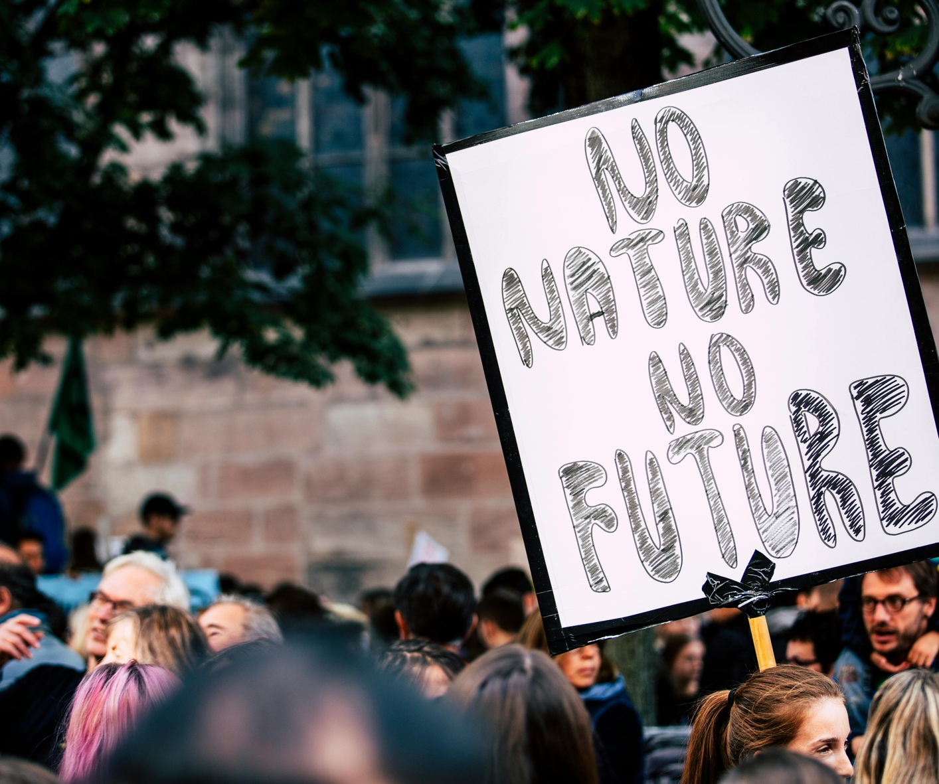
02
Read
Book – Climate Anxiety and the
Kid Question
This book looks at how climate anxiety can affect decisions about the future, such as whether
to have children. It’s a sensitive topic but one
that reflects the depth of climate worries
today. Reading it can help you reflect on how
climate change shapes long-term life choices.
Link
Blog – From Climate Anxiety to Climate Action (National Wildlife Federation)
This blog explains how climate change
affects young people emotionally and offers
tips to cope. It’s written with a practical approach, helping you channel anxiety
into small but meaningful actions.
Link
Article – Helping Young People Turn Climate Anxiety into Climate Action
Here, youth activists share how they deal
with climate anxiety by getting involved
in collective action. It shows that when you work with others, feelings of helplessness can ease.
Link
Factsheet – How to Handle Climate Anxiety (SpunOut.ie)
This short resource offers straightforward
advice from experts and young people on
how to cope when climate worries feel overwhelming. It includes practical suggestions you can try right away, like journaling, mindfulness, or talking with a peer.
Link
Article – Climate Emotions
(Trinity College Dublin)
This article explains different climate emotions
you may experience — such as sadness,
guilt, or frustration — and how they
can affect your mental health. It
encourages you to acknowledge these
feelings instead of ignoring them.
Link
Book – Healing Through Words
(Rupi Kaur)
This book of guided writing exercises
is not climate-focused, but it’s a great
way to process heavy emotions. The creative prompts can help you work through fear
and anxiety while building resilience.
Link
Survey – Young People’s Climate Anxiety (Nature, 2021)
A global study of 10,000 young people
showed that most feel climate anxiety, and
many feel betrayed by political inaction.
It’s powerful evidence that you’re not alone — millions of others share these emotions.
Link

Slide 5
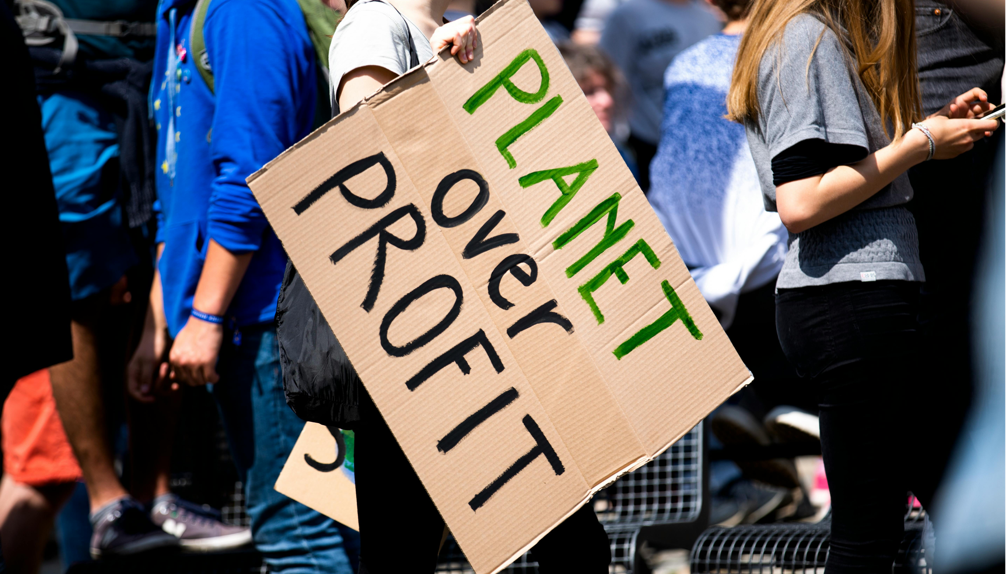
03
Watch
TED Talk – Katharina Van Bronswijk:
How Your Climate Emotions Can Save
the World
This talk shows how emotions like fear
and grief can be useful — they can motivate
you to act instead of holding you back.
Watch
TED Talk – Heather White: Adopt a Daily Practice to Ease Eco Anxiety
Heather White explains that everyone reacts differently to climate change and introduces the idea of different “climate warrior” identities. It helps you see which type of action fits you best.
Watch
TED Talk – Claudia Kemfert: Climate Change is a Climate Chance
This talk highlights how climate change
can also be seen as an opportunity for transformation. It’s an optimistic take
that reframes fear into possibility.
Watch
TikTok – EcoTok Collective (@ecotokcollective)
A group of young climate creators sharing short, witty videos that explain climate issues,
debunk myths, and share solutions. Great
for quick bursts of relatable learning.
Watch
TikTok – Sam Bentley (@sambentley)
Sam Bentley posts daily positive
environmental news, reminding us that
progress is being made. Perfect for a
hopeful scroll when news feels heavy.
Watch

Slide 6
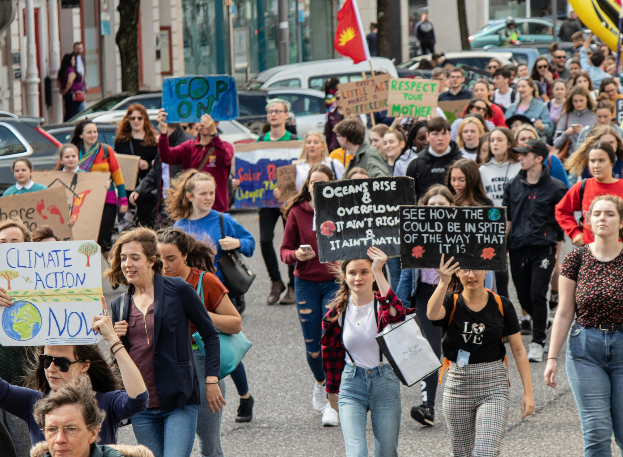
04
Listen
Podcast – Outrage + Optimism
Hosted by Christiana Figueres and team,
this podcast blends honesty about the crisis
with optimism about solutions. It’s helpful if
you need both realism and hope.
Listen
Podcast – Climate Change and Happiness
Led by climate psychology experts, this
podcast helps put words to feelings like fear,
grief, or guilt. It reminds you that you’re not
strange for feeling anxious — you’re human.
Listen
Radio/Podcast – Climate Anxiety (RTÉ)
Oisín Coghlan from Friends of the Earth Ireland
talks about why ignoring climate change isn’t
an option and how action can ease anxiety.
Listen

Slide 7

05
Take It Further
WRITE:
Try a journaling exercise: “When I think about climate change, the three strongest emotions I feel are…”. Reflect on which ones you could turn into energy for action.
DISCUSS:
With a group, share one climate worry and one action you believe helps. Talk about whether sharing openly reduces the weight of your worry.
ACT:
Pick one small action from the SpunOut.ie fact sheet (like talking to a friend or spending time in nature). Try it this week and note how it affects your mood.

Slide 8
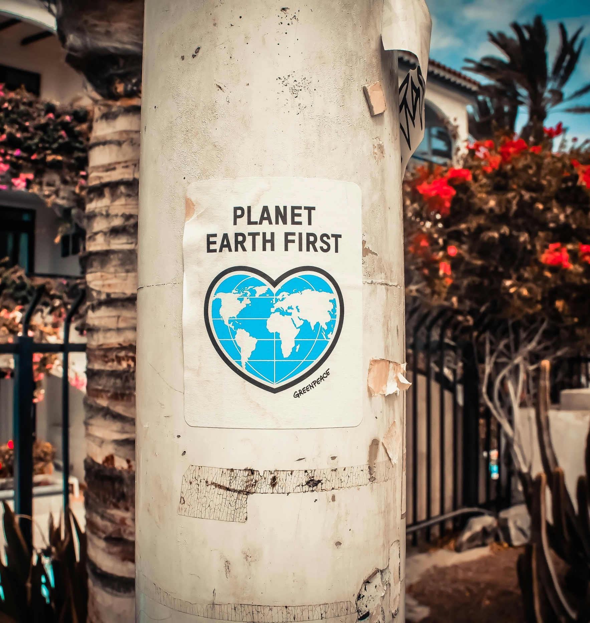
Key Takeaway
Climate anxiety shows how much you care. These feelings are shared by young people worldwide, and they can be transformed into strength, resilience, and collective action. By exploring, reflecting, and acting — even in small ways — you can take back a sense of control and hope.
Reflect and act
When climate worry shows up for you, what is one grounding practice from this resource you could use, and one action that helps you feel less powerless?

