Slide 1
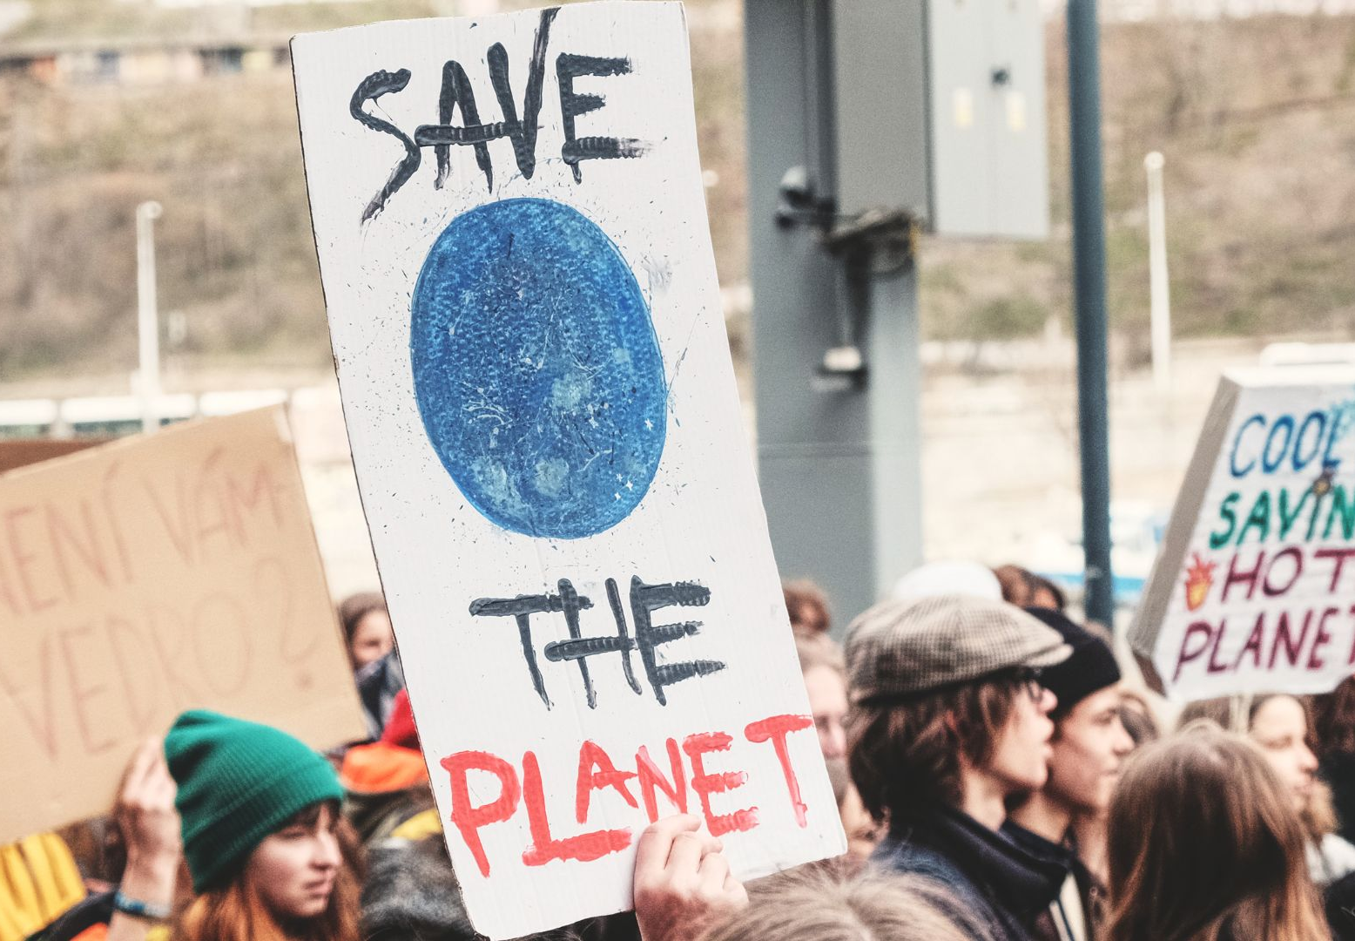

Resilience
Read/Watch/Listen/Write/Act
www.planet-pulse.eu

Slide 2
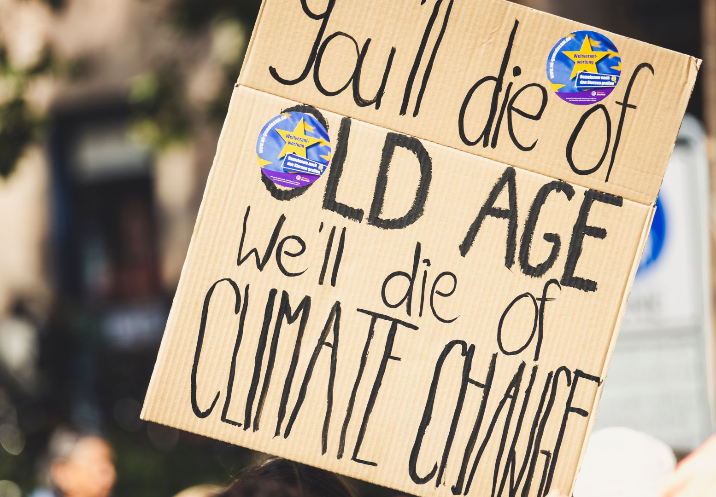



Resources
Resilience isn’t about being “tough” or pretending nothing bothers you. It’s about finding ways to bounce back, adapt, and keep going when things get hard. Climate change can feel overwhelming, but resilience gives us tools to turn fear into energy, to look after our mental health, and to support each other in community.
This set of open educational resources pulls together books, articles, videos, and podcasts to show practical ways young people and educators can explore and build resilience.
Read/Watch/Listen/Write/Act

Slide 3
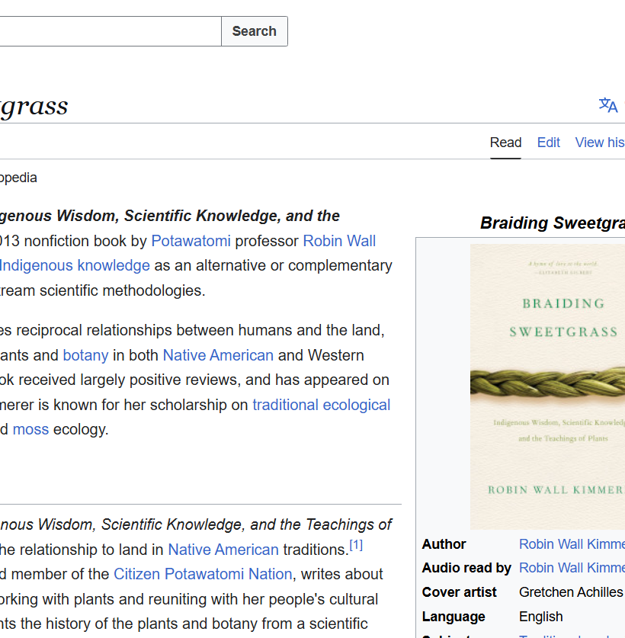
Read
Book – Braiding Sweetgrass by Robin Wall Kimmerer
A beautiful blend of Indigenous knowledge and science. This book shows how nature itself teaches us resilience — how communities and ecosystems recover and thrive. Not free to access, but widely available in libraries and online.
Read here

Slide 4
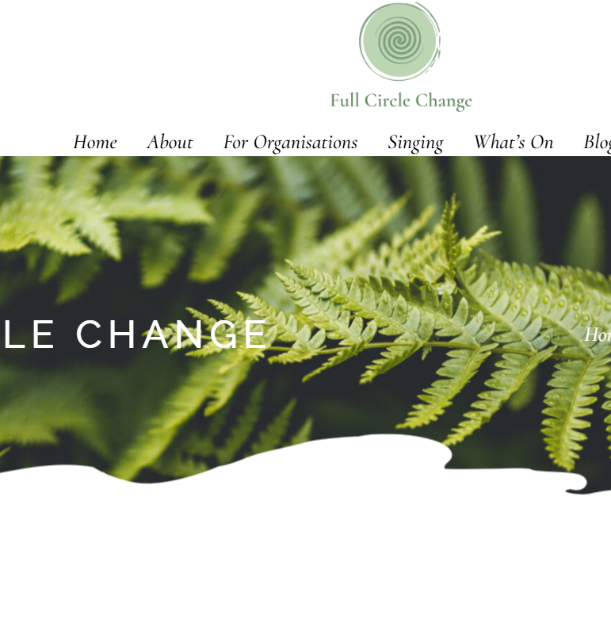
Read
Article – From Climate Anxiety to Climate Resilience (Full Circle Change)
A personal story about turning eco-anxiety into resilience. Helpful for showing how mindset can shift from “overwhelm” to “I can cope, I can act.”
Read here

Slide 5
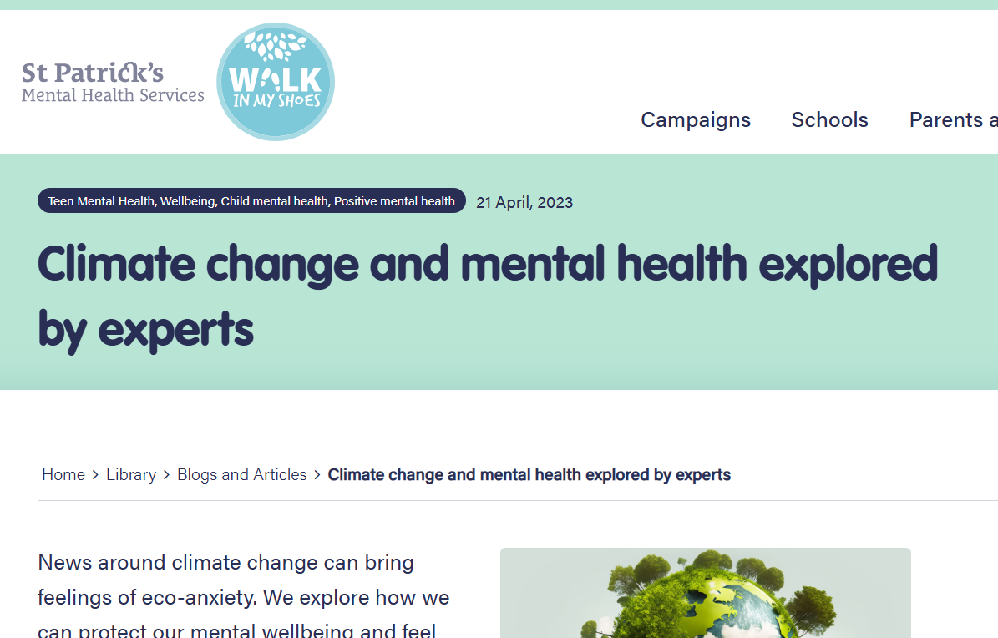
Read
Article – Climate Change and Mental Health (Walk in My Shoes)
This piece explains how climate emotions affect everyday life but also shares steps people can take to adapt, cope, and reduce anxiety. It’s written with a focus on resilience and practical action.
Read here

Slide 6
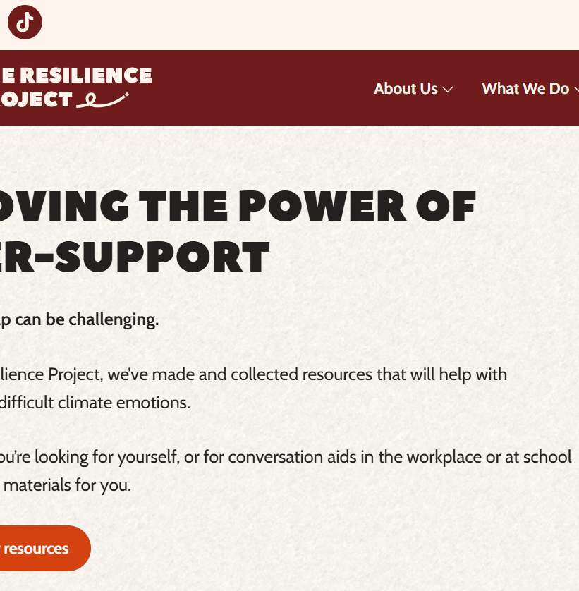
Read
Online Resource – The Resilience Project
A collection of free, open resources for young people, educators, and health professionals. It covers mental health, climate action, and resilience skills — great for planning youth workshops.
Explore here

Slide 7

Watch
Webinar – Climate Change and Mental Health (Irish experts)
A full discussion with mental health specialists on how climate change impacts our wellbeing, plus tips on how to strengthen resilience individually and collectively.
Watch here

Slide 8
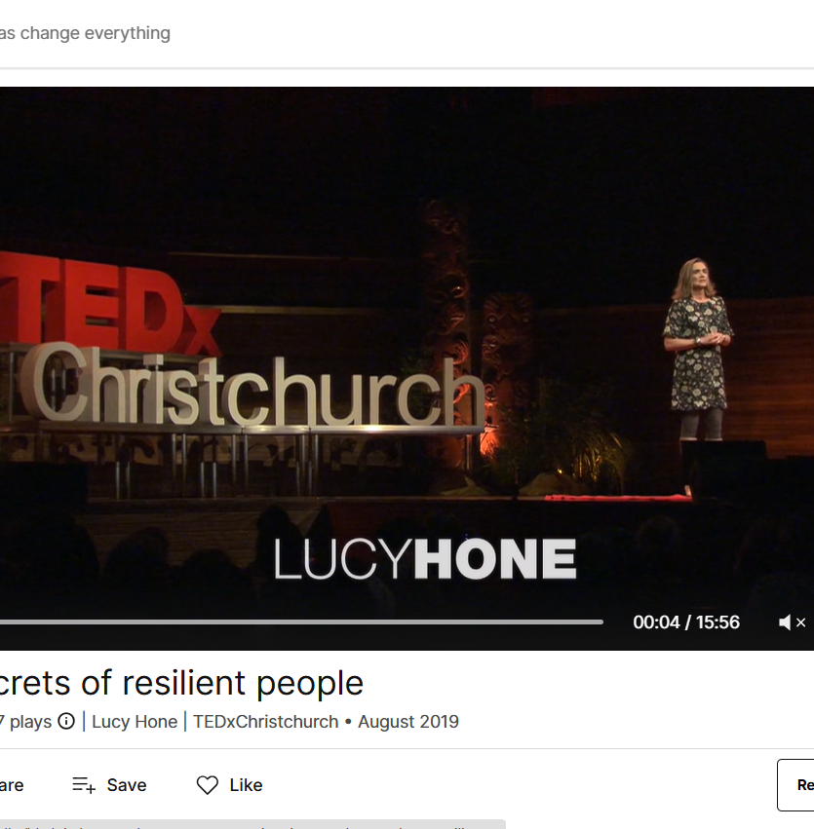
Watch
TEDx Talk – Lucy Hone: 3 Secrets of Resilient People
Clear, memorable strategies you can start using right away: accepting that pain is part of life, focusing on what you can control, and asking “Is this helping or harming me?”
Watch Here

Slide 9
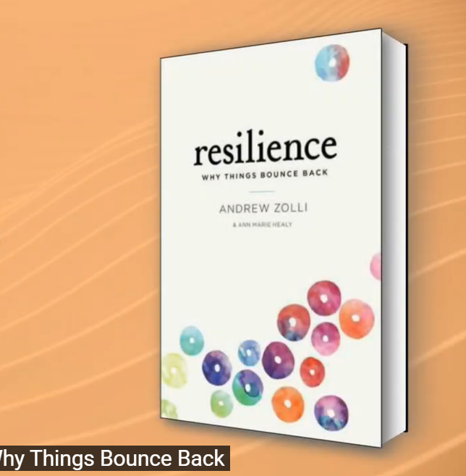
Watch
Book – Andrew Zolli: Resilience — Why Things Bounce Back
Explores resilience in communities and ecosystems. Useful for thinking beyond the individual and seeing resilience as a group skill.
Watch here

Slide 10

Watch
Short Film – The Great Green Wall
A hopeful story of African communities planting trees across the Sahel to fight desertification. Shows resilience in action, linking climate action to culture and survival.
Watch here

Slide 11
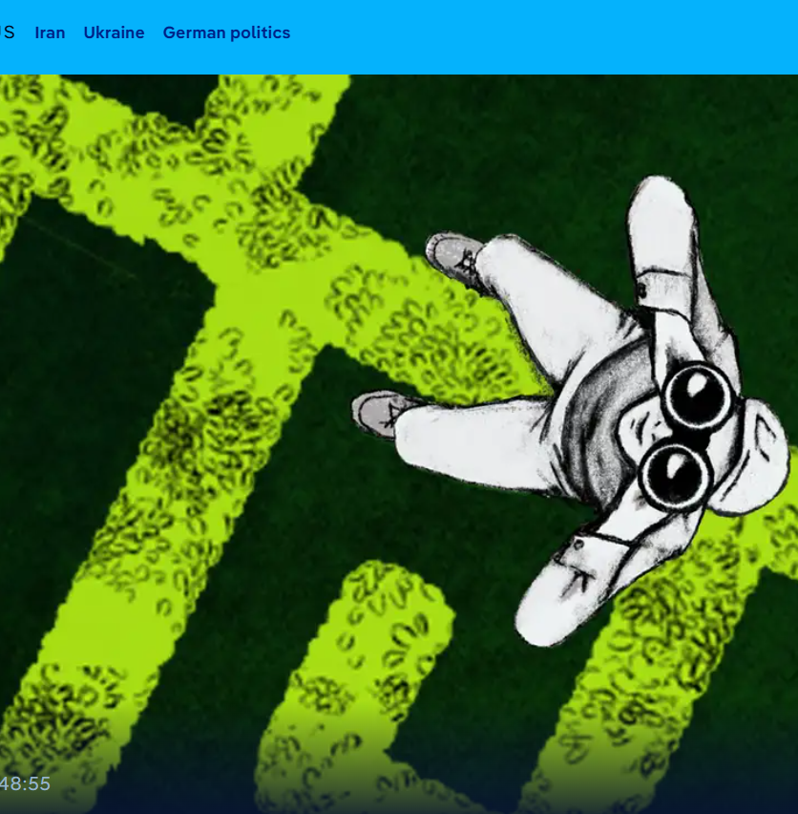
Listen
Podcast – How to Cope with Climate Anxiety (DW, 2022)
These are practical tips from psychologists on naming feelings and building habits that reduce feelings of being overwhelmed. You might find they’re ideal for homework or study listening.
Listen here

Slide 12

Listen
Podcast – For the Wild
Deep conversations on ecology, justice, and resilience. Slower-paced, thoughtful listening that connects climate issues with personal grounding.
Listen here

Slide 13
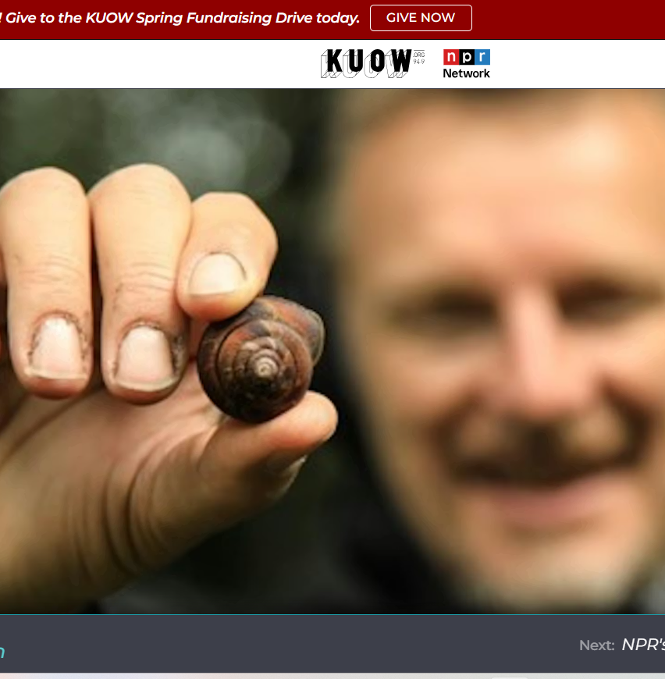
Listen
Podcast – The Wild with Chris Morgan
Calming stories about wildlife and wild places. Great for taking an “awe break” when stress feels high — a reminder that resilience also comes from reconnecting with nature.
Listen here

Slide 14
Try it yourself
Write: List three challenges you’ve faced recently. For each, write one way you adapted or learned from it. Notice what this says about your resilience.
Discuss: In a group, share one resilience strategy you already use (e.g. walking, humour, art, friends). How might these work at a community level?
Act: Choose one resilience-building habit (journaling, time outdoors, breathing exercises) and try it daily for one week. Track how you feel.

Slide 15
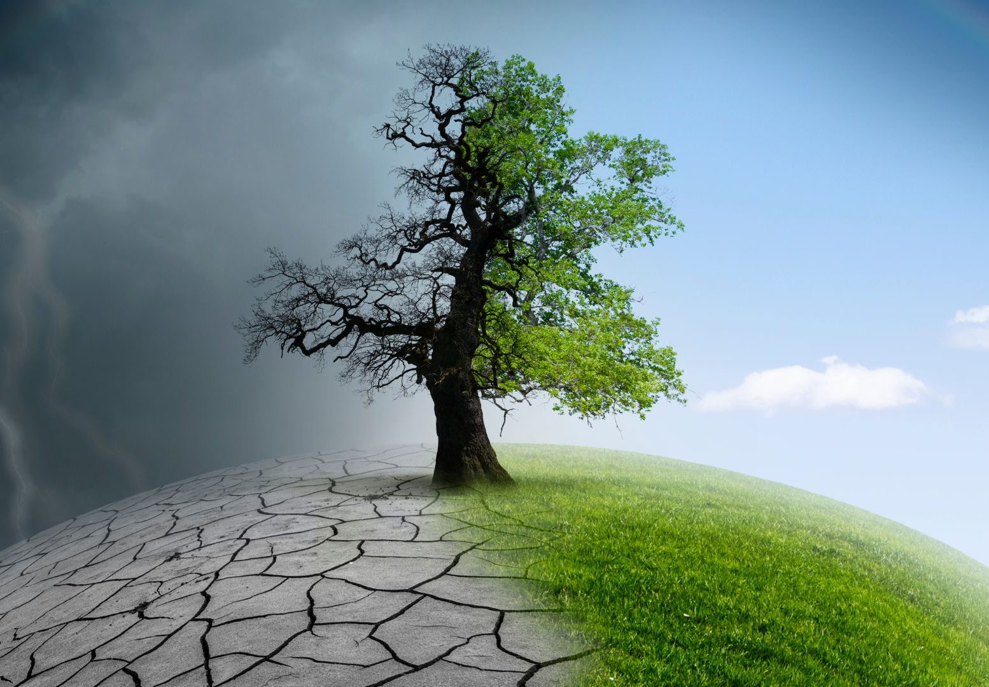
01
Key Takeaways

Slide 16
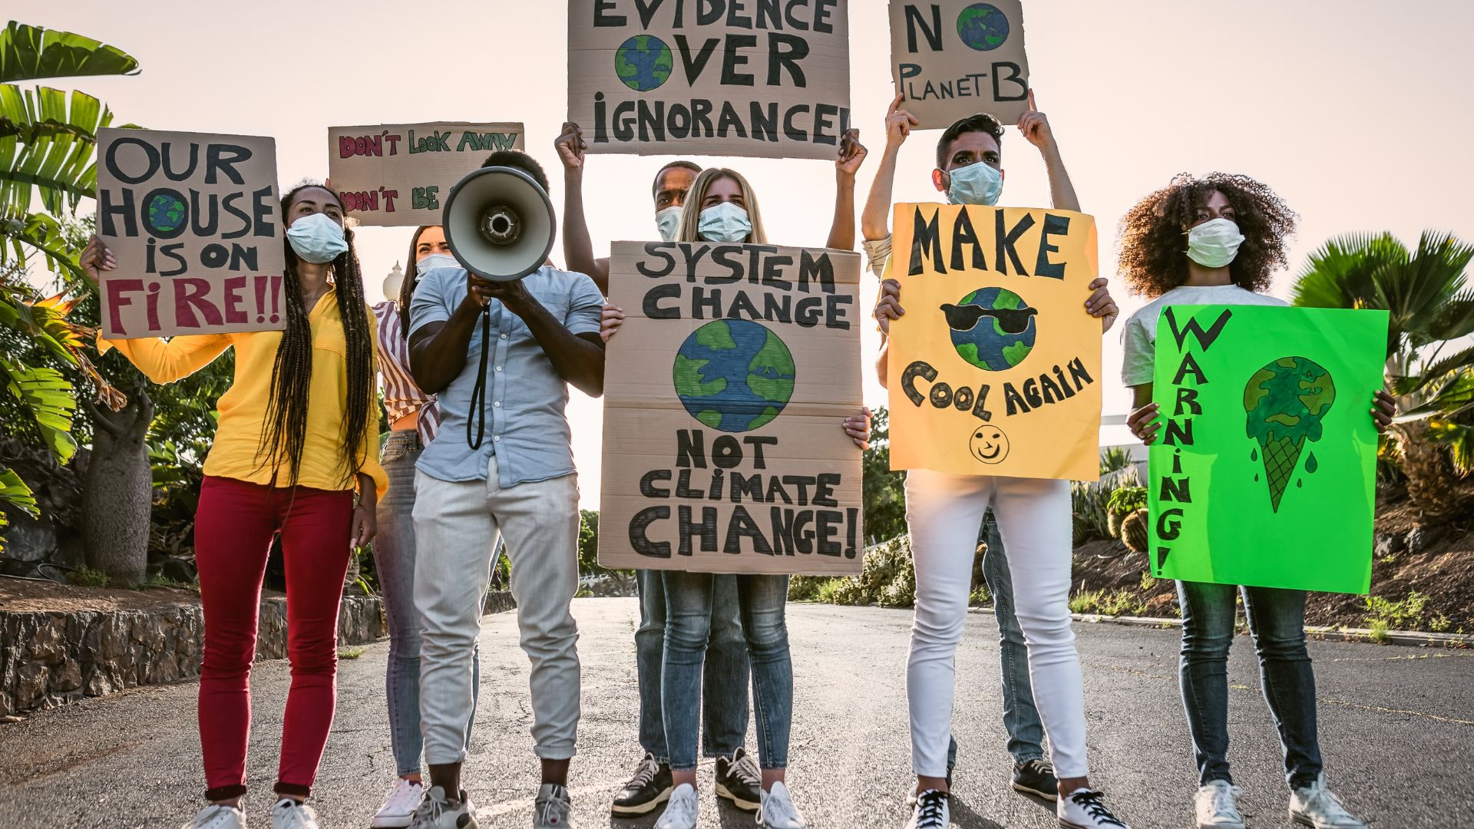
Key Takeaways
Resilience isn’t about never feeling worried it’s about knowing how to respond when things get tough. By learning from others, trying small daily practices, and connecting with community, we can build the kind of resilience that keeps us grounded and hopeful in the face of climate challenges.
01
Key Takeaways

Slide 17
Reflect and act
Think of a setback in something you care about. What helped you keep going, and how could that same strength support your climate action?
www.planet-pulse.eu

