Slide 1
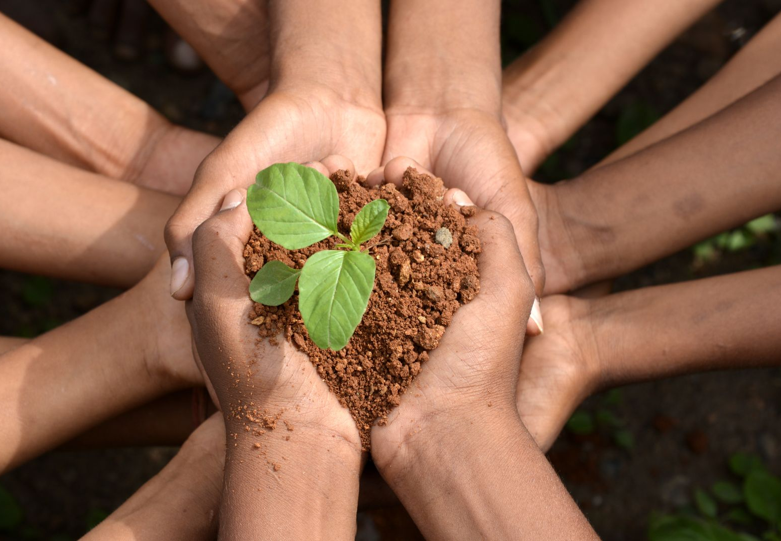

Digital Literacy:
Visualizing the Facts About Climate Anxiety
www.planet-pulse.eu

Slide 2
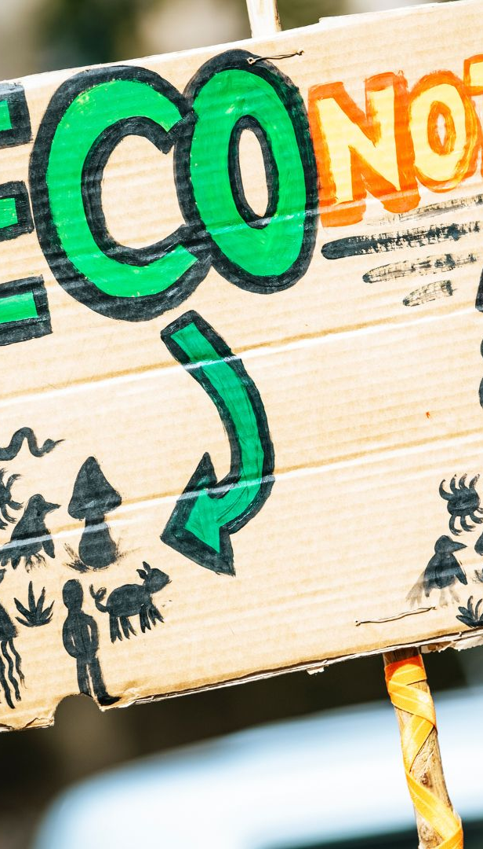
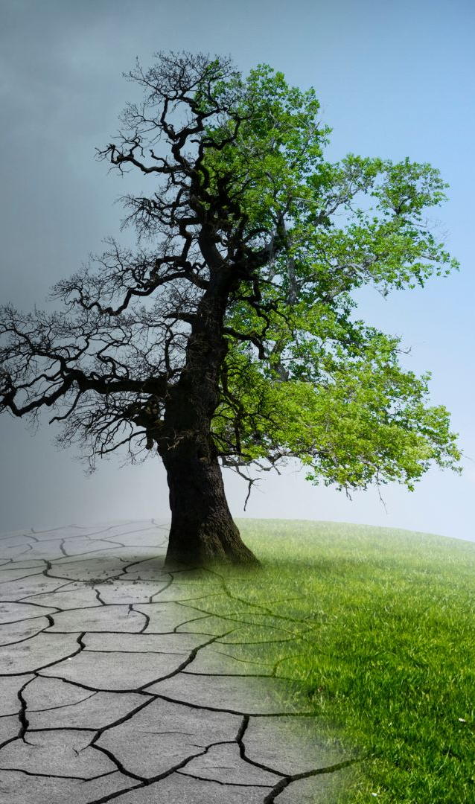
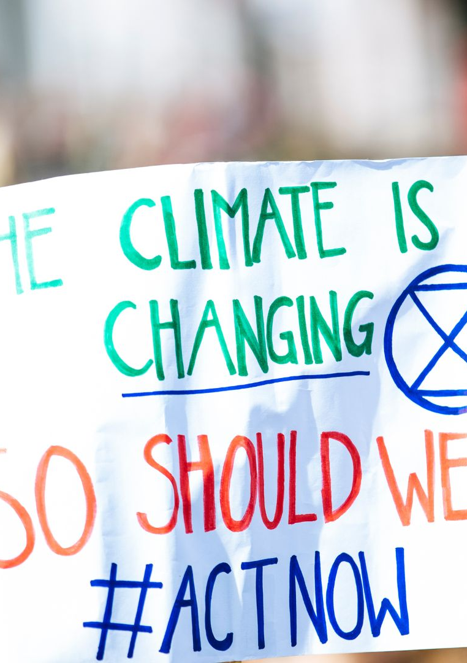
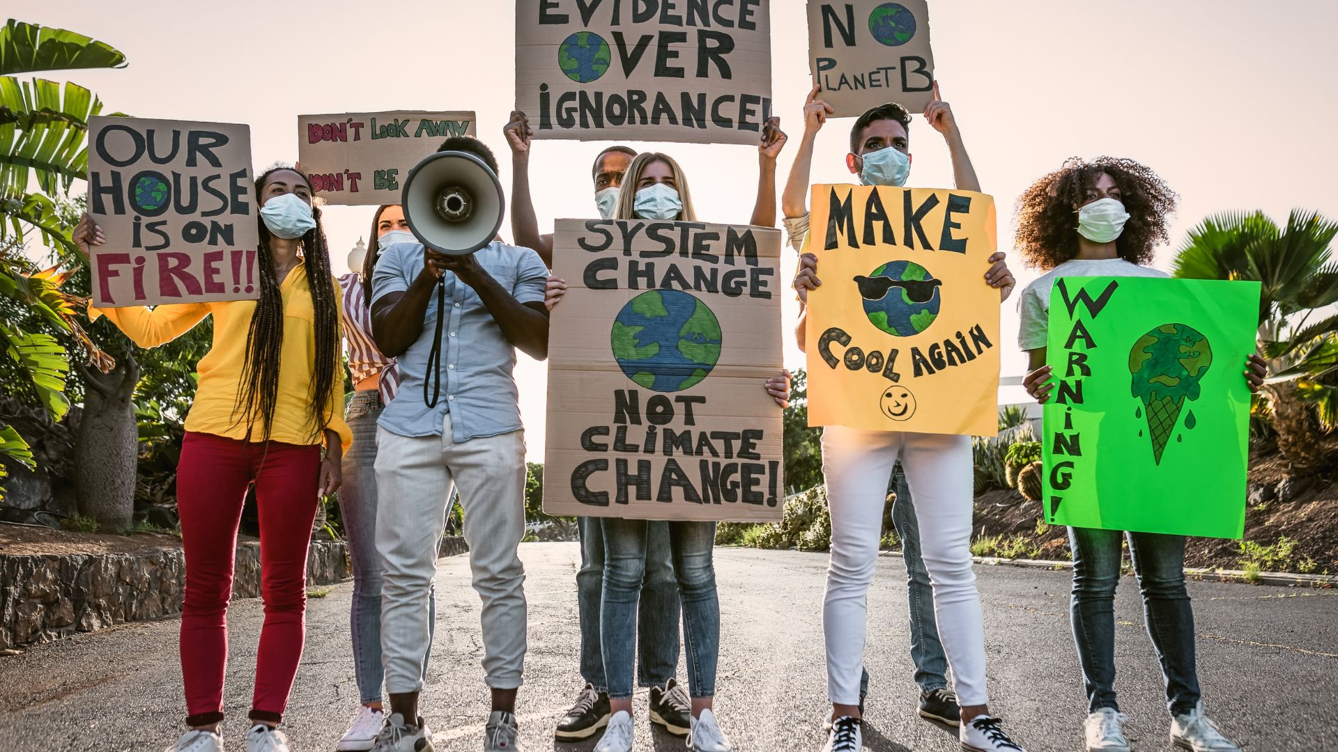
01
03
Step 1: Explore the Topic and Select Facts
Step 3: Design Your Infographic
CONTENTS
00
02
Introduction
Step 2: Choose a Free Design Tool

Slide 3
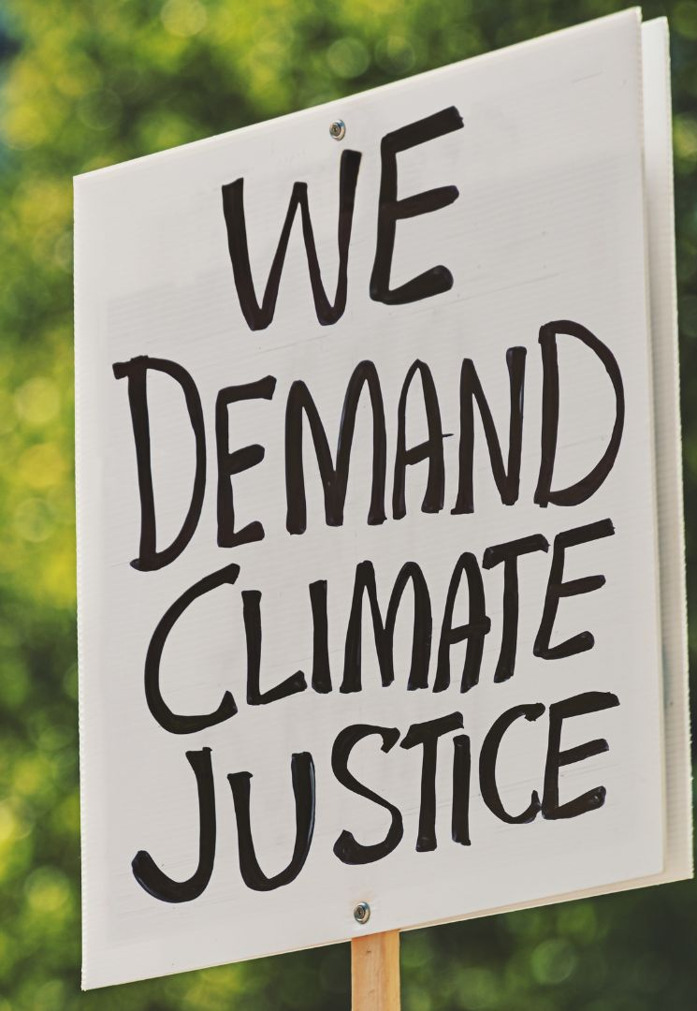
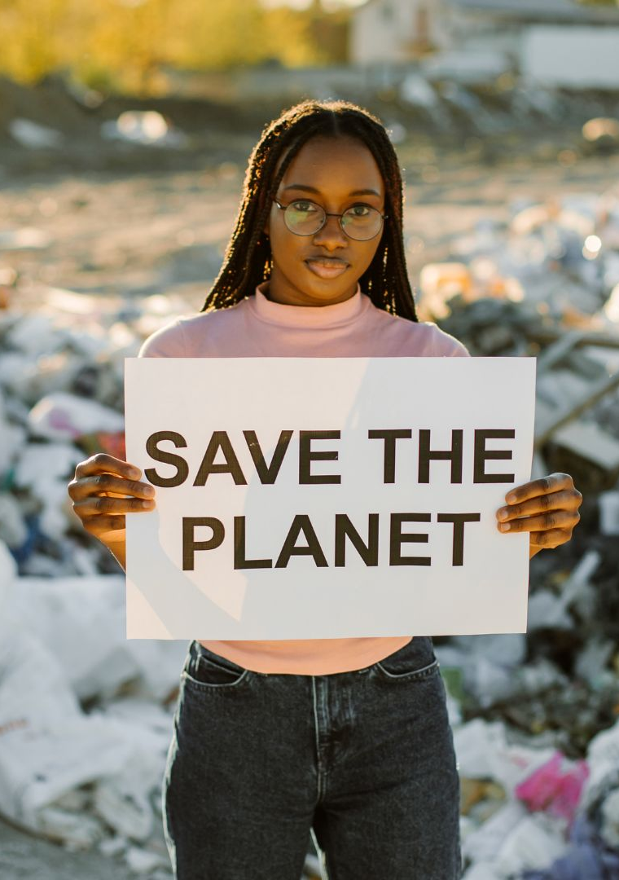
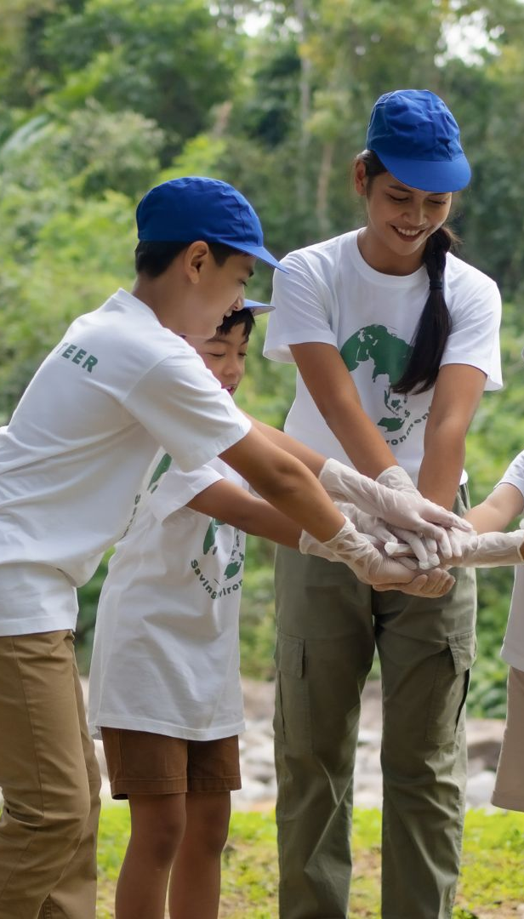
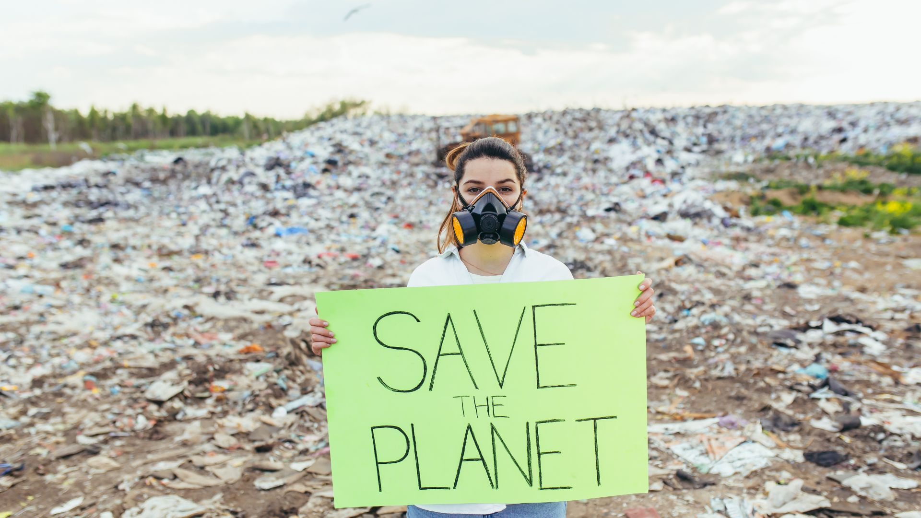
04
06
Step 4: Share and Reflect
Part 6: Key Takeaways
CONTENTS
05
07
Facts/Definitions/Stats
Thanks

Slide 4
00
INTRODUCTION

Slide 5
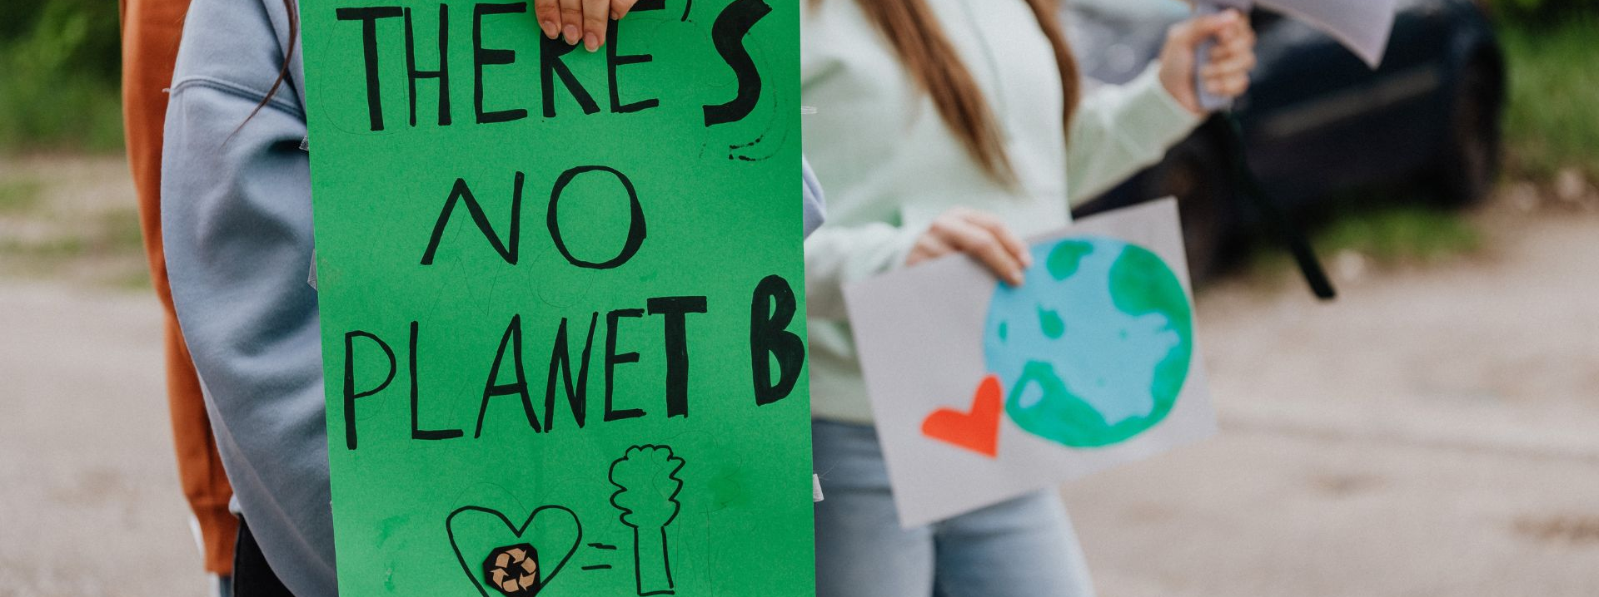
00
INTRODUCTION
In this project, you will build your digital literacy skills by creating an infographic that presents key facts and statistics about climate change and climate anxiety. Using the modules, as well as a provided fact sheet and digital design tools, you will organise and interpret information, apply principles of visual communication, and create clear, engaging graphics. This task supports critical thinking, creativity, and a deeper understanding of the climate crisis and its emotional impact. The goal is to help you communicate your ideas clearly through visuals, facts, and compelling messages that raise awareness and inspire action on climate change and climate anxiety.
Exercise: Follow the steps below to design your infographic and build your digital literacy skills.

Slide 6
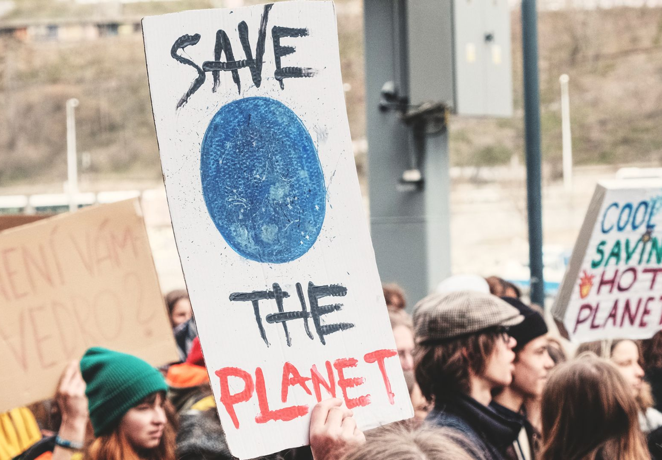
01
Explore the Topic & Select Facts

Slide 7

Step 1: Explore the Topic and Select Facts
Prompt:
Carefully read the provided fact sheet containing key facts and definitions about climate change and climate anxiety. As you review, think about which facts stand out most to you.
Task:
Choose the four most impactful facts or statistics that you want to include in your infographic. Consider how each fact helps tell the story about climate anxiety and its effects.
01
Step 1: Explore the Topic and Select Facts

Slide 8
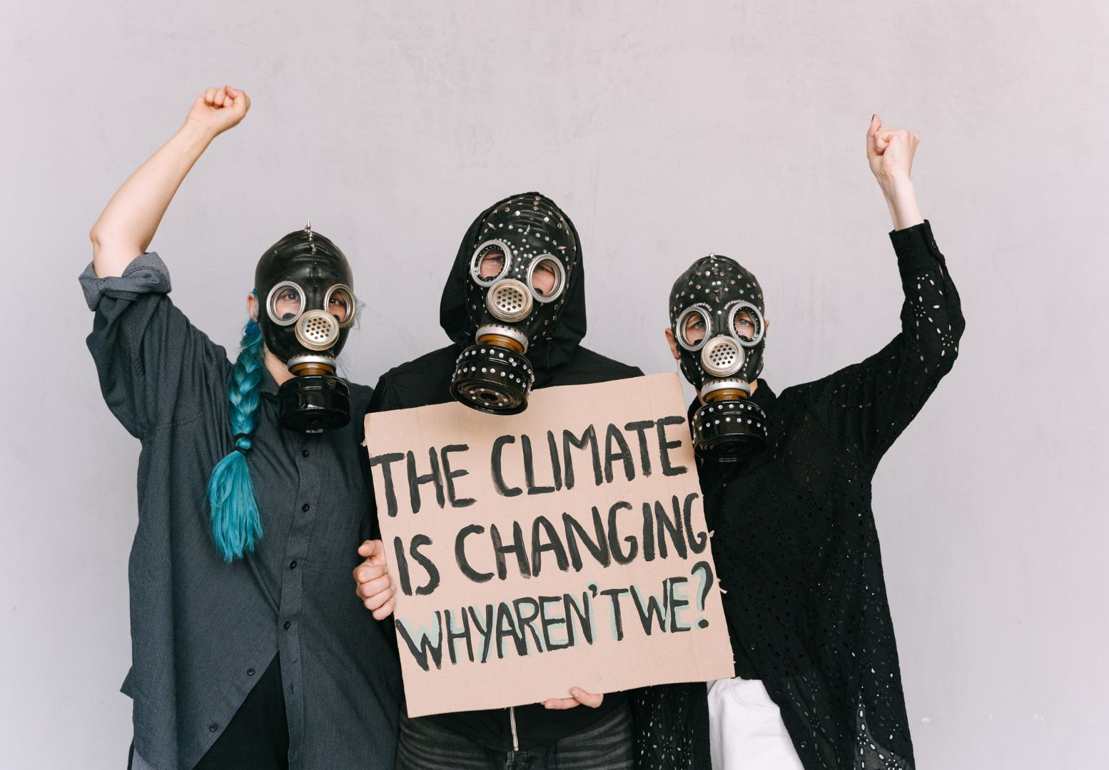
02
Choose a Free Design Tool

Slide 9
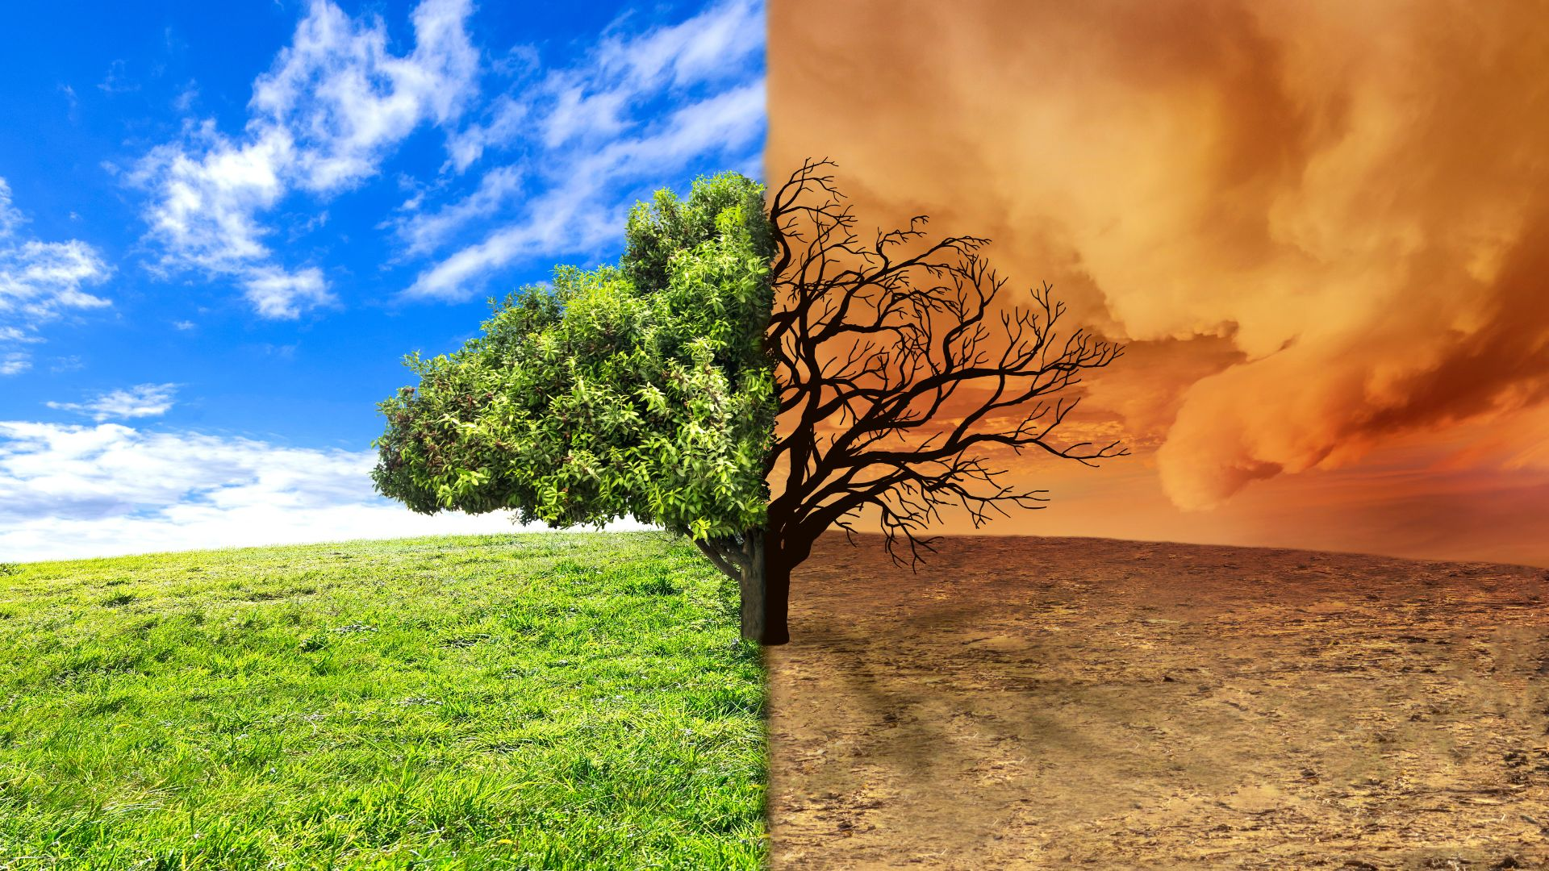


Step 2: Choose a Free Design Tool
Prompt:
Explore the digital tools available and create a free account to create your infographic. Think about which platform will help you best communicate your chosen facts visually.
Tools:
Canva – offers ready-made templates for infographics and visuals.
Adobe Express – an easy-to-use platform for designing engaging learning visuals
02
Step 2: Choose a Free Design Tool

Slide 10
03
Design Your Infographic

Slide 11
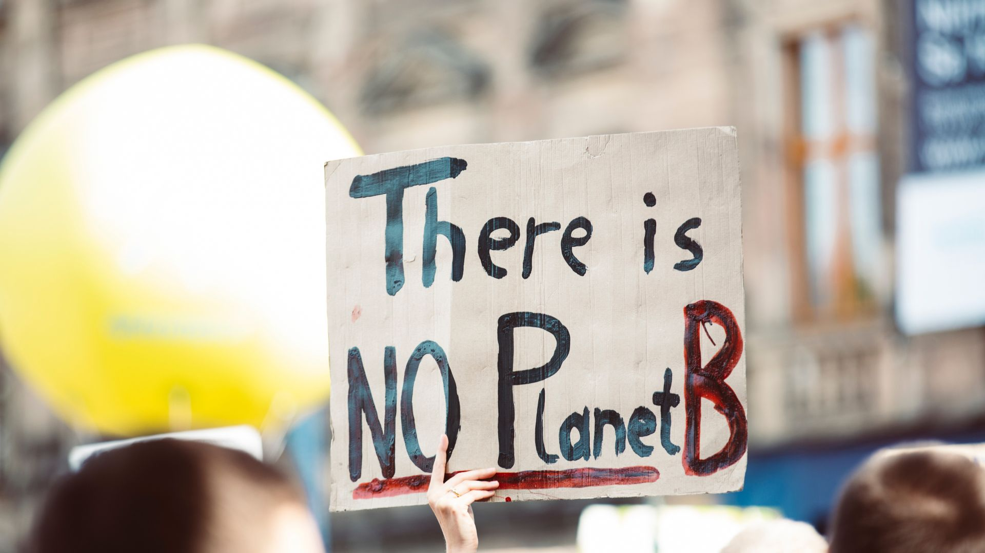
Step 3: Design Your Infographic
Prompt:
Using the facts you’ve selected, begin arranging your information visually. Focus on making your infographic clear, engaging, and easy to understand.
Tips:
Organize your content with headings or sections.
Use 2–3 colours to keep the design consistent.
Choose readable fonts and limit font styles.
Add icons, images, or charts to illustrate key points.
Keep text concise and focused on the most important facts.
03
Step 3: Design Your Infographic

Slide 12
04
Share and Reflect

Slide 13
Step 4: Share and Reflect
Prompt:
Submit your completed infographic and be prepared to explain your design choices and the key facts you included. Reflect on how this project has helped you improve your digital literacy skills (such as researching, evaluating information, and using design tools) and deepen your understanding of climate change and climate anxiety.
Task:
Discuss how your infographic communicates the topic and how your digital skills have grown through this project. Sharing your work helps raise awareness and inspire others to take action.
04
Step 4: Share and Reflect

Slide 14
05
Facts/Definitions/Stats

Slide 15
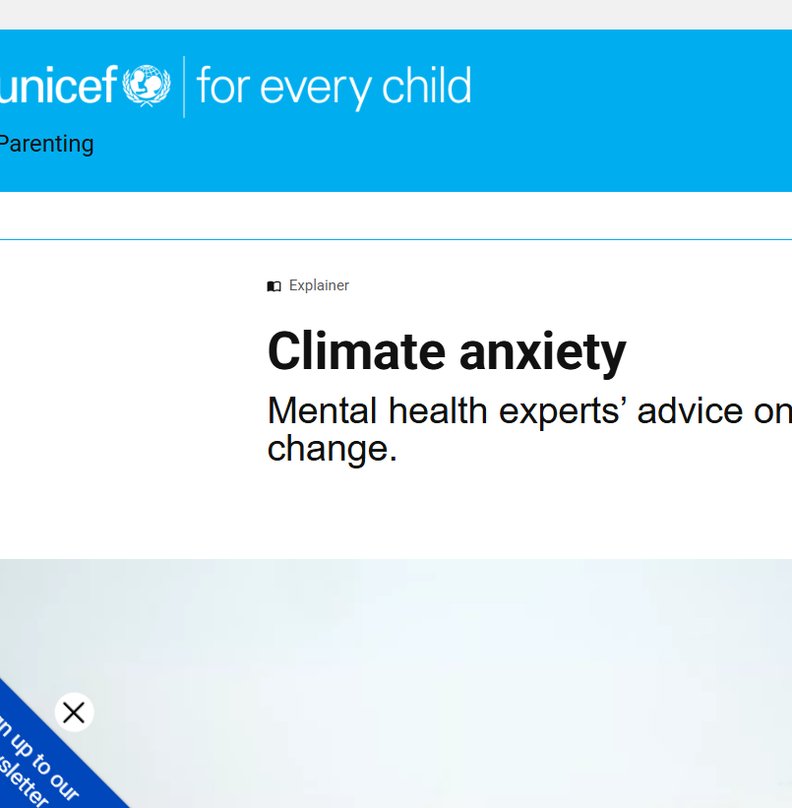
05
Facts/Definitions/Stats
Definition of Climate Anxiety
Climate anxiety (also known as eco-anxiety) is the distress or worry people feel about climate change and its impact on the planet, people, and the future. It’s especially common among young people.
Climate anxiety | UNICEF Parenting

Slide 16
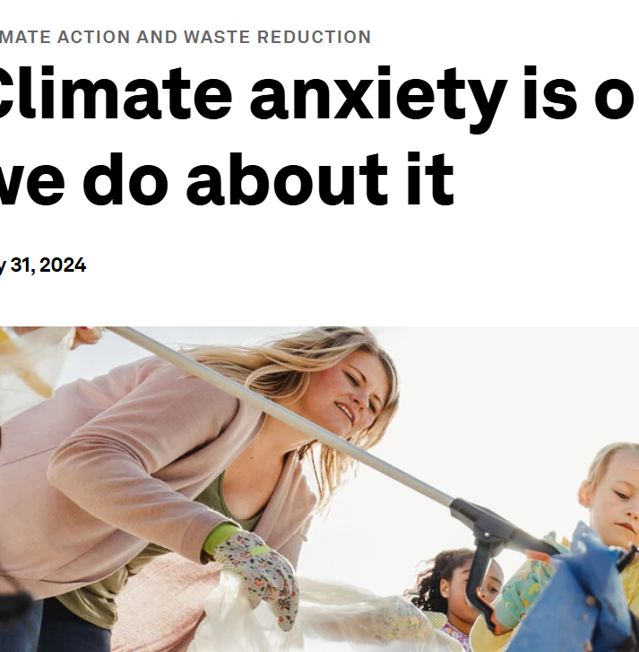
05
Facts/Definitions/Stats
Climate Anxiety Facts/Stats
Climate anxiety affects over half of young people: A global survey published in 2024 found that 59% of youth aged 16–25 say climate change makes them “extremely worried”.
Climate anxiety is on the rise — here's what we do about it | World Economic Forum

Slide 17
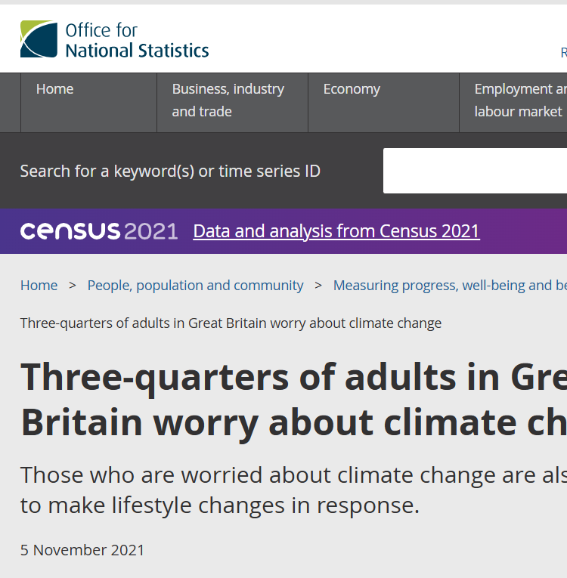
05
Facts/Definitions/Stats
In October 2021, three-quarters (75%) of adults in Great Britain said they were either very or somewhat worried about the impact of climate change
Around 8 in 10 women (79%) reported being either very or somewhat worried. This was statistically significantly higher than the proportion of men reporting this (72%).
Three-quarters of adults in Great Britain worry about climate change - Office for National Statistics

Slide 18
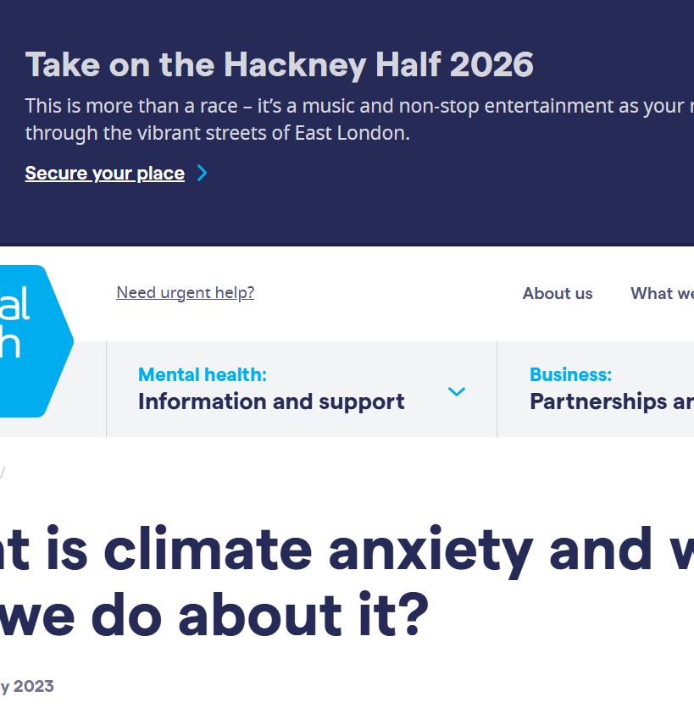
05
Facts/Definitions/Stats
Surveying 10,000 young people aged 16-25 years in 10 countries across the world, the Lancet found that 59% were very or extremely worried about climate change, with 84% at least moderately worried. Over 50% mentioned feeling anxious, powerless, helpless, and sad, while 45% said their feelings about climate change “negatively affected their daily life and functioning.”
A 2022 survey from the Office of National Statistics found that 62% of UK people over the age of 16 are worried that rising temperatures will directly affect them by 2030. Of these, we can break them down by age: 70% of 16 to 29-year-olds. 59% of 50 to 69-year-olds. 57% of those aged 70 or older.
What is climate anxiety and what can we do about it? - Mental Health UK

Slide 19
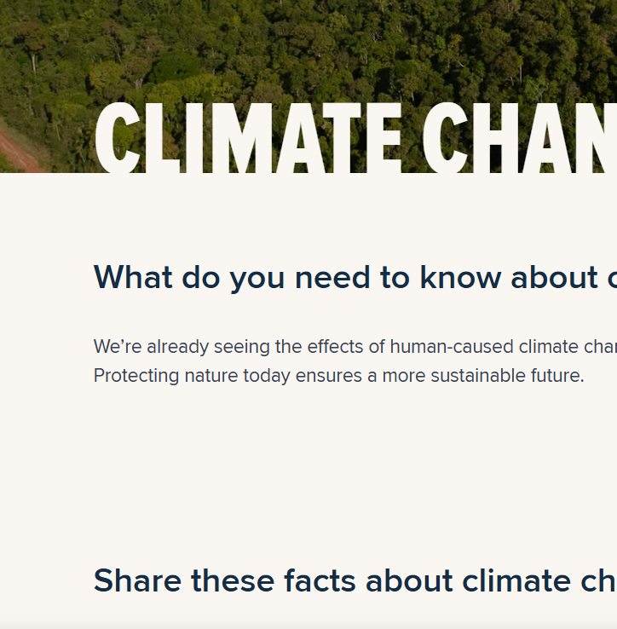
05
Facts/Definitions/Stats
In 2024, the average concentration of carbon dioxide (CO2) in our atmosphere was 421.73 ppm— the highest in human history and more than 50% higher than pre-industrial levels of CO2.
As much as 20 percent of all global greenhouse gas emissions caused by humans are due to deforestation— exceeding the emissions from all of the passenger vehicles on the planet
Climate Change - 10 Facts You Need To Know

Slide 20
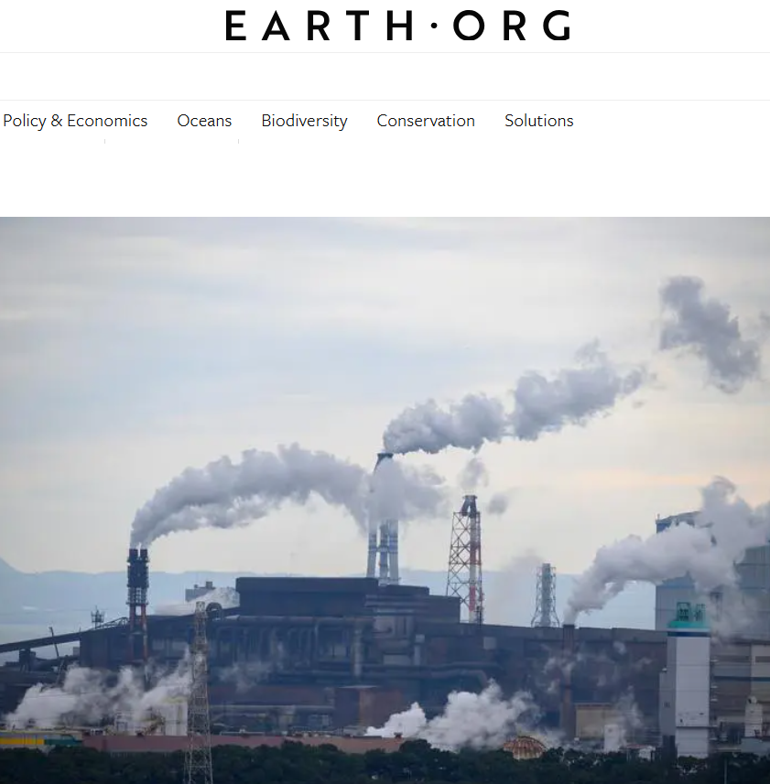
05
Facts/Definitions/Stats
Since the mid-1990s, we’ve lost around 28 trillion tons of ice, with today’s melt rate standing at 1.2 trillion tons a year.
It was recently found that air pollution kills more than 9 million people per year.
11 Interesting Climate Change Facts | Earth.Org

Slide 21
Reflect and act
Next time you see a climate claim online, which check from this resource will you use before deciding whether to share it?
www.planet-pulse.eu

