Slide 1
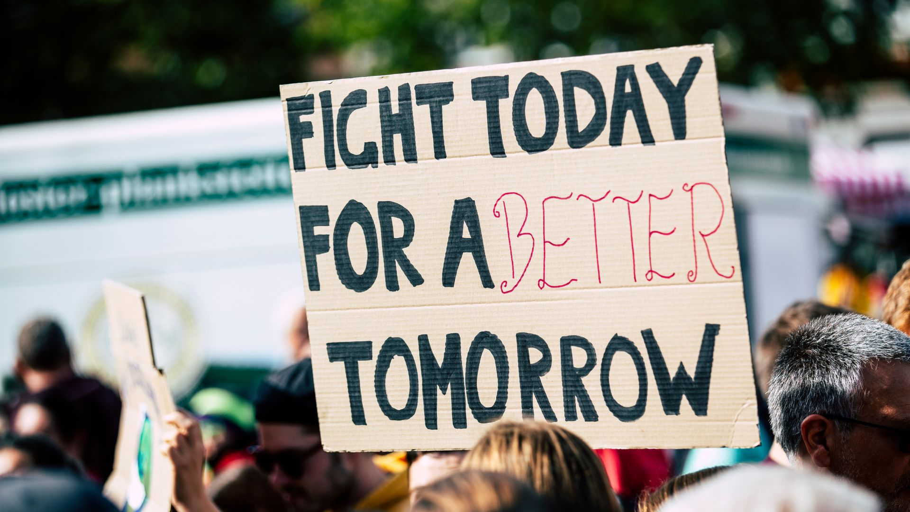

Empowerment:
Share and Promote Your Climate Vision
www.planet-pulse.eu

Slide 2
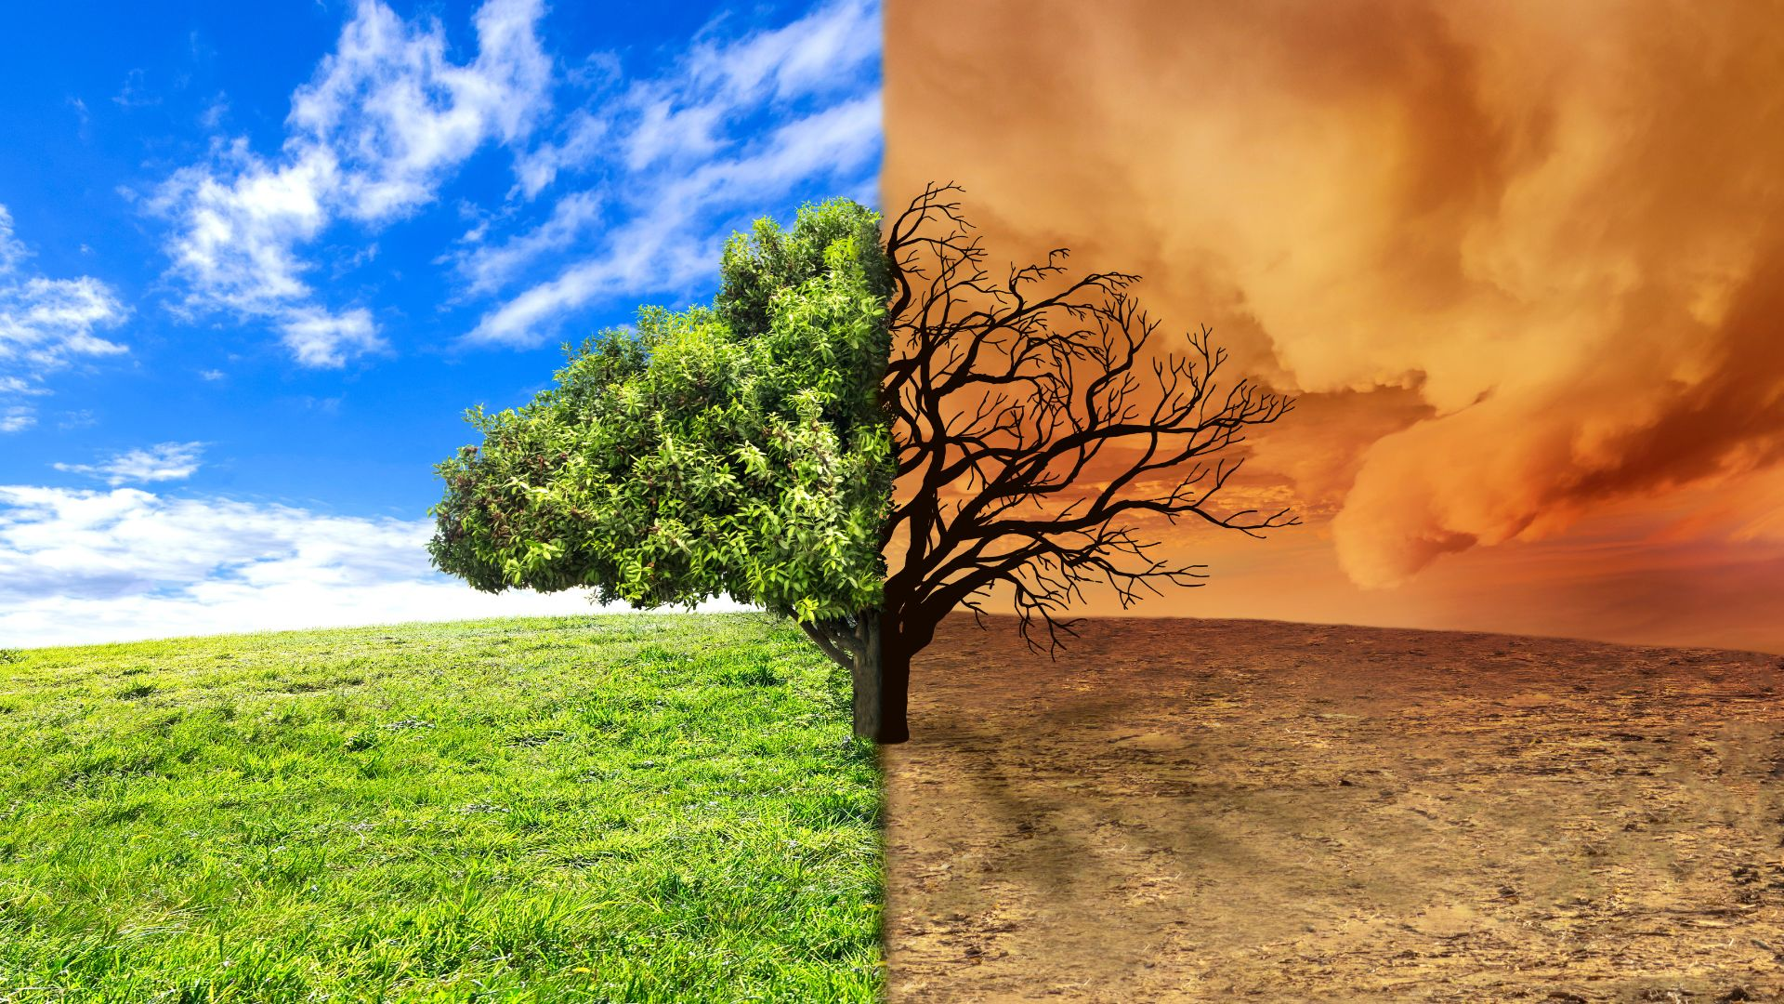
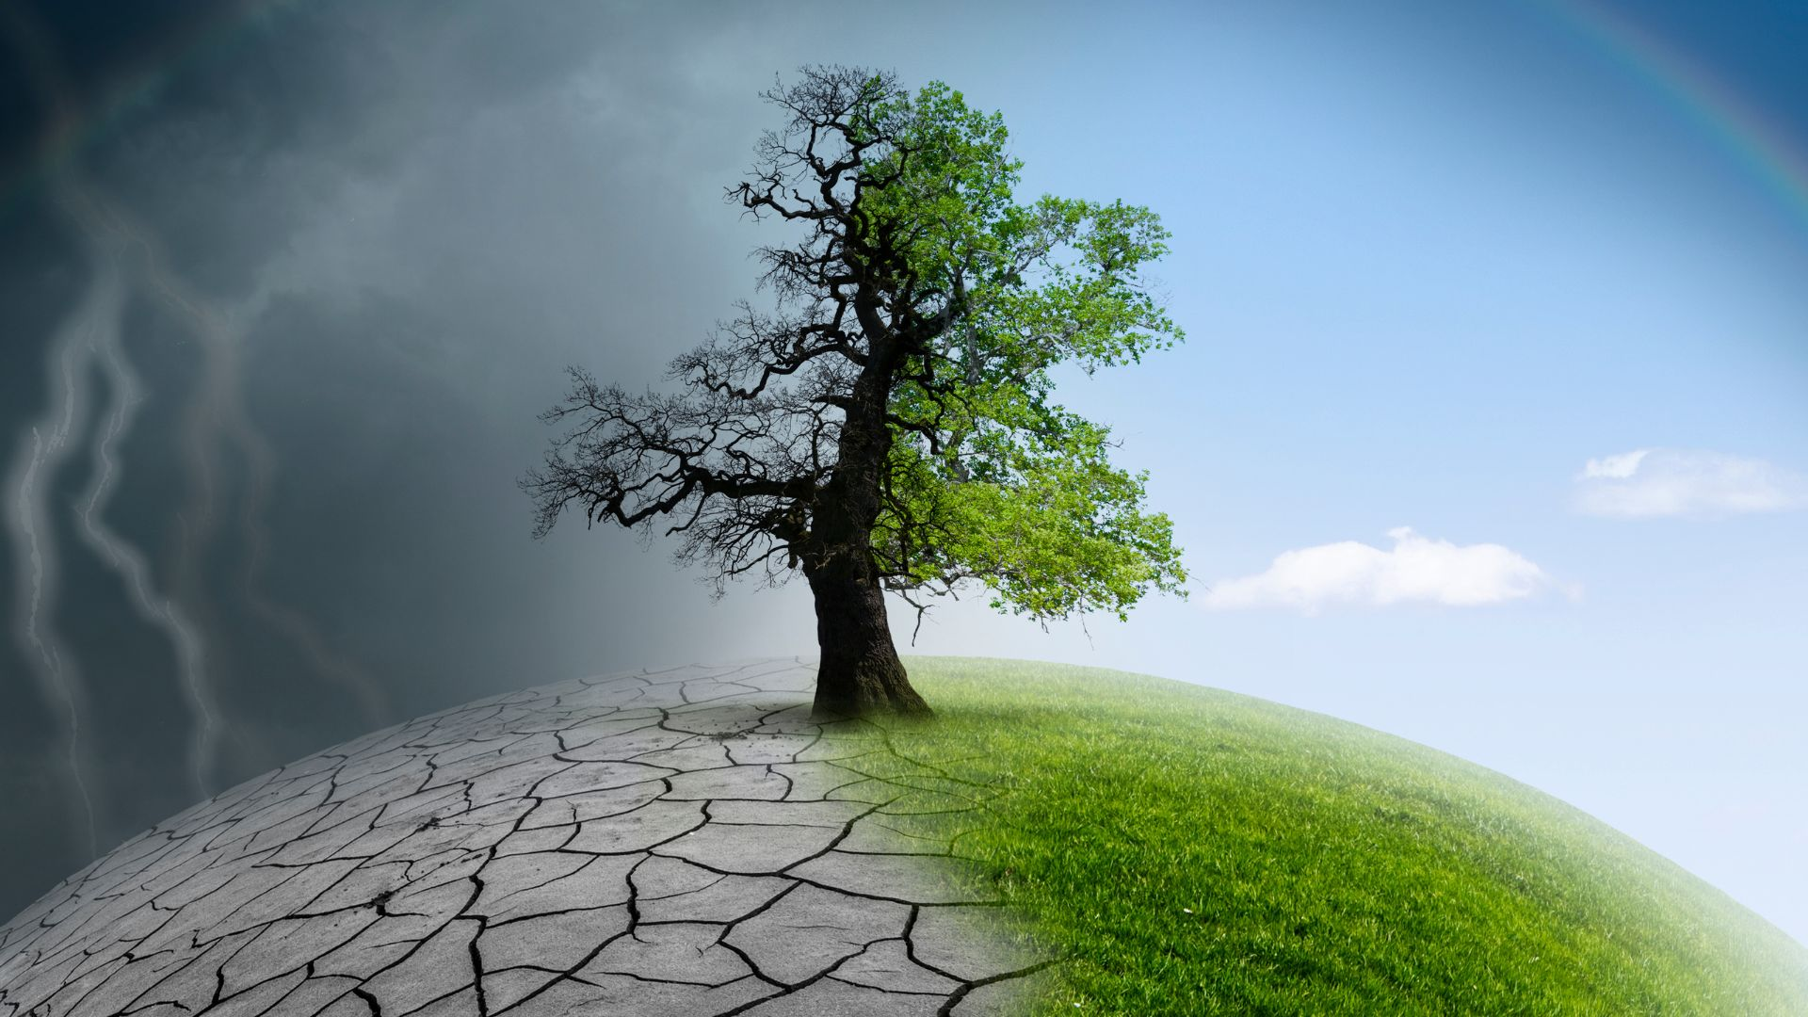
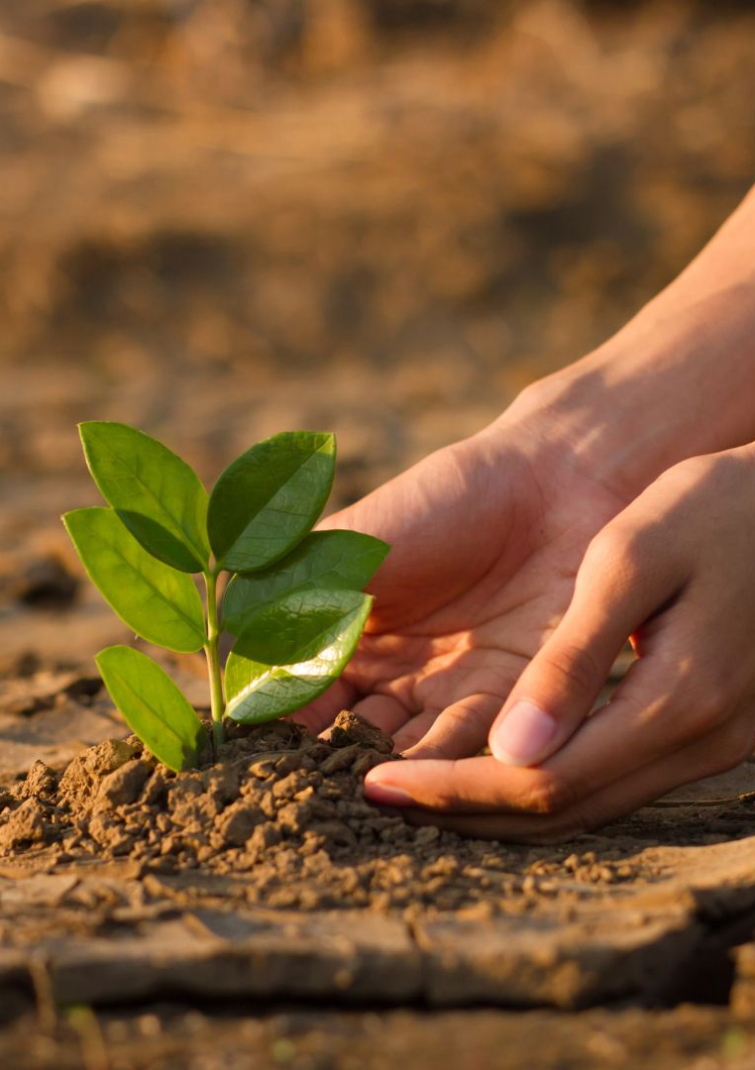
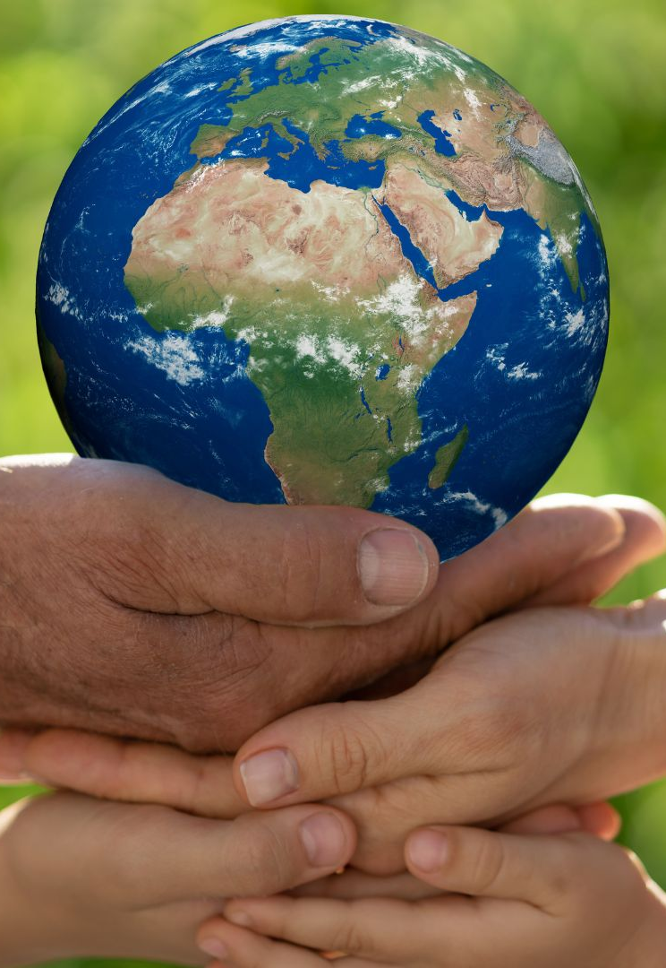
01
03
Step 1: THINK with Questions
Step 3: TRY Creative Solutions
CONTENTS
00
02
Introduction & What to Avoid
Step 2: WATCH Expert Videos

Slide 3
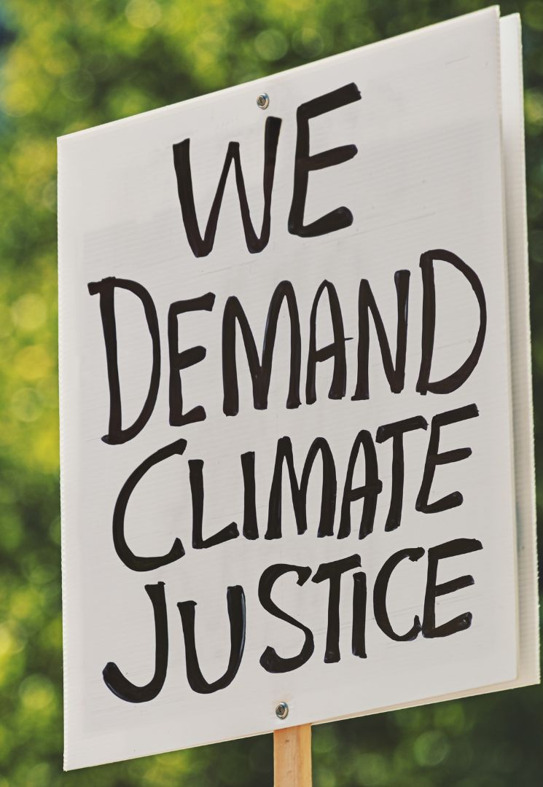
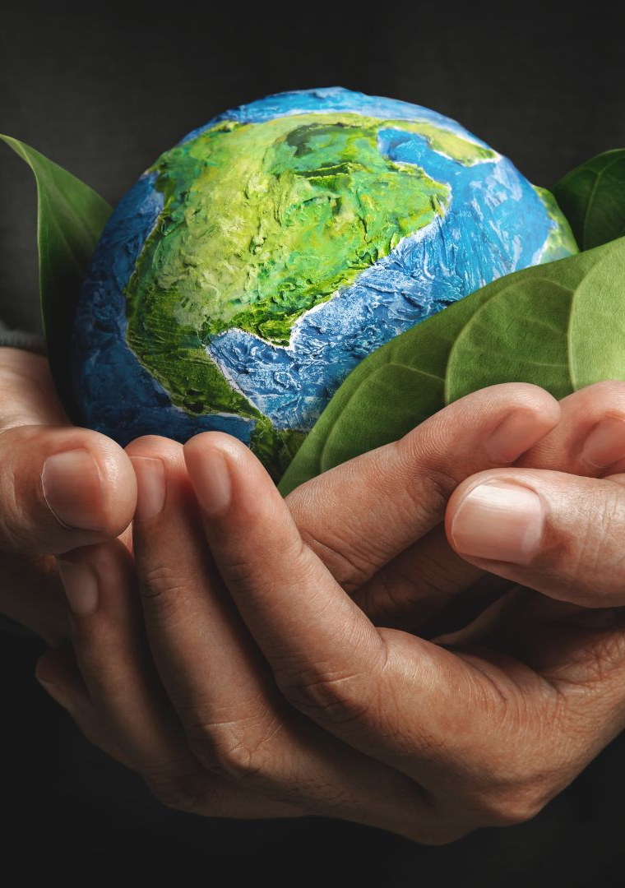
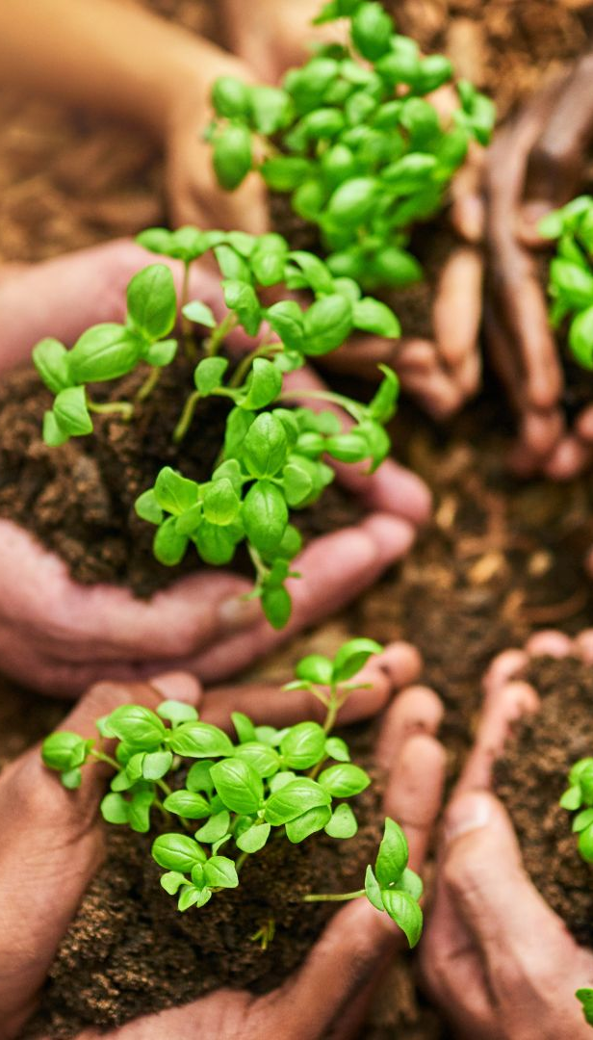
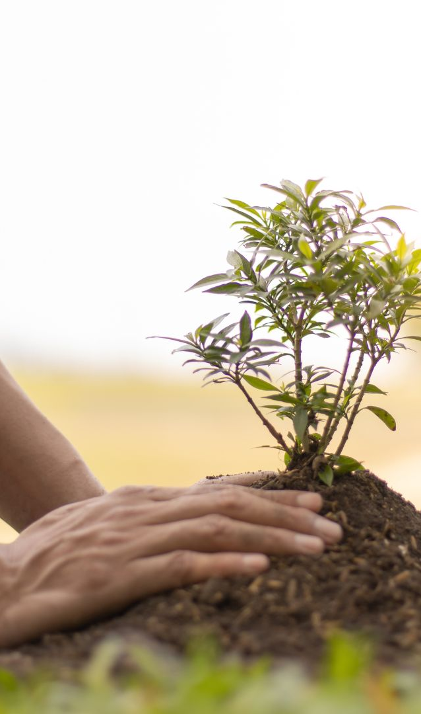
04
06
Step 4: USE the Tools below
Key Takeaways
CONTENTS
05
07
Step 5: Reflect & Improve
Thank you

Slide 4
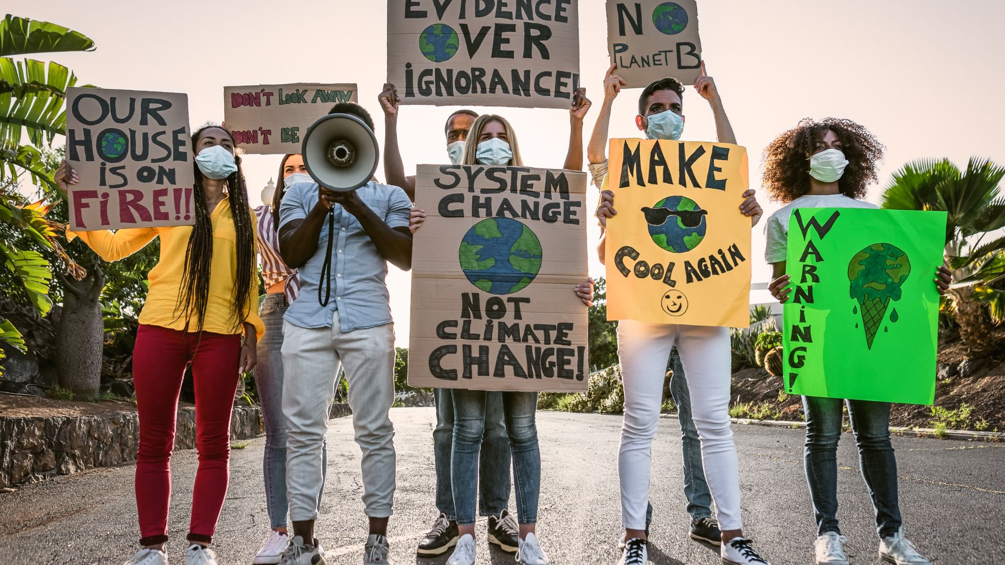
00
INTRODUCTION
& What to Avoid

Slide 5
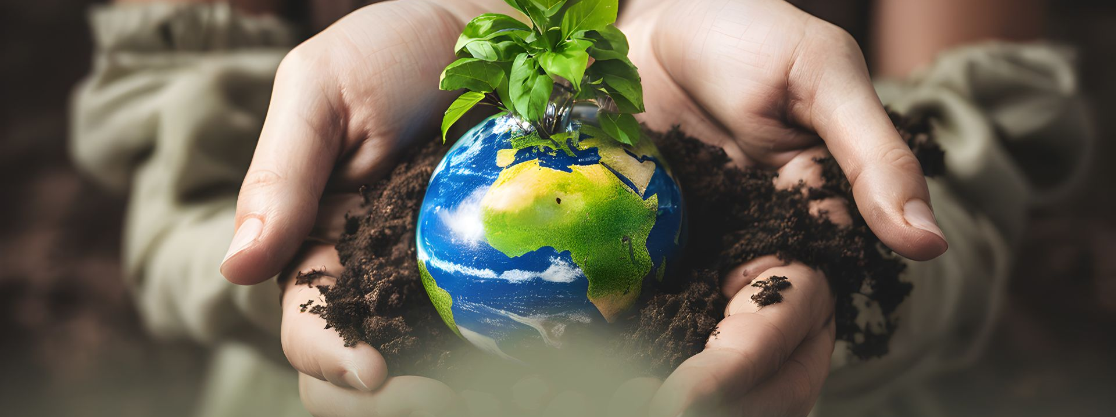
00
INTRODUCTION
Youth are often the most powerful voices for climate action, but visions can be lost without clear communication. This OER empowers young people to share and promote their climate ideas in ways that are creative, authentic, and impactful. It builds on earlier Planet Pulse modules:
Resilience – bouncing back when promotion doesn’t get immediate traction.
Community – using peer networks to spread your message.
The goal is to help you communicate their ideas through visuals, stories, and campaigns that inspire action.

Slide 6
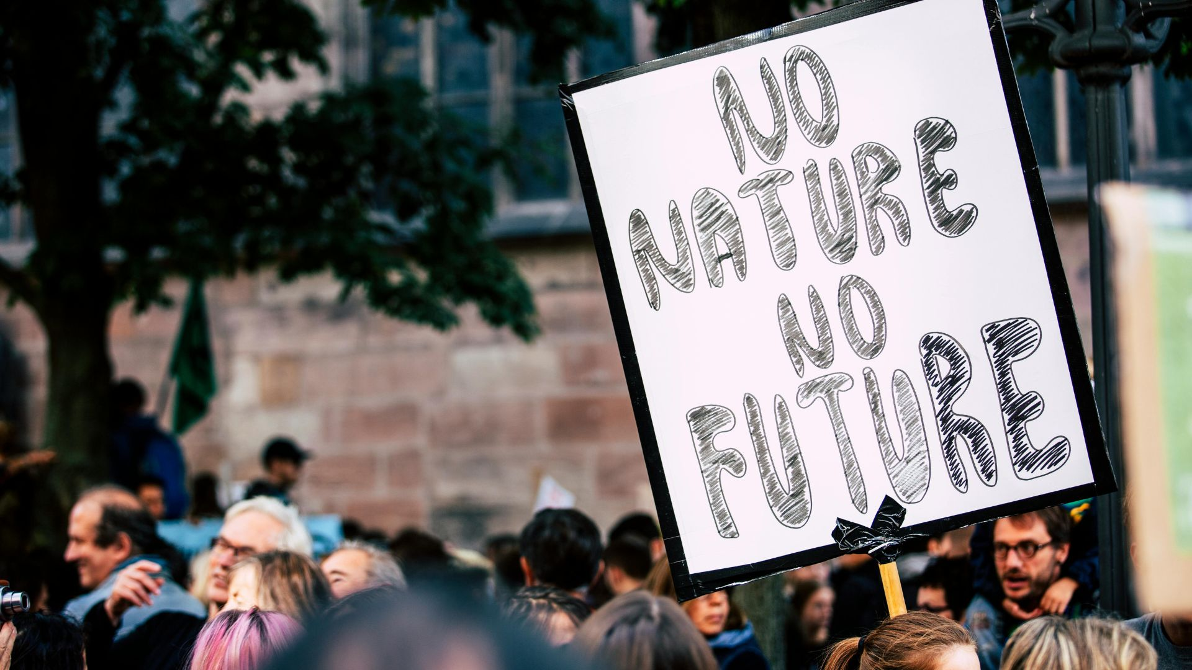
INTRODUCTION - What to Avoid
Overpromising results you cannot deliver.
Excluding local voices or failing to represent your community authentically.
Using misleading information or unverified facts (connect to Digital Literacy OER).
Posting for attention without real engagement.
Promoting your vision should be about trust, honesty, and collaboration, not just likes or shares.

Slide 7
01
THINK with Questions

Slide 8
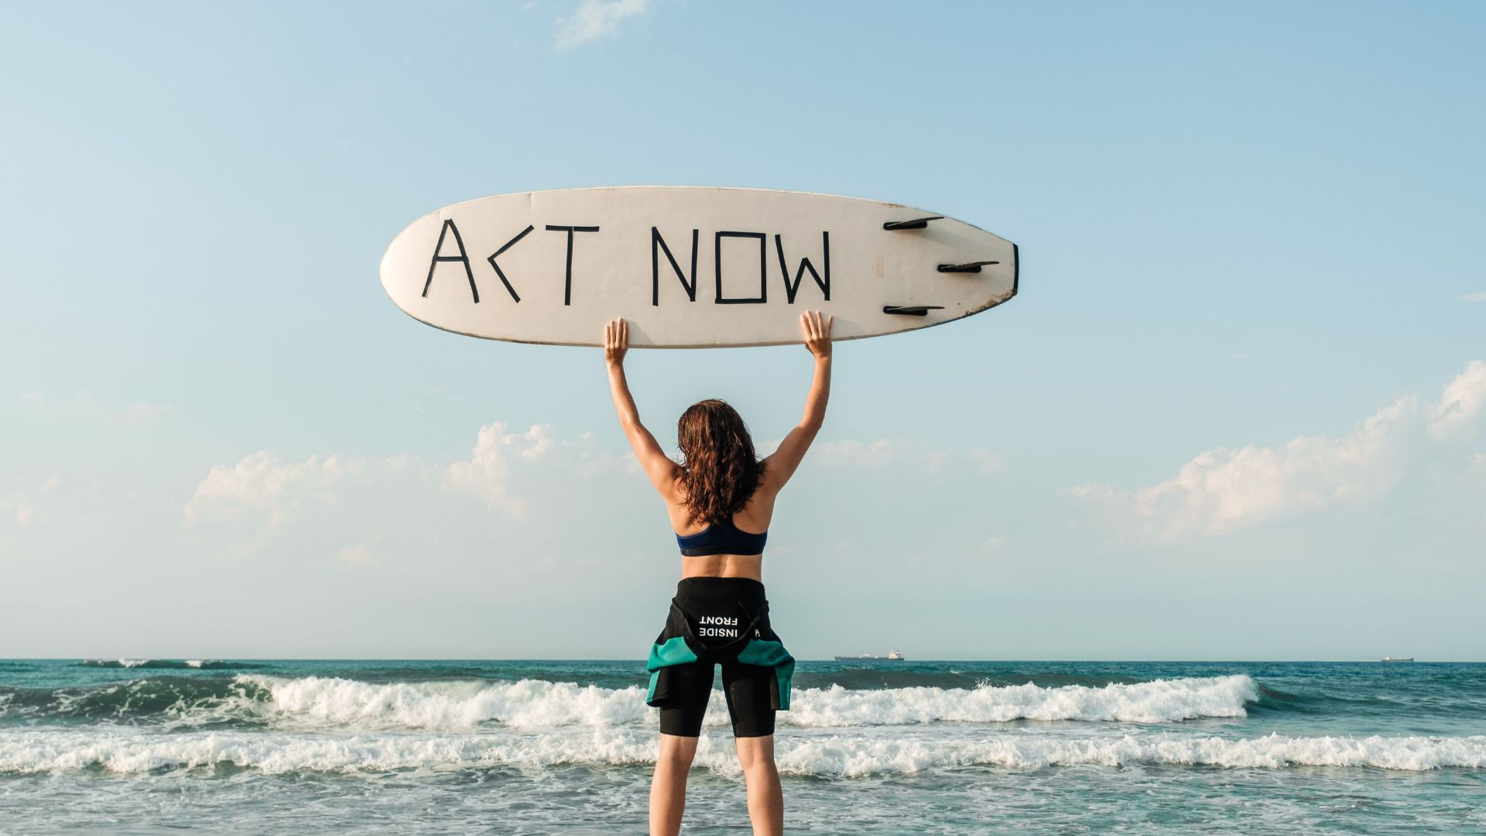
Use questions to clarify your message:
How can my visuals inspire action?
What story connects emotionally with my audience?
What makes my idea unique compared to others?
Who could help me amplify my message?
How can I use feedback to improve?
01
THINK with Questions
Exercise: Write down 3 answers per question, then discuss in pairs or groups.

Slide 9
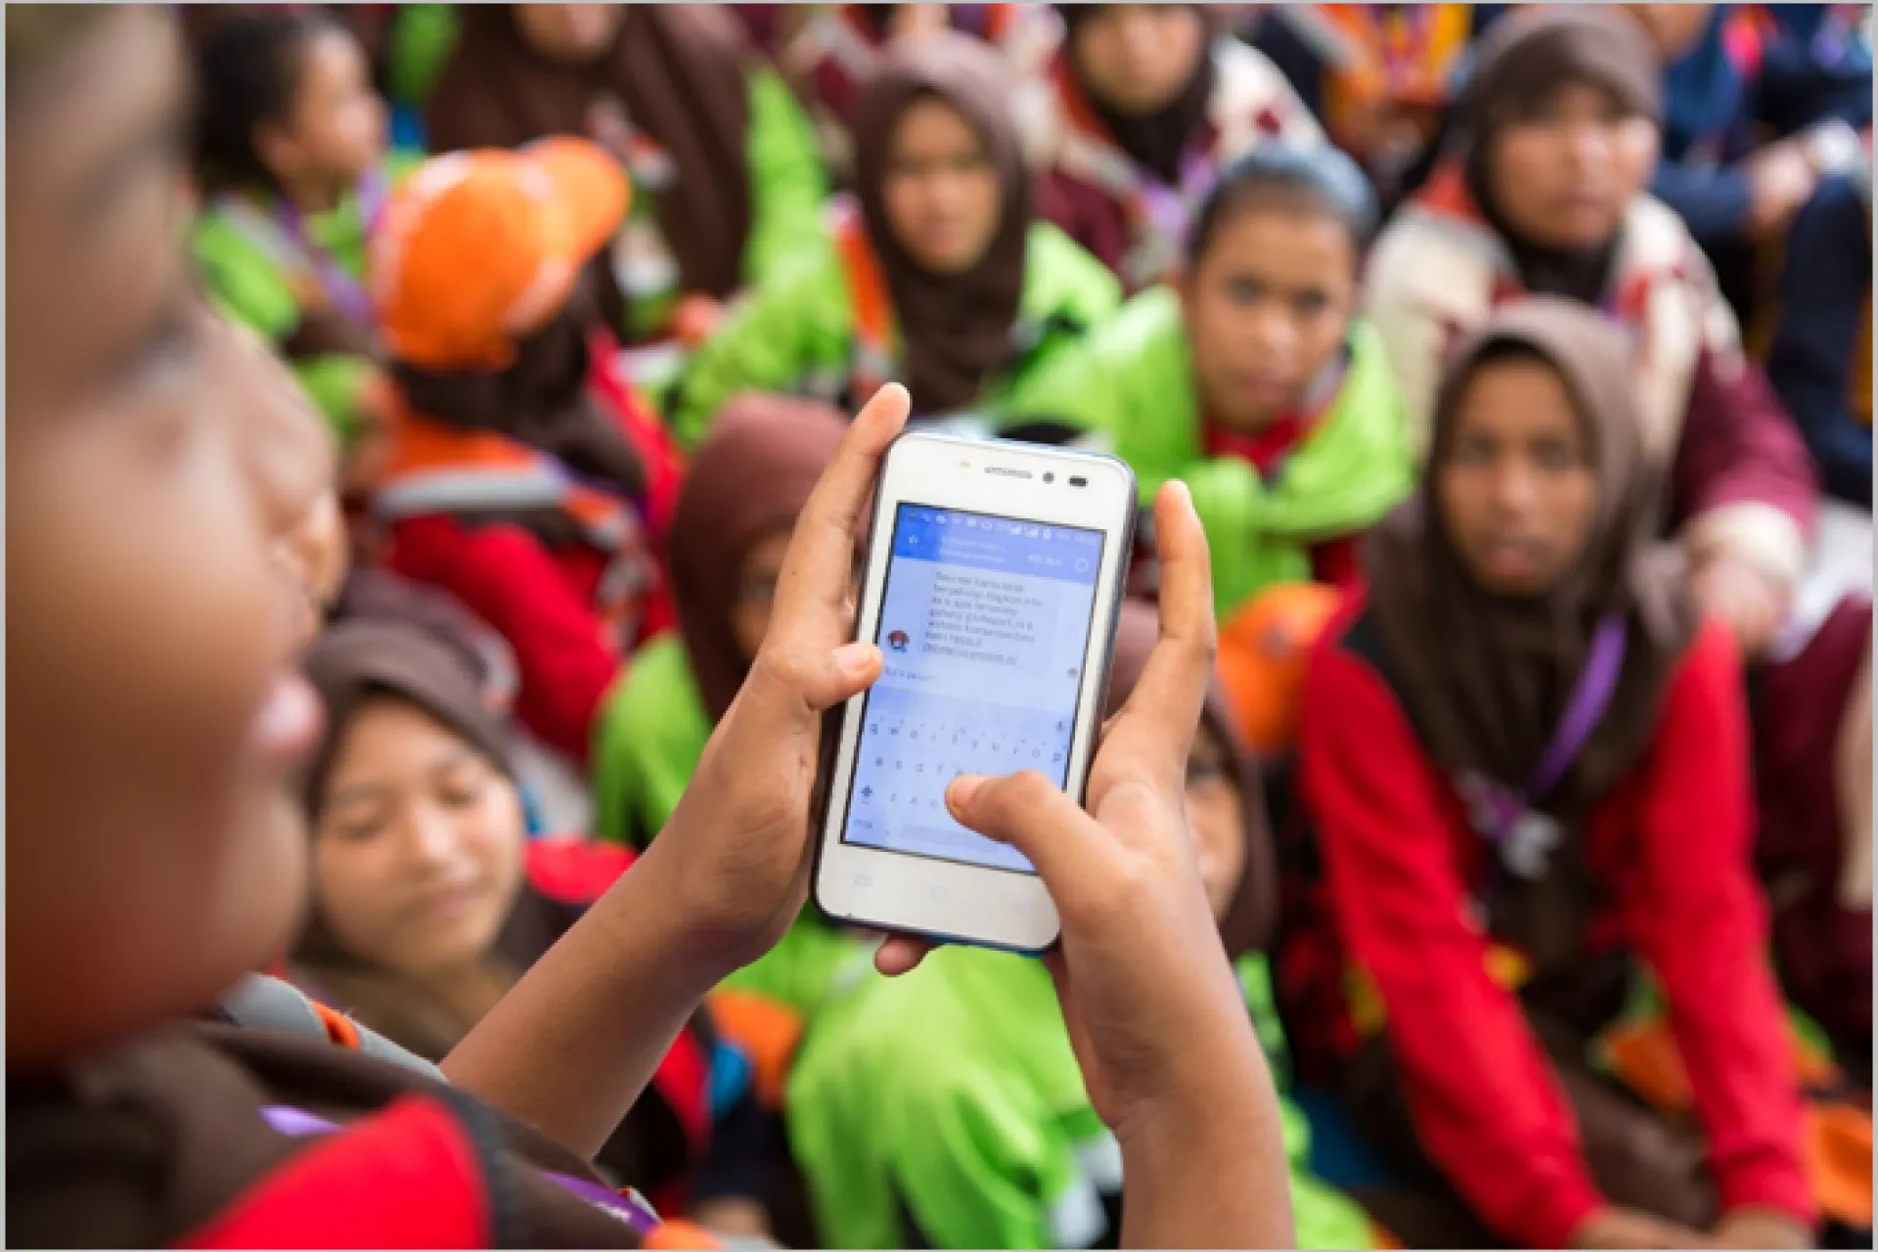
02
WATCH Expert Videos

Slide 10
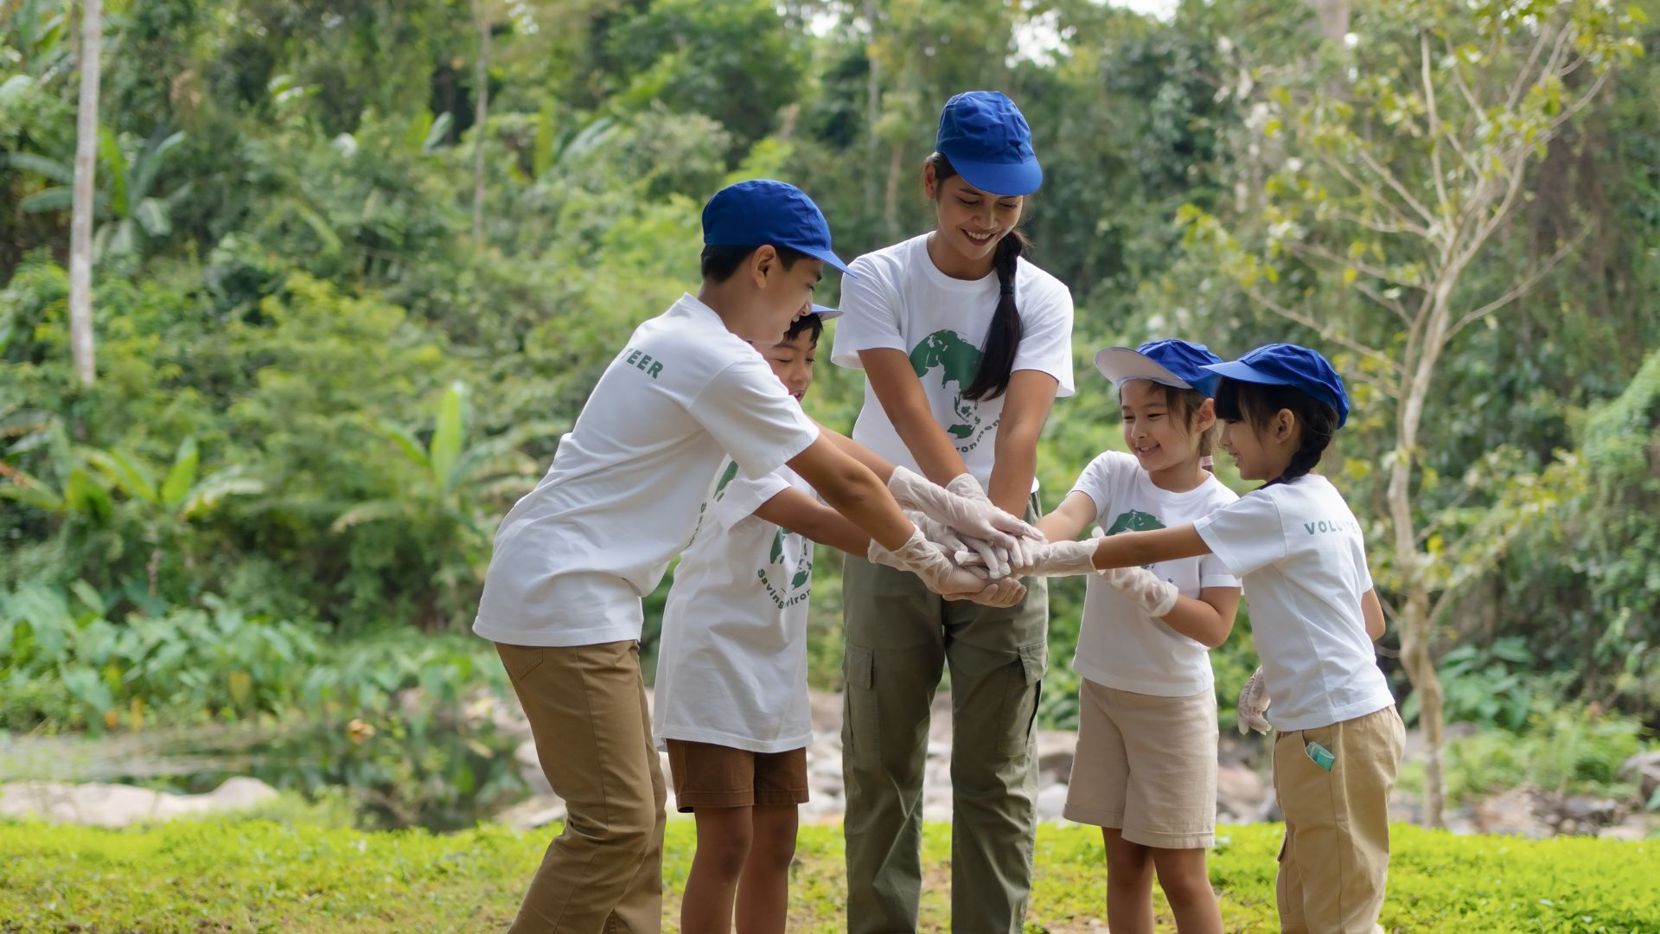
WATCH Expert Videos
Videos are a great entry point to understand authentic storytelling and campaign-building. Use these before creating your own outputs.
02
WATCH Expert Videos

Slide 11
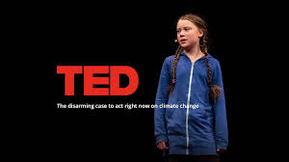
WATCH Expert Videos
1. Greta Thunberg’s TEDx Talk: “The Disarming Case to Act Right Now”
This video shows how plain, direct language can be more powerful than polished speeches.
Reflection prompt: How does Greta make her message feel urgent?
2. UNICEF Voices of Youth – Digital Storytelling Resources
Offering Step-by-step guides on creating short, impactful videos and posts.
Activity: Explore one toolkit as a group and pick 1 tip to apply today.
02
WATCH Expert Videos

Slide 12

WATCH Expert Videos
3. TED-Ed: How to Tell a Story That Moves People
Explains narrative arcs (beginning, problem, action, resolution).
Reflection prompt: Which part of the arc is strongest in your own story?
4. Canva Design School Tutorials
Provides you with practical lessons on creating posters, reels, and infographics.
Activity: Follow one tutorial as a group and produce a poster in 15 minutes.
02
WATCH Expert Videos

Slide 13
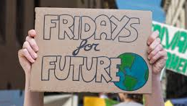
WATCH Expert Videos
5. Fridays for Future Campaign Examples
Check out real-world youth campaigns (hashtags, marches, digital actions).
Reflection prompt: What makes these campaigns shareable?
02
WATCH Expert Videos

Slide 14
03
TRY Creative Solutions
Now put your ideas into practice. This step is hands-on and should be interactive.

Slide 15
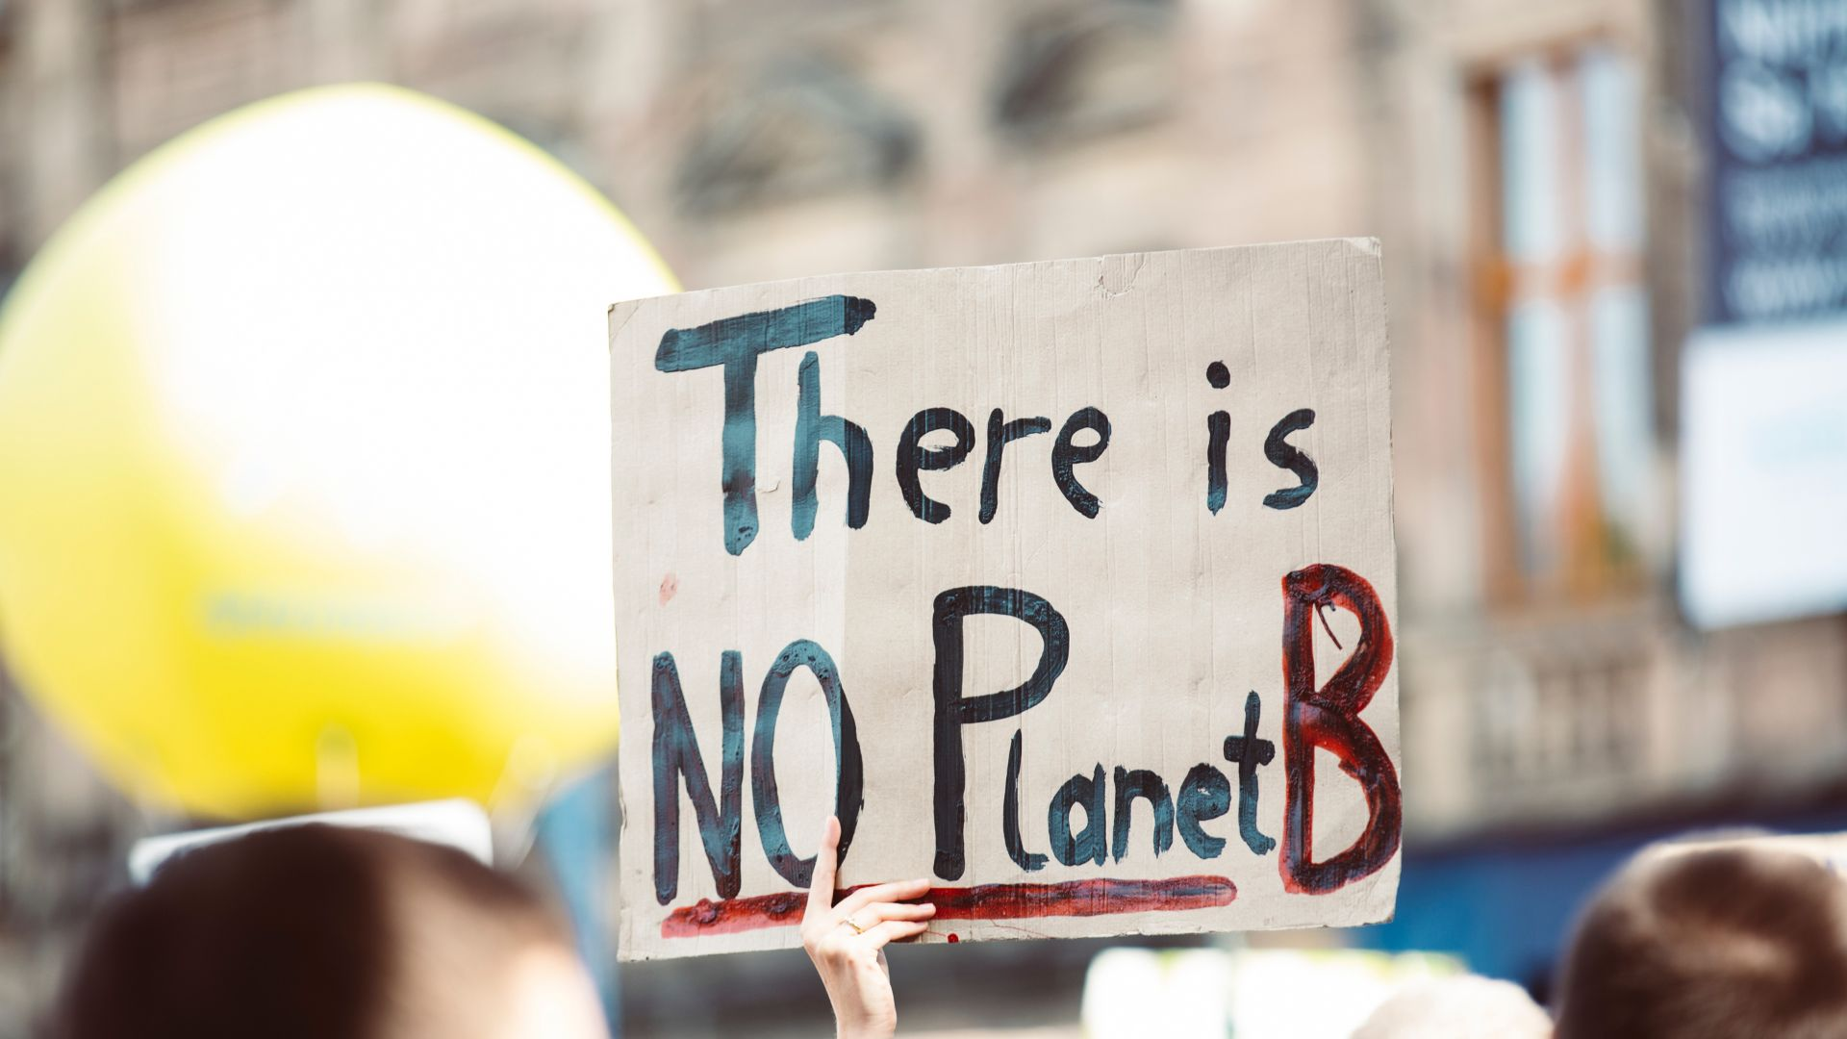
Option A – Poster Challenge (30 min)
Use Canva/PowerPoint to create a poster with a slogan, image, and call-to-action.
Example: “No Planet B – Join our beach cleanup.”
Share posters in a “gallery walk” session and give peer feedback.
03
TRY Creative Solutions

Slide 16
Option B – One-Minute Video/Reel (45 min)
Plan: Write a simple script (intro → why it matters → action to take).
Record: Use CapCut, InShot, or phone cameras.
Edit: Add subtitles and a short caption.
Share: Post in a private group first for feedback.
03
TRY Creative Solutions

Slide 17
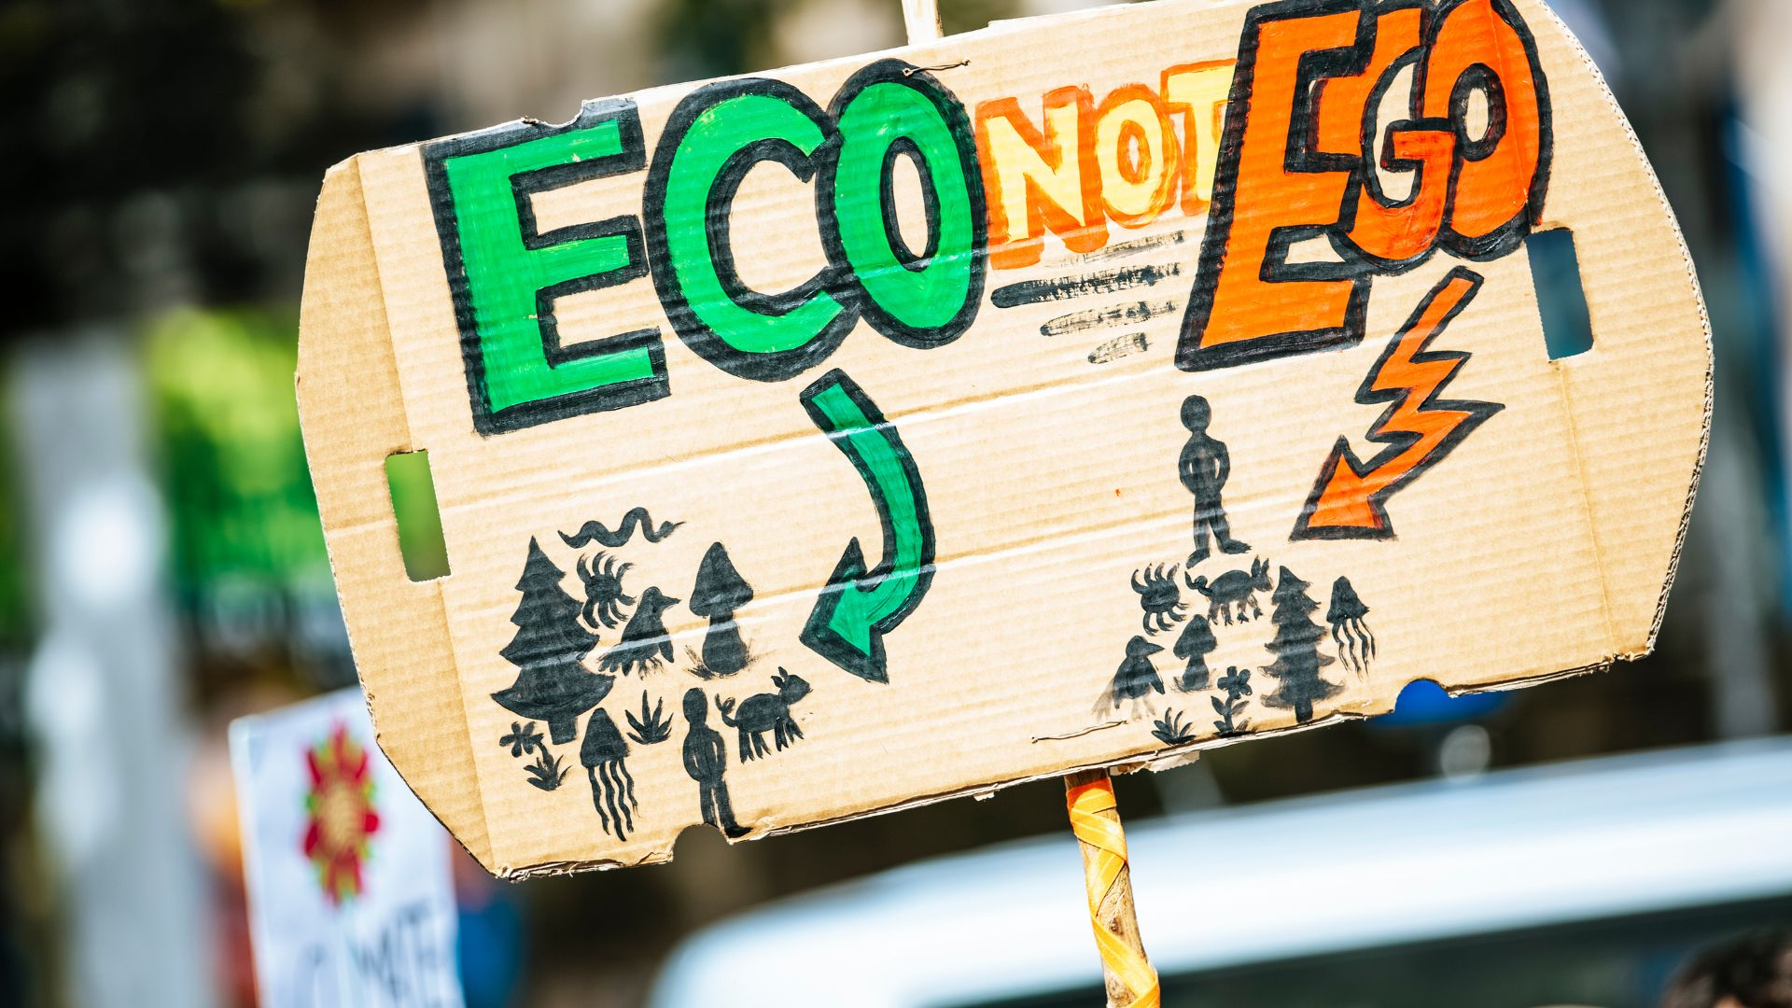
Option C – Podcast/Voice Snippet (20–30 min)
Record a short “vision pitch” on Anchor or phone voice memo.
Example format: “My vision for my school is… Here’s why it matters… Here’s how you can help.”
Share with peers to practice public speaking.
03
TRY Creative Solutions

Slide 18
Option D – Storyboard Exercise
(20 min)
Draw 3–5 slides showing your idea’s journey (problem → solution → impact).
Example: Plastic waste at school → Student recycling hub → Cleaner campus & student leadership.
03
TRY Creative Solutions

Slide 19
04
Use the TOOLS
Practical tools to make your outputs polished and professional:

Slide 20
USE the Tools below
Visuals & Design
Canva – templates for posters, infographics, social posts.
Adobe Express – simple poster and flyer design.
Video & Multimedia
CapCut – quick edits, captions, and effects for reels.
InShot – beginner-friendly mobile video editing.
Pexels Video – free stock videos for storytelling.
04
USE the Tools below

Slide 21
USE the Tools below
Audio & Storytelling
Anchor – record and share podcasts.
Audacity – free audio editing.
Images & Visual Support
Unsplash and Pixabay – royalty-free photos.
04
USE the Tools below

Slide 22
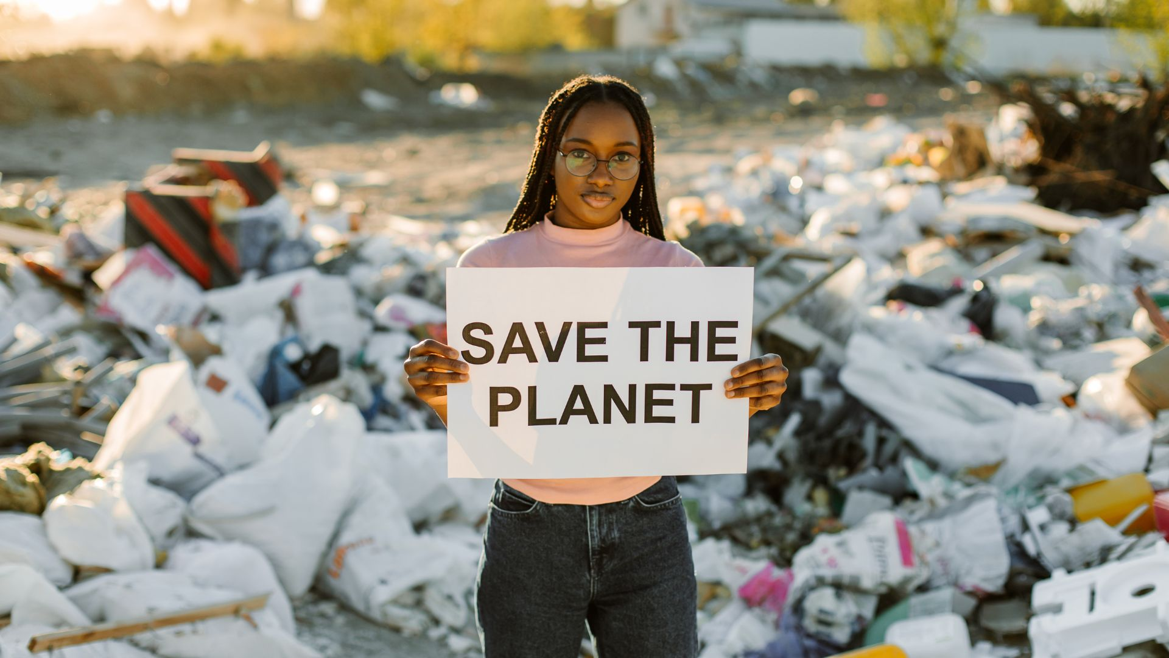
USE the Tools below
Engagement & Sharing
Linktree – share all your project links in one place.
Mentimeter – run polls and live feedback during presentations.
Google Forms – collect community opinions.
Educator Tip: Pair each tool with a task (e.g. Canva → Poster, CapCut → Reel, Mentimeter → Poll).
04
USE the Tools below

Slide 23
05
Reflect & Improve

Slide 24
Reflection Prompts
Which content (poster, video, story) was easiest for me to make?
Which was most impactful for my peers?
How did feedback help me adjust my approach?
How can I keep improving my communication skills?
05
Reflect & Improve
Activity – Peer Feedback Circle (20 min)
Each participant shows their output.
Peers give 1 positive comment and 1 improvement suggestion.
Participants write a “next step” commitment: “Next time, I will…”.

Slide 25
06
Key Takeaways

Slide 26
Key Takeaways
Empowerment = making your vision visible and authentic.
Use stories and visuals to inspire action, not just to inform.
Rely on community and collaboration for reach.
Always check facts and stay transparent (Digital Literacy OER).
Sharing your vision is an ongoing process:
create → share → listen → improve.
06
Key Takeaways

Slide 27
Reflect and act
Imagine your community ten years from now if climate action goes well. What is one detail of that future you could help bring closer?
www.planet-pulse.eu

