Slide 1
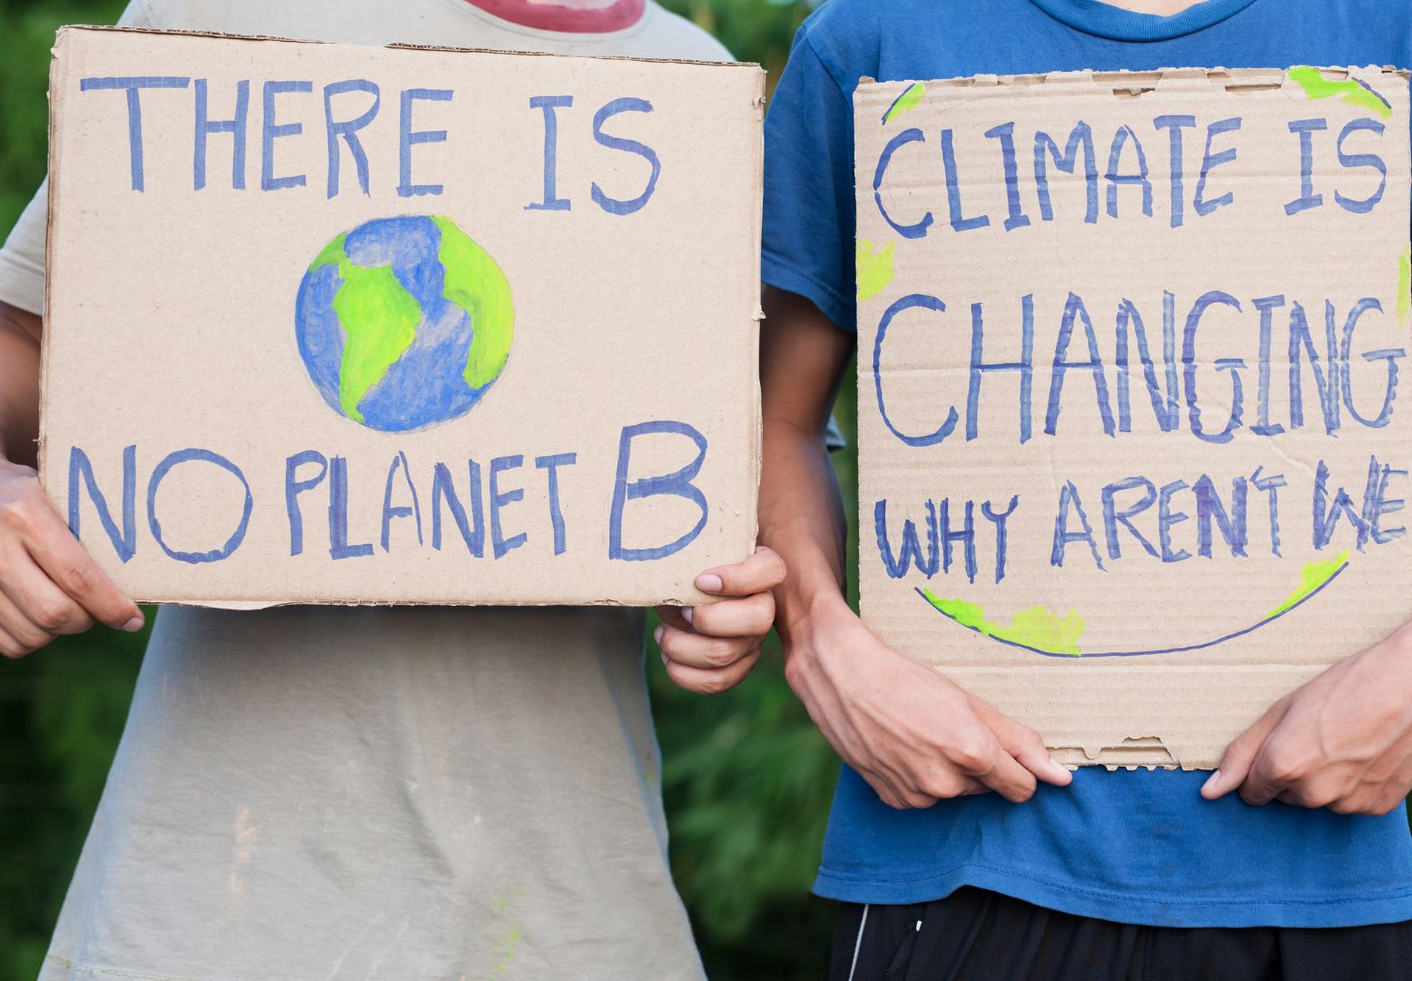

Climate Science:
Making Sense of a Changing Planet
www.planet-pulse.eu

Slide 2
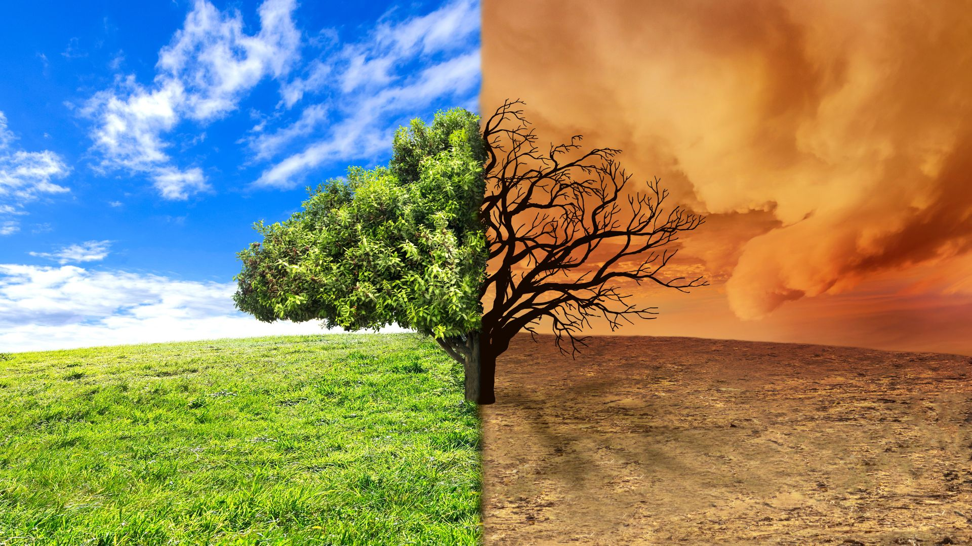
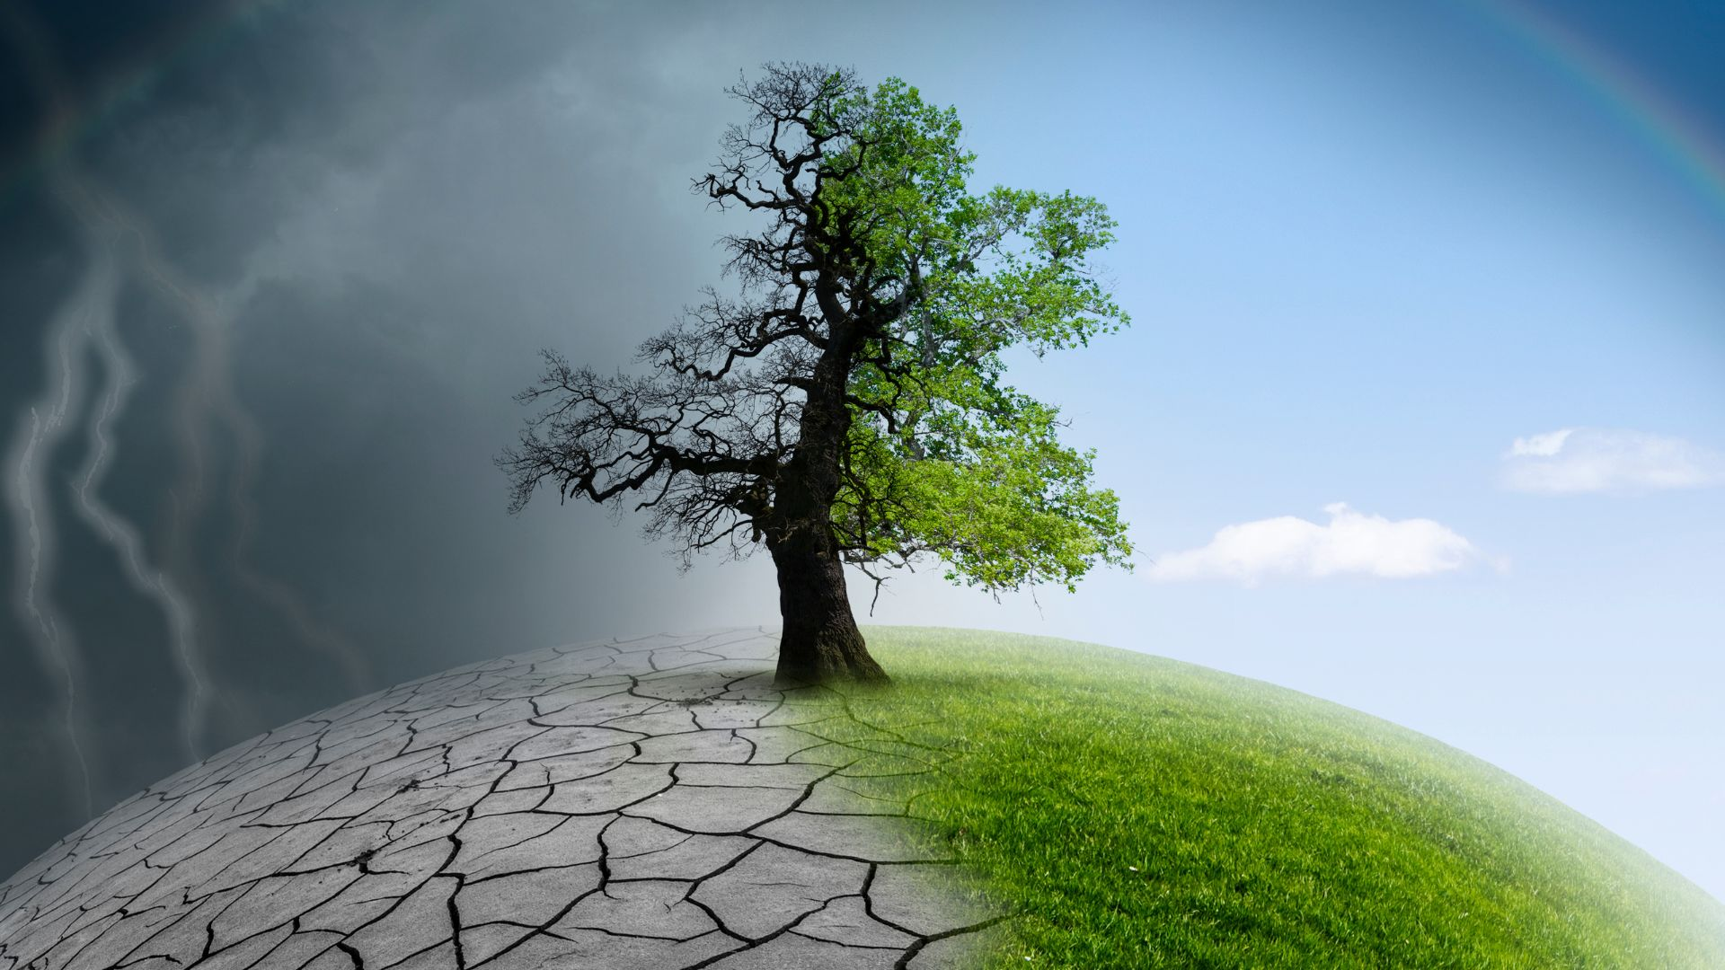
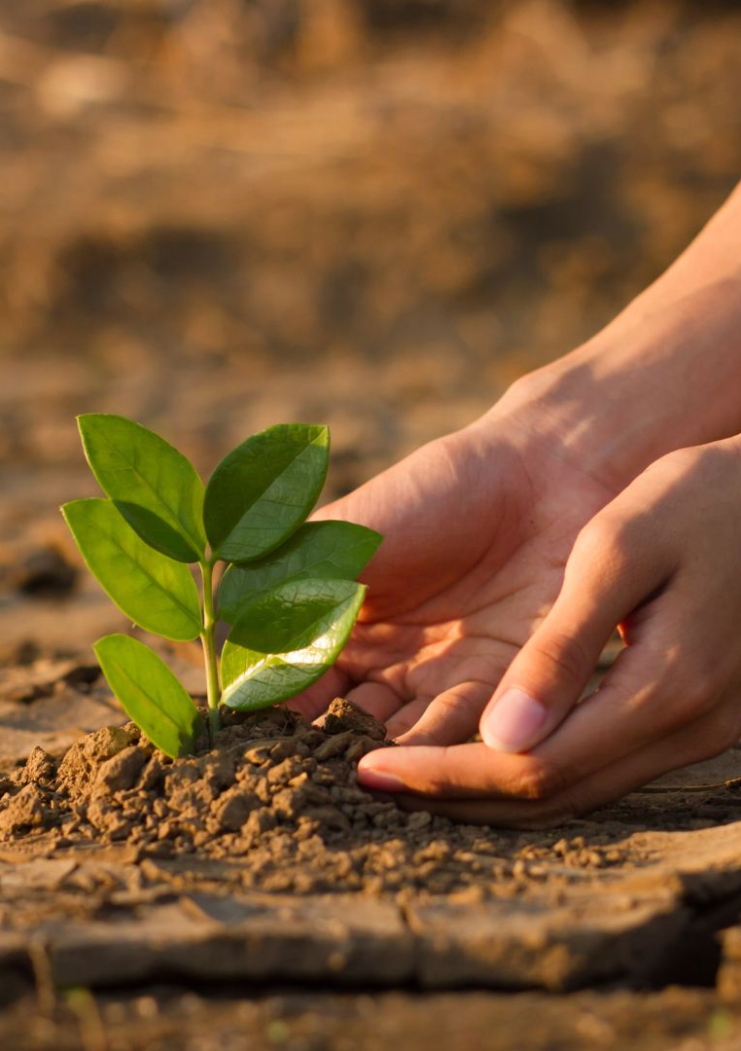
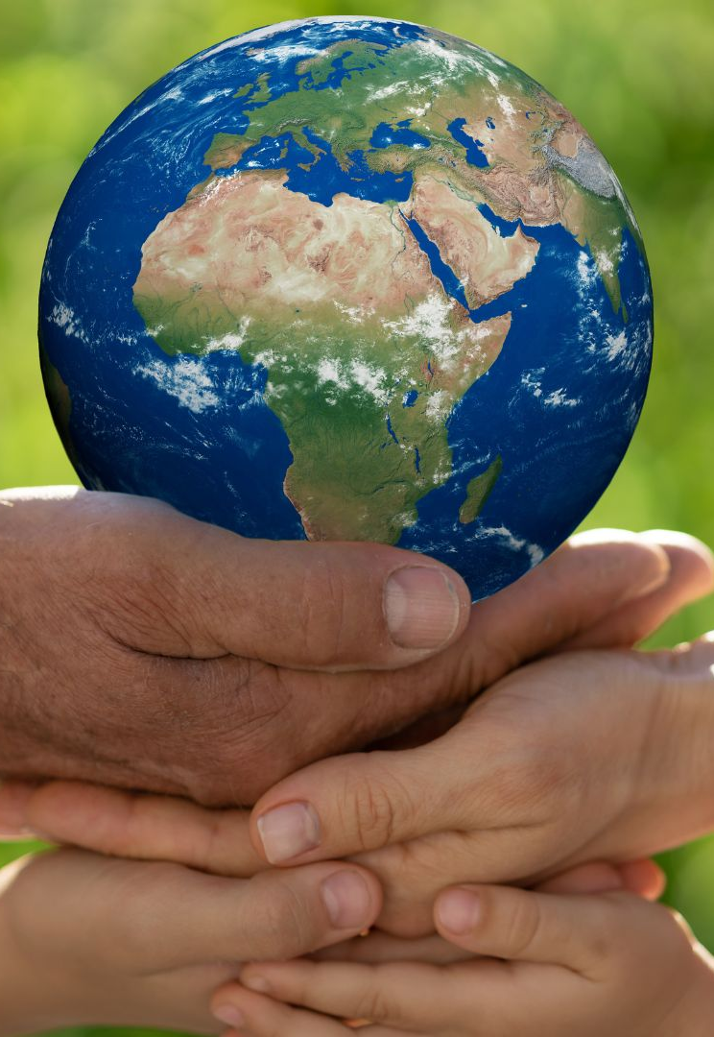
01
03
Part 1: Climate Science Essentials (Factsheet)
Part 3: TRY — Mini Greenhouse Experiment
CONTENTS
00
02
Introduction & Learning Objectives
Part 2: THINK — Discussion Prompts

Slide 3

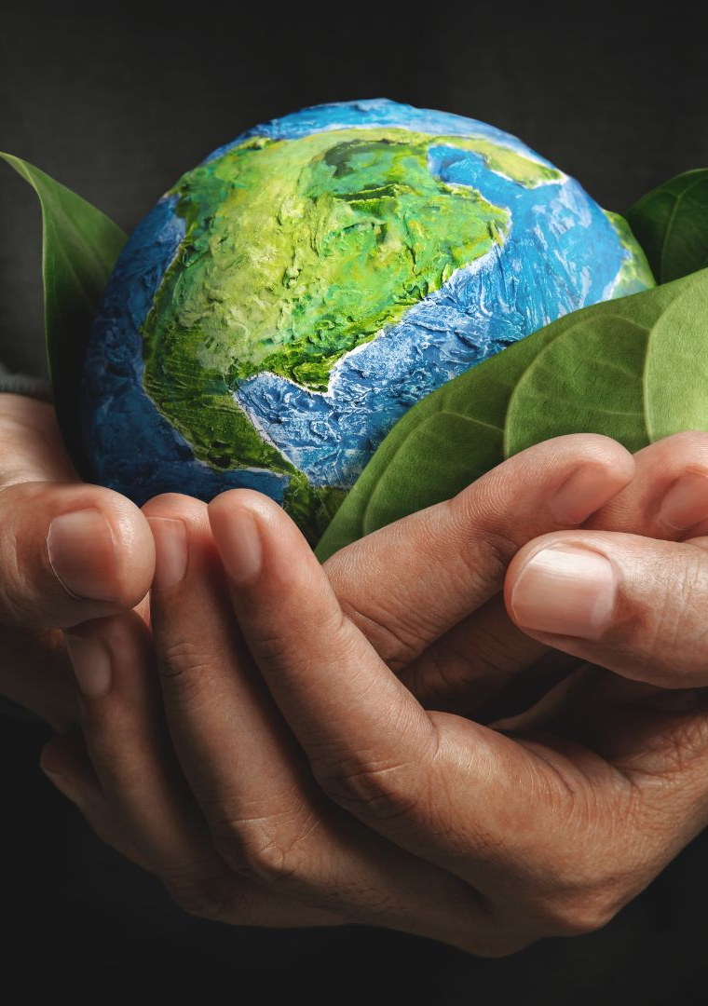
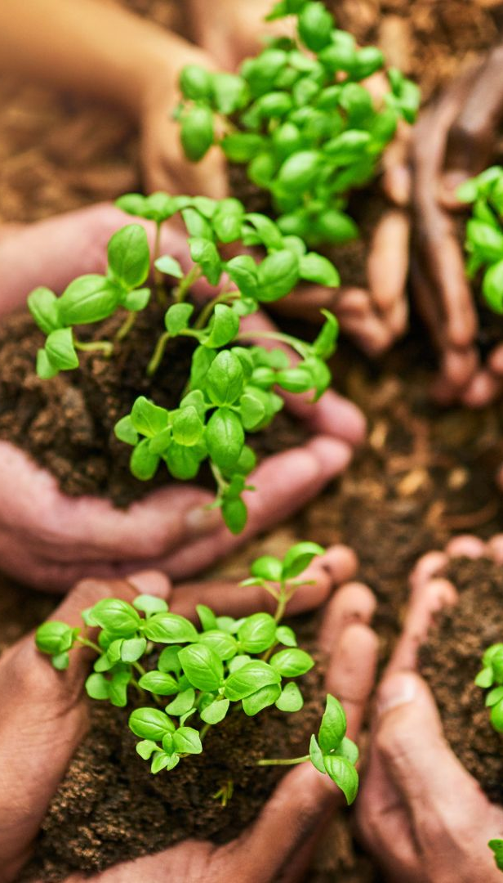
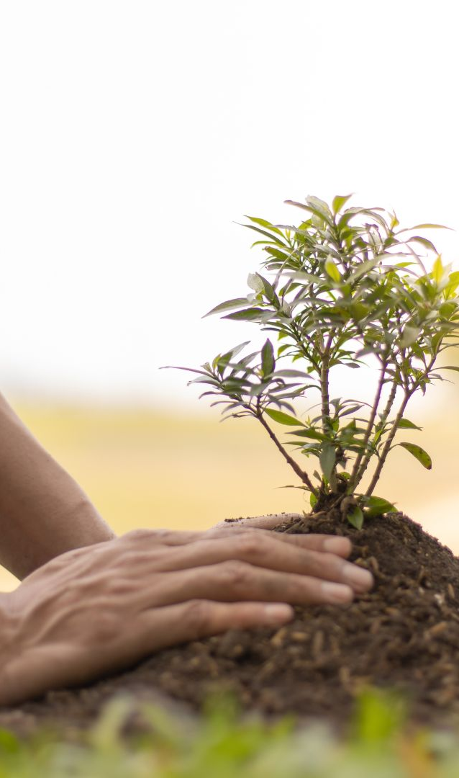
04
06
Part 4: CONNECT — Real-World Relevance
Part 6: Key Takeaways
CONTENTS
05
07
Part 5: REFLECT — Deepening Understanding
Part 7: Explore More — Read, Watch & Listen

Slide 4
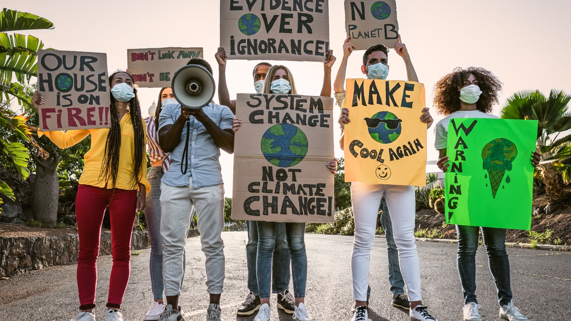
00
INTRODUCTION
& Learning Objectives

Slide 5
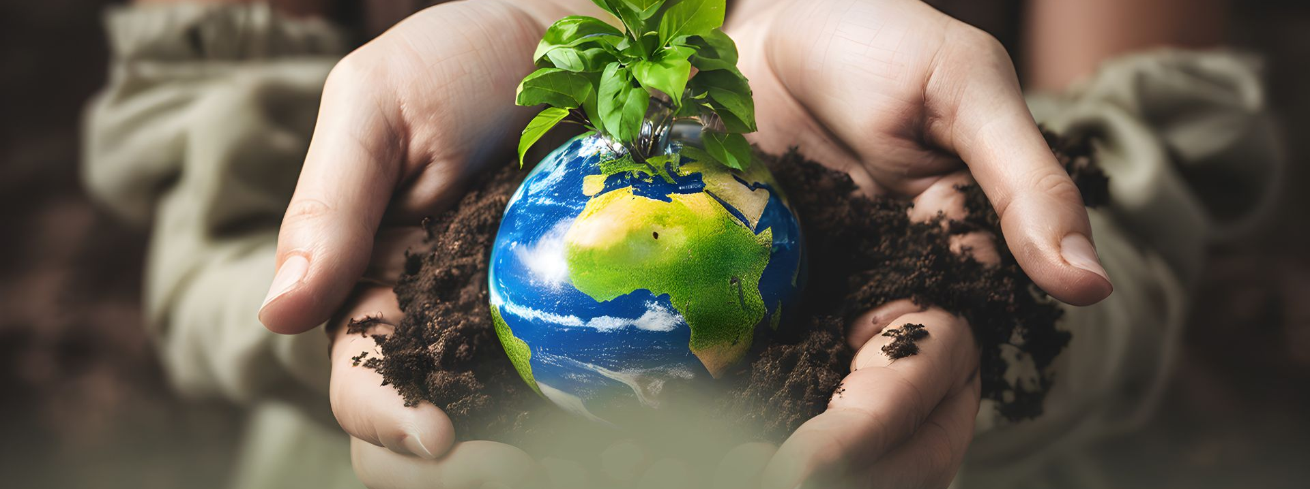
00
INTRODUCTION
Climate science provides a factual basis for understanding how and why the planet is changing. Many people encounter conflicting information, rapid climate news, or unclear explanations.
Building a clear scientific foundation helps make sense of these signals, supports informed discussion, and strengthens the ability to evaluate claims encountered in daily life, work, or public debates.
This activity offers a concise overview of climate science, a hands-on experiment, and applied analysis for real-world contexts.

Slide 6

Learning Objectives
After completing this activity, participants will be able to:
Distinguish clearly between weather and climate
Explain the greenhouse effect with scientific accuracy
Identify the main drivers of climate change
Understand how long-term climate data is collected and used

Slide 7
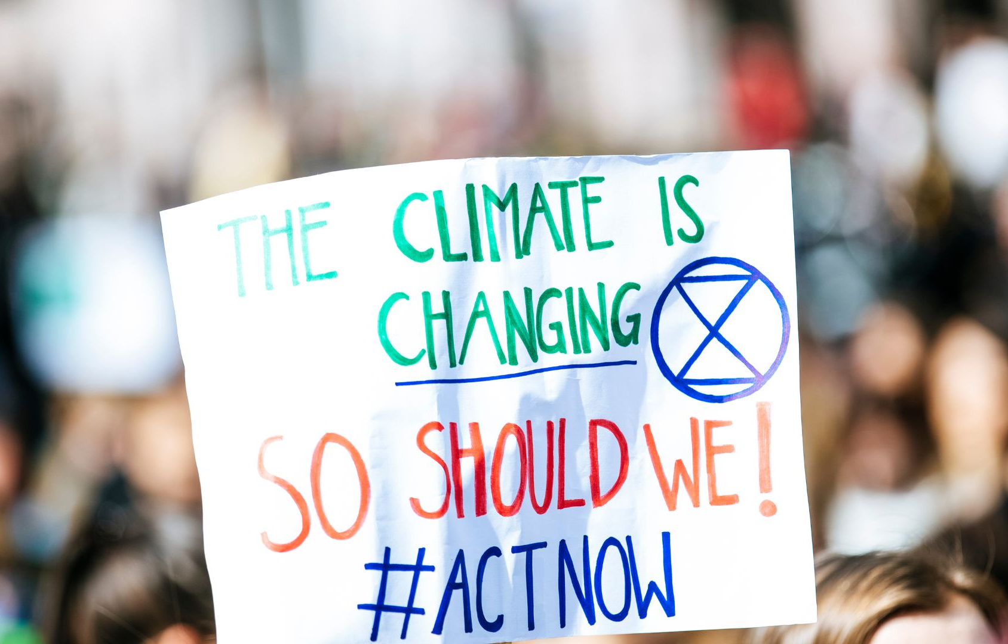
Learning Objectives
Build a simple model demonstrating atmospheric heat trapping
Connect climate science concepts to personal, social, and urban environments
Evaluate the reliability of climate information sources

Slide 8
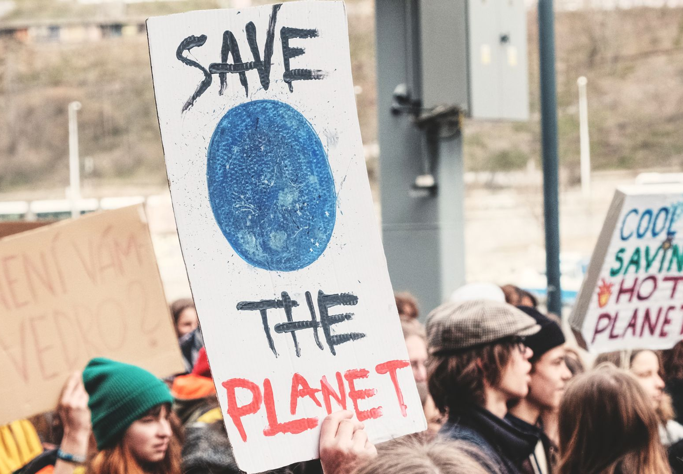
01
Climate Science Essentials
(Factsheet)

Slide 9

Weather vs. Climate
Weather refers to short-term atmospheric conditions (hours to days).
Climate refers to long-term patterns over decades or more.
Understanding the distinction is essential, particularly when evaluating claims such as “cold weather disproves global warming.”
01
Part 1: Climate Science Essentials (Factsheet)

Slide 10
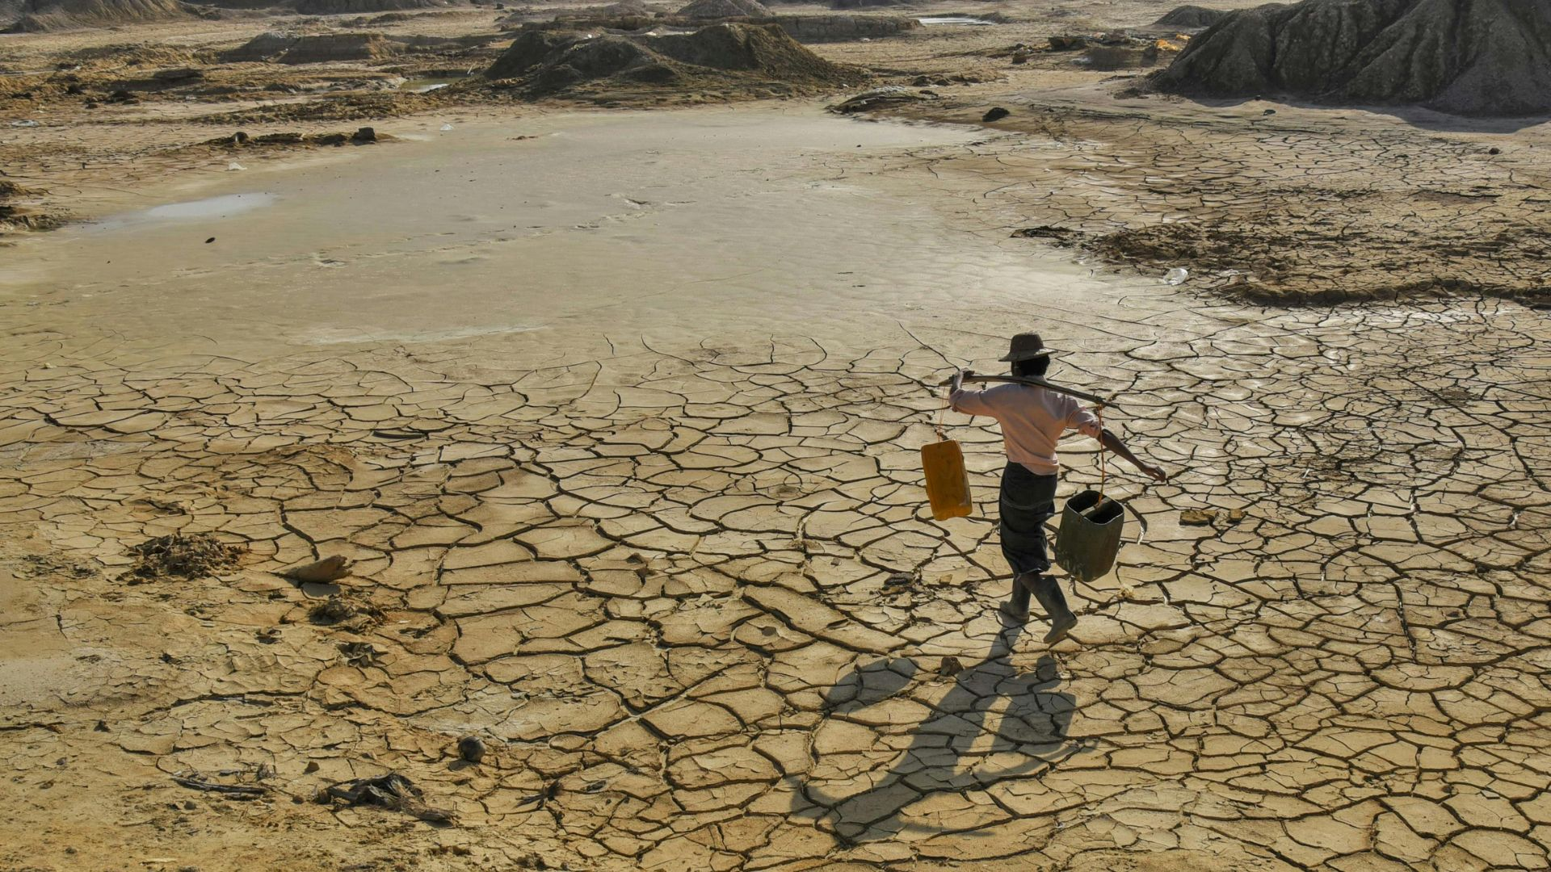
The Greenhouse Effect
Earth absorbs sunlight and radiates heat back into space. Greenhouse gases trap part of this heat, creating a habitable temperature range.
Human activities increase greenhouse gas concentrations, strengthening this effect and leading to global warming.
Key greenhouse gases:
CO₂ — energy, transport, manufacturing
CH₄ — agriculture, waste, fossil fuel extraction
N₂O — agriculture and industrial processes
Water vapor — amplifies heating as a feedback
01
Part 1: Climate Science Essentials (Factsheet)

Slide 11
How Scientists Study Climate
A variety of independent sources reveal long-term climate shifts:
Satellite observations
Global weather station networks
Ocean buoys and heat-content measurements
Ice cores and tree rings
Climate models that simulate Earth’s systems
The convergence of these methods provides strong evidence of rapid warming.
01
Part 1: Climate Science Essentials (Factsheet)

Slide 12

02
THINK
Discussion Prompts

Slide 13

WATCH Expert Videos
What changes in seasonal patterns or extreme weather have you noticed in recent years?
Which platforms or sources shape your understanding of climate issues?
Why do you think climate science is sometimes misunderstood or misrepresented?
How might climate science knowledge influence decisions in everyday life, work, or community involvement?
Which climate science topic would you like to explore more deeply?
02
Part 2: THINK — Discussion Prompts

Slide 14
03
TRY— Mini Greenhouse Experiment
A simple, visual demonstration of how heat becomes trapped in the atmosphere.

Slide 15
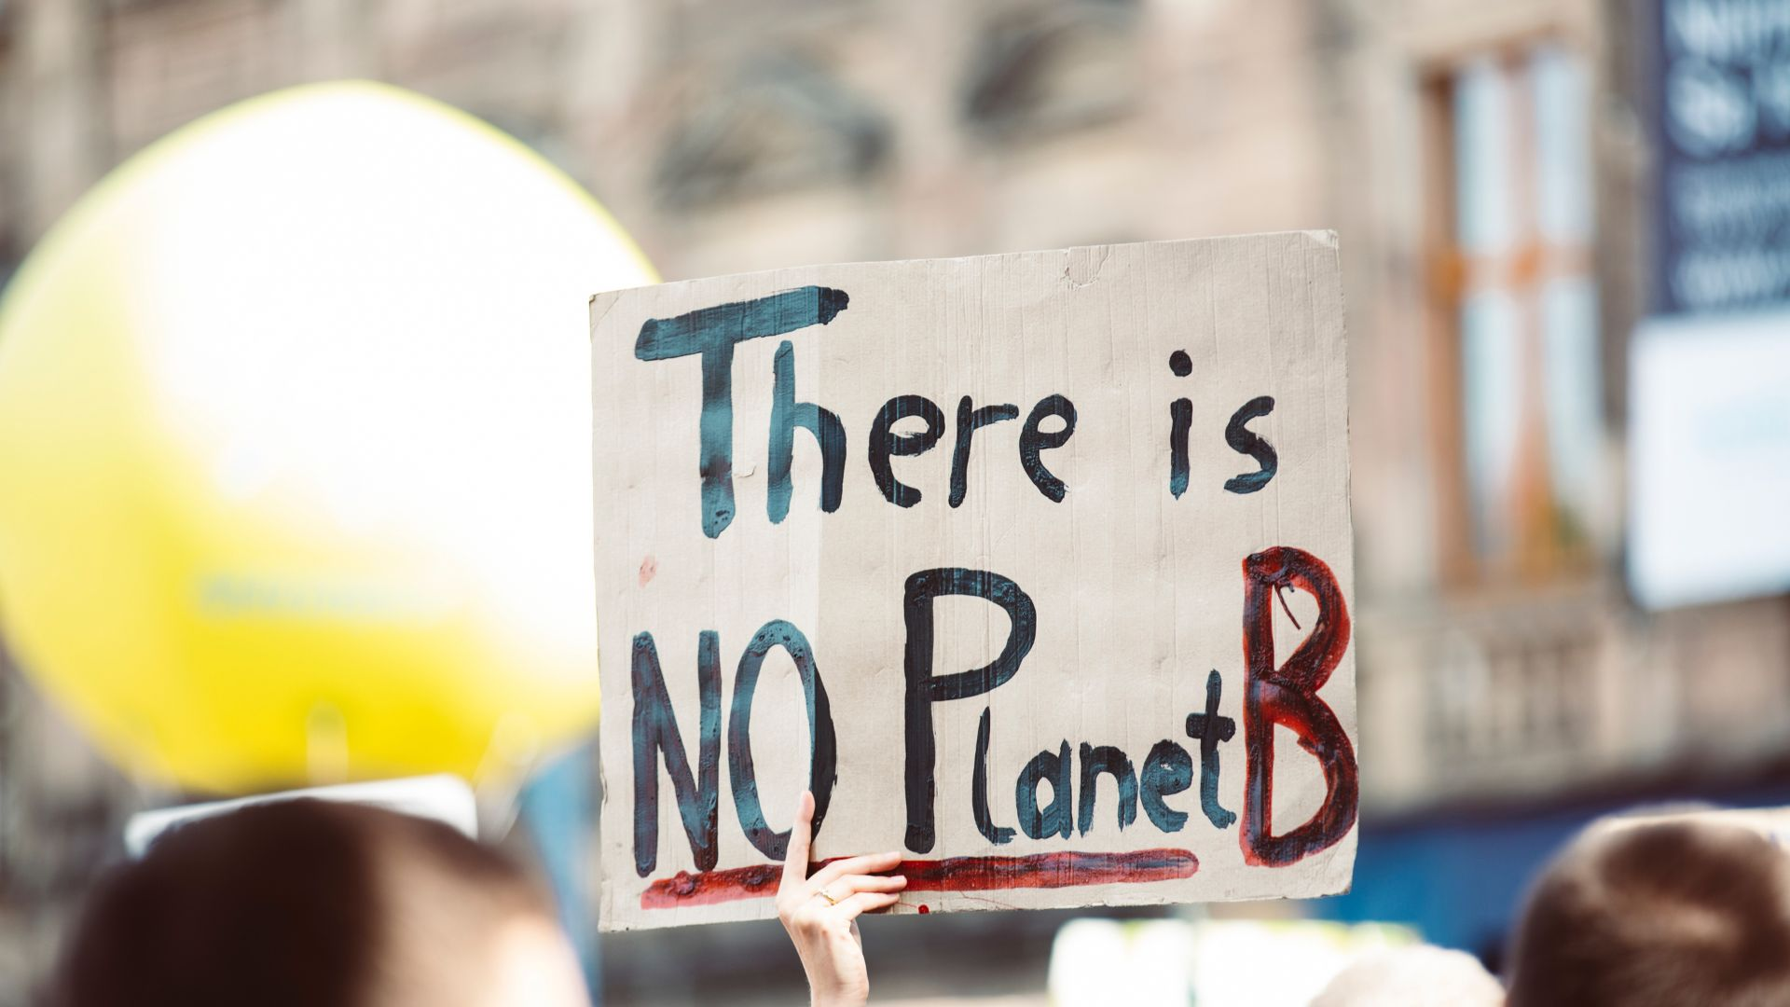
Experiment: Modelling the Greenhouse Effect
Materials
Transparent jar or large glass
Plastic wrap
Thermometer
Lamp or direct sunlight
03
Part 3: TRY — Mini Greenhouse Experiment

Slide 16
Experiment: Modelling the Greenhouse Effect
Instructions
Place the thermometer inside the jar.
Seal the opening tightly with plastic wrap.
Record the starting temperature.
Place under a lamp for 10 minutes.
Record the temperature again.
03
Part 3: TRY — Mini Greenhouse Experiment

Slide 17
Experiment: Modelling the Greenhouse Effect
What It Shows
The sealed container traps heat, replicating at a small scale how increased greenhouse gases intensify warming in the atmosphere.
Reflection Prompt
“How did seeing this physical model influence your understanding of how atmospheric warming works?”
03
Part 3: TRY — Mini Greenhouse Experiment

Slide 18
04
CONNECT
Real-World Relevance

Slide 19
Choose One Activity
Option A: Climate Check — Local Data
Option A: Climate Check — Local Data
Look up regional climate data (temperature trends, rainfall shifts, extreme events).
Discuss:
“Which trends could influence daily life, housing, work routines, transport, or local infrastructure?”
04
Part 4: CONNECT — Real-World Relevance

Slide 20
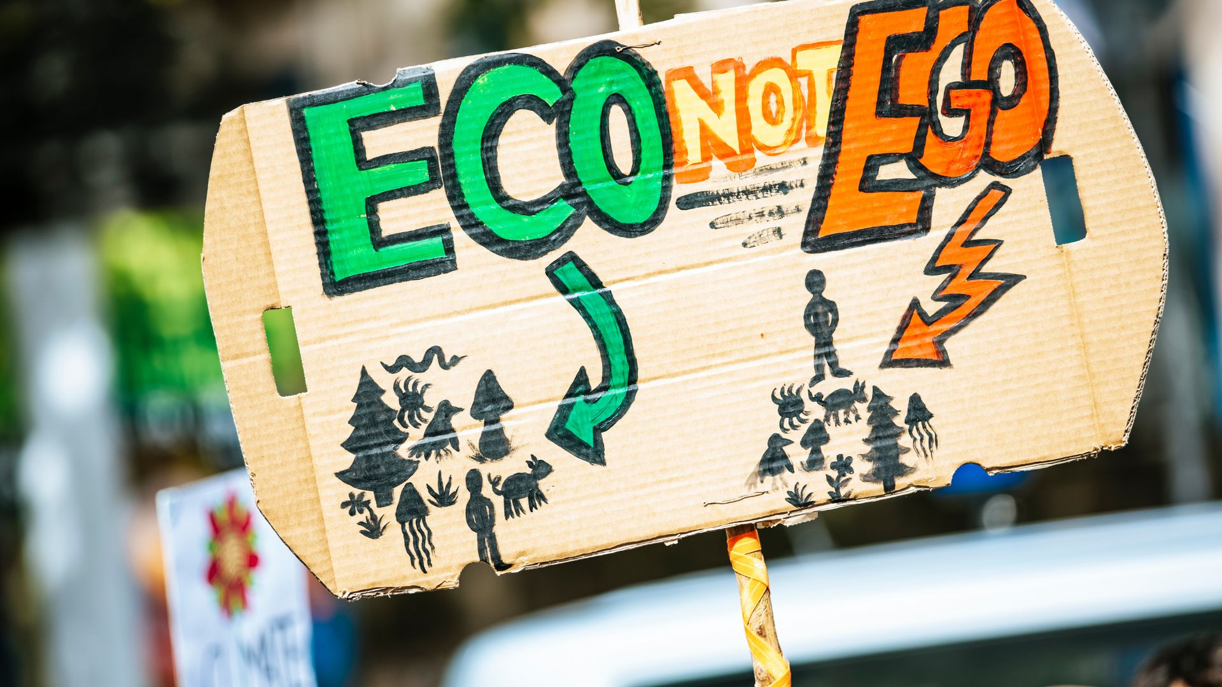
Choose One Activity
Option B: Micro-Observation Walk
Observe features that influence heat and water flow:
Hard surfaces vs. green areas
Shade and tree cover
Drainage patterns
Local heat-absorbing materials
Discuss:
“How do these elements affect comfort, resilience, and sustainability in the surrounding environment?”
04
Part 4: CONNECT — Real-World Relevance

Slide 21
05
REFLECT
Deepening Understanding

Slide 22

REFLECT — Deepening Understanding
Which scientific concept became clearer today?
How confident do you feel distinguishing reliable information from misinformation?
How might science-based understanding influence decisions or conversations?
What would you like to investigate next?
05
Part 5: REFLECT — Deepening Understanding

Slide 23
06
Key Takeaways

Slide 24
Key Takeaways
Climate refers to long-term trends, not short-term weather fluctuations.
The greenhouse effect is a fundamental and measurable physical process.
Multiple independent data sources confirm rapid human-influenced warming.
Simple models and observations help translate abstract processes into practical understanding.
Climate science supports better decision-making in personal, professional, and civic contexts.
06
Part 6: Key Takeaways

Slide 25
07
Explore More
Read, Watch & Listen

Slide 26
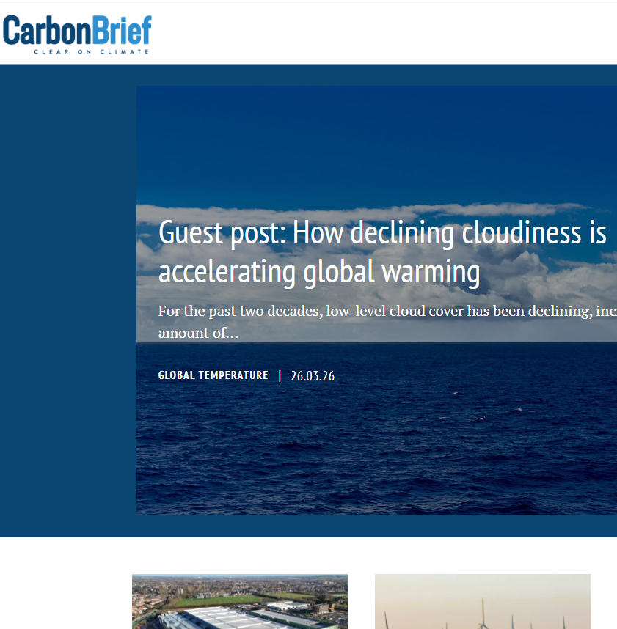
07
Read
Carbon Brief – Climate Science Explainers
Data-driven summaries of scientific research.
https://www.carbonbrief.org
NASA Climate – Evidence & Causes
Accessible and scientifically robust overviews.
https://climate.nasa.gov/evidence/

Slide 27
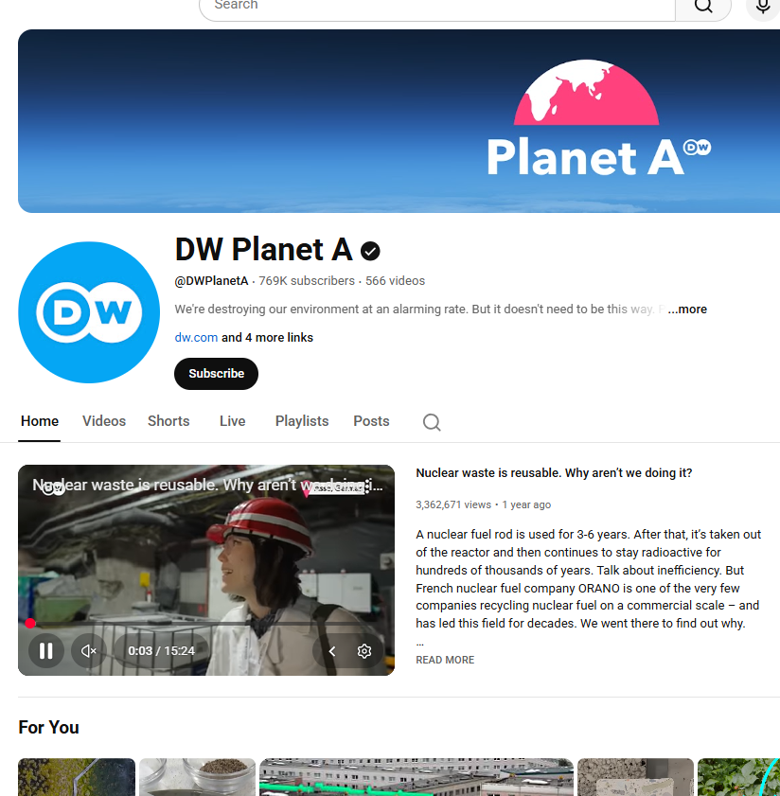

07
Watch
DW Planet A (YouTube)
Short videos on climate systems, impacts, and innovations.
https://www.youtube.com/@DWPlanetA/
Vox Climate Series
Visual breakdowns of global climate topics.
https://www.youtube.com/playlist?list=PLJ8cMiYb3G5eNh88rkSNQonaKMKjT-P6h

Slide 28
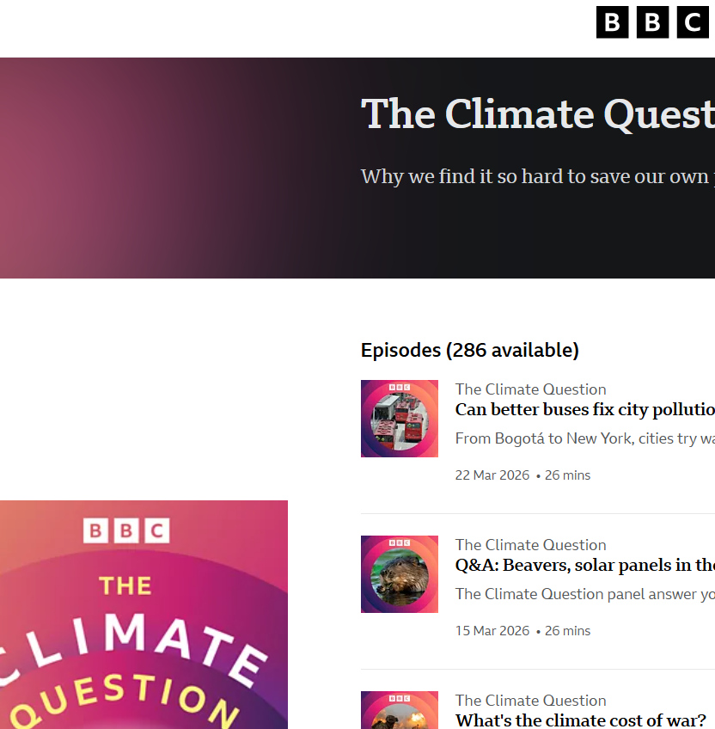
07
Listen
TILclimate (MIT)
Concise, science-focused episodes ideal for structured learning.
https://open.spotify.com/show/3n9rdUxp4307MuFJJIP8eE
BBC – The Climate Question
Journalistic explorations of climate issues with expert insights.
https://www.bbc.com/audio/brand/w13xtvb6

Slide 29
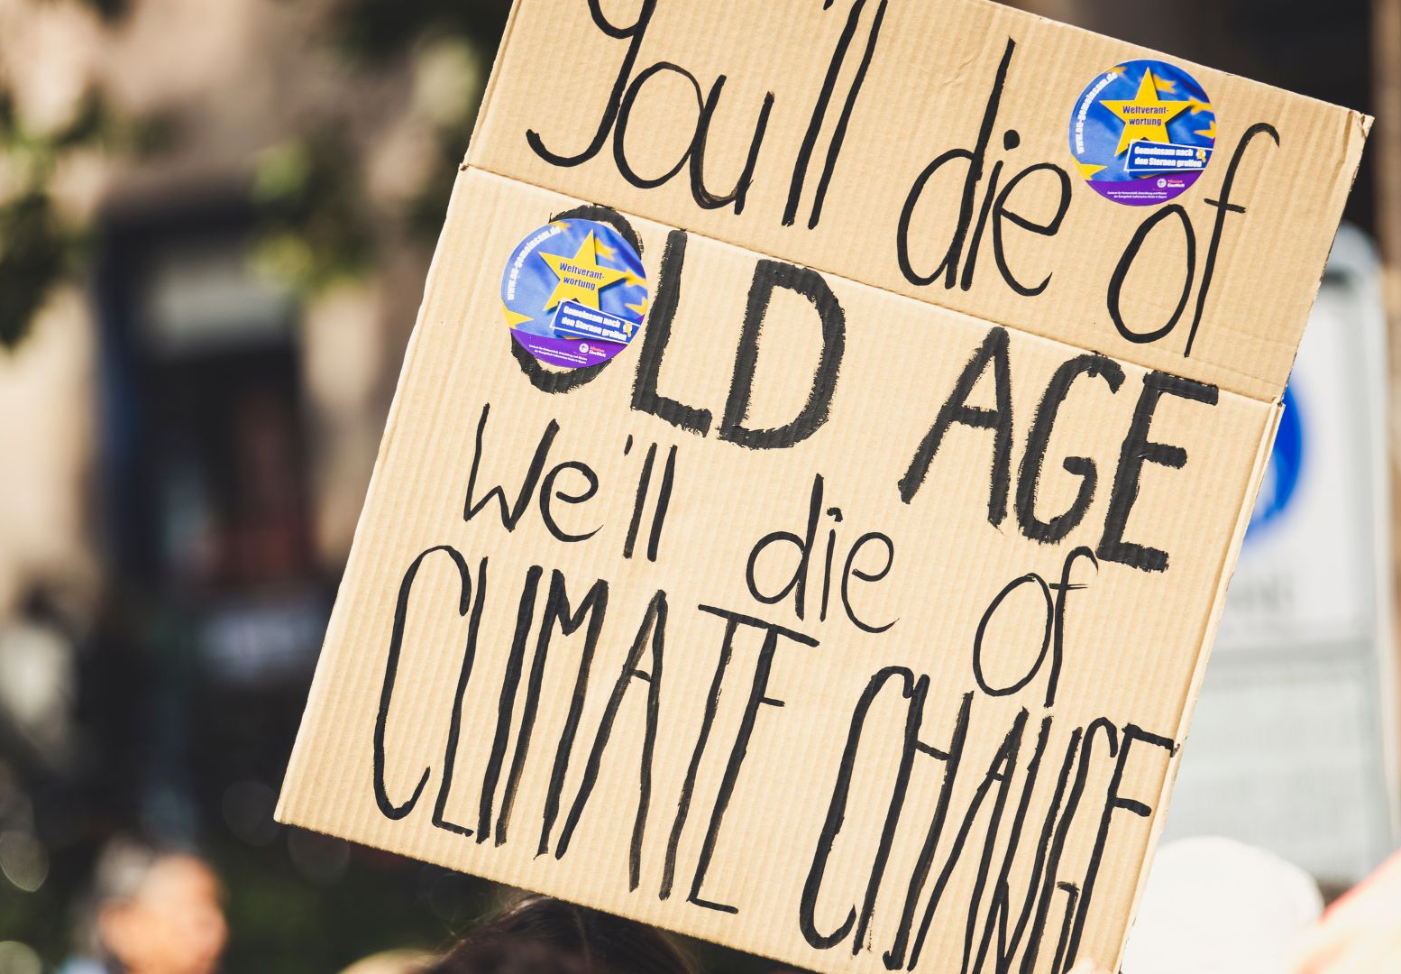
Educator Notes
Encourage evidence-based discussion and curiosity.
Allow time for questions and nuanced conversations.
Highlight connections to daily life, cities, technologies, and emerging careers.
Emphasis credible information sources for independent exploration.

Slide 30
Reflect and act
Pick one climate fact from this resource that surprised you. How would you explain it simply to a friend who feels anxious about the future?
www.planet-pulse.eu

