Slide 1
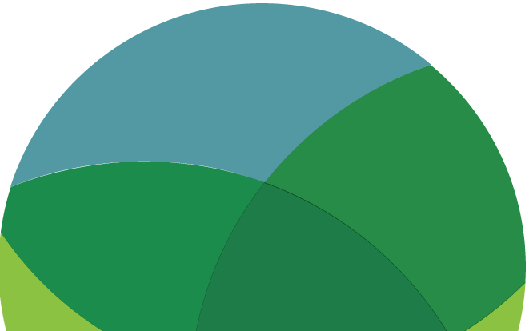
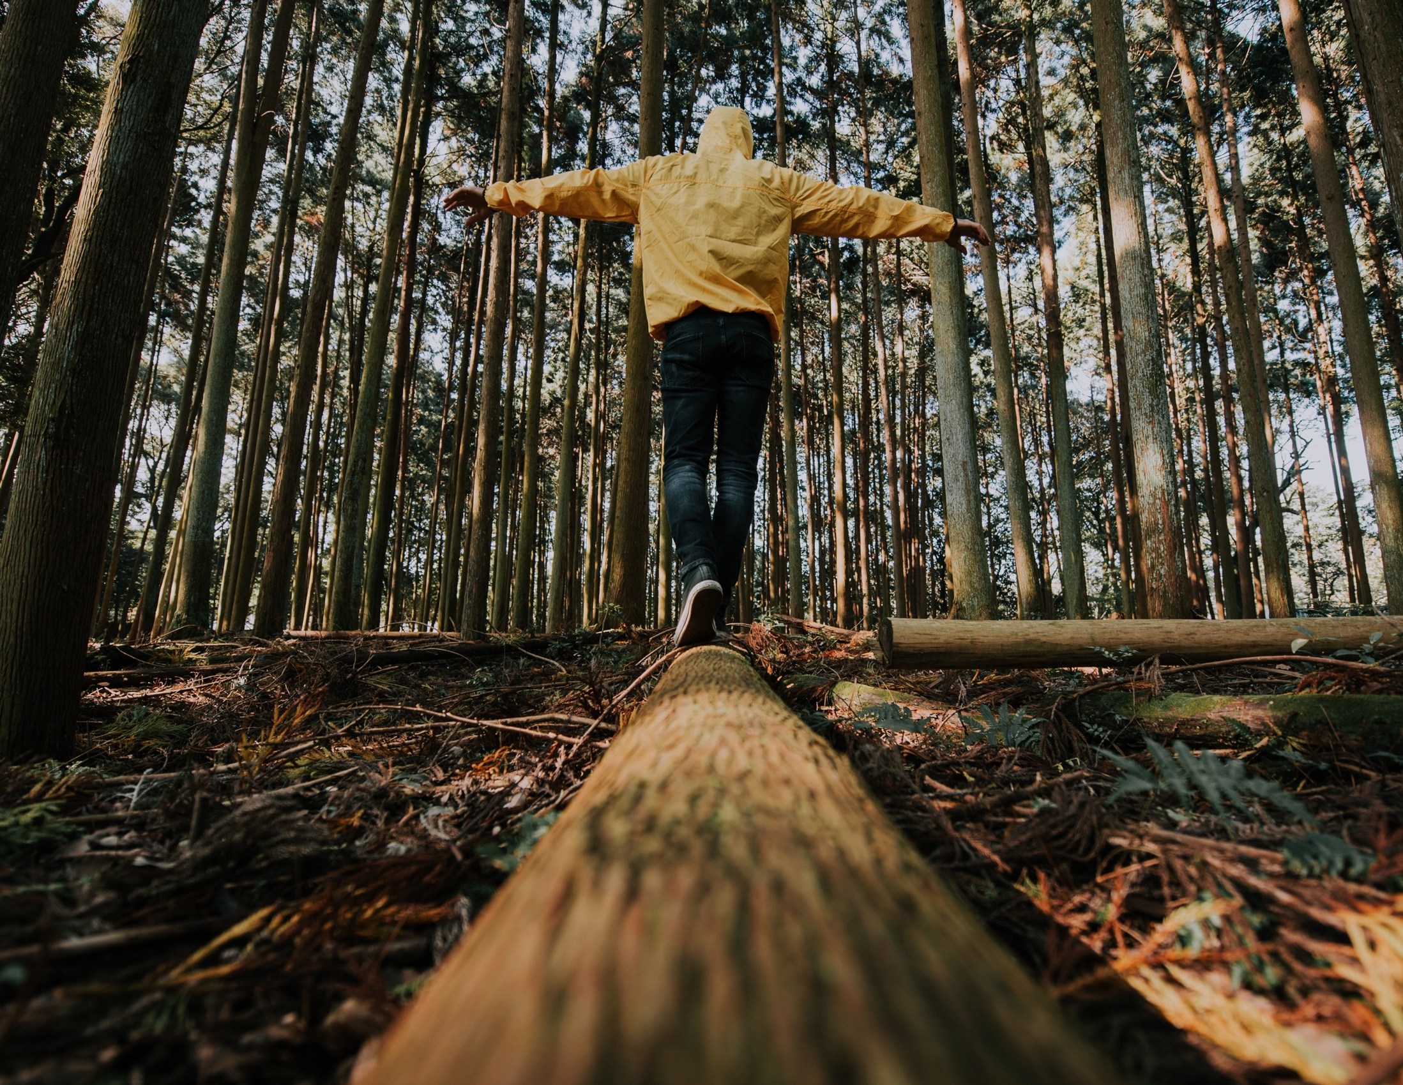
SUSTAINABLE CONSUMPTION
EXPLORE / REFLECT /
CHOOSE / ACT
www.planetpulse.eu

Slide 2
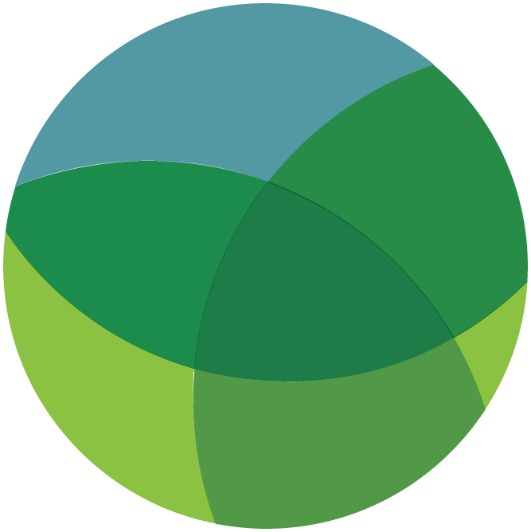
CONTENTS
01
Introduction
02
Read
03
Watch
04
Think & Reflect
05
Act
06
Key Takeaway

Slide 3
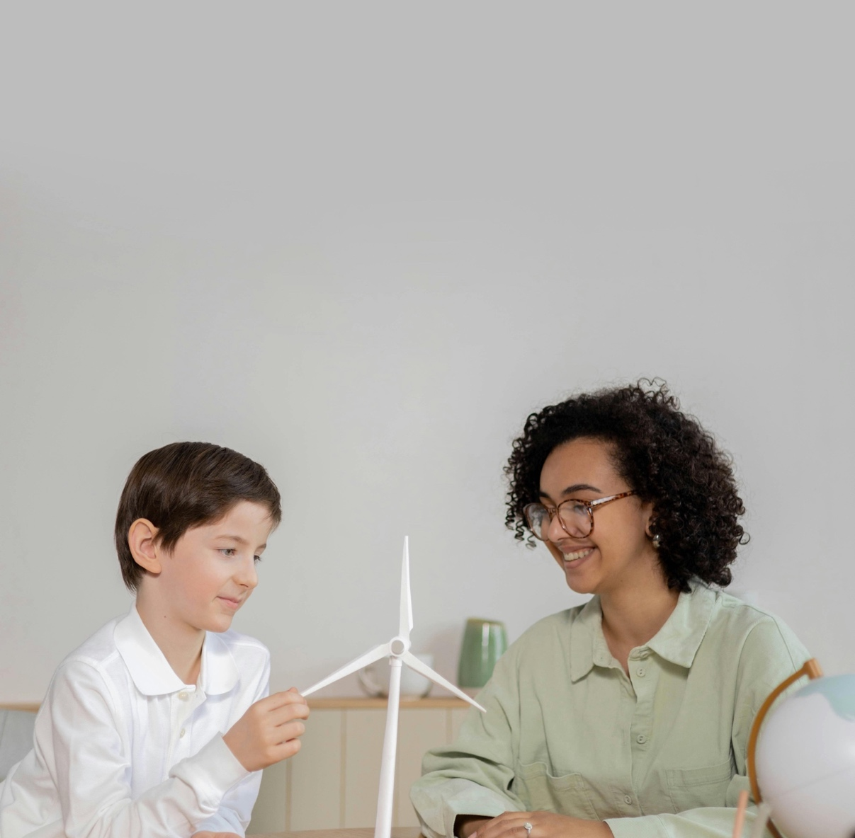
01
Introduction
What we buy, eat, wear, and use has a direct impact on the planet. Sustainable consumption means meeting our needs today without compromising the ability of future generations to meet theirs.
This toolkit explores how everyday habits connect to global environmental challenges — and how individual choices, multiplied across communities, can drive real change.
Learning Goals
• Understand what sustainable consumption means and why it matters.
• Explore the environmental impact of everyday choices.
• Discover circular economy alternatives and practical swaps.
• Connect individual action to broader collective and policy change.

Slide 4
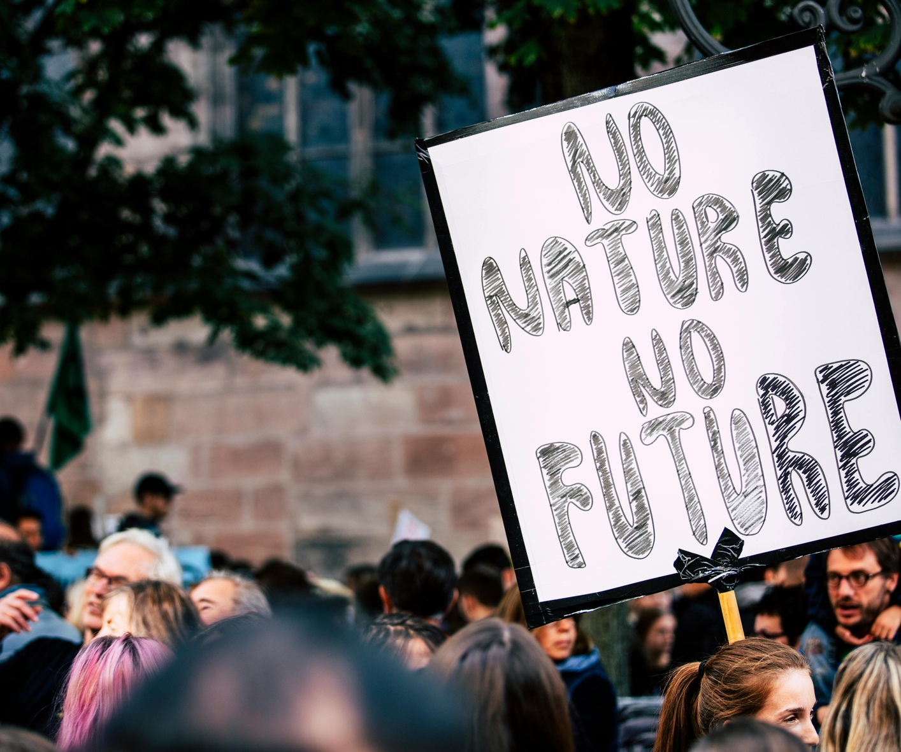
02
Read
Report – Sustainable Consumption in Europe (EEA)
The European Environment Agency explains how European consumption patterns drive environmental pressures — from food and housing to transport and clothing — and what policy responses are emerging.
Read
Policy – EU Sustainable Products Regulation (European Commission)
Explains the EU Ecodesign for Sustainable Products Regulation, setting requirements for products sold in the EU to be more durable, repairable, and recyclable.
Read
Guide – Circular Economy Introduction (Ellen MacArthur Foundation)
Introduces the circular economy model — rethinking how products are designed, used, and returned, moving beyond the linear “take, make, dispose” approach.
Read
Directory – Good On You Fashion Brand Ratings
A trusted platform rating fashion brands on environmental and ethical performance. Useful for making more conscious clothing choices and understanding who makes your clothes.
Explore

Slide 5
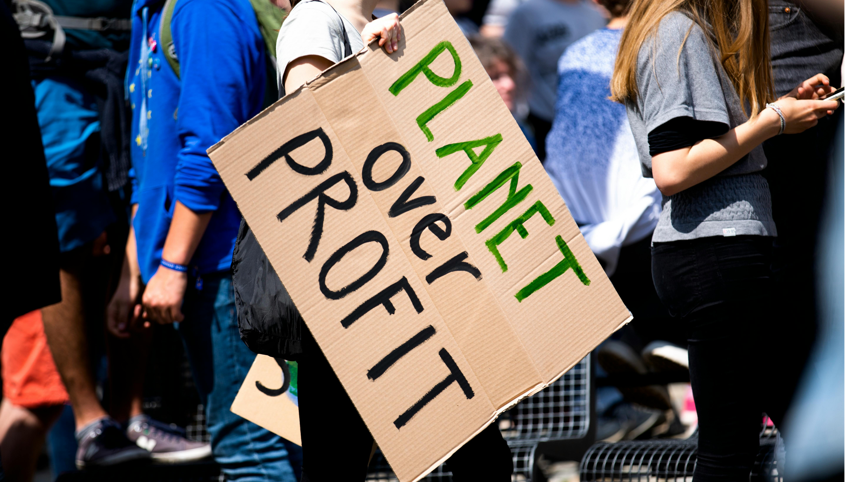
03
Watch
TEDx Talk – How to Shop Less and Live More (Tara Button)
Tara Button introduces the “buyerarchy of needs” — a practical framework for deciding when buying new is actually necessary. Challenges the habit of consumption as a default response.
Watch
Documentary – Why Fast Fashion is a Problem (DW Planet A)
German public broadcaster DW breaks down the environmental cost of fast fashion with clear data. Covers water use, carbon emissions, and the scale of textile waste globally.
Watch
Explainer – The Story of Stuff (Story of Stuff Project)
A short animated documentary tracing the lifecycle of consumer goods — from extraction to disposal. One of the most widely used environmental education resources in the world.
Watch

Slide 6
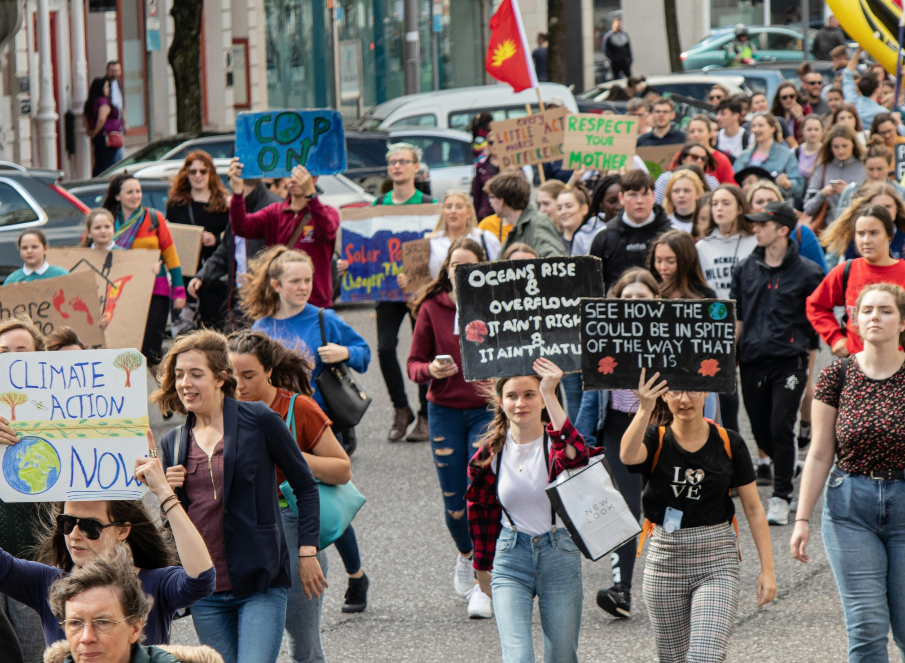
04
Think & Reflect
THINK – Discussion Questions
• Which of your daily habits uses the most resources — food, clothing, transport, or technology?
• Who made your clothes, and under what conditions?
• What does “good enough” look like — instead of always choosing “new”?
• If your whole community consumed the way you do, what would the impact be?
REFLECT – Personal Footprint Calculator
Use the WWF Footprint Calculator to estimate the environmental impact of your lifestyle choices — across food, shopping, home energy, and travel.
Try the Calculator
REFLECT – Consumption Audit
Look back at your last month of purchases. For each one, ask: Was this necessary? Could it have been borrowed, repaired, or bought second-hand? Write down three things you could change next month.

Slide 7
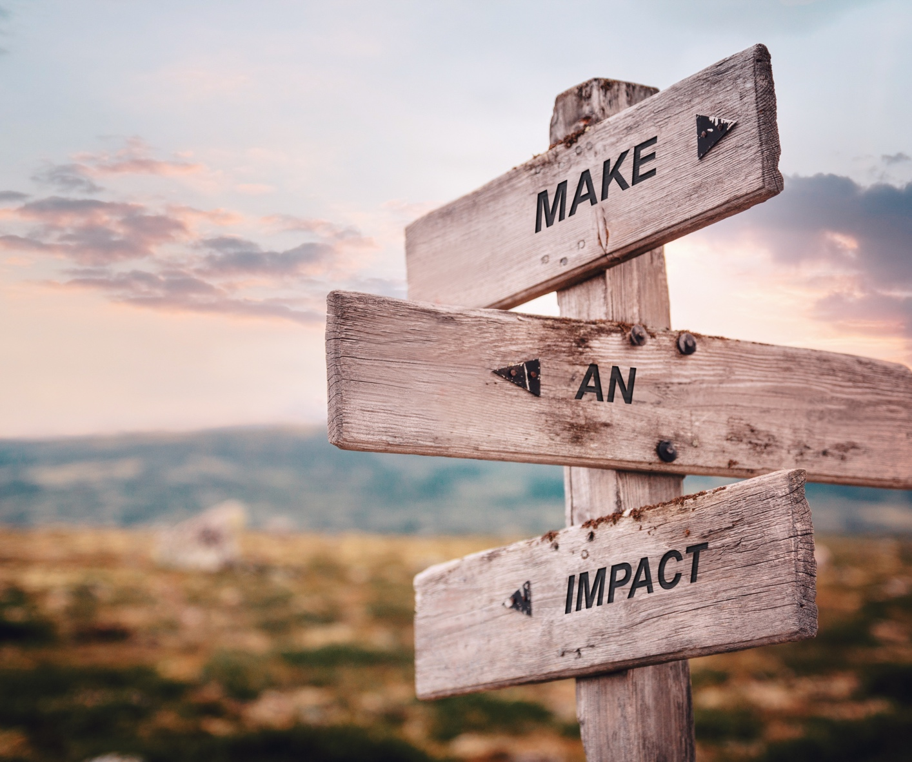
05
Act
SWAP:
Pick one item you buy regularly — clothing, food, or a household product — and research a more sustainable alternative. Try it for one month and share your findings with your group.
DISCUSS:
As a group, map out one product — a t-shirt, a phone, or a meal — from raw material to landfill. Where does the environmental harm happen? Where could the chain be broken?
REPAIR:
Find something broken at home or in your school. Repair it, repurpose it, or donate it instead of discarding it. Document what you did and what you saved from waste.
CAMPAIGN:
Create a one-page guide or short social post on one sustainable swap. Share it with peers, a local community group, or on your school’s notice board. Small information spreads can shift norms.

Slide 8
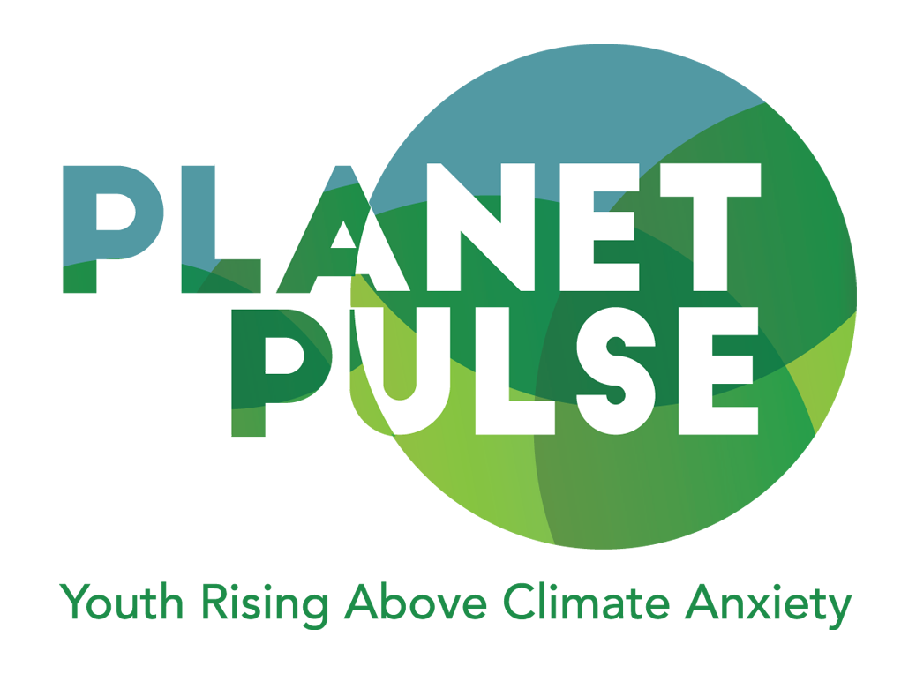
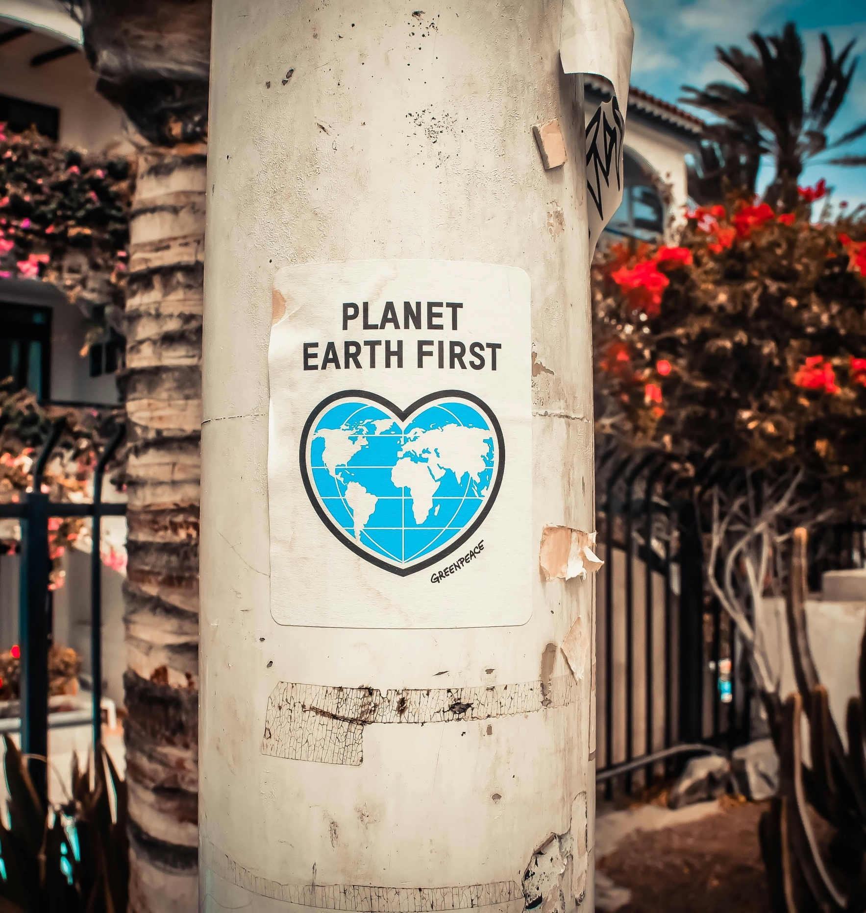
Key Takeaway
Every purchase is a decision. Sustainable consumption is not about perfection — it is about awareness, intention, and progress. What we buy shapes what gets made. When individuals, communities, and policymakers act together, consumption patterns can shift at scale. The circular economy already exists in small pockets everywhere. Our job is to widen it.
Reflect and act
Look at one everyday habit. What is one realistic change you could keep up for a month, and how will you know it is working?

