Slide 1
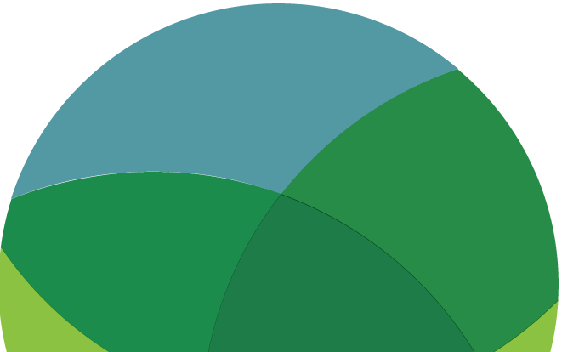
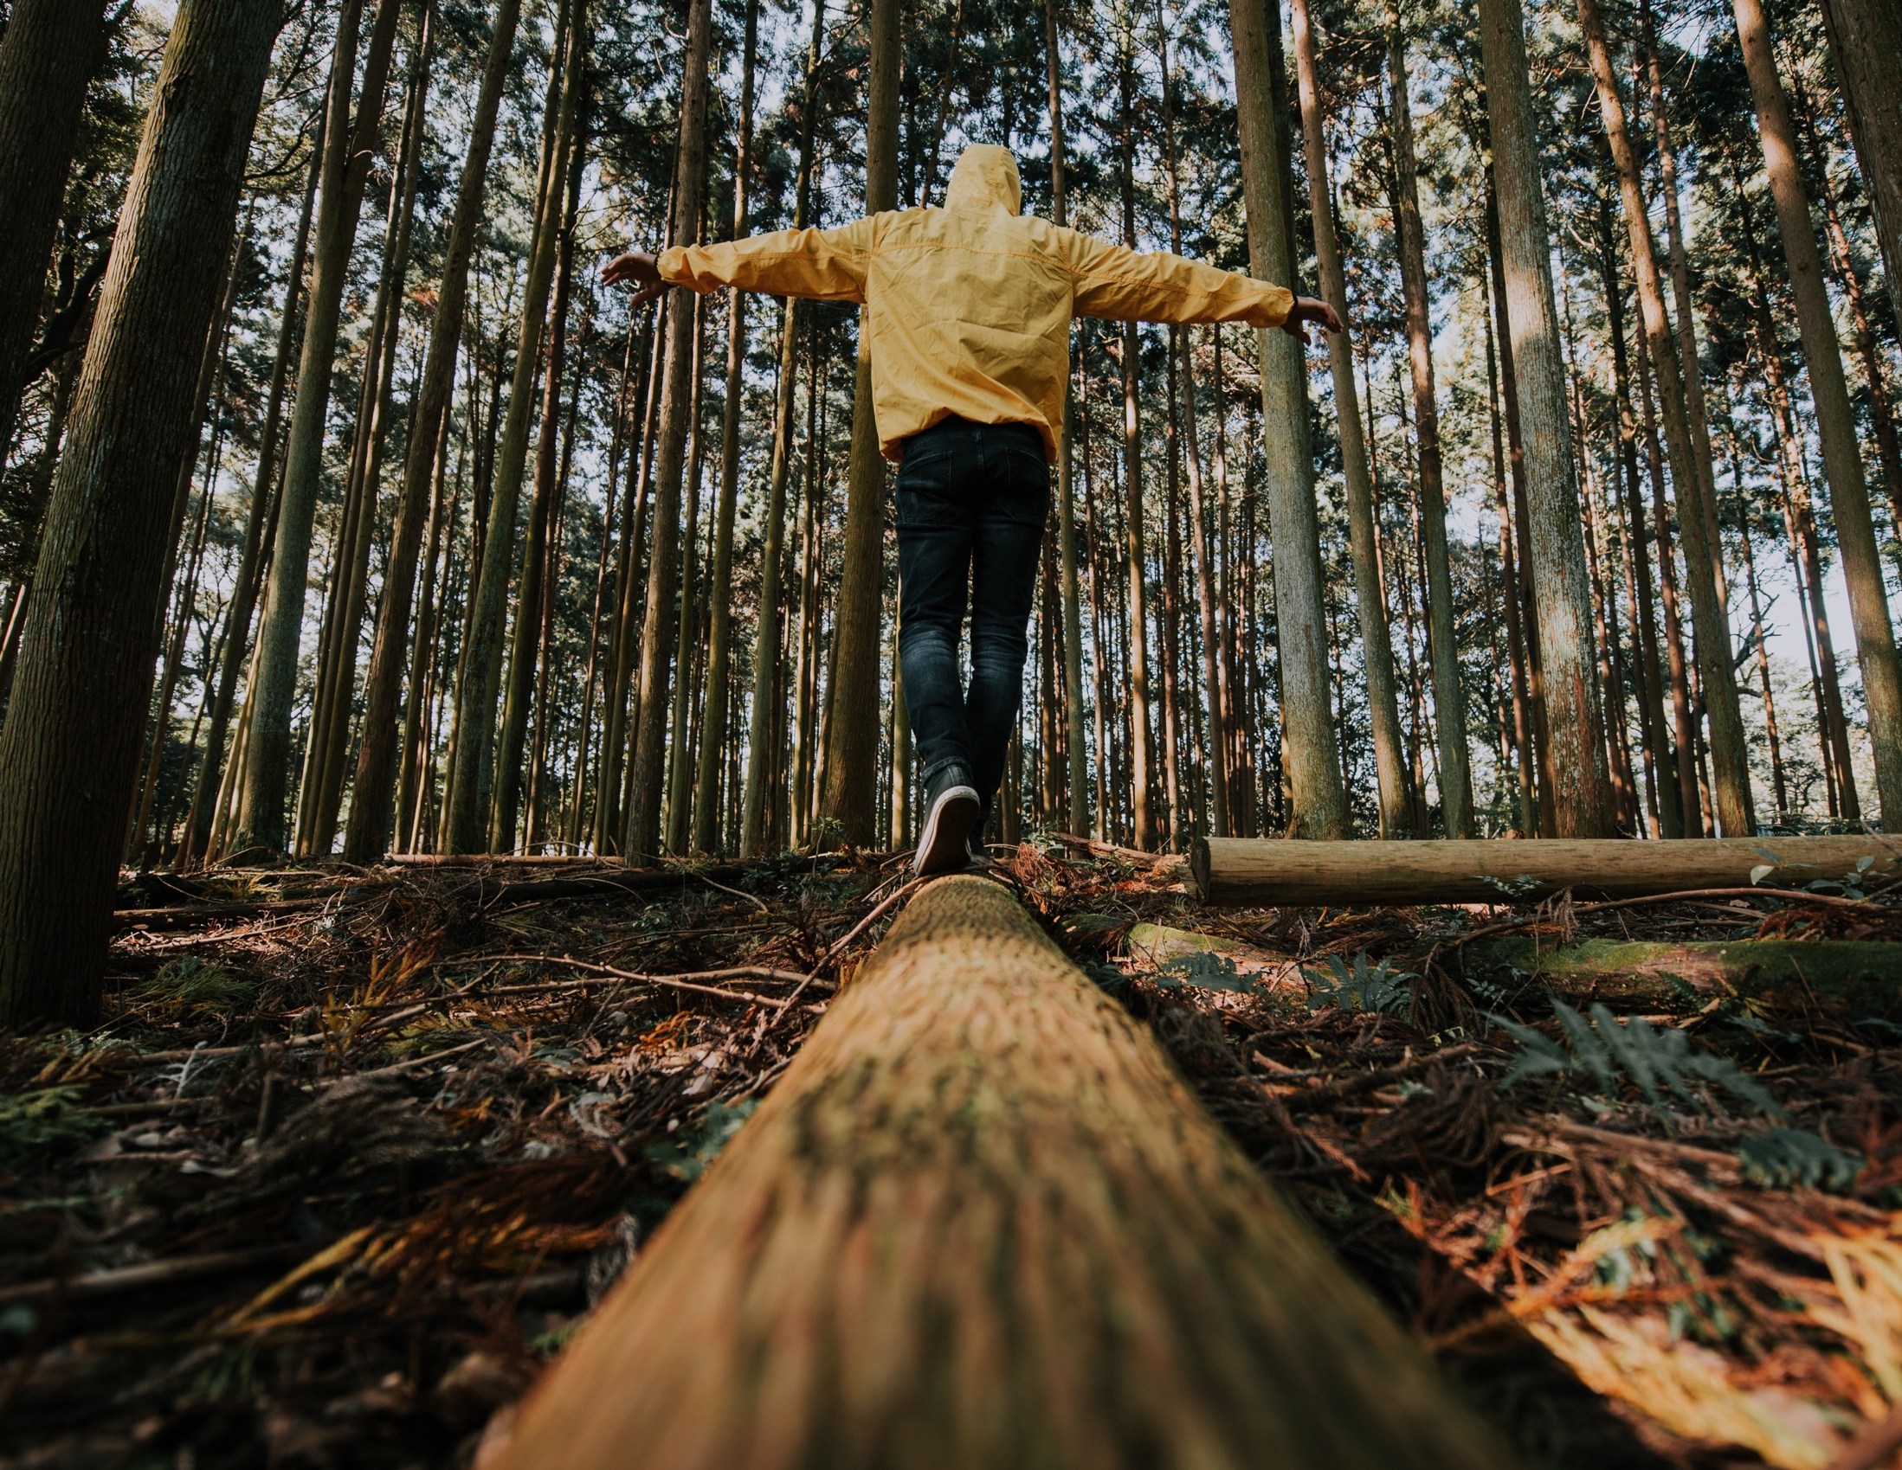
INDIGENOUS KNOWLEDGE
READ/WATCH/
LISTEN
www.planetpulse.eu
2024 - 2026
Document Name
By
Partner Name

Slide 2

CONTENTS
01
Introduction
02
Read
03
Watch
04
Listen
06
Key Takeaway

Slide 3

01
Introduction
Indigenous Knowledge isn’t just history — it’s a living system of wisdom, care, and connection with the Earth. Across generations, Indigenous peoples have observed, adapted, and protected their environments using practices rooted in respect and balance.
This Open Educational Resource invites you to explore how Indigenous and local ecological knowledge can guide sustainable living today. You’ll find stories, videos, and audio examples from Indigenous communities, including materials from the Indigenous Partnership Learning Platform and FirstVoices, showing how language, culture, and nature are deeply intertwined.

Slide 4
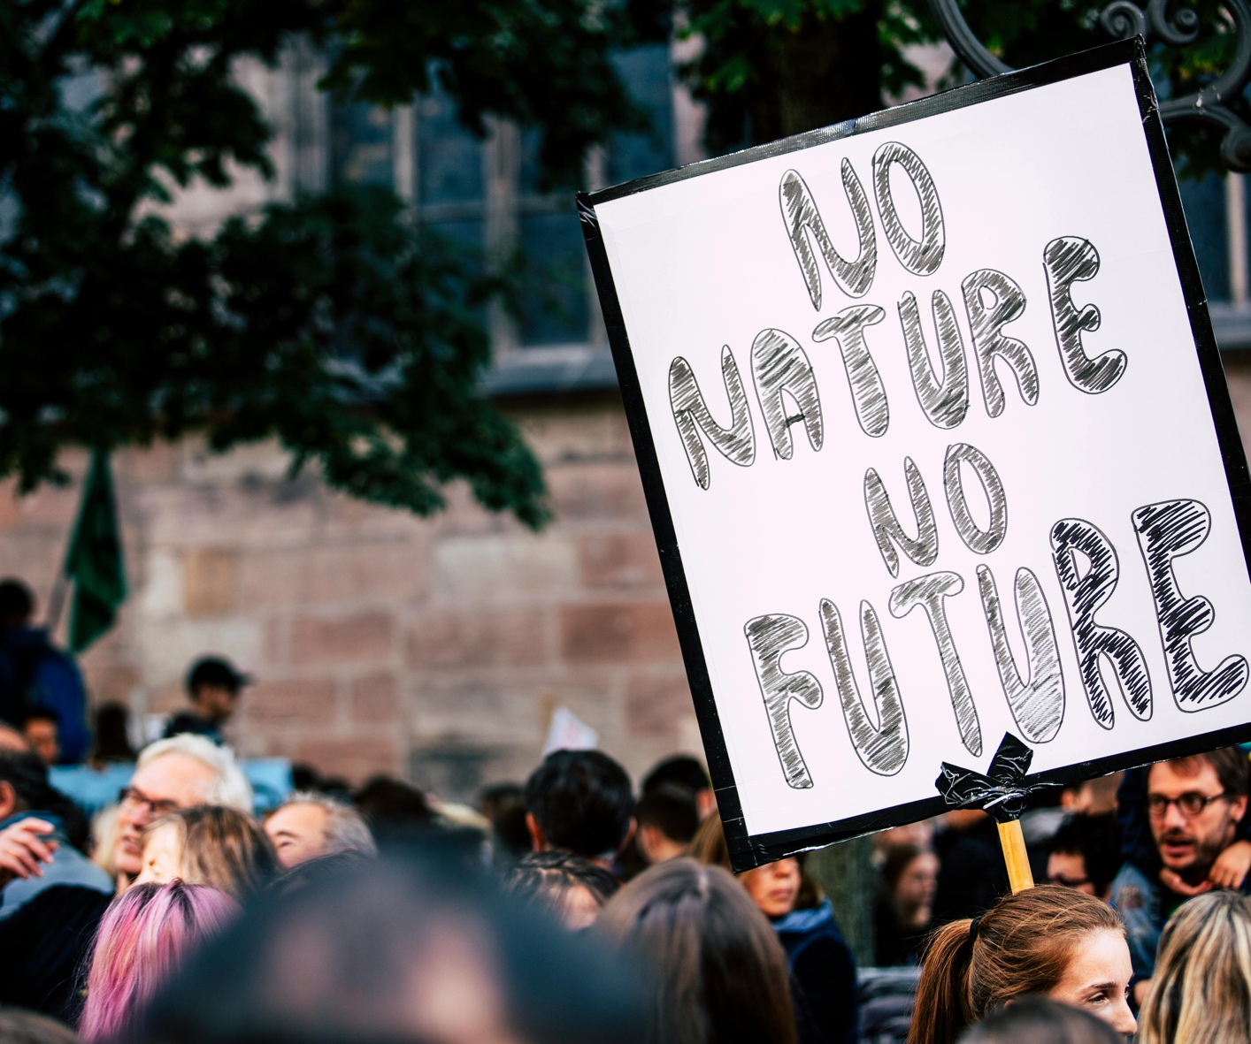
02
Read
The Indigenous Partnership — Learning Platform / Guidebooks
The Indigenous Partnership (TIP) hosts a learning platform with guidebooks on climate adaptation, Indigenous food systems, and related content.
Link
You can use their guidebooks (e.g. “Climate Change Adaptation Planning Guidebooks for Indigenous Communities”) as reading material.
FirstVoices
FirstVoices is an Indigenous language revitalization platform — good for audio, vocabulary, language mapping, etc.
Link
Case Study — Bolivia: Indigenous Knowledge & Climate Resilience
This is a documented example of combining Indigenous knowledge with scientific approaches to build resilience in Bolivia.
Link
Case Study — Language, history and climate action: unpacking climate adaptation across Gaelic and English
The article “Language, History and Climate Action: Unpacking Climate Adaptation Across Gaelic and English” explores how translating climate action materials into Gaelic helps make climate information more accessible and culturally meaningful for Gaelic-speaking communities in Scotland. It highlights the importance of language in shaping how people understand and respond to climate change, showing that Gaelic carries deep connections to land, local knowledge, and identity. The translation process faced challenges due to limited climate vocabulary in Gaelic, but it also opened up opportunities to innovate and include Indigenous perspectives. Overall, the project emphasizes that climate action is not just technical, it’s also cultural, and including minority languages like Gaelic helps build inclusive, locally relevant strategies while preserving and revitalizing heritage.
Link

Slide 5
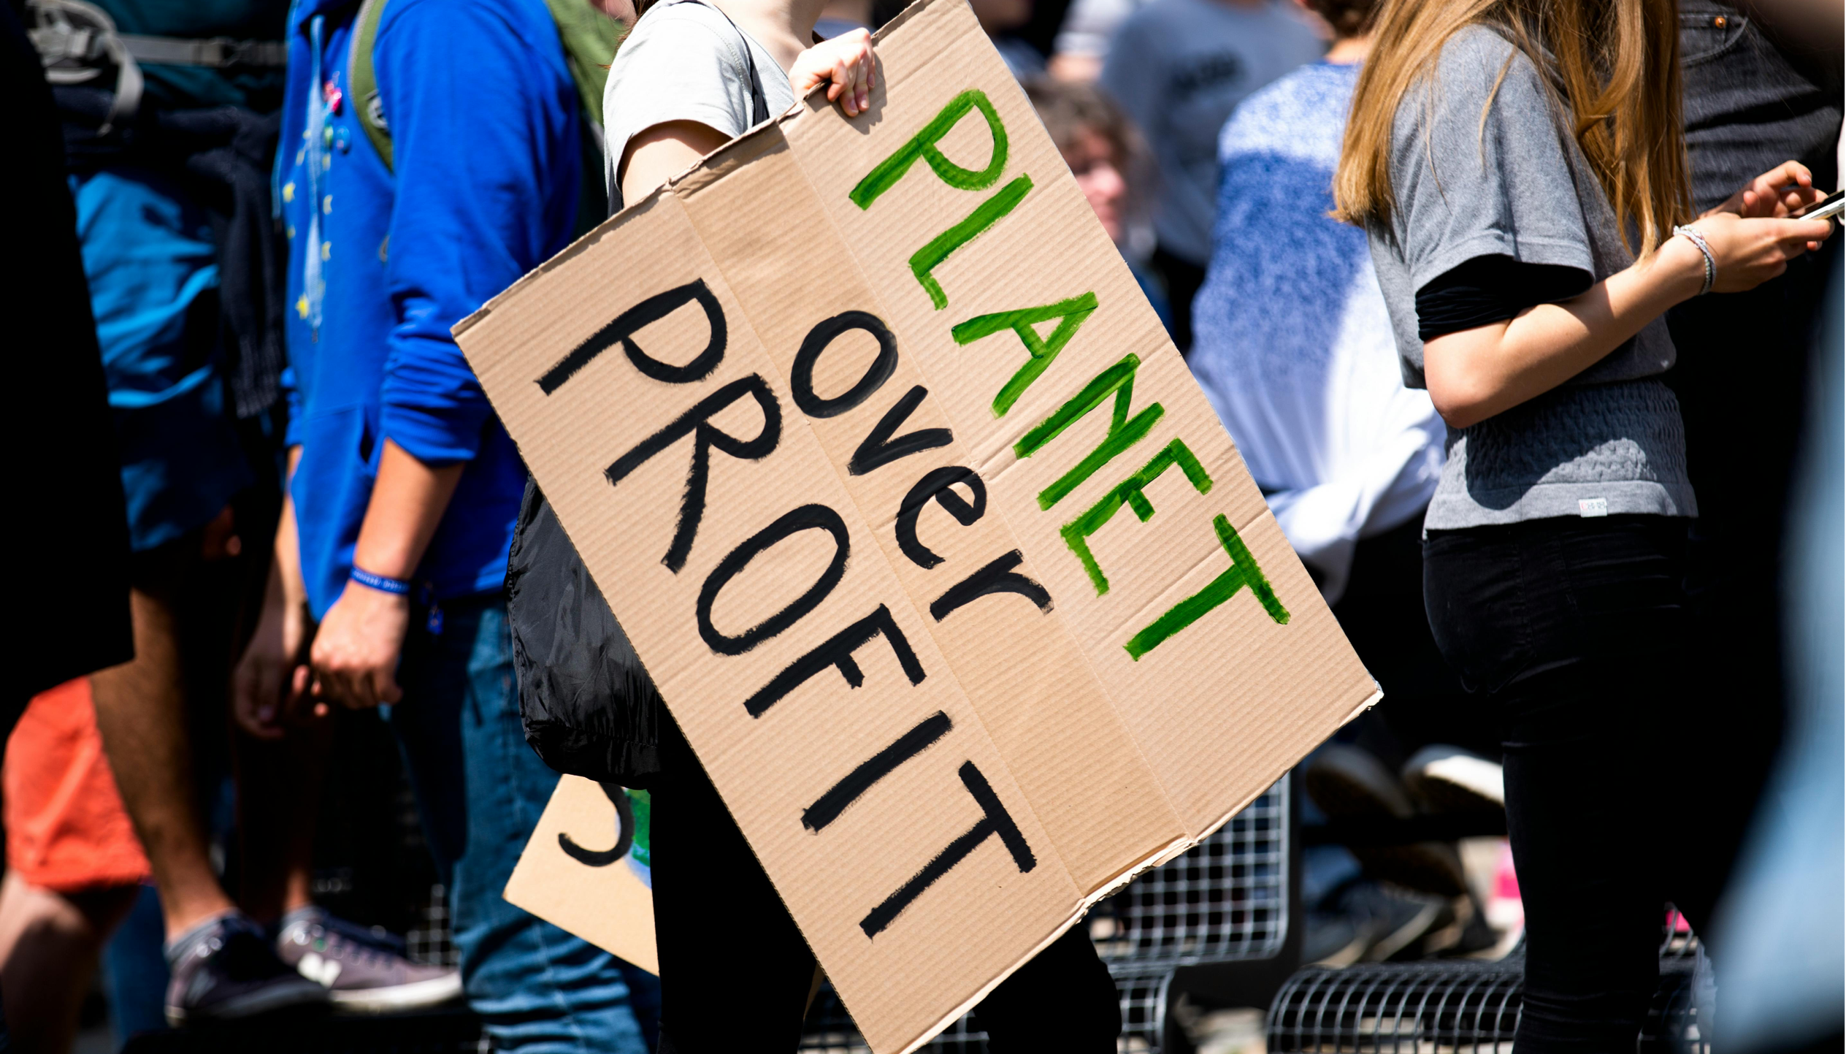
03
Watch
Agroecology: Voice From Social Movements (Long Version)
From The Indigenous Partnership – Learning Platform
This video explores the different perspectives of food providers on agroecology and the calls from the social movements to embed agroecology in the struggle for food sovereignty.
Link
Read more on the declaration: Link
Rattan Lal: The solutions underfoot – The power of soil
From The Indigenous Partnership – Learning Platform
This is a public lecture from 2 November 2015, when IIASA co-hosted with Rattan Lal, a distinguished Professor of soil Sciences.
This discusses the functionality of soil, and the interconnected issues associated with it – such as water, climate, food, and environmental security.
Link

Slide 6
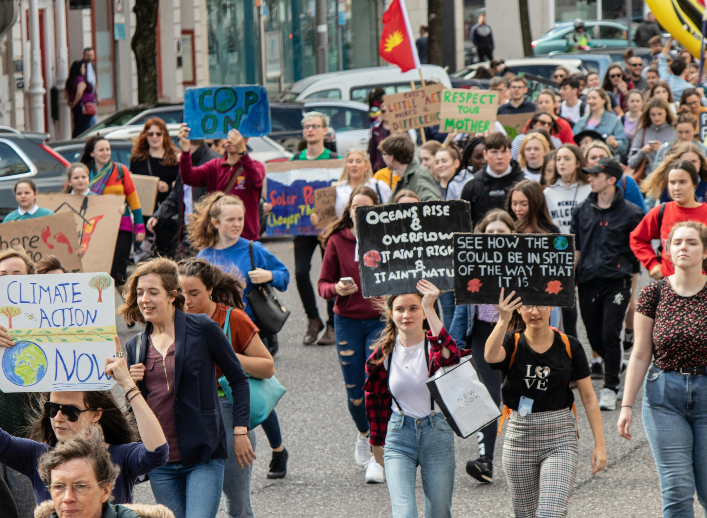
04
Listen
Podcasts | Reciprocity Project
The Reciprocity Project is a multimedia storytelling platform that brings together Indigenous voices from around the world to share powerful narratives about climate, land, and cultural resilience. Through short films, podcasts, and educational resources, it explores how Indigenous communities are responding to environmental change by drawing on ancestral knowledge, spiritual relationships with nature, and community-based practices. While the project is not specific to Ireland, its themes resonate strongly with Indigenous Irish experiences, such as those of Irish Travellers and
Gaelic-speaking communities, who also hold deep cultural ties to land and heritage. The project offers valuable parallels for understanding climate anxiety and ecological stewardship through a lens of cultural identity, making it a rich resource for educators, activists, and anyone interested in inclusive climate action.
Link

Slide 7
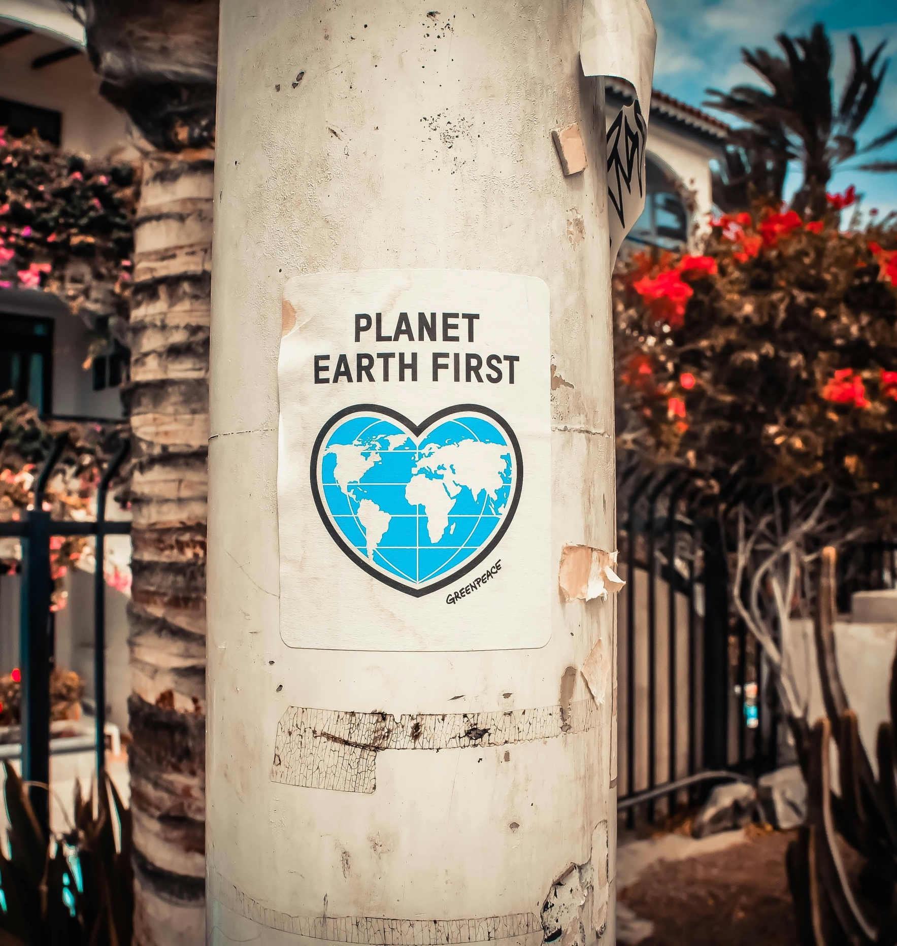
Key Takeaway
Indigenous Knowledge reminds us that sustainability is not just a science — it’s a relationship. Through stories, language, and ecological wisdom, Indigenous communities model how to live in balance with the Earth. When we listen, learn, and act respectfully, we help keep that wisdom alive for future generations.

Slide 8
01
Introduction
Indigenous Knowledge isn’t just history — it’s a living system of wisdom, care, and connection with the Earth. Across generations, Indigenous peoples have observed, adapted, and protected their environments using practices rooted in respect and balance. This Open Educational Resource invites you to explore how Indigenous and local ecological knowledge can guide sustainable living today. You’ll find stories, videos, and audio examples from Indigenous communities, including materials from the https://www.theindigenouspartnership.org/learning-platform and https://www.firstvoices.com/, showing how language, culture, and nature are deeply intertwined.

Slide 9
02
Read
[ ]
Offers guidebooks on climate adaptation, Indigenous food systems, and more. A key resource is the Climate Change Adaptation Planning Guidebooks for Indigenous Communities, which provides practical frameworks for community-led resilience.
Link
[ ]
A platform dedicated to Indigenous language revitalization. It includes audio recordings, vocabulary tools, and language mapping, supporting cultural preservation and ecological knowledge.
Link
[ ]
A case study showing how Indigenous knowledge and scientific approaches were combined to strengthen climate resilience in Bolivia.
Link
Language, History and Climate Action: Unpacking Climate Adaptation Across Gaelic and English
This article explores how translating climate materials into Gaelic makes climate information more accessible and culturally meaningful for Gaelic-speaking communities in Scotland. It highlights the deep connections between language, land, and identity, and shows how climate action can be both technical and cultural.
Link

Slide 10
03
Watch
Agroecology: Voices From Social Movements (Long Version)
From The Indigenous Partnership – Learning Platform
A video exploring food sovereignty and agroecology from the perspectives of Indigenous food providers and social movements.
Watch
Rattan Lal: The solutions underfoot - The power of soil
From The Indigenous Partnership – Learning Platform
A public lecture discussing the vital role of soil in climate, water, food, and environmental security.
Watch
Declaration of the International Forum for Agroecology
A foundational document calling for agroecology to be central in the fight for food sovereignty.
Watch

Slide 11
04
Listen
Reciprocity Project
A multimedia storytelling platform featuring Indigenous voices from around the world. Through short films, podcasts, and educational resources, it explores how communities respond to environmental change using ancestral knowledge and spiritual relationships with nature. Though not Ireland-specific, its themes resonate with Indigenous Irish experiences, including those of Irish Travellers and Gaelic-speaking communities.
Listen
Reflect and act
Choose one principle from Indigenous approaches to land and community in this resource. How might it apply to a place or relationship you care about?

