Slide 1
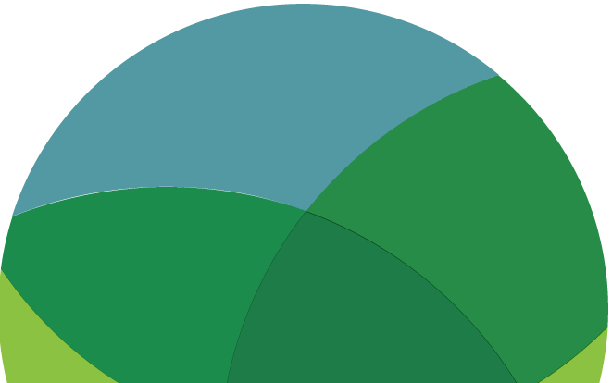
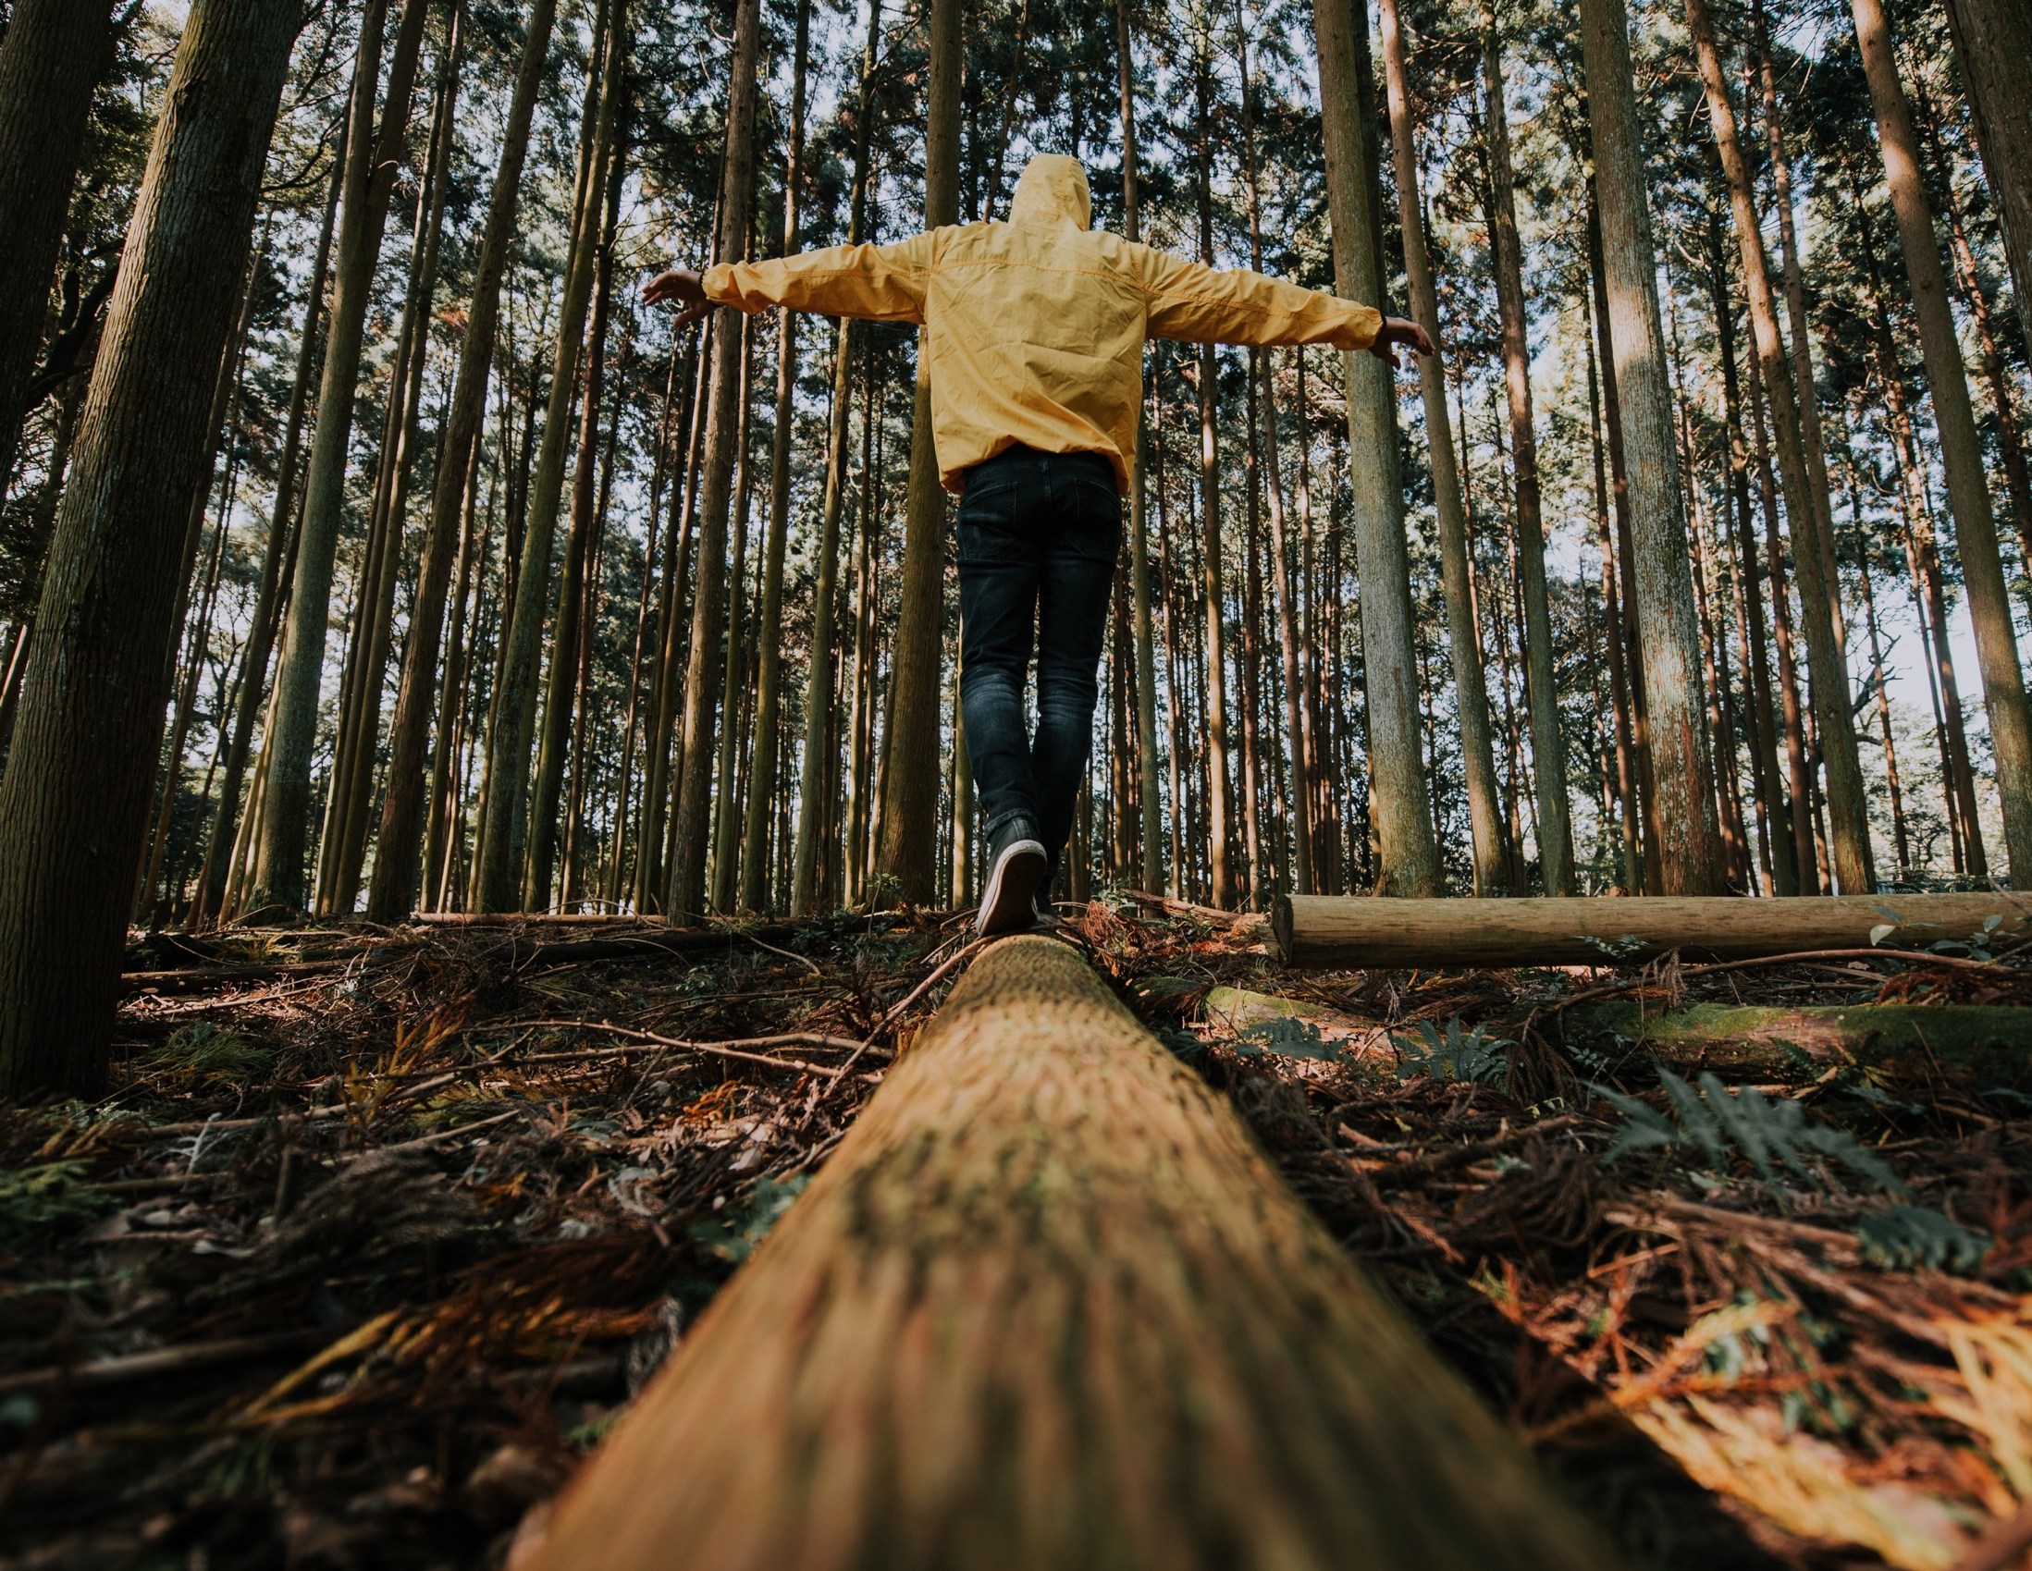
HOPE
READ/WATCH/
LISTEN/WRITE/ACT
www.planetpulse.eu
2024 - 2026
Document Name
By
Partner Name

Slide 2

CONTENTS
01
Introduction
02
Read
03
Watch
04
Listen
05
Try it yourself
06
Key Takeaway

Slide 3
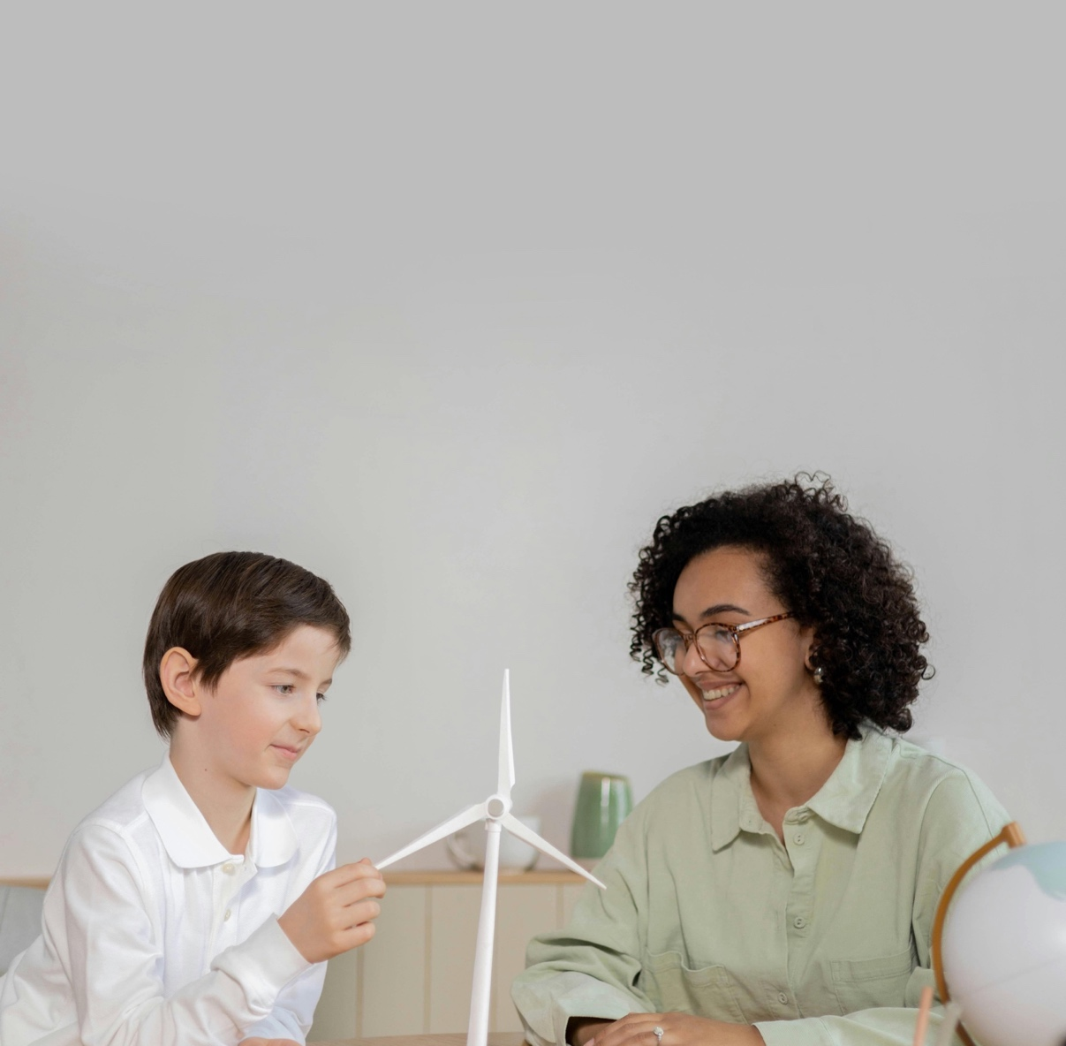
01
Introduction
Hope is not wishful thinking or ignoring the seriousness of climate change.
It’s a mindset that says: change is possible, and our actions matter. When young people see examples of solutions already working and hear stories of resilience, they gain the energy to keep going. This toolkit is designed to give you reasons to believe in a better future — through books, stories, talks, and podcasts that show how hope can drive real action.

Slide 4
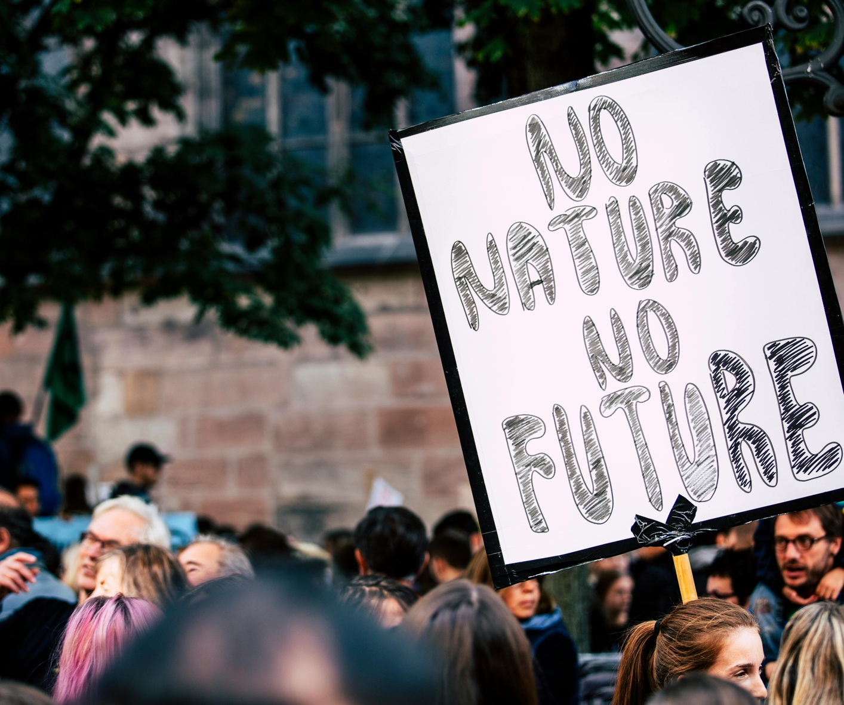
02
Read
Book – Saving Us by Katharine Hayhoe
Katharine Hayhoe, a climate scientist and communicator, explains why conversations are powerful tools for climate action. Her book is packed with real stories showing how sharing values and personal experiences can open up space for hope.
Link
Article – Nurturing Hope Amidst Climate Change (Oxfam Ireland)
This story follows a farmer who has faced devastating crop failures but focuses on rebuilding with support from organisations and her community. It’s a reminder that hope often comes from cooperation and shared effort.
Link
Book – A Short, Hopeful Guide to Climate Change by Oisín McGann
Written for younger audiences, this book explains climate change in an easy, engaging way. Its focus is on solutions and the message that there is a future worth fighting for.
Link

Slide 5
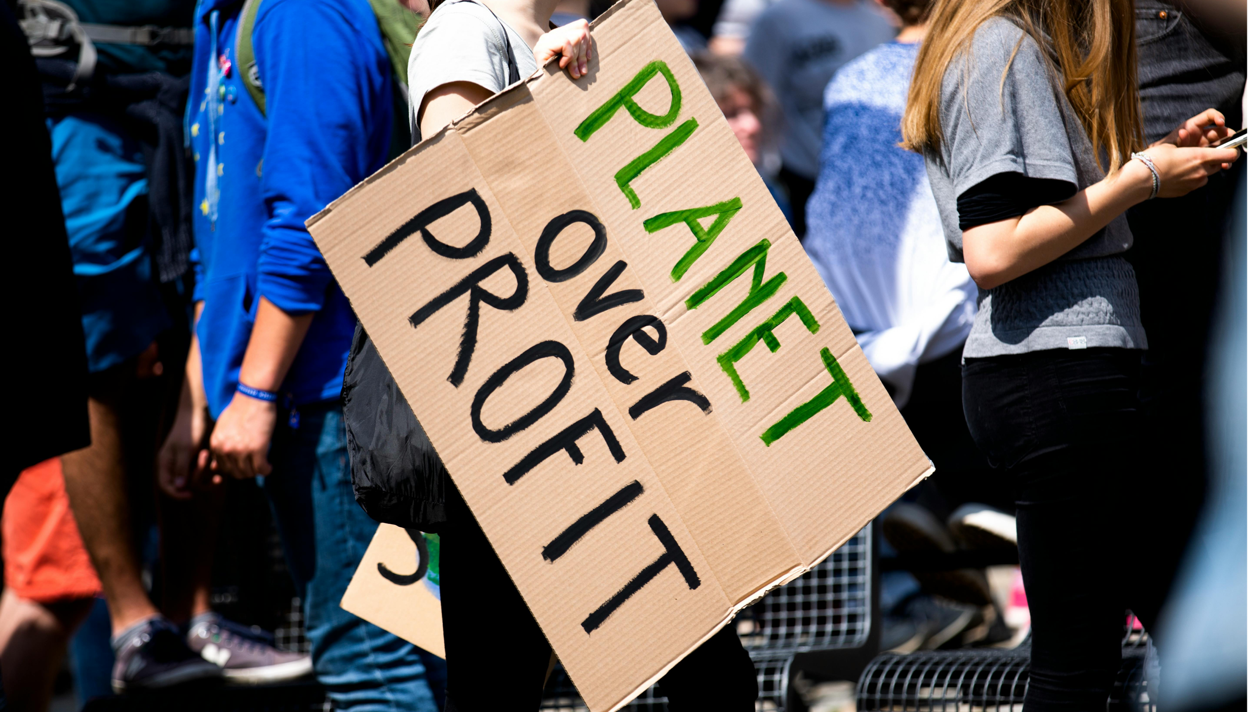
03
Watch
TED Talk – The Case for Optimism on Climate Change by Al Gore
Al Gore highlights why optimism is critical — the technology and solutions exist, and progress is already happening. Great for showing that hope is rooted in real evidence.
Link
Panel Discussion – Not Too Late: Changing the Climate Story from Despair to Possibility (C-SPAN)
A conversation featuring activists and thinkers about shifting the narrative around climate change. It’s filled with motivational stories that show possibility rather than despair.
Link
TED Talk – Jane Goodall: What Separates Us From the Apes
Jane Goodall reflects on human empathy, resilience, and why she remains hopeful despite global challenges. Her perspective is calming yet motivating.
Link

Slide 6
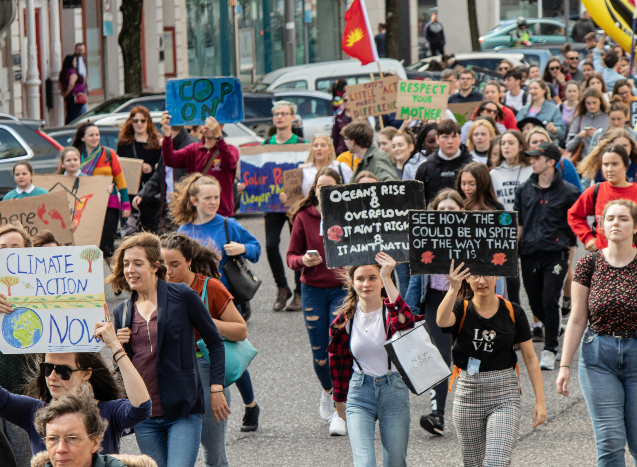
04
Listen
Podcast – How to Save a Planet
(Spotify, archived)
Although it ended in 2022, its episodes remain fresh and fun. They focus on solutions — from rewilding to energy transitions — making it one of the most hopeful climate podcasts available.
Link
Podcast – Outrage + Optimism
Hosted by Christiana Figueres and colleagues, this podcast mixes honesty about the climate crisis with reasons to feel hopeful. They interview leaders and activists who prove that progress is possible.
Link
Podcast – The Yikes Podcast
A youth-friendly show that covers climate, politics, and culture. Despite its name, it leans into hope by showing how young people can be powerful changemakers.
Link
Podcast – Mothers of Invention
Hosted by Mary Robinson (former President of Ireland) and Maeve Higgins, this podcast highlights women leading climate solutions around the world. Full of inspiring, hopeful stories.
Link

Slide 7
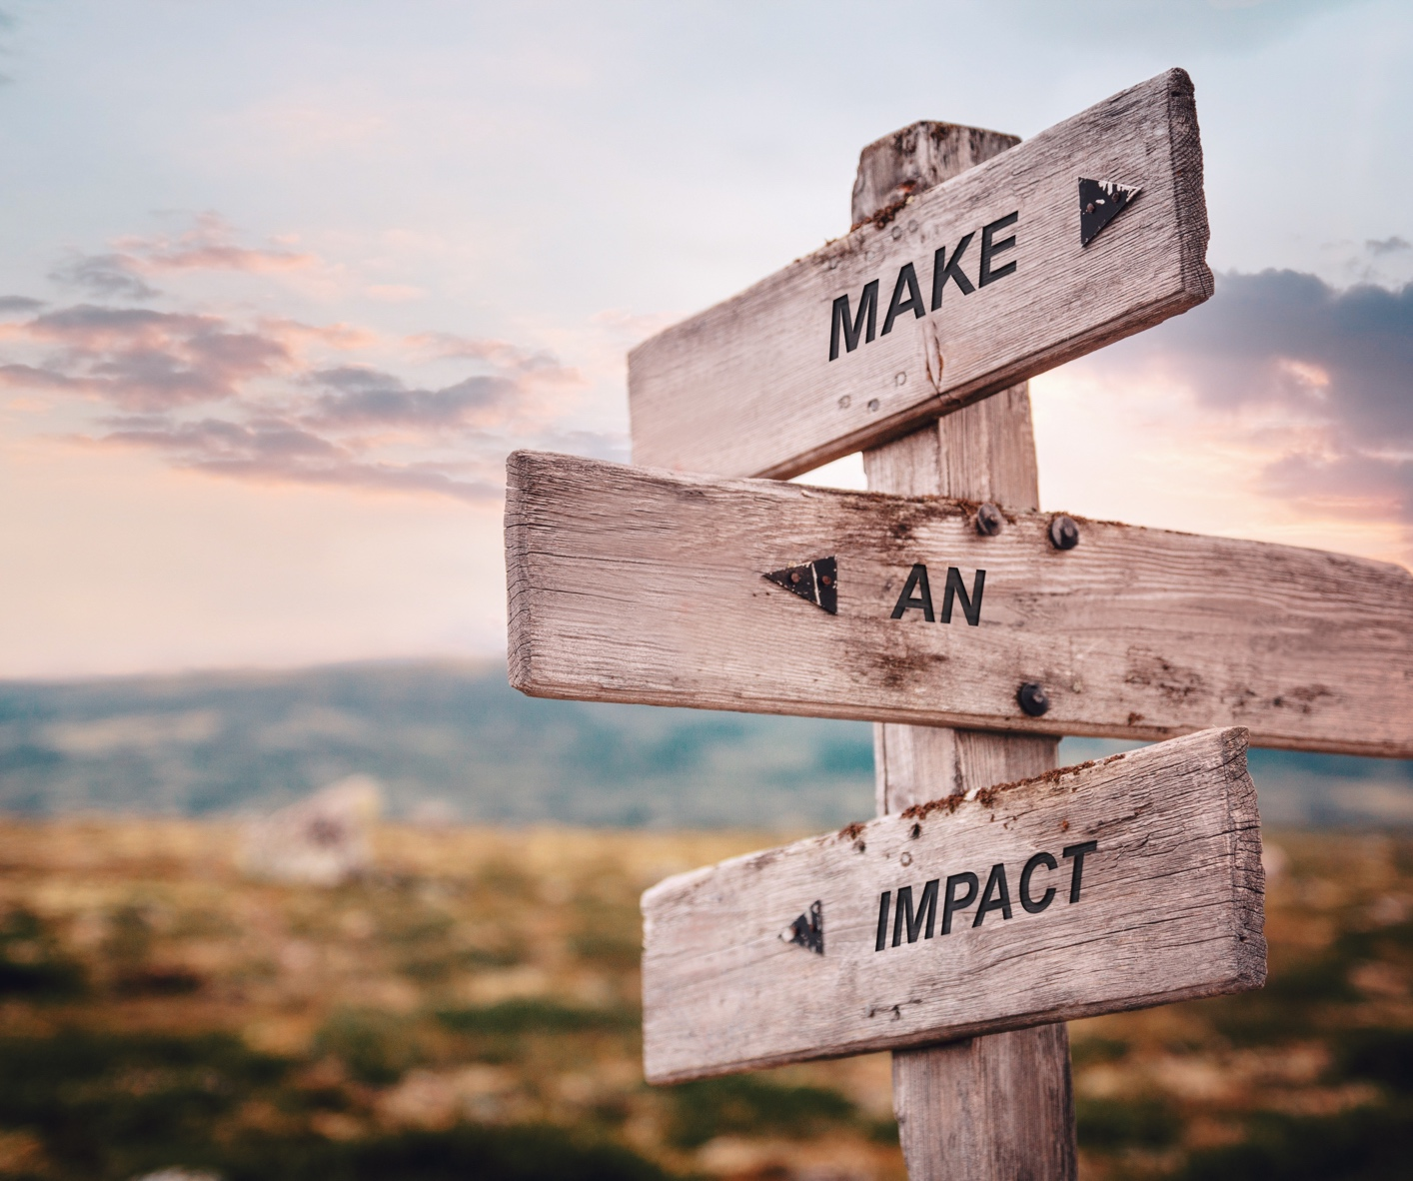
05
Try it yourself
WRITE:
Jot down three hopeful climate stories you’ve read or heard recently (e.g. about renewable energy, youth activism, or local community projects). Reflect on how they make you feel.
DISCUSS:
Share in pairs or small groups: When was the last time you felt hopeful about the climate? What sparked that feeling? Notice how hope spreads when stories are shared.
ACT:
Pick one hopeful story from this toolkit and retell it — on social media, in class, or to a friend. Hope grows stronger when it’s passed on.

Slide 8
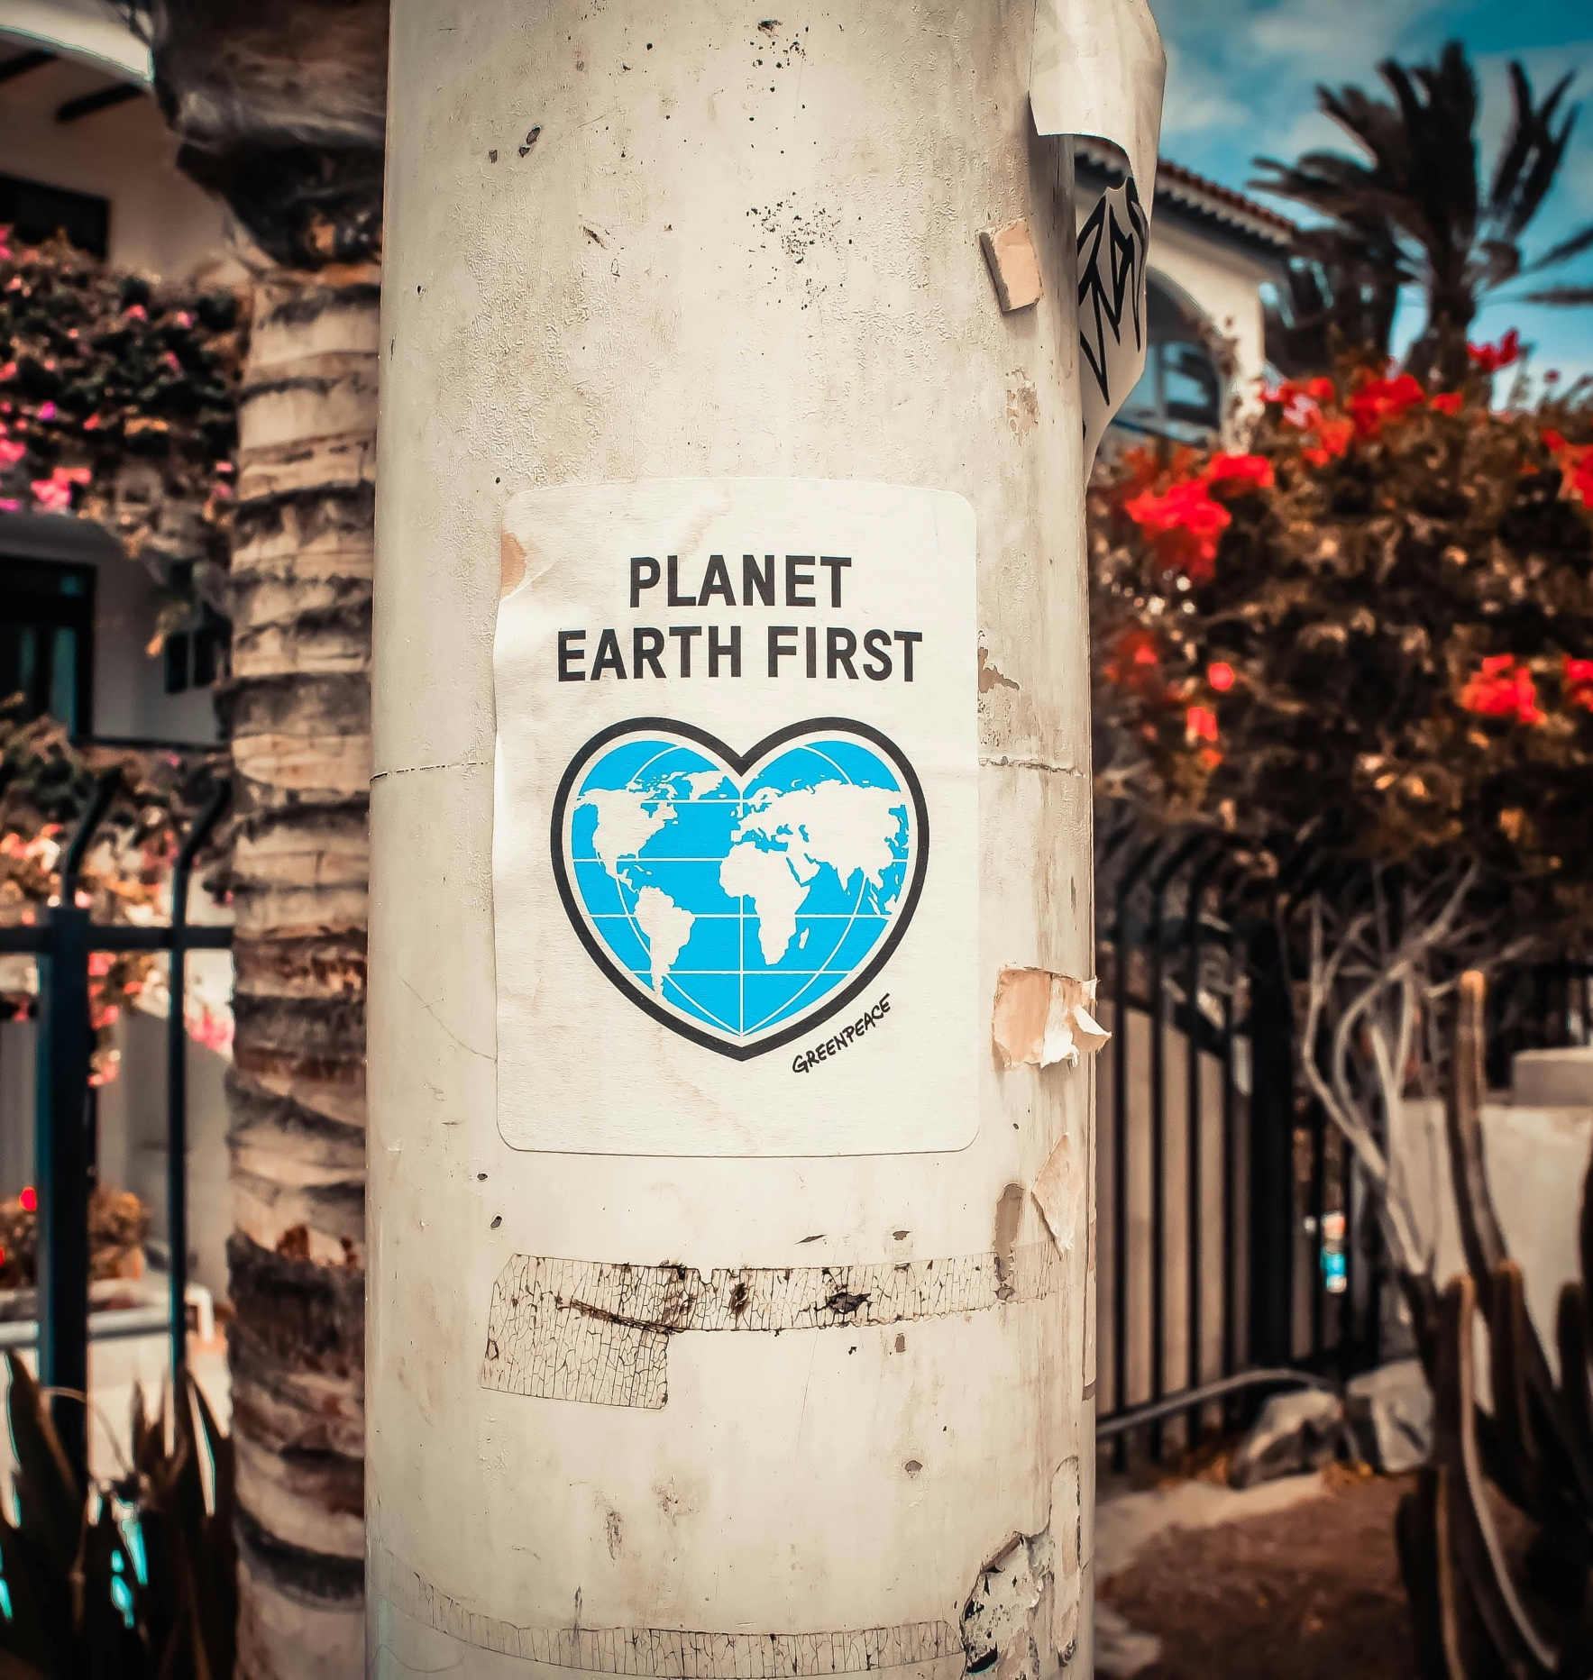
Key Takeaway
Hope doesn’t mean ignoring the challenges. It means recognising solutions, celebrating progress, and believing that change is possible when we act together. By reading, watching, and listening to stories of resilience and success, young people can build a hopeful mindset that fuels action and keeps the climate movement alive.
Reflect and act
Recall one piece of climate progress you have seen this year. How does focusing on what is working change the way you feel about taking action?

