Slide 1
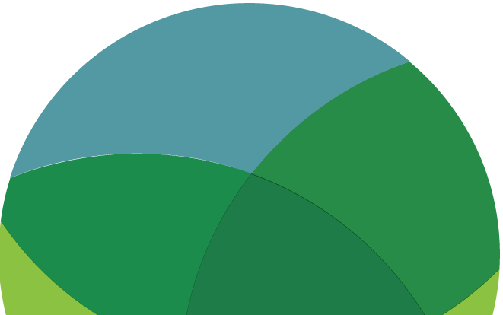
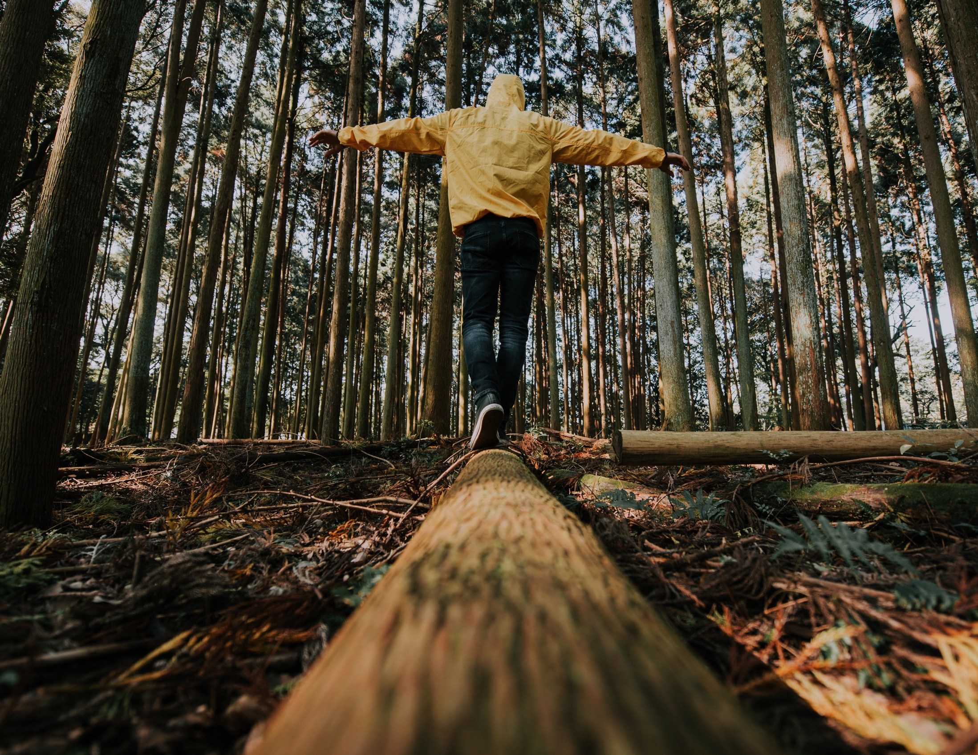
GREEN CAREERS & FUTURE SKILLS
EXPLORE / DISCOVER /
PLAN / ACT
www.planetpulse.eu

Slide 2

CONTENTS
01
Introduction
02
Read
03
Watch
04
Think & Reflect
05
Act
06
Key Takeaway

Slide 3

01
Introduction
The shift to a sustainable economy is creating new jobs, new industries, and new skill demands across every sector. Green careers span engineering, policy, education, finance, design, agriculture, and beyond — and they are growing fast.
This toolkit helps young people explore what a green career might look like for them, what skills to start building now, and how to connect learning with real-world opportunity.
Learning Goals
• Understand what green jobs are and which sectors are growing fastest.
• Identify skills you already have that are relevant to the green economy.
• Explore EU policy driving the demand for green skills and workers.
• Take one concrete step toward a more sustainable career path.

Slide 4
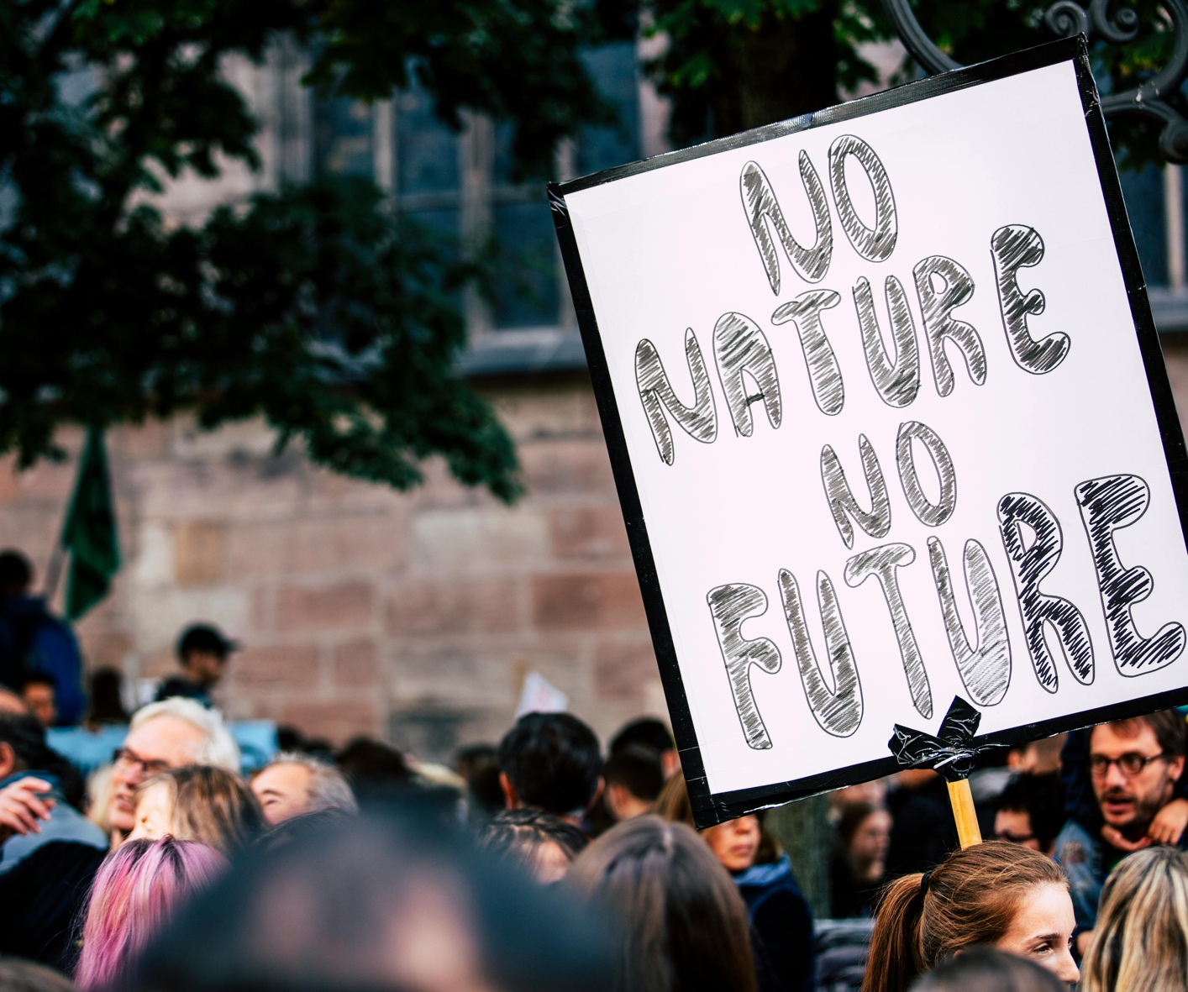
02
Read
Report – Green Jobs in Europe (Eurofound)
The EU’s research agency for work and living conditions maps which green job sectors are growing across Europe, which skills are in demand, and what the transition means for workers and employers.
Read
Overview – What Are Green Jobs? (International Labour Organization)
The ILO defines green jobs, outlines which sectors they belong to, and explains the link between sustainable development, decent work, and the global shift to a low-carbon economy.
Read
Policy – European Green Skills Agenda (European Commission)
The European Commission’s agenda on green skills for industry sets out how education and training systems are being reshaped to equip workers for a net-zero economy by 2050.
Read
Guide – Green Jobs: What Are They and How Do I Get One? (Prospects UK)
A practical career guide covering green job sectors, entry routes, and the qualifications and experience most valued by sustainable employers. Useful for early-stage career planning.
Read

Slide 5
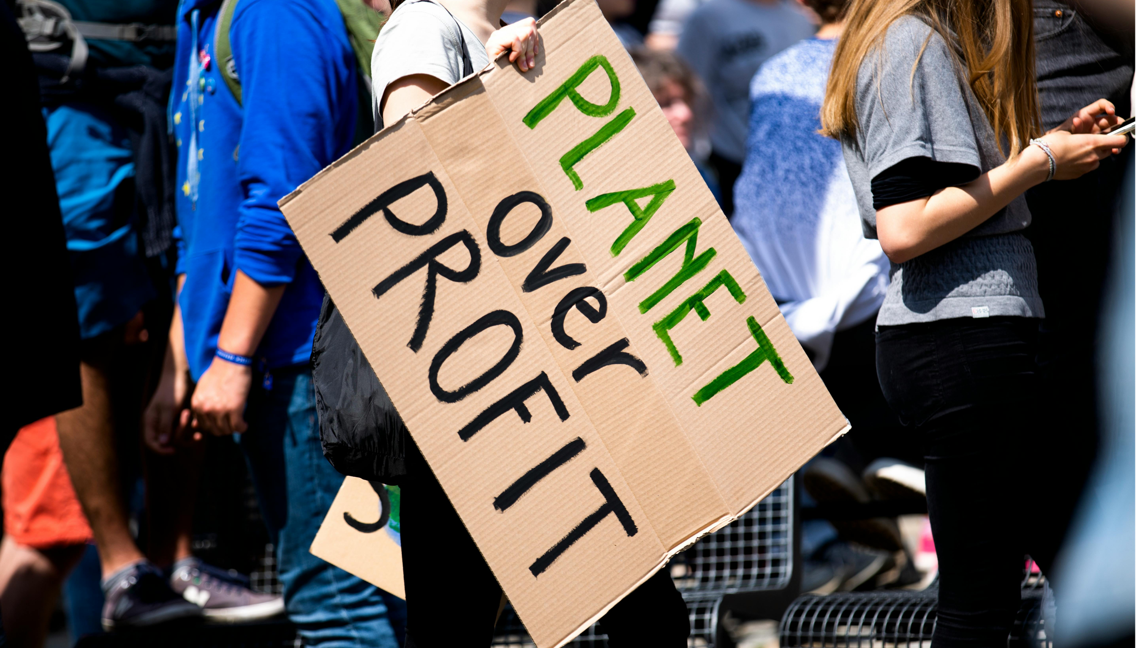
03
Watch
TED Talk – Biomimicry in Action (Janine Benyus)
Janine Benyus shows how nature-inspired design is creating new industries and professions. A compelling introduction to careers at the intersection of biology, engineering, and sustainable innovation.
Watch
TEDx Talk – The Green Economy is the New Economy (various)
This TEDx talk explores how the economic transition to sustainability is not just an environmental story — it is a story of reinvention, entrepreneurship, and opportunity for the next generation of workers.
Watch
Documentary – Europe’s Green Deal and the Future of Work (DW News)
DW examines how the European Green Deal is reshaping industries across the continent — from energy and construction to transport and agriculture — and what it means for young job seekers entering the market.
Watch

Slide 6
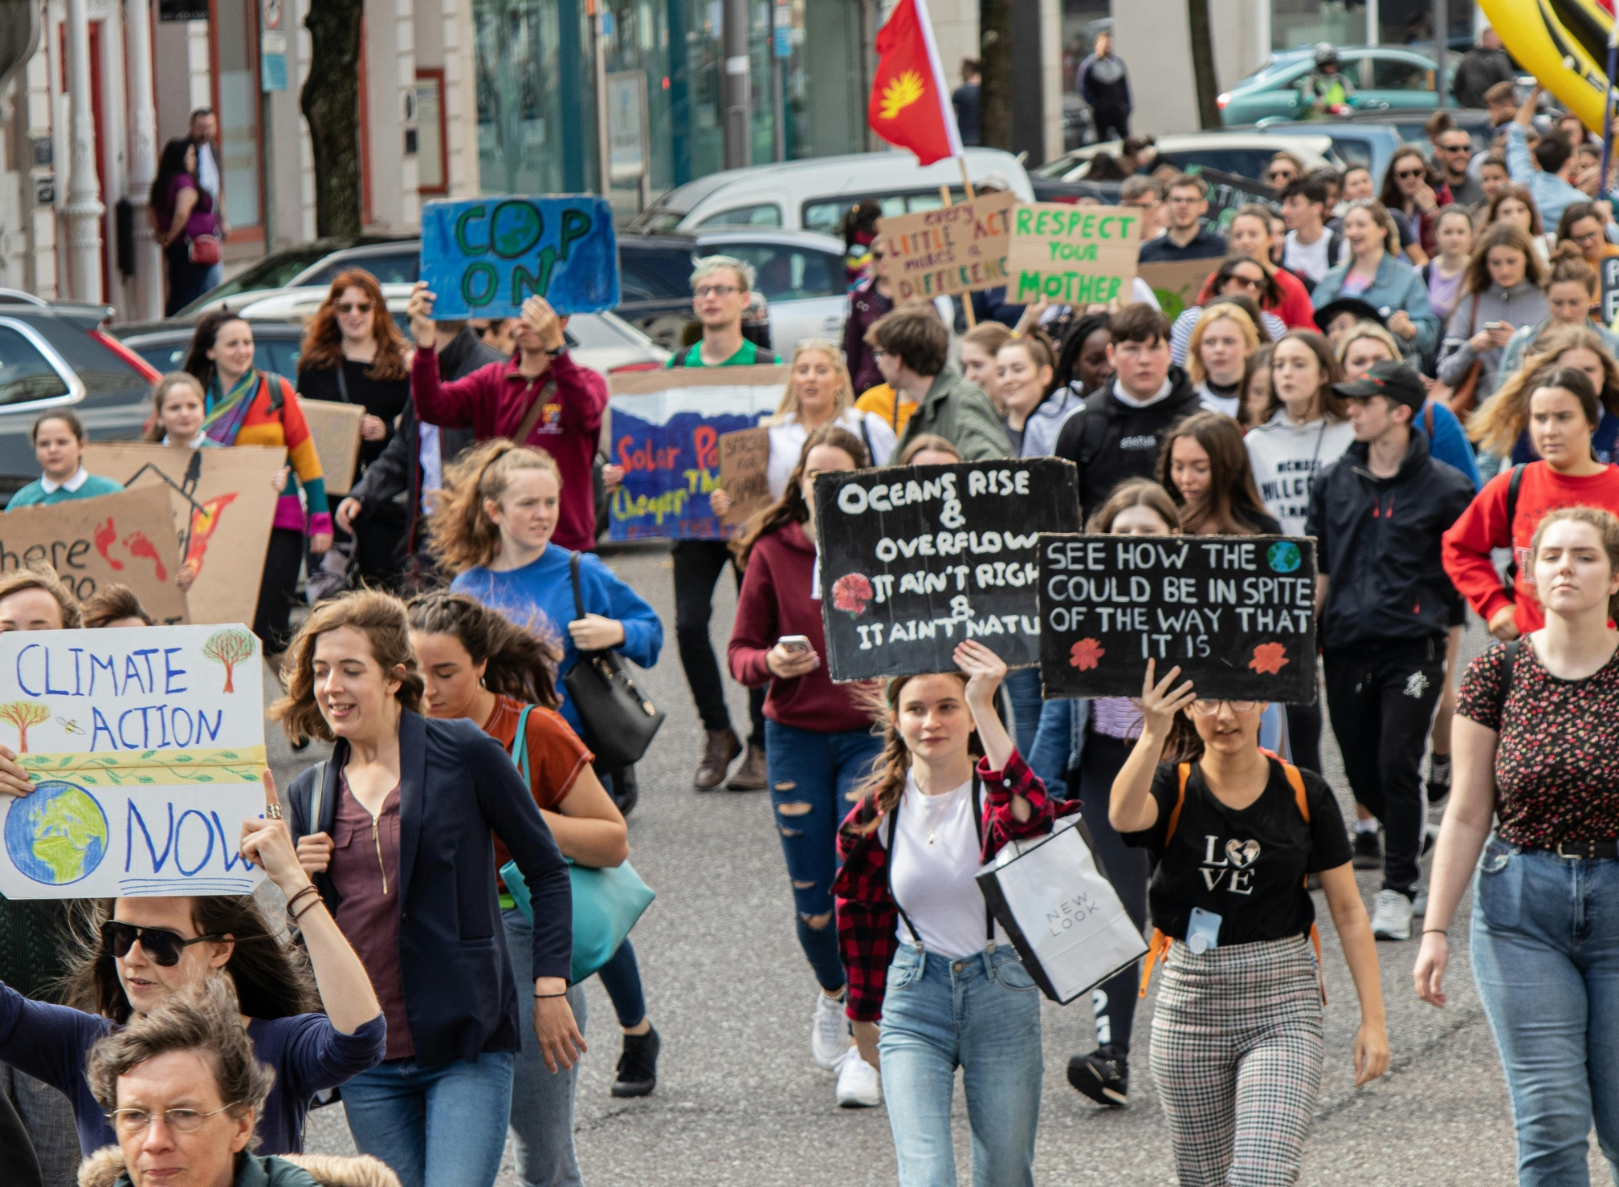
04
Think & Reflect
THINK – Discussion Questions
• What does a “green job” mean to you?
Could your dream job become greener?
• Which industries in your country are changing most because of sustainability pressures?
• What skills do you think will matter most in a low-carbon economy — technical, social, or creative?
• Is there a tension between economic growth and environmental sustainability? Can green jobs resolve it?
REFLECT – EU Green Jobs Explorer
Browse the ESCO database — the
European classification of occupations and skills — to explore green occupations and the competencies they require. Filter by sector or skill to find what fits you.
Explore ESCO

Slide 7

05
Act
SKILLS AUDIT:
List 10 skills you already have — including soft skills, languages, and hobbies. Then use the ESCO database to identify one green occupation that matches at least three of them. Share your findings with the group.
RESEARCH:
Choose one green career that interests you. Research its daily tasks, average salary, required qualifications, and growth outlook. Prepare a two-minute pitch to your group: “Here’s why this job matters and how I could get there.”
CONNECT:
Find one green employer, NGO, or start-up operating in your country or region. Follow them on LinkedIn or their website. Identify one open role, internship, or volunteering opportunity and note what it requires.
PLAN:
Write a 12-month personal development plan. Include one course, one organisation to follow, one skill to build, and one action to take. Keep it realistic — small steps, taken consistently, create careers.

Slide 8
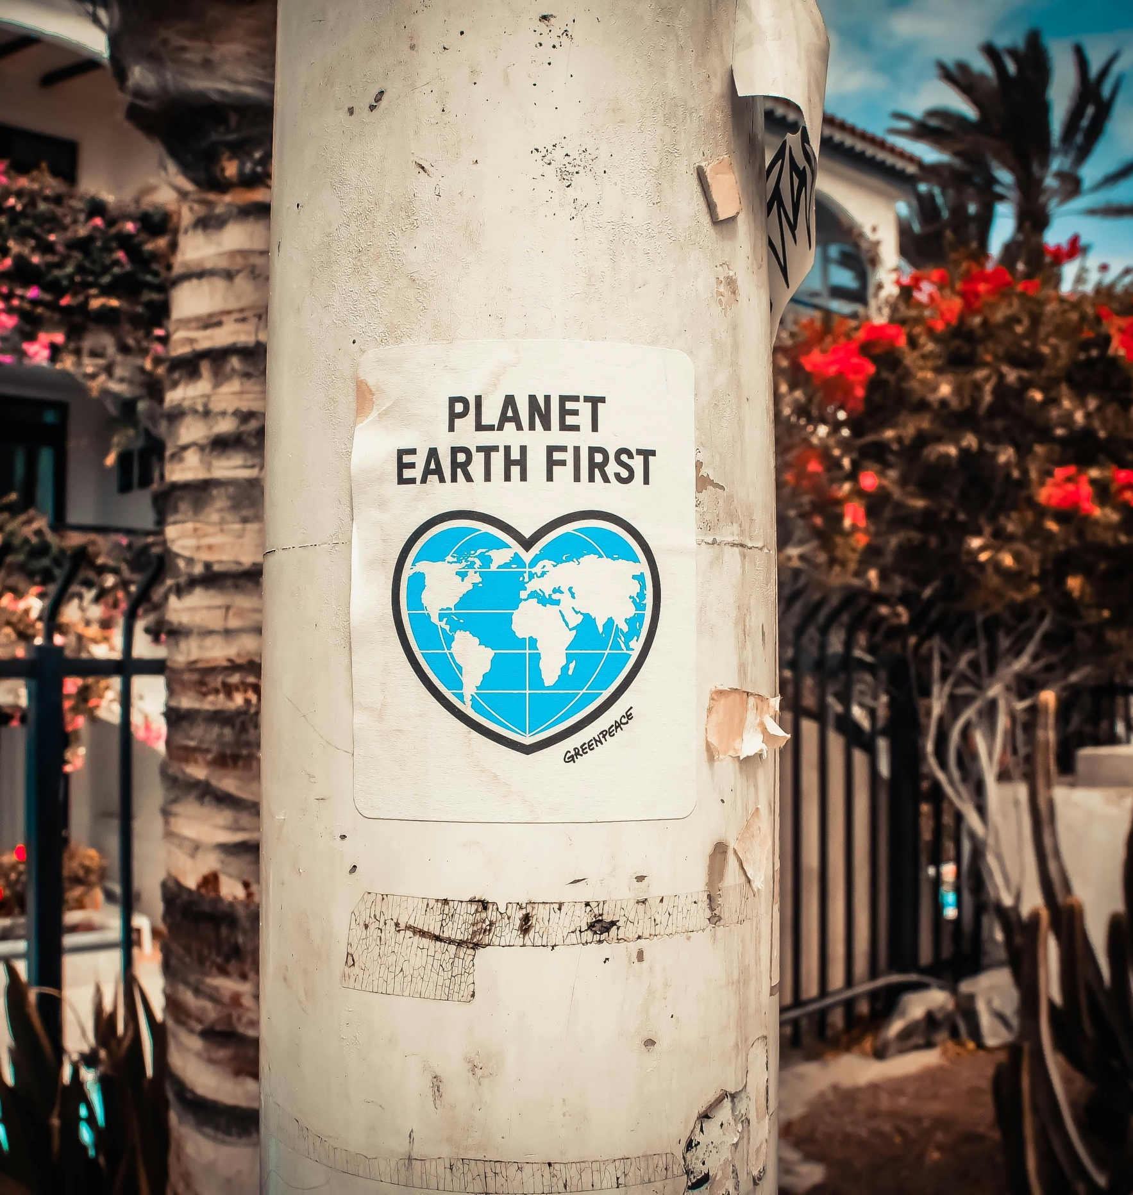
Key Takeaway
The green economy is not a future possibility — it is already here and growing fast. Every sector, from construction to finance, from farming to technology, is being reshaped by the shift to sustainability. The question is not whether green jobs exist. It is whether you are ready to step into them. Start building your skills, your curiosity, and your connections now. The planet needs people who care. It also needs people who are qualified.
Reflect and act
Pick one green career path that interests you. What is one course, person or experience that would help you explore it further?

