Slide 1
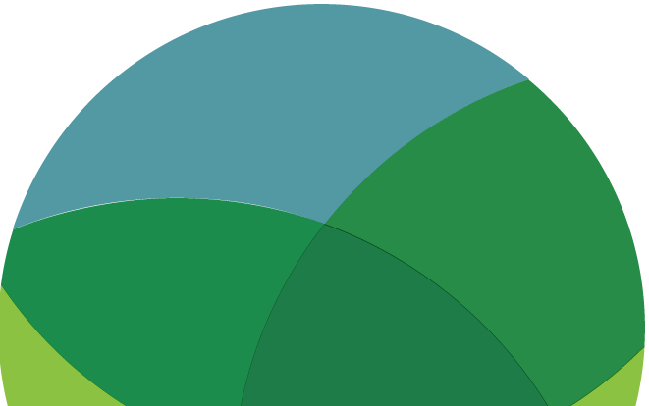
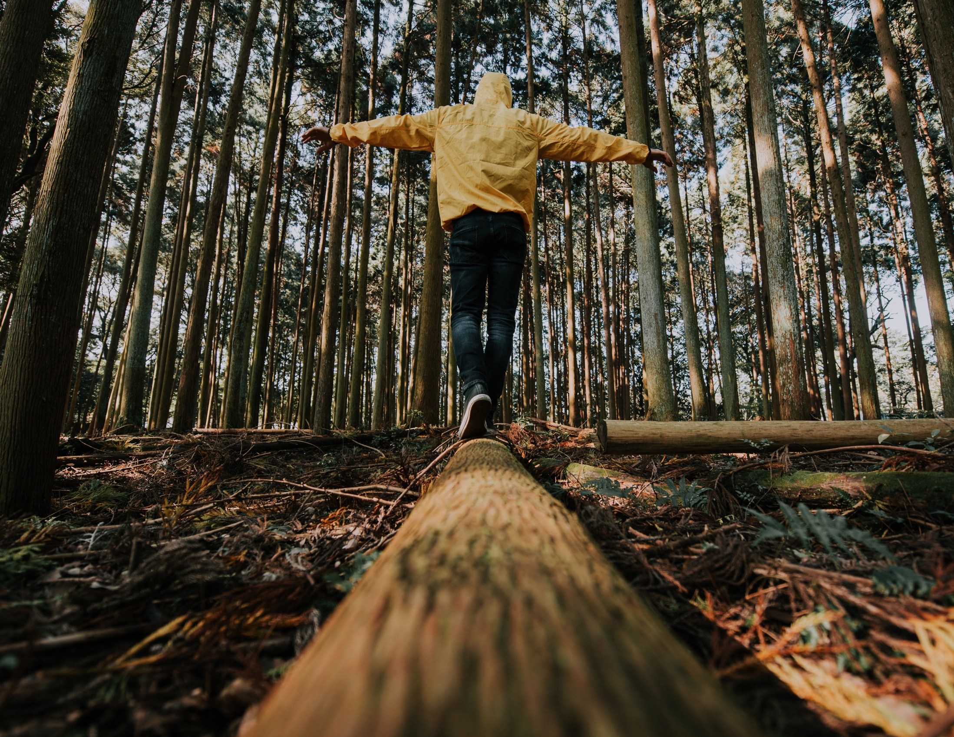
EMPOWERMENT
READ/WATCH/
LISTEN/WRITE/ACT
www.planetpulse.eu
2024 - 2026
Document Name
By
Partner Name

Slide 2

CONTENTS
01
Why Empowerment Matters
02
Read
03
Watch
04
Listen
05
Try it yourself

Slide 3
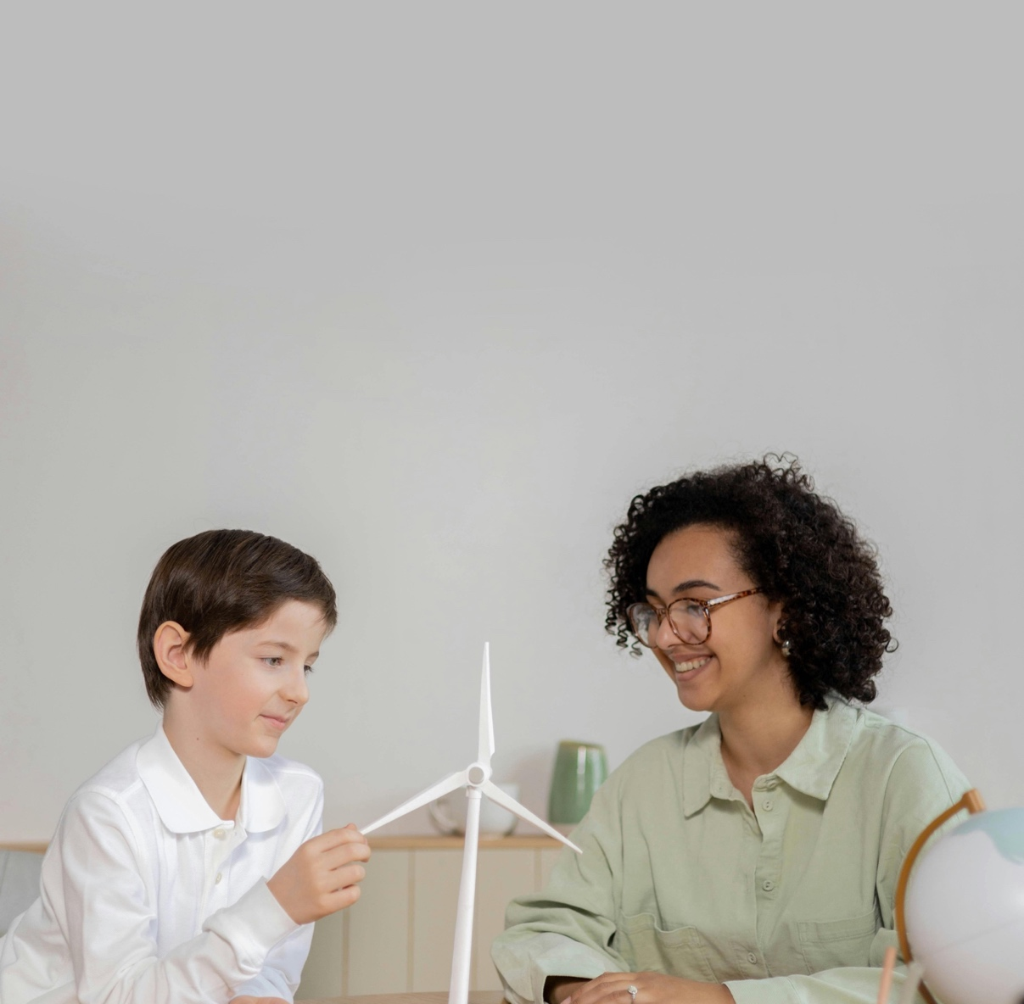
01
Why Empowerment Matters
Empowerment means recognising that your voice and your actions count. When it comes to climate change, it’s easy to feel powerless, but across the world, young people are proving that small steps add up to big change. This toolkit gives you ideas, stories, and tools to help you share your vision, find your voice, and take action in ways that feel real and meaningful.

Slide 4
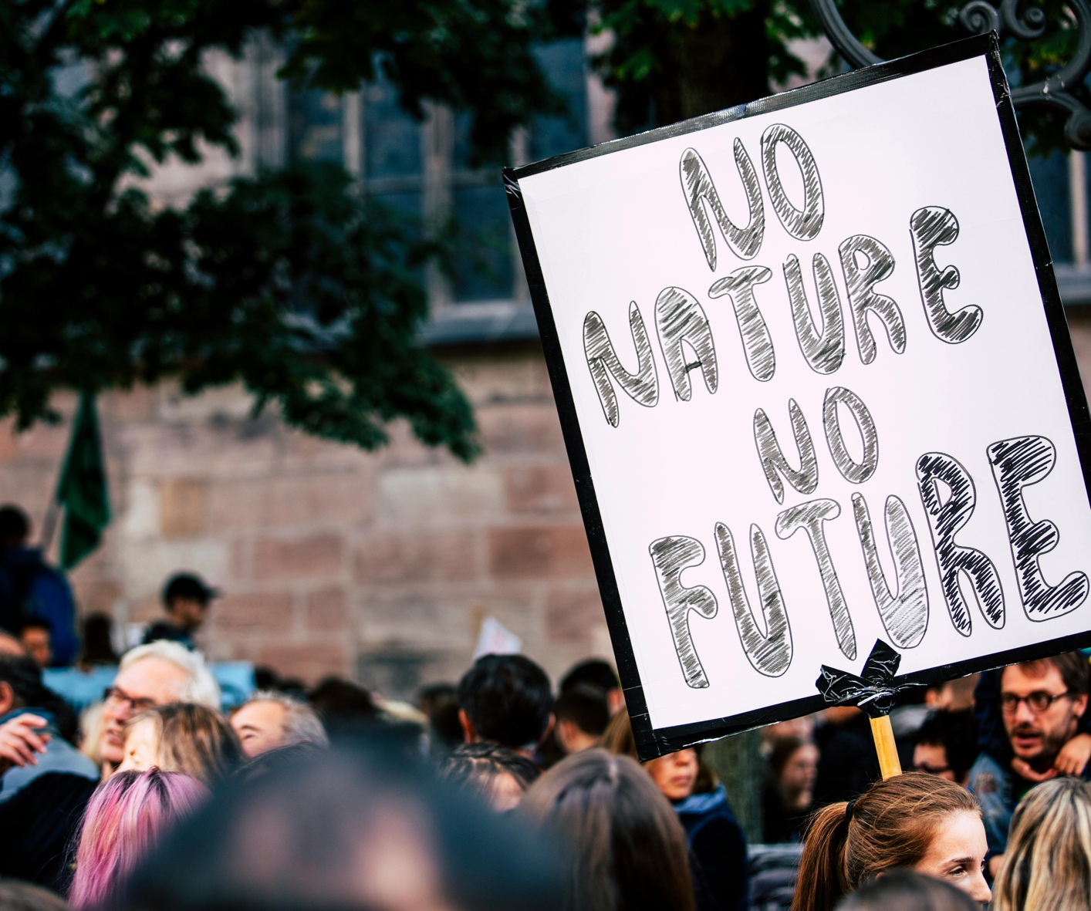
02
Read
UNFCCC – Action for Climate Empowerment
ACE is a global framework that encourages people everywhere to engage in climate education, training, and participation. It’s useful for youth who want to understand how empowerment connects with international climate goals.
Link
Blog – 7 Ways Young People Are Leading the Climate Movement (EarthDay.org)
A collection of youth-led initiatives showing the many different ways young people are already changing the story. This blog is a good place to spark ideas for your own projects.
Link
Book – This Is Not a Drill (Extinction Rebellion Handbook) (Review)
Written as a call to action, this handbook mixes stories, guides, and practical tips. It’s especially helpful if you want to move from “thinking about action” to actually taking the first steps.
Link

Slide 5
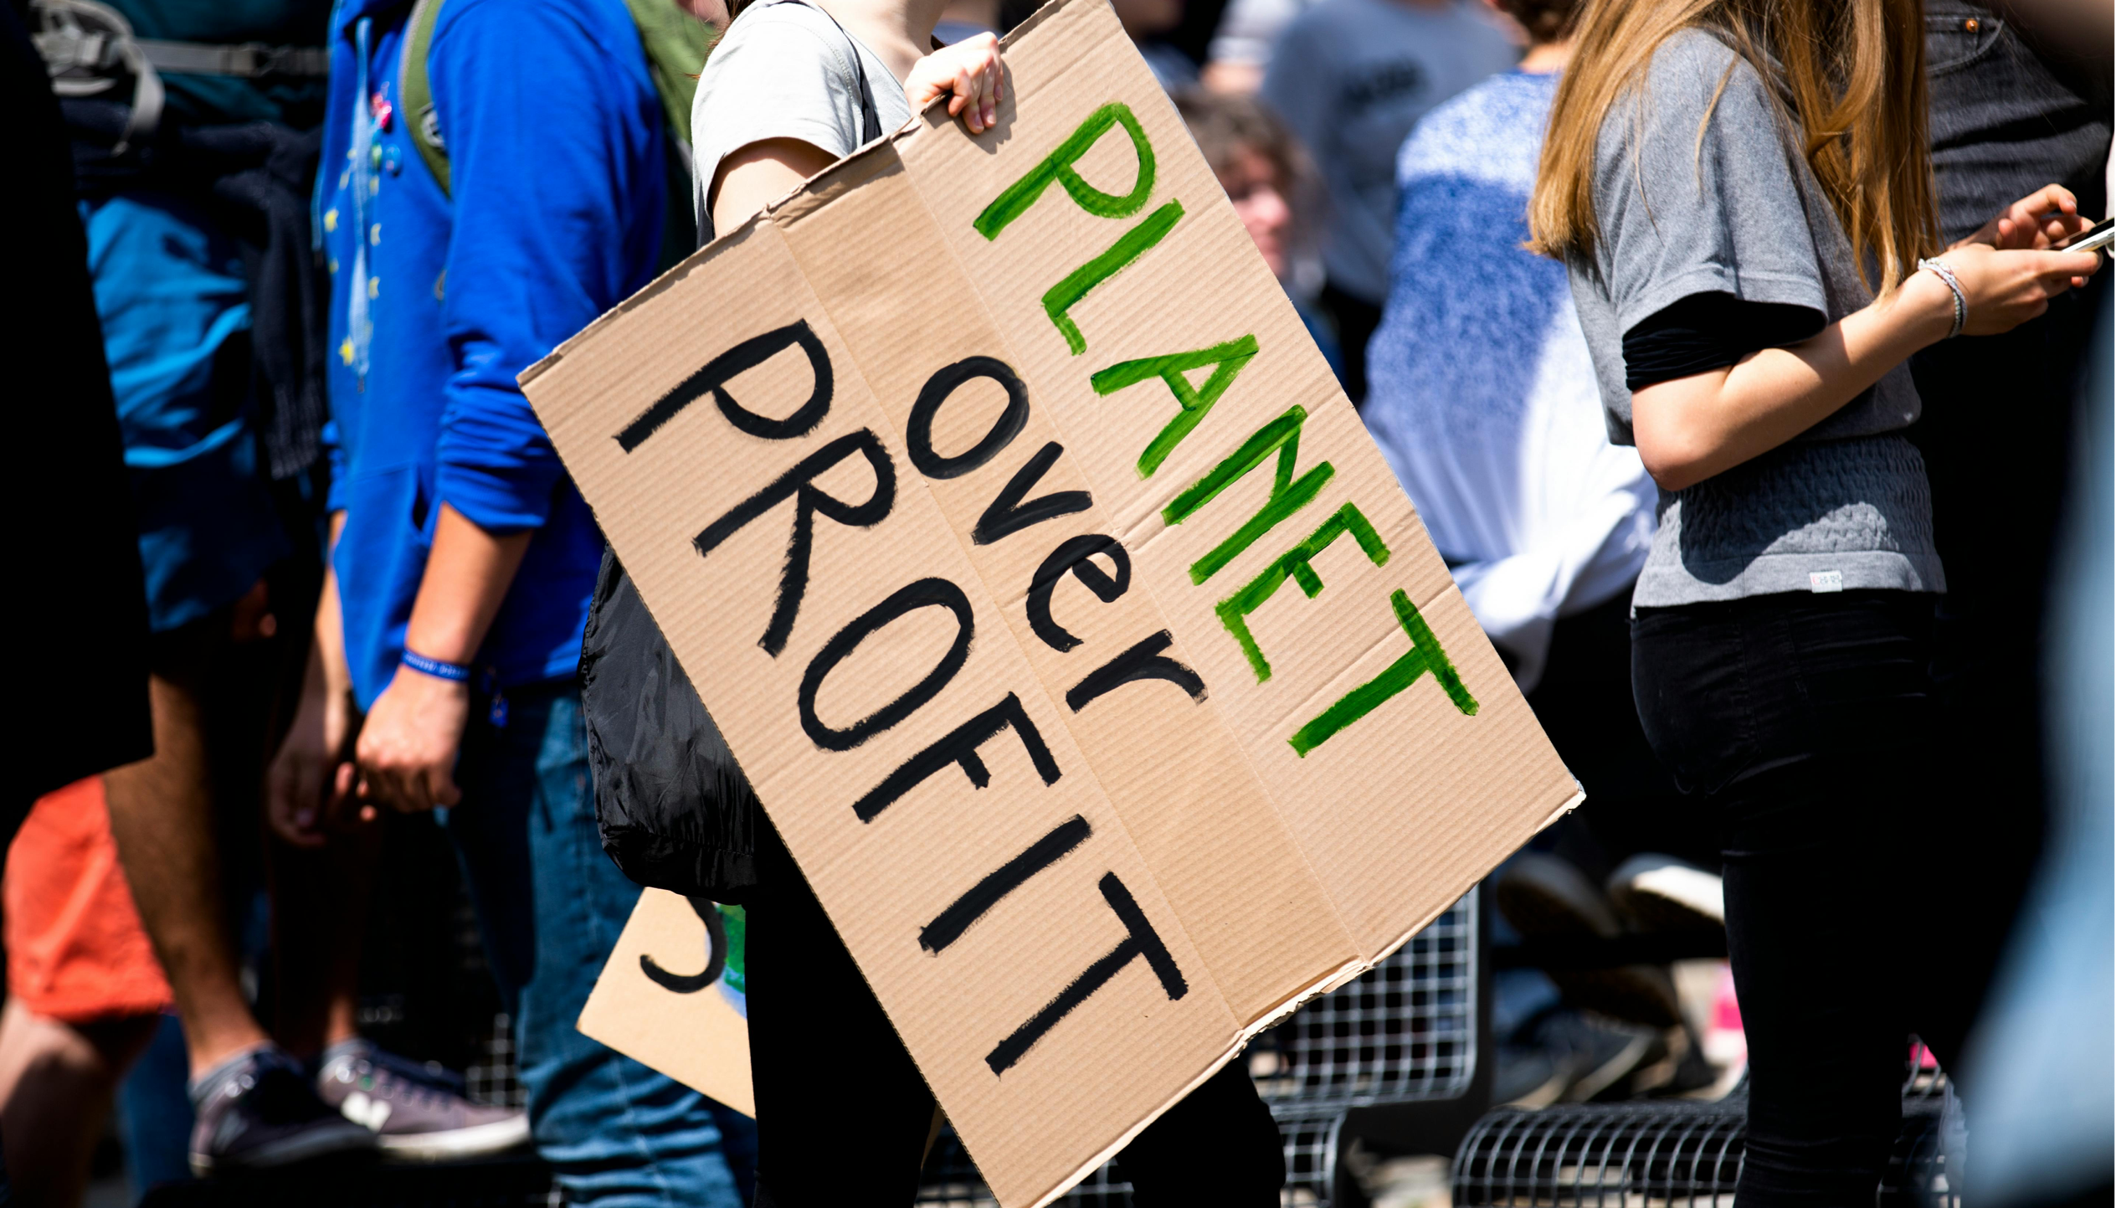
03
Watch
TED Talk – How Empowering Women and Girls Can Help Stop Global Warming
This talk makes the case that gender equality is climate action. When women and girls are empowered, whole communities become more sustainable and resilient.
Link
TED Talk – How to transform apocalypse fatigue into action
on global warming (Per Espen Stoknes)
Stoknes explains the psychology of climate despair and offers practical ways to stay motivated instead of paralysed. A useful watch if you sometimes feel like “what’s the point?”
Link
UNICEF Young climate activists demand action and inspire hope
Short, powerful clips from youth climate activists across the world. Their projects show how local ideas can inspire global change. Great for classroom or group discussions.
Link
Documentary Short – Youth v Gov (Netflix)
Follows young activists in the US who filed a landmark lawsuit against the government for failing to protect their right to a safe climate. A striking story of young people taking power into their own hands.
Link

Slide 6
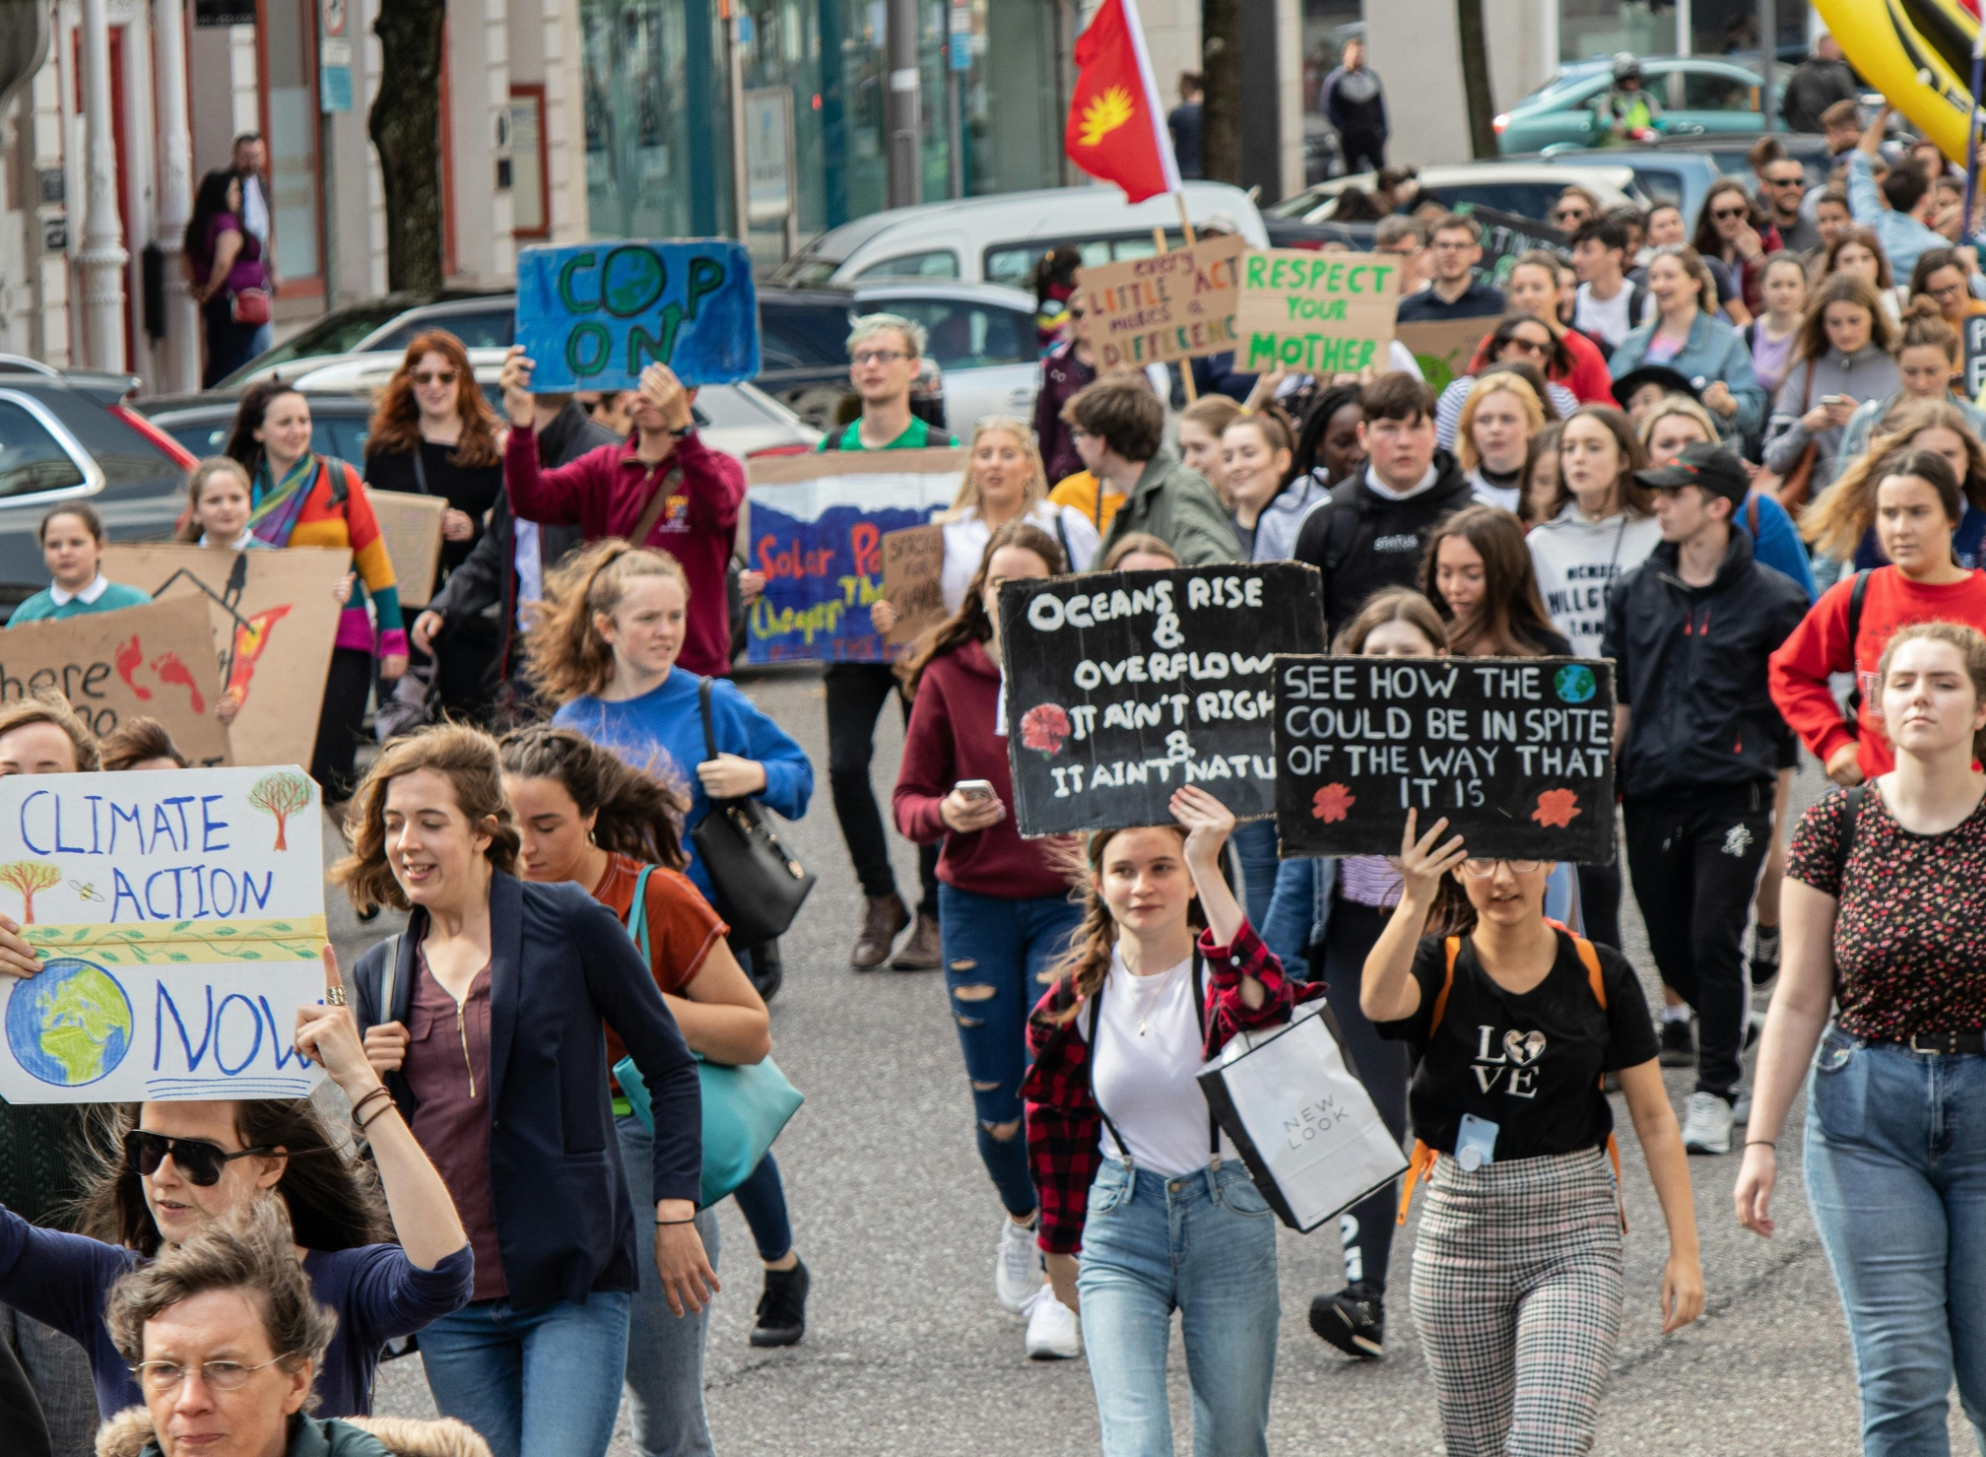
04
Listen
Podcast – Force of Nature
A youth-focused series that explores eco-anxiety and shows how it can be transformed into courage and leadership. Listening feels like sitting in on a supportive conversation with peers.
Link

Slide 7
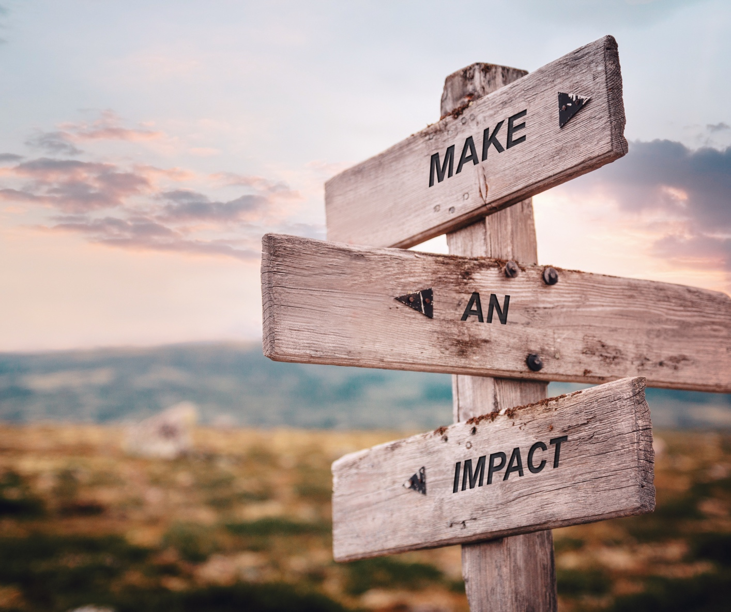
05
Try it yourself
WRITE:
Jot down one issue in your community that you’d love to change. Write a short “why I care” statement — this can become the heart of your personal climate vision.
DISCUSS:
Share your “why I care” statement with a friend, classmate, or group. Ask them what issue they care most about. You’ll see how quickly shared visions spark ideas for collaboration.
ACT:
Take a tiny step — post your vision online, create a poster, or share it at school or in your community. Empowerment grows when you put your voice into the world.
Reflect and act
Write down one climate issue you care about and one skill you already have. How could you put that skill to use in the next four weeks?

