Slide 1
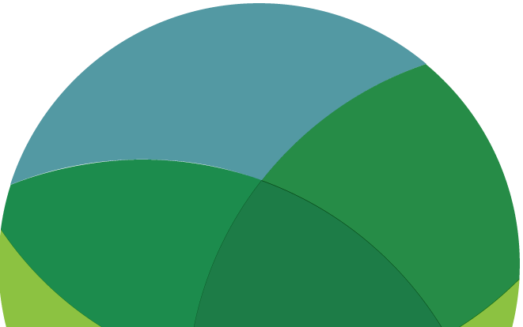
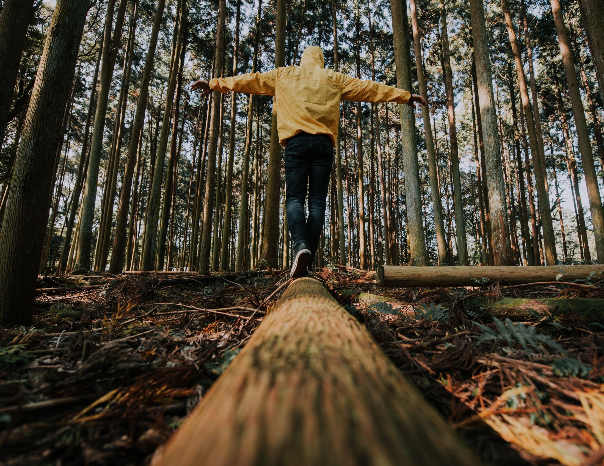
CLIMATE JUSTICE
EXPLORE / QUESTION /
CONNECT / ACT
www.planetpulse.eu

Slide 2

CONTENTS
01
Introduction
02
Read
03
Watch
04
Think & Reflect
05
Act
06
Key Takeaway

Slide 3
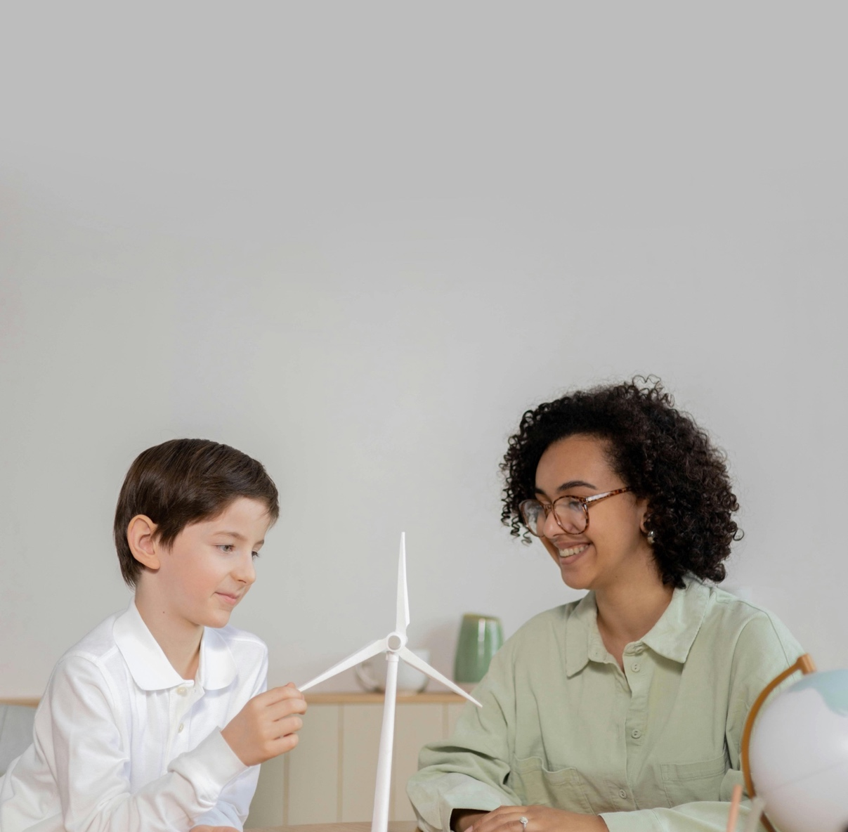
01
Introduction
Climate change does not affect everyone equally. The communities least responsible for global carbon emissions — including low-income populations, indigenous peoples, and nations in the Global South — often face the most severe impacts.
Climate justice connects environmental science with human rights, asking not just what is happening to the planet, but who is being harmed, and who holds responsibility. This toolkit invites you to explore those questions.
Learning Goals
• Understand what climate justice means and why it matters.
• Explore how climate impacts fall unequally across communities and regions.
• Connect local experiences of climate harm to global systems and policy.
• Consider what fair and equitable climate action looks like in practice.

Slide 4
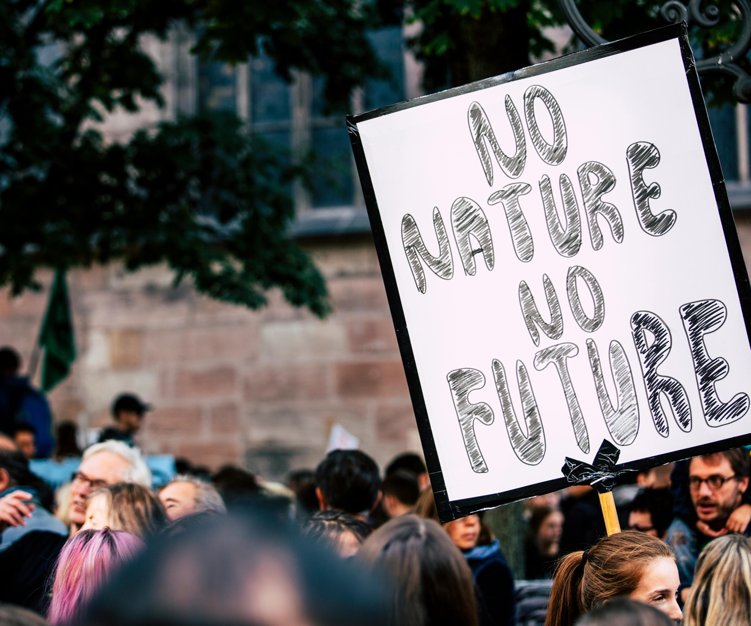
02
Read
Explainer – What is Climate Justice? (United Nations)
A clear, accessible overview from the UN covering the core principles of climate justice — equity, human rights, and shared but differentiated responsibility between nations.
Read
Principles – Climate Justice (Mary Robinson Foundation)
Former Irish President and UN High Commissioner Mary Robinson outlines seven core principles for climate justice. A foundational European reference document on equity and climate policy.
Read
Report – Climate Impacts on Vulnerable Communities (IPCC AR6)
The IPCC Sixth Assessment Report documents how climate change disproportionately harms the most vulnerable populations worldwide, with detailed regional breakdowns and evidence on inequity.
Read
Framework – Just Transition (Climate Justice Alliance)
Explains the concept of a “Just Transition” — ensuring the shift to a green economy does not leave behind the workers and communities most dependent on fossil fuel industries.
Read

Slide 5
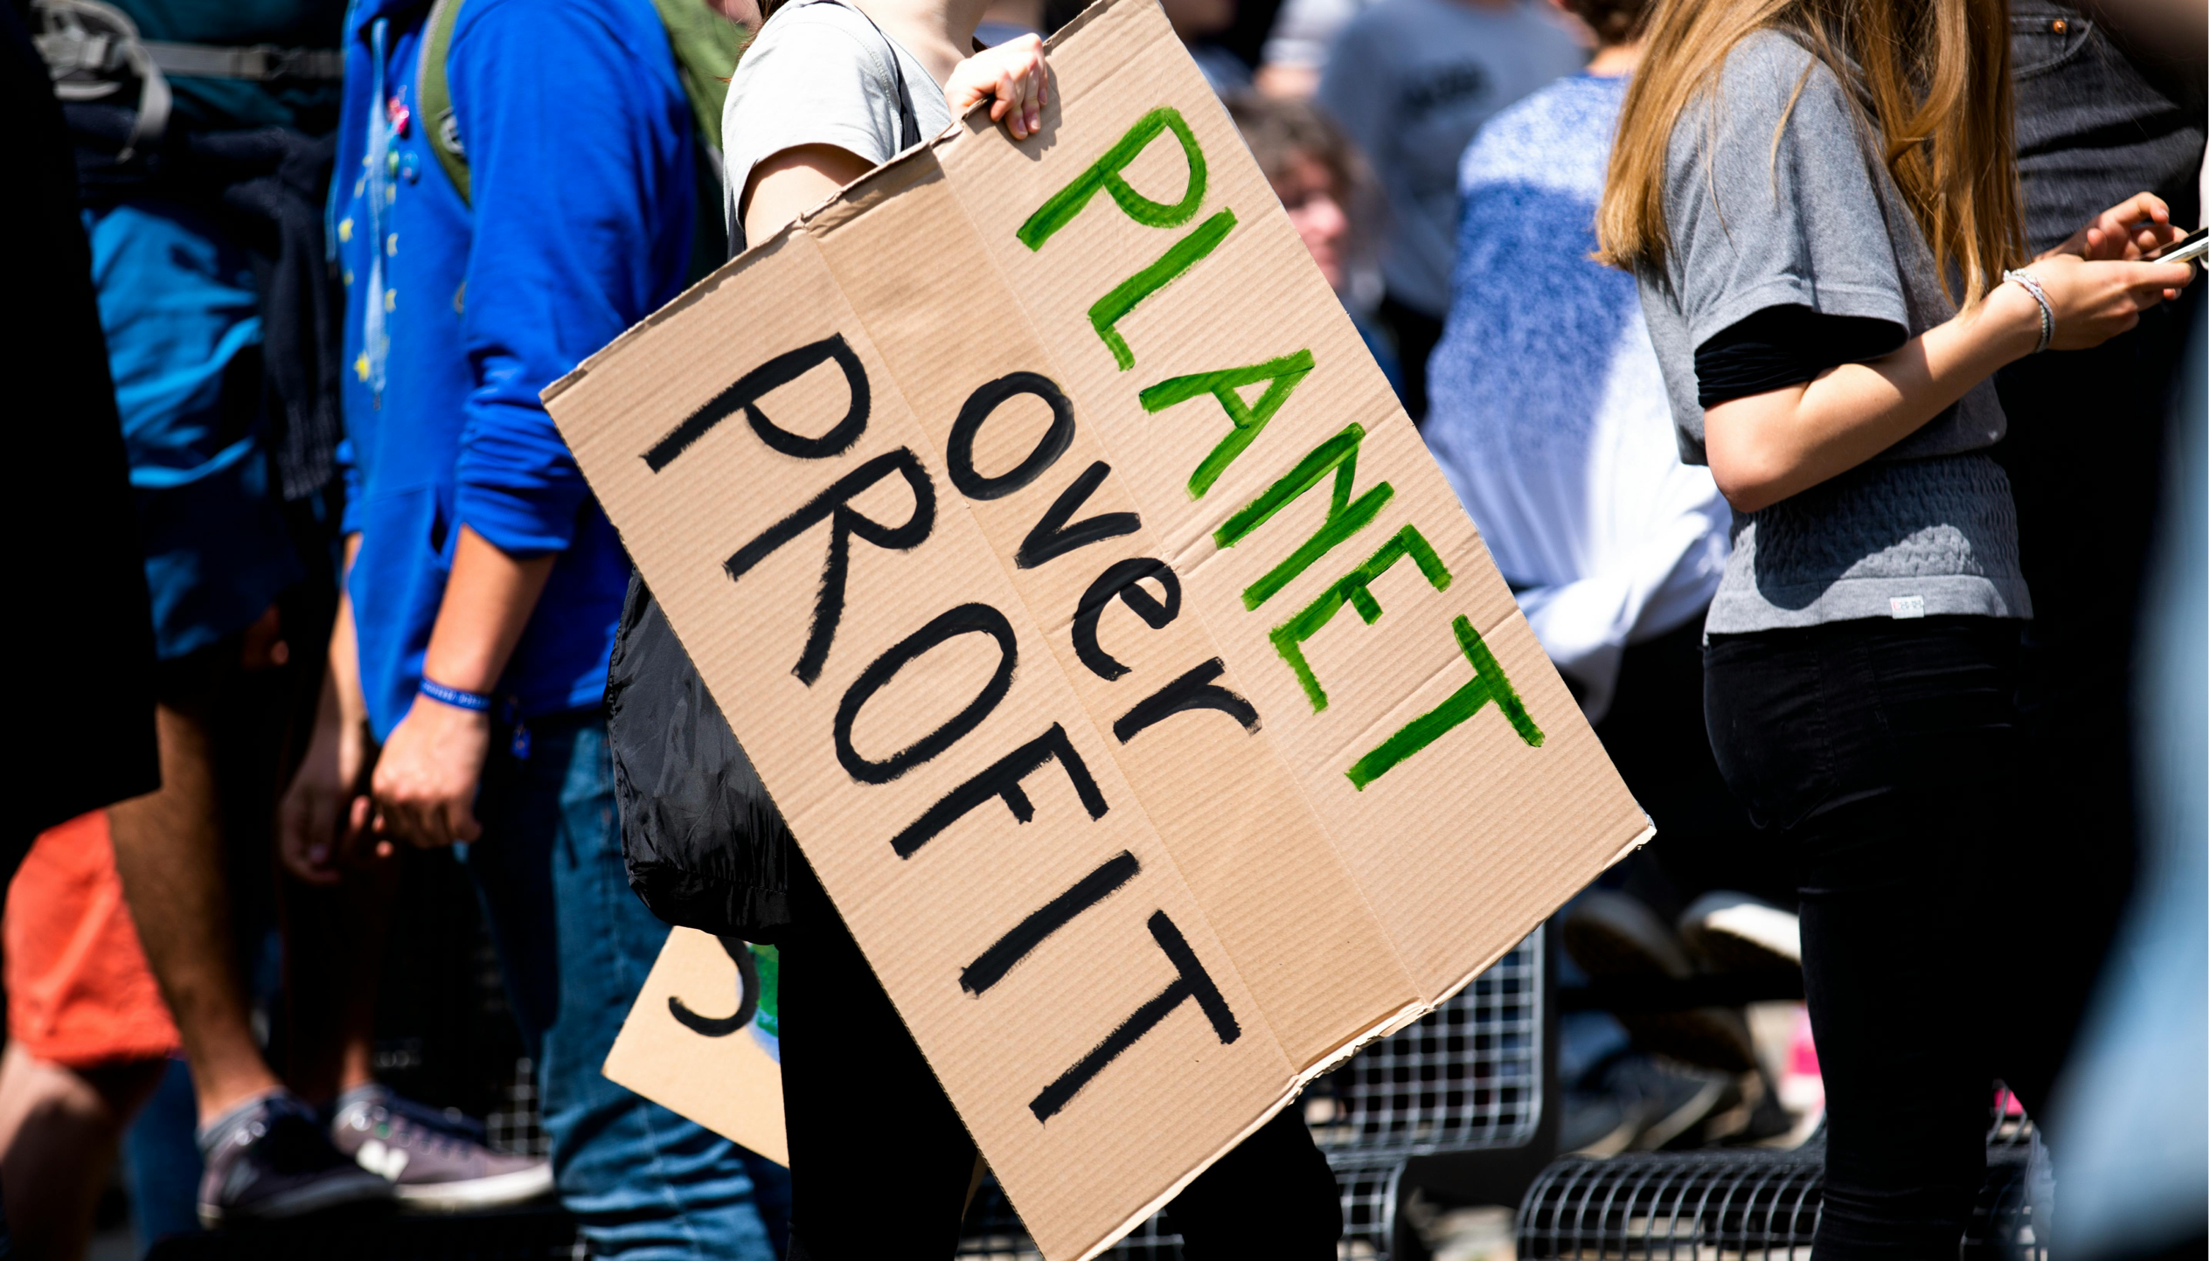
03
Watch
TED Talk – A Plea to Those Who Care About Our World (Vanessa Nakate)
Ugandan climate activist Vanessa Nakate speaks about how African communities bear the heaviest climate impacts despite contributing least to global emissions — a powerful personal account of climate injustice.
Watch
TED Talk – Indigenous Knowledge Meets Climate Science (Hindou Oumarou Ibrahim)
Chadian environmental activist Hindou Oumarou Ibrahim shows how indigenous communities are already living the consequences of climate change — and how their knowledge offers solutions science alone cannot.
Watch
Documentary – Who Pays for Climate Change? (DW Planet A)
DW’s Planet A series examines loss and damage — the question of whether wealthy, high-emitting nations should compensate poorer countries already suffering severe climate impacts they did little to cause.
Watch

Slide 6
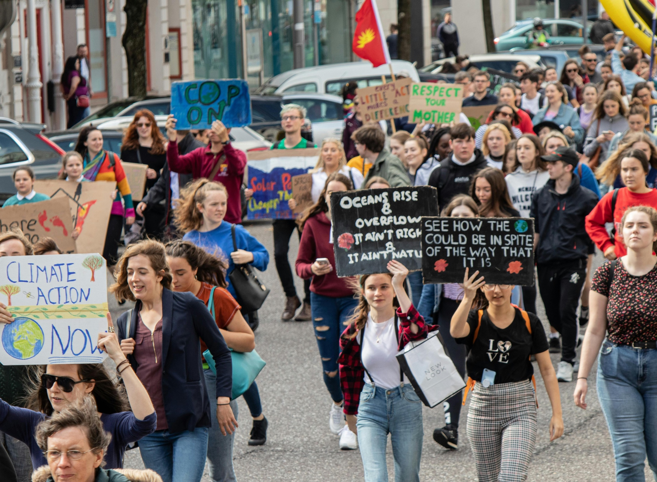
04
Think & Reflect
THINK – Discussion Questions
• Who in your country or region is most exposed to climate impacts? Who is least exposed?
• Is it fair that some nations bear the cost of damage caused mainly by others? Who should pay?
• What does “a just transition” mean for people working in fossil fuel industries today?
• How does climate injustice connect to other forms of inequality you see in daily life?
REFLECT – Climate Vulnerability Index
Explore the ND-GAIN Country Index to see which nations are most vulnerable to climate change and least ready to adapt. Compare high-emitting versus low-emitting countries.
Explore the Index

Slide 7
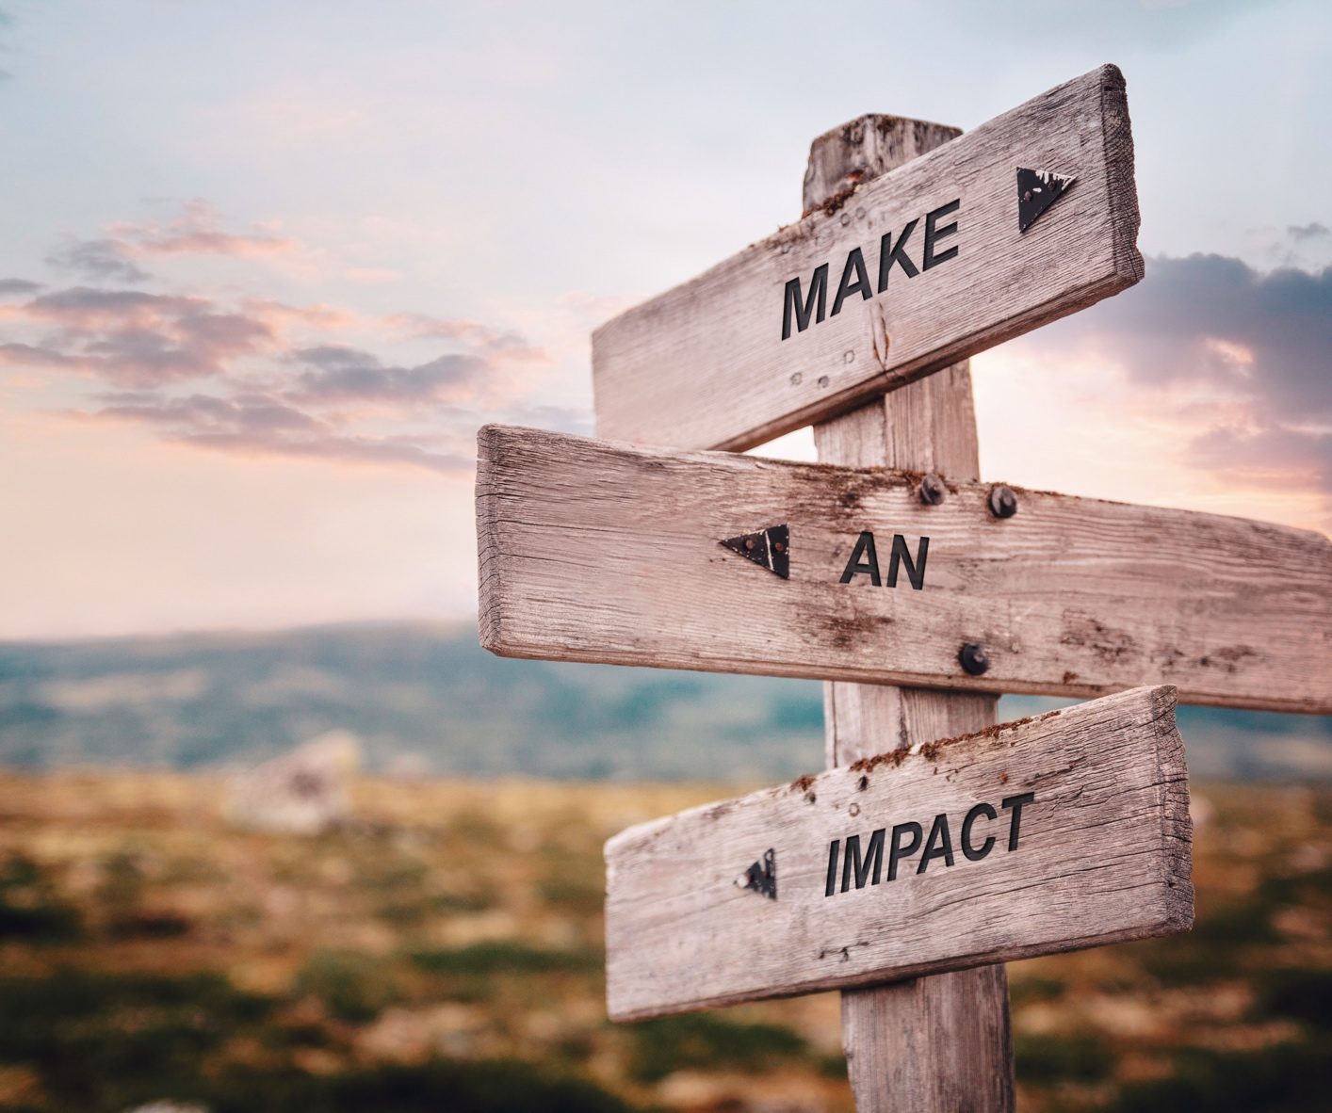
05
Act
MAP IT:
Using the ND-GAIN Index, identify three countries highly vulnerable to climate change. Research their emissions levels. Present your findings to your group: what does the data reveal about fairness?
DISCUSS:
In groups, debate: “High-income nations should pay a climate reparations fund for loss and damage in vulnerable countries.” Assign roles — some argue for, some against, some as affected communities.
WRITE:
Write a short open letter (150–200 words) from the perspective of a young person in a climate-vulnerable country, addressed to a world leader at COP. What would you demand, and why?
CONNECT:
Find a youth climate justice organisation in your country or region. Share their campaign with your network. Small acts of amplification build solidarity across borders.

Slide 8

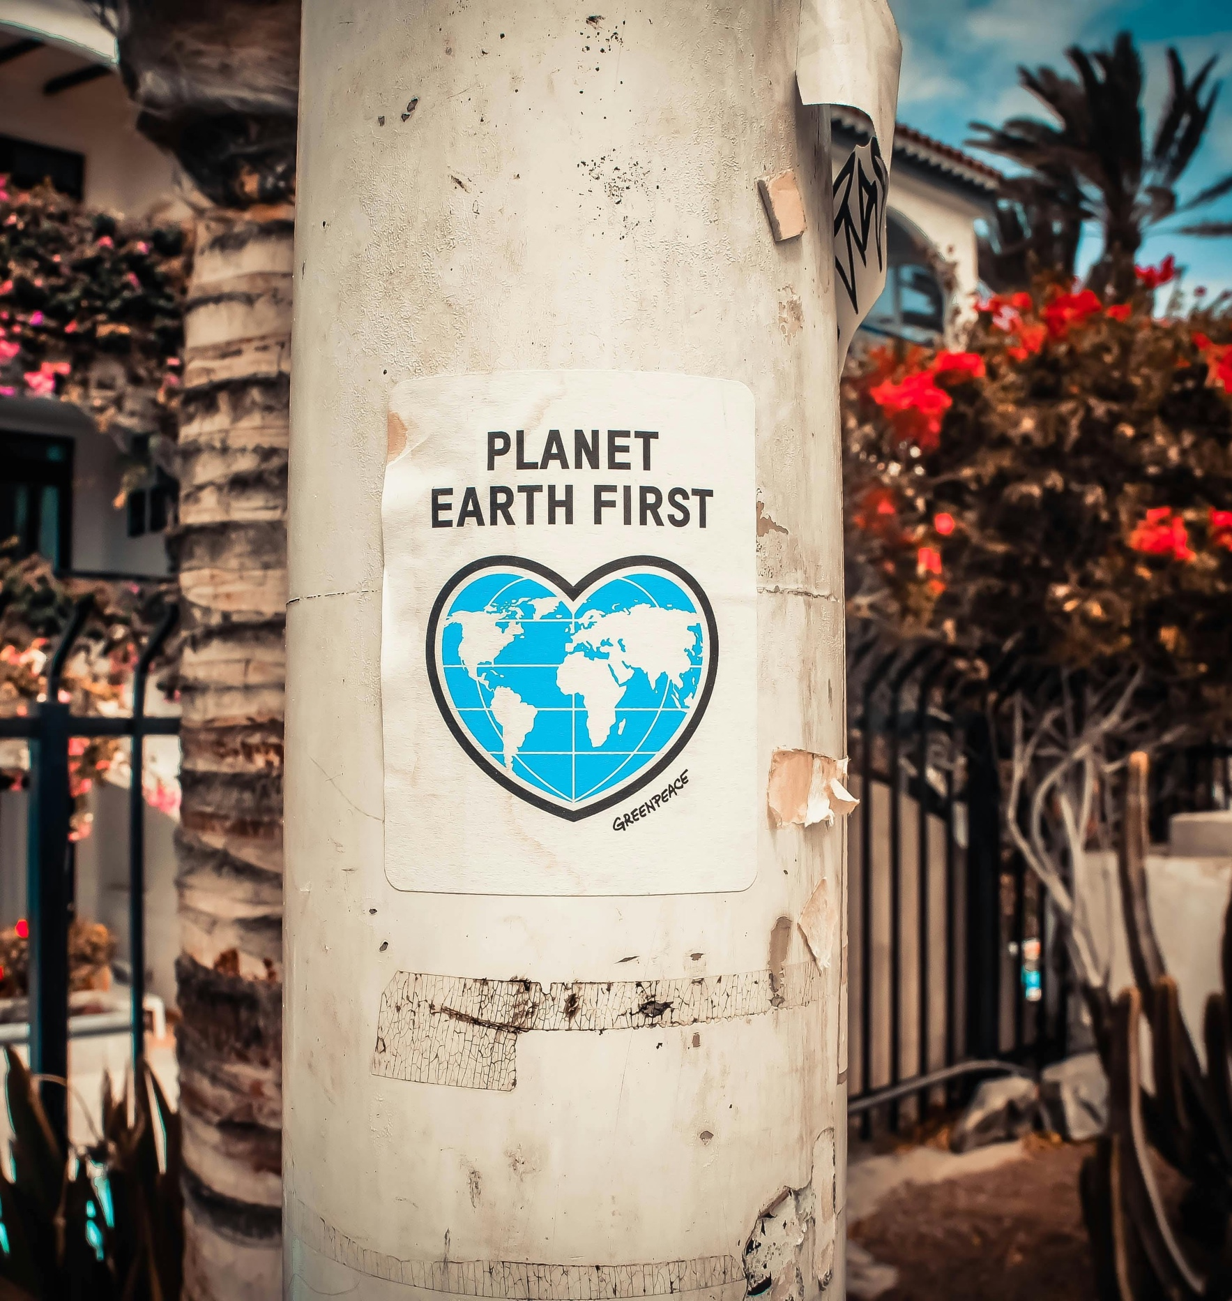
Key Takeaway
Climate justice is not a distant concept — it is a question of who survives, who adapts, and who is left behind. The science is clear: the most vulnerable communities did the least to cause this crisis. Understanding that gap between responsibility and impact is the first step toward demanding better. Justice is not only about the environment. It is about people. And it starts with paying attention.
Reflect and act
Identify one group in your own community most exposed to climate impacts. What is one action you could take, or support, to make a fairer outcome more likely?

