Slide 1
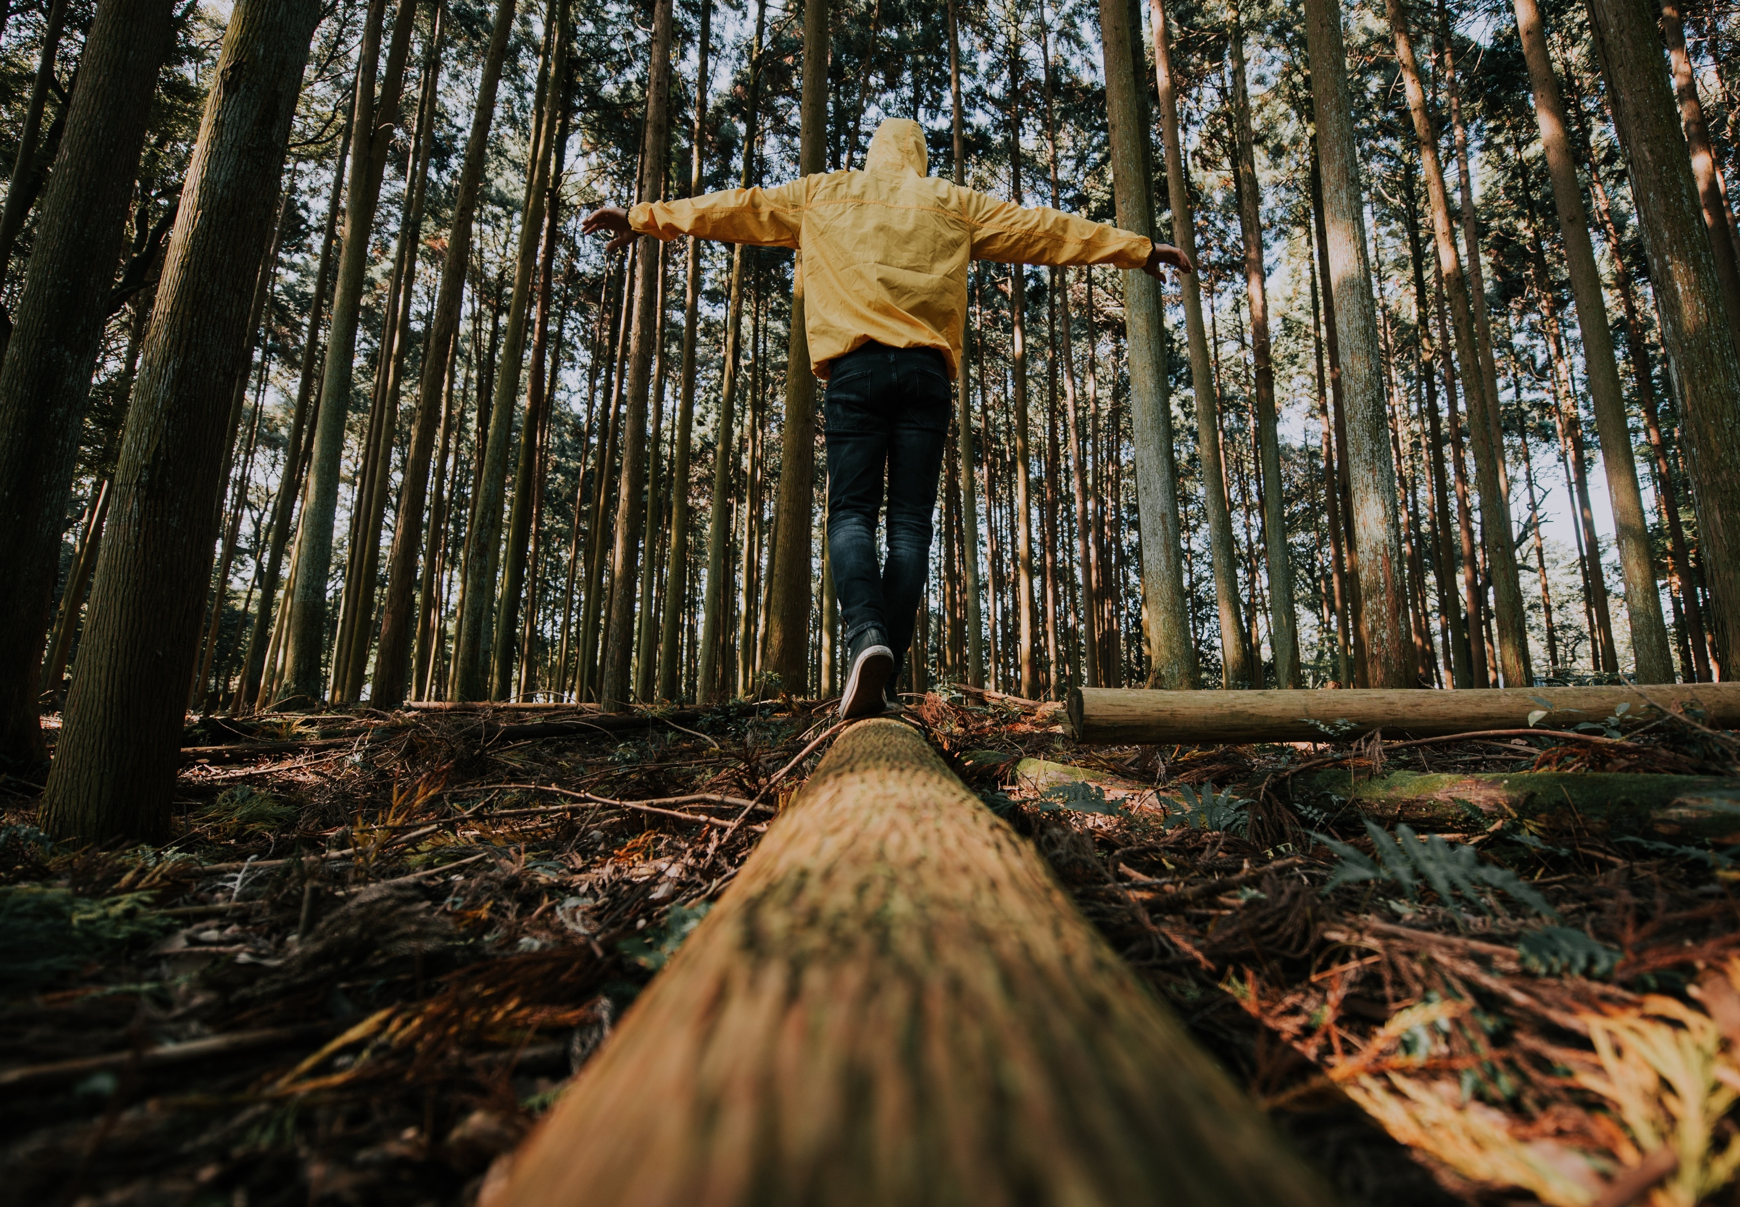

BUILDING
RESILIENCE
www.planetpulse.eu

Slide 2
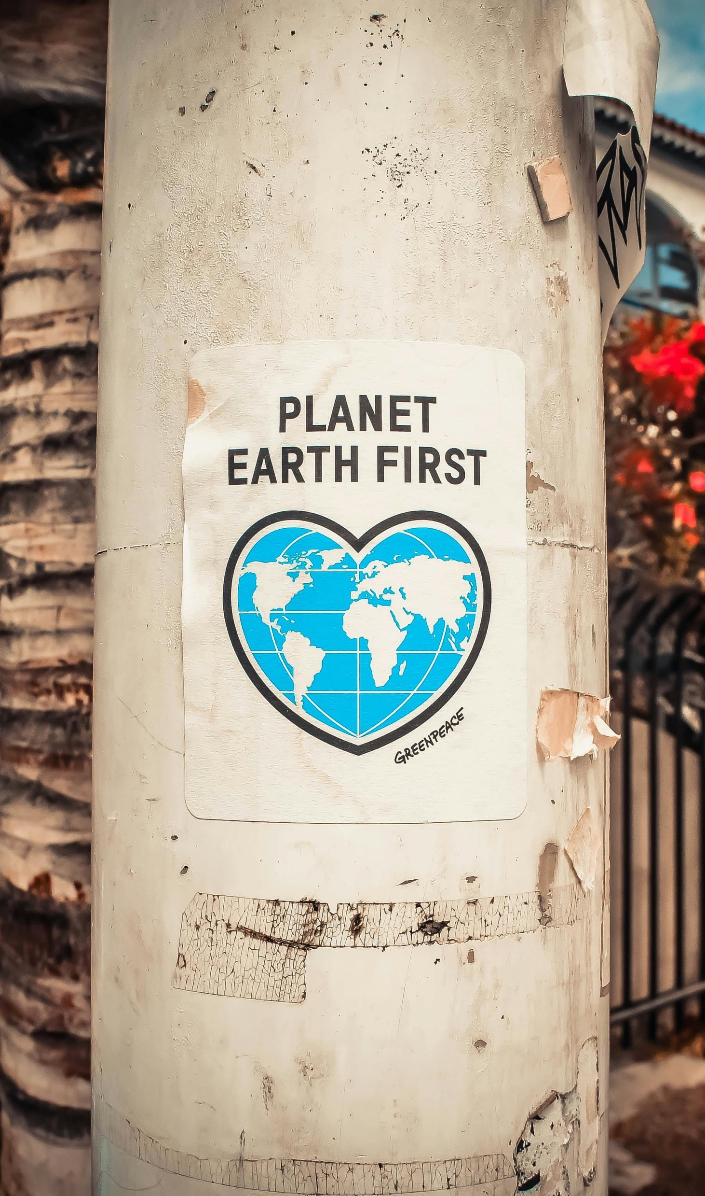
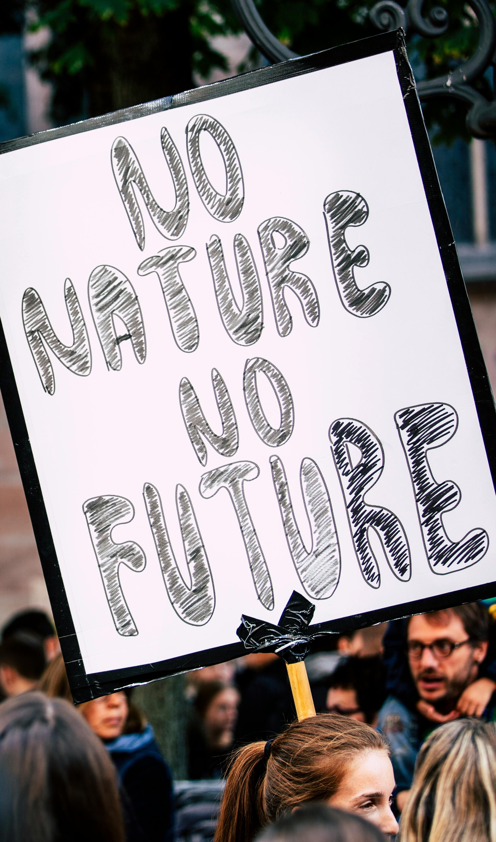
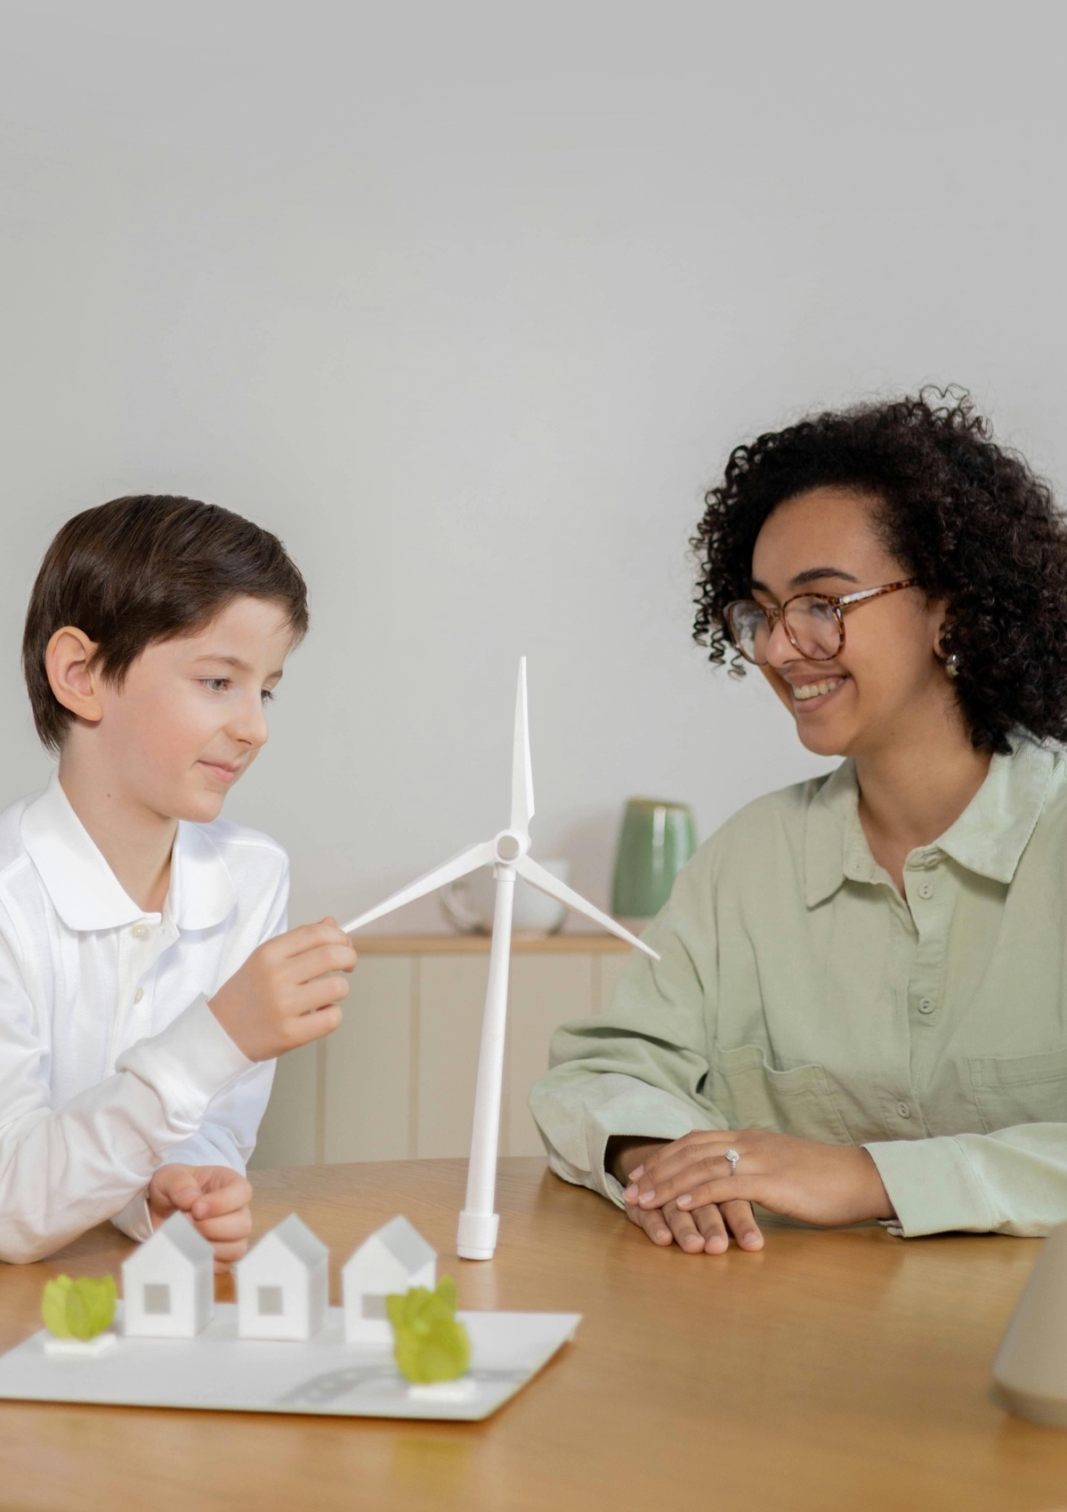
02
Page 6
Part 1:
Journal Prompts
(Self-Reflection)
CONTENTS
01
03
Page 4
Page 7
Introduction
Part 2:
Resilience Building Exercise

Slide 3
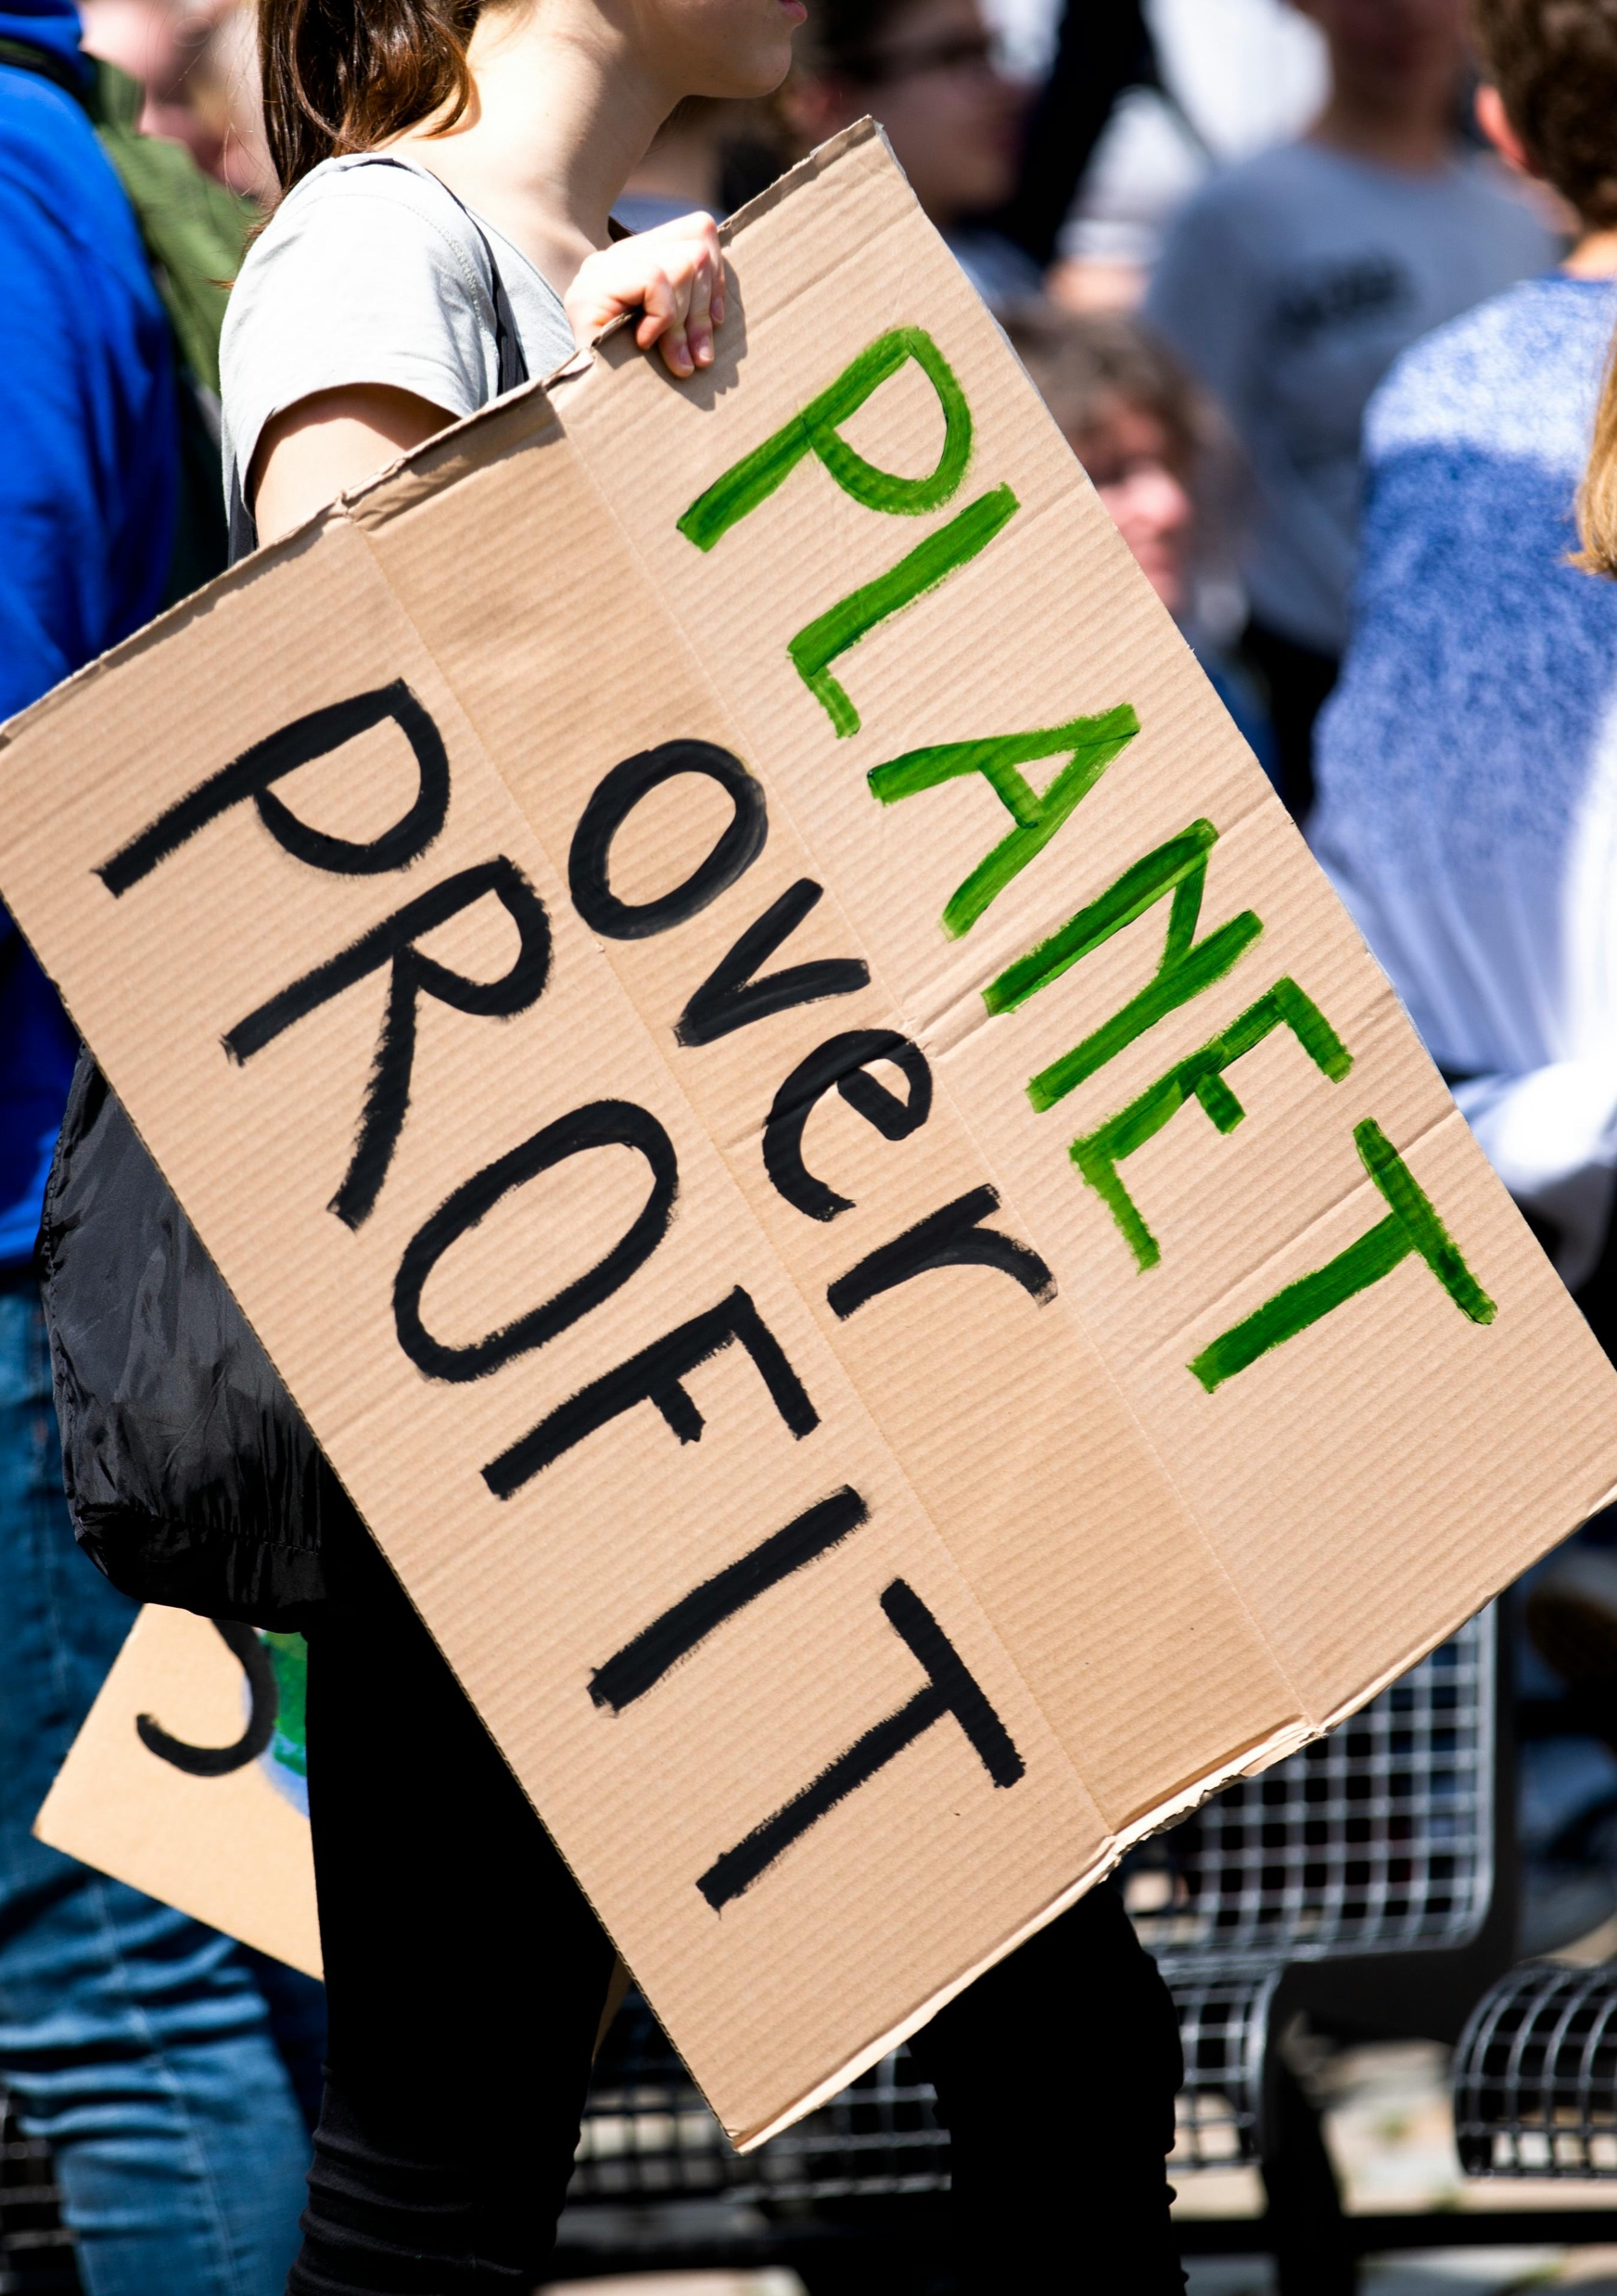
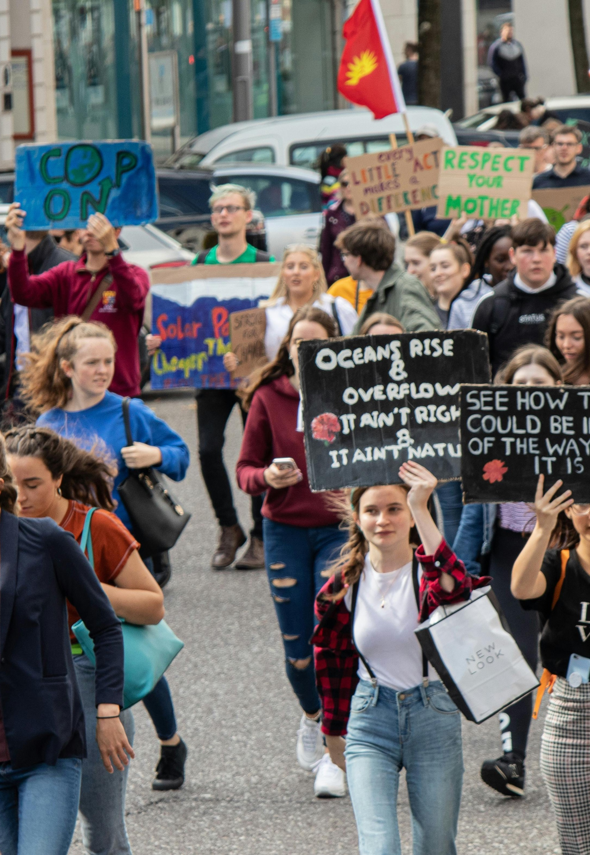

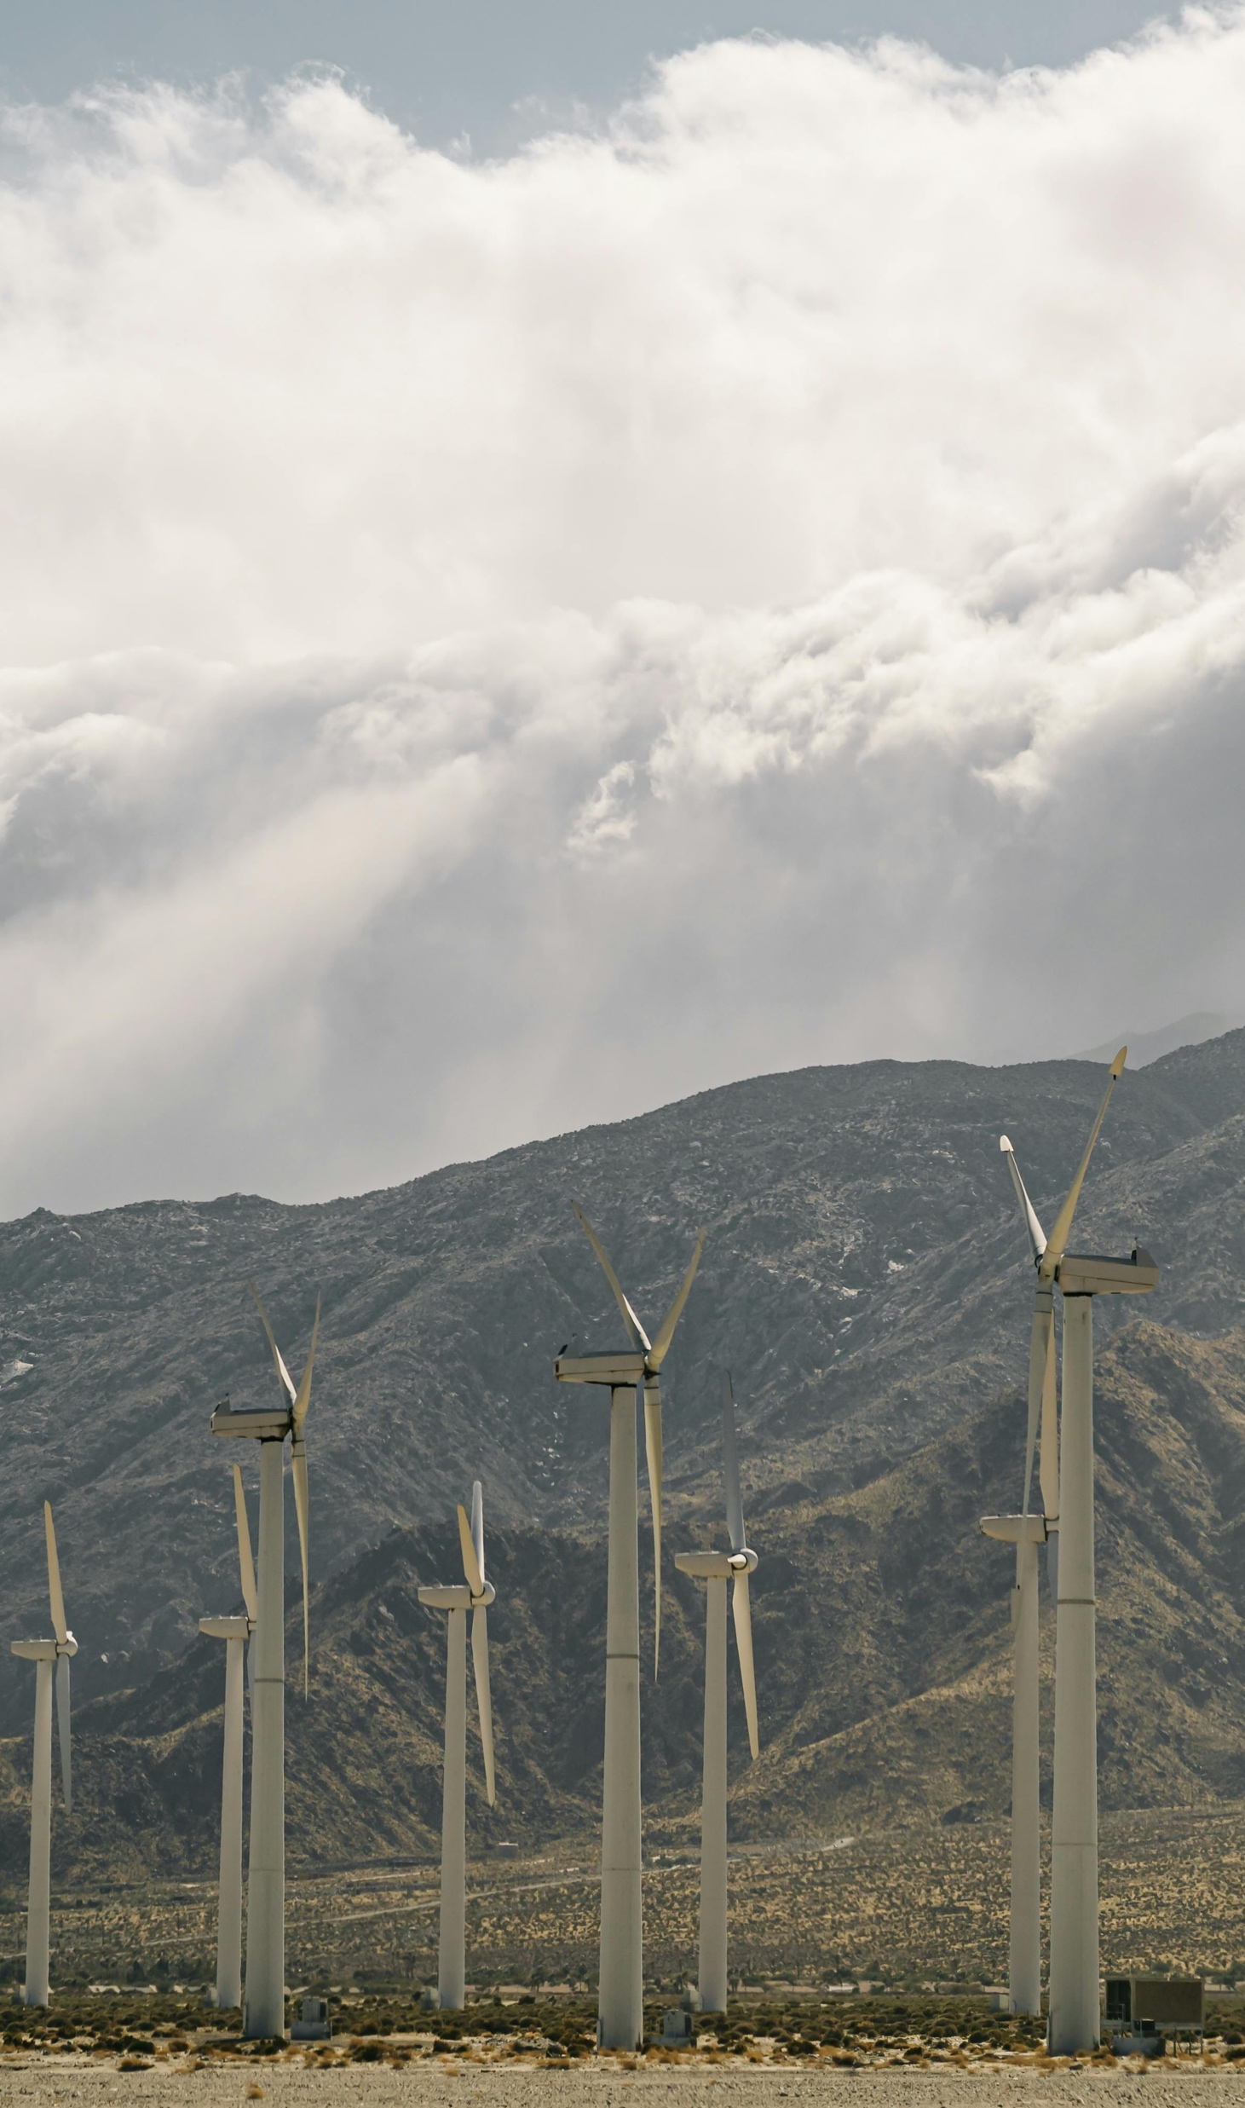
05
07
Page 9
Page 11
Wrap-Up
Facilitator Notes
CONTENTS
04
06
Page 8
Page 10
Part 3:
Building Confidence & Resilience
Resources & Links

Slide 4
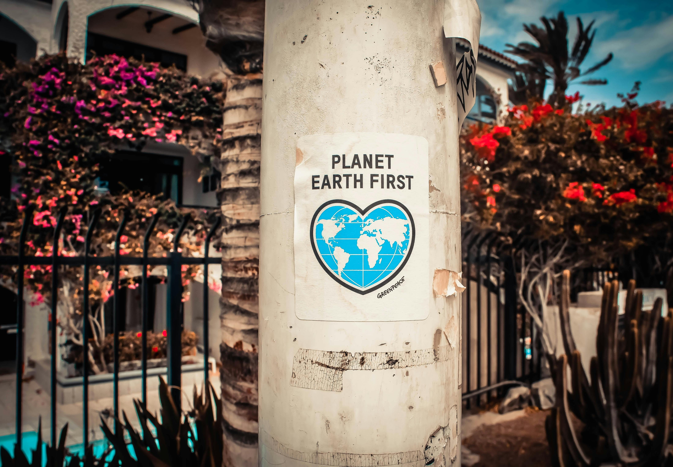

01
INTRODUCTION

Slide 5
Introduction
Resilience is the skill of bouncing back from difficulties, learning from setbacks, and staying hopeful in the face of climate uncertainty. Young people often feel eco-anxiety and frustration about slow progress. This discussion guide offers space for reflection and practical tools to turn that energy into strength.
Learning Goals
Recognise resilience in daily life and climate action.
Practice simple strategies to cope with stress and setbacks.
Build confidence by identifying personal strengths.
Set one achievable action to strengthen resilience in the next month.

Slide 6
Time: 15 minutes
Instructions for Youth: Write freely – this is about your ideas, not grammar. Be honest; you don’t have to share unless you want to.
Prompts:
When does climate change feel most overwhelming
to you?
Think of a challenge you faced – how did you handle it?
What helps you stay calm or hopeful when things
get tough?
Who supports you when you feel stressed, and how?
Optional “Lite” version: Discuss 1–2 prompts in pairs or groups instead of journaling.
Part 1:
Journal Prompts
(Self-Reflection)

Slide 7
Time: 20 minutes
Choose one activity that suits your group:
Role Play: Act out how to respond when a classmate shares climate misinformation online.
Problem-Solving: Pick one local challenge (waste at school, transport, energy use) and brainstorm 2–3 practical solutions.
Creative Expression: Draw or tell a story showing yourself overcoming a climate-related challenge.
Reflection Questions:
What worked well?
How did it feel to try new strategies?
How could these strategies help you in real life?
Part 2:
Resilience Building Exercise

Slide 8
Time: 20 minutes
Icebreaker: Share one climate-friendly action you’ve tried.
Strengths & Achievements: Celebrate one personal win
(big or small).
Identify Obstacles: What holds you back? Fear of failure, online negativity, lack of time?
Create Affirmations: Start with “My actions make a difference.”
Visualisation: Close your eyes – picture yourself leading a climate project that inspires others.
Role Model Story: Share the story of a young climate activist who overcame setbacks. (Examples: Greta Thunberg’s first solo school strike, Leah Namugerwa’s youth-led campaigns in Uganda, or perhaps an example from the Planet Pulse Climate Stories (Link here when published).
Set a Small Goal: Write down one achievable action for the next month.
Closing Circle: Invite each person to share one takeaway.
Part 3:
Building Confidence & Resilience

Slide 9

Ask: What one strategy from today will you take with you?
Emphasise: resilience is like a muscle – the more you use it, the stronger
it gets.
Encourage: revisit today’s goals in one month to check progress.
Wrap-Up

Slide 10
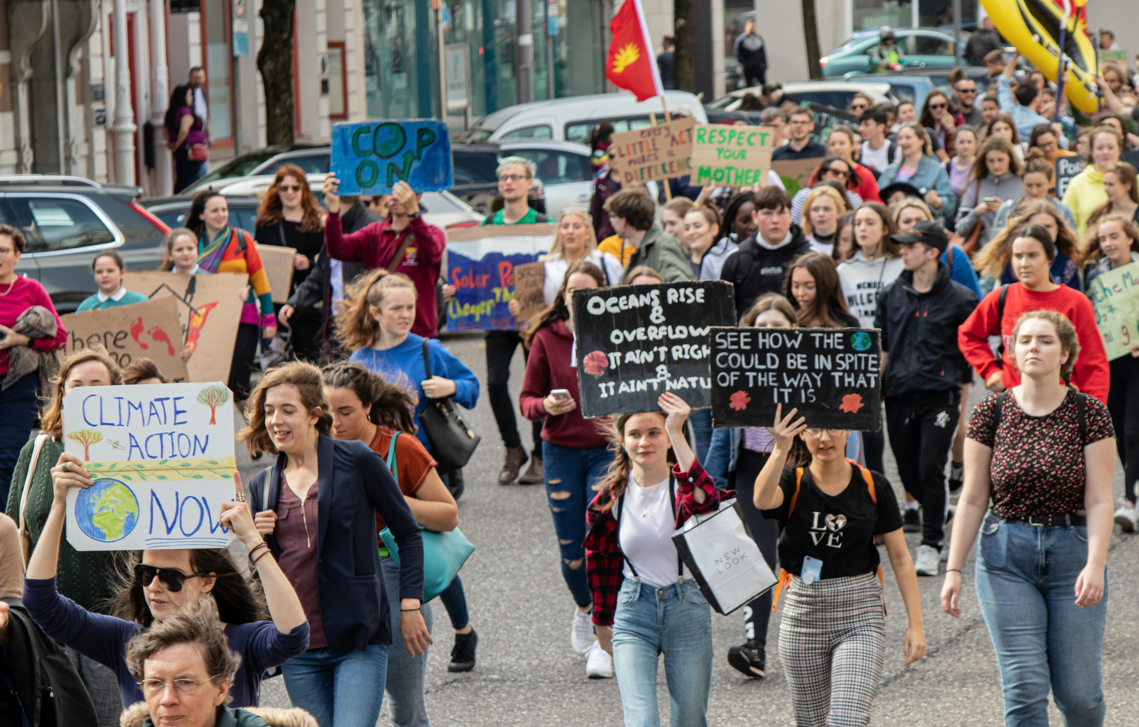
Resources & Links
Planet Pulse Online Course: Planet Pulse Resilience Module (to link once published).
The Resilience Project – Developing Resilience: theresilienceproject.nl
How to build resilience as your superpower | Denise Mai (TED Talk)
UNICEF Voices of Youth
Climate Mental Health Network:
Building emotional resilience in a climate of change
Mindfulness for Teens (guided practices for stress)

Slide 11
Reflect and act
Think of one recent moment when climate news felt overwhelming. Which coping strategy from this resource would you try next time, and who could you reach out to?
www.planetpulse.eu

Slide 12
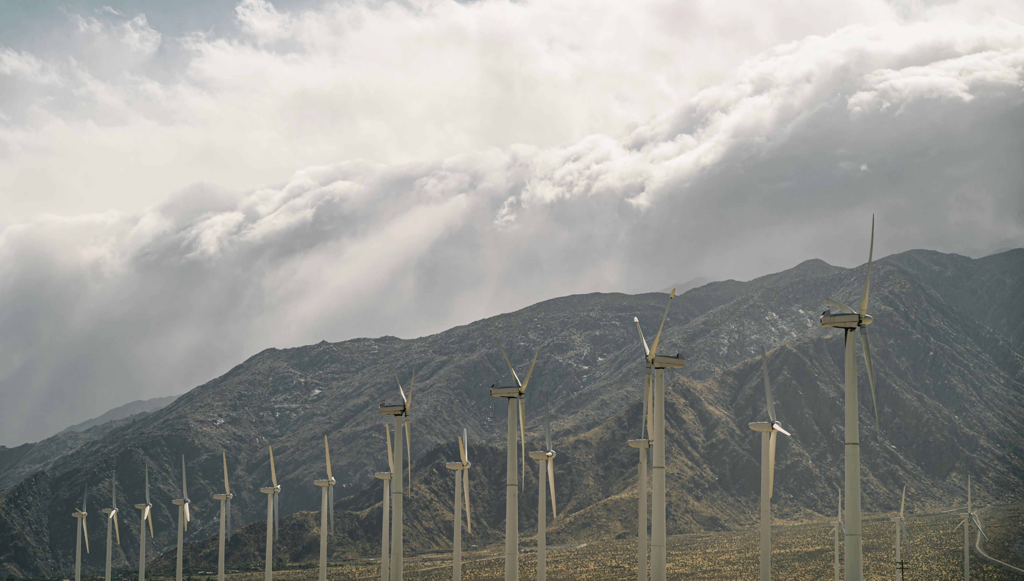
Choose activities based on group energy and available time.
Offer both “lite” (short) and “deep dive” versions
to suit different contexts.
Respect that some participants may prefer not
to share aloud.
Connect back to other Planet Pulse themes:
Hope, Empowerment, Collective Action
(links when published).
Facilitator Notes

