Slide 1
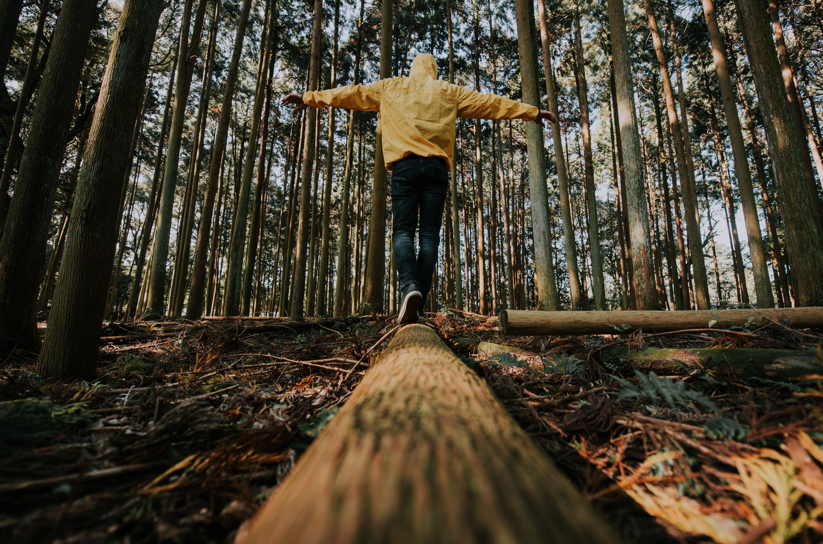

MODULE 4
Community
www.planet-pulse.eu

Slide 2
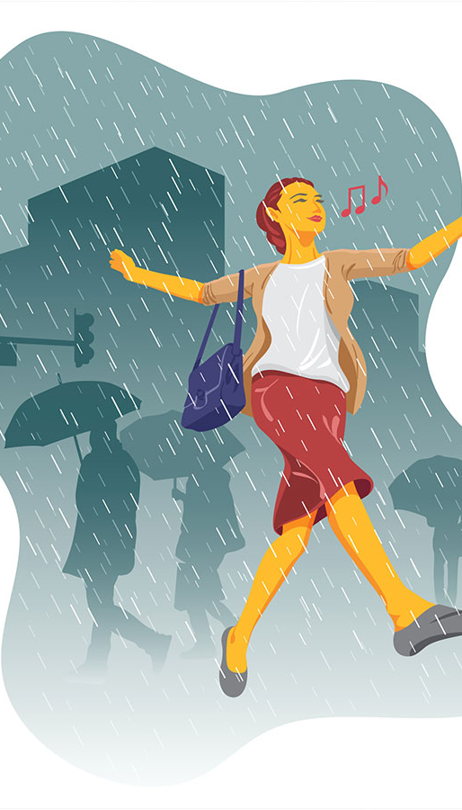
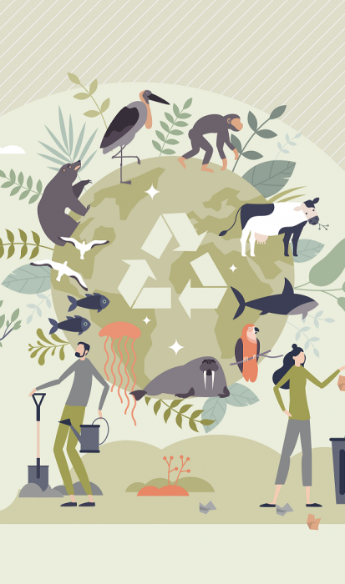
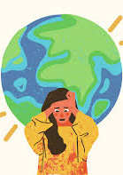
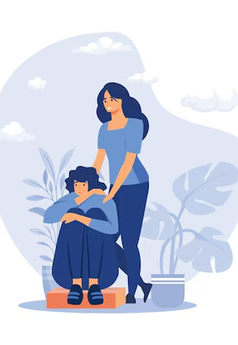
02
04
Page 13
Page 22
From fear to action: Turning Climate Anxiety into Change
The Emotional Compass: Navigating Climate Anxiety Collectively
CONTENTS
01
03
Page 6
Page 19
The Power of We: Strengthening Emotional Resilience
Cultivating Climate-Ready Communities

Slide 3
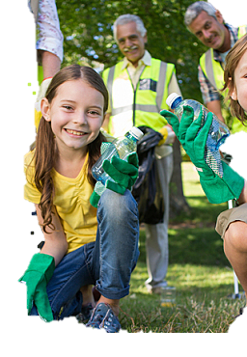
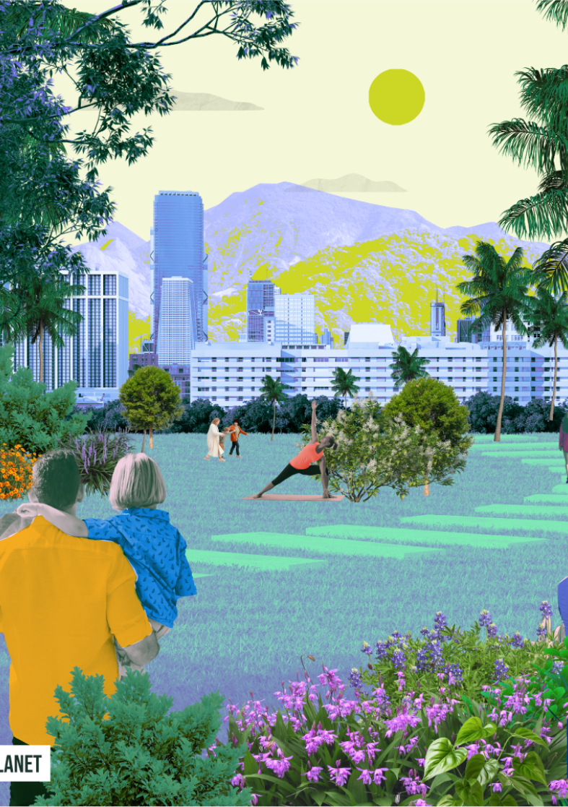
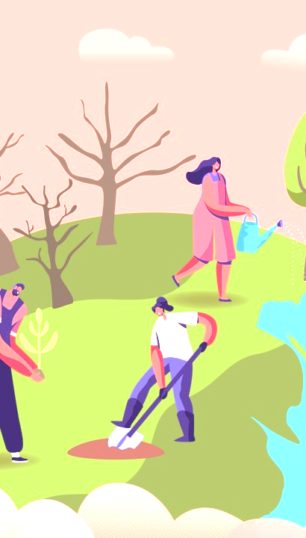
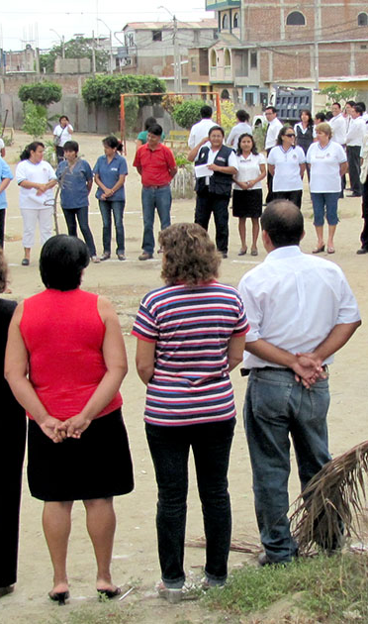
05
07
Page 25
Page 31
The Resilience Blueprint:
How Communities Adapt & Thrive
A Pulse for Every Community
CONTENTS
06
08
Page 28
Page 37
Re-Planet-ing Our Communities
Planet Pulse, Community Pulse

Slide 4
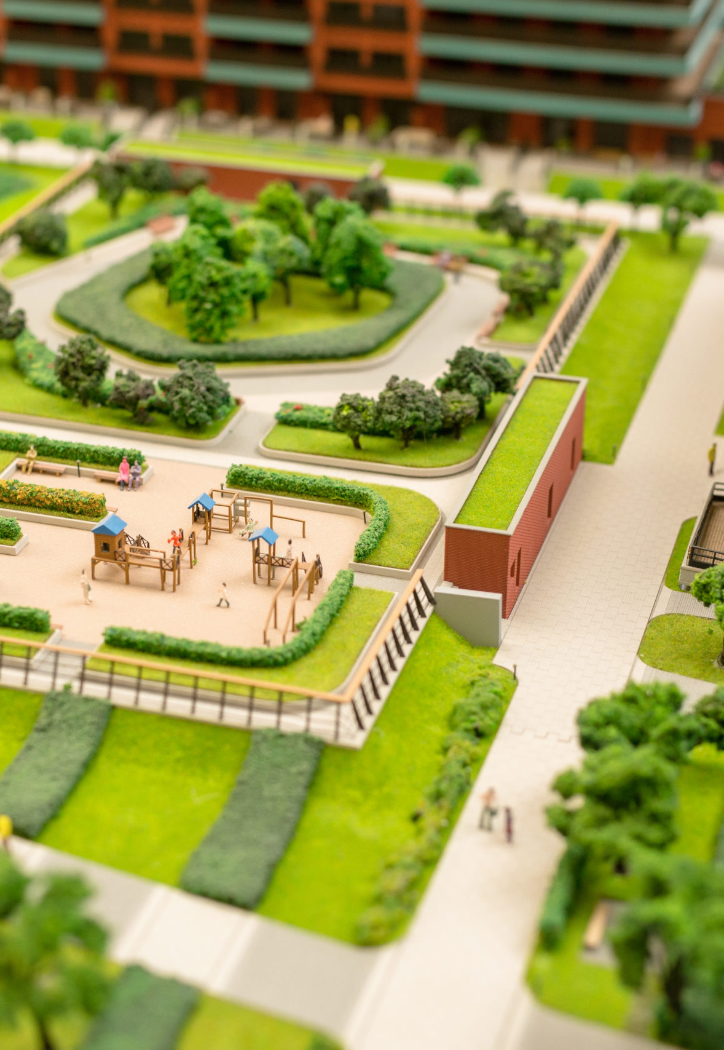
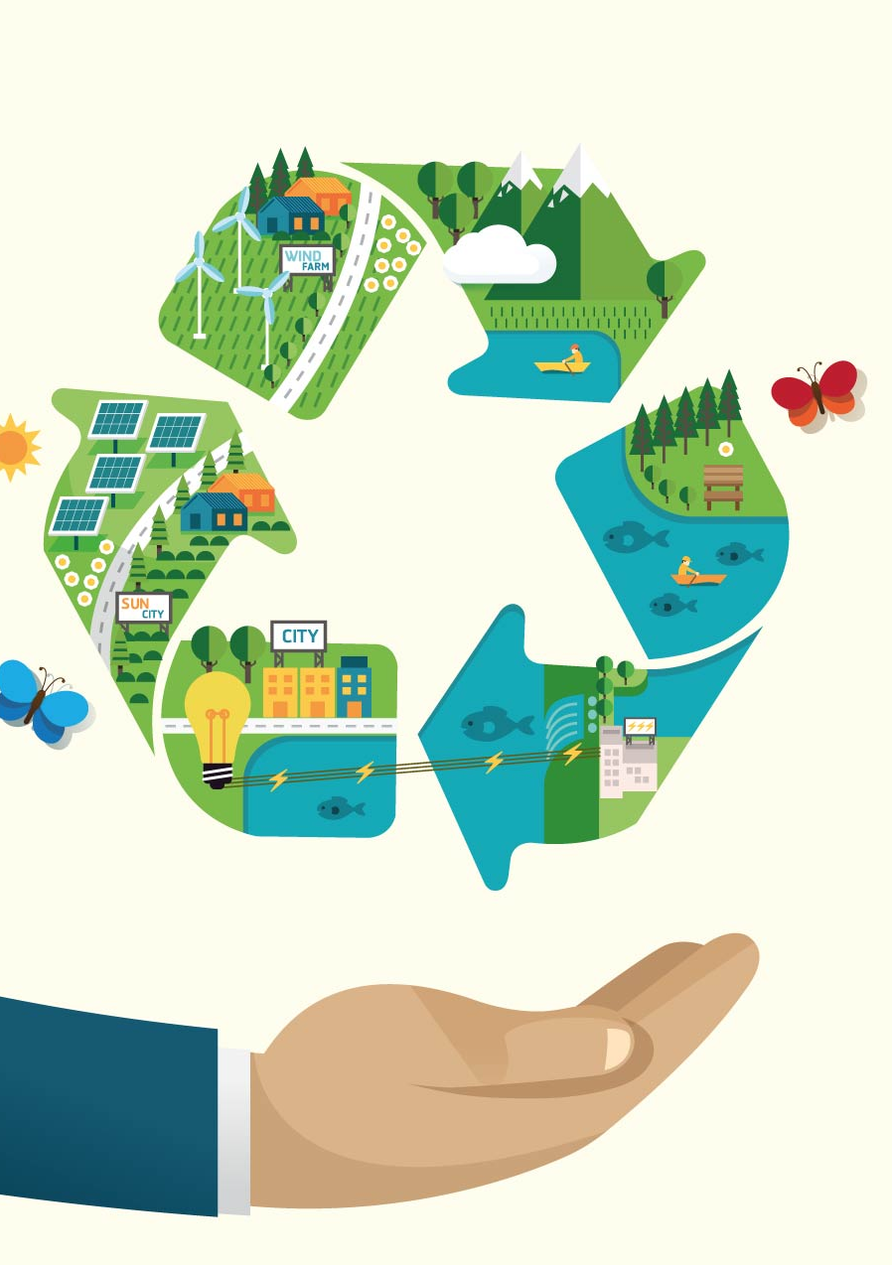
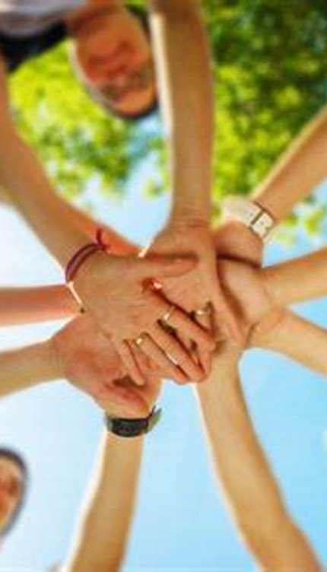
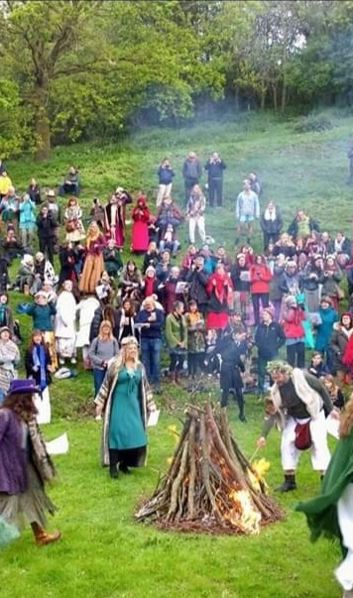
09
11
Page 40
Page 44
Communities &
Organizations
Successfully
Implementing
Sustainable Actions
Local sustainability festivals in Ireland that teach and showcase sustainable living practices
CONTENTS
10
12
Page 42
Page 46
Measures taken by European Union communities to reduce their ecological footprint through sustainable practices
Green Infrastructure projects in the European Union.

Slide 5

A community is defined as a social unit (a group of people) with shared characteristics such as place, culture, norms, or values.
In the context of CLIMATE CHANGE;
"Community" usually refers to a group of people who are connected by shared geography, identity, interests, or vulnerabilities.
Community is a sense of belonging
It encompasses both a feeling, and a set of
relationships among individuals, characterized
by trust, belonging, and mutual support.
A group of people who are collectively affected by, and capable of responding to, climate-related risks.
Defining Community

Slide 6
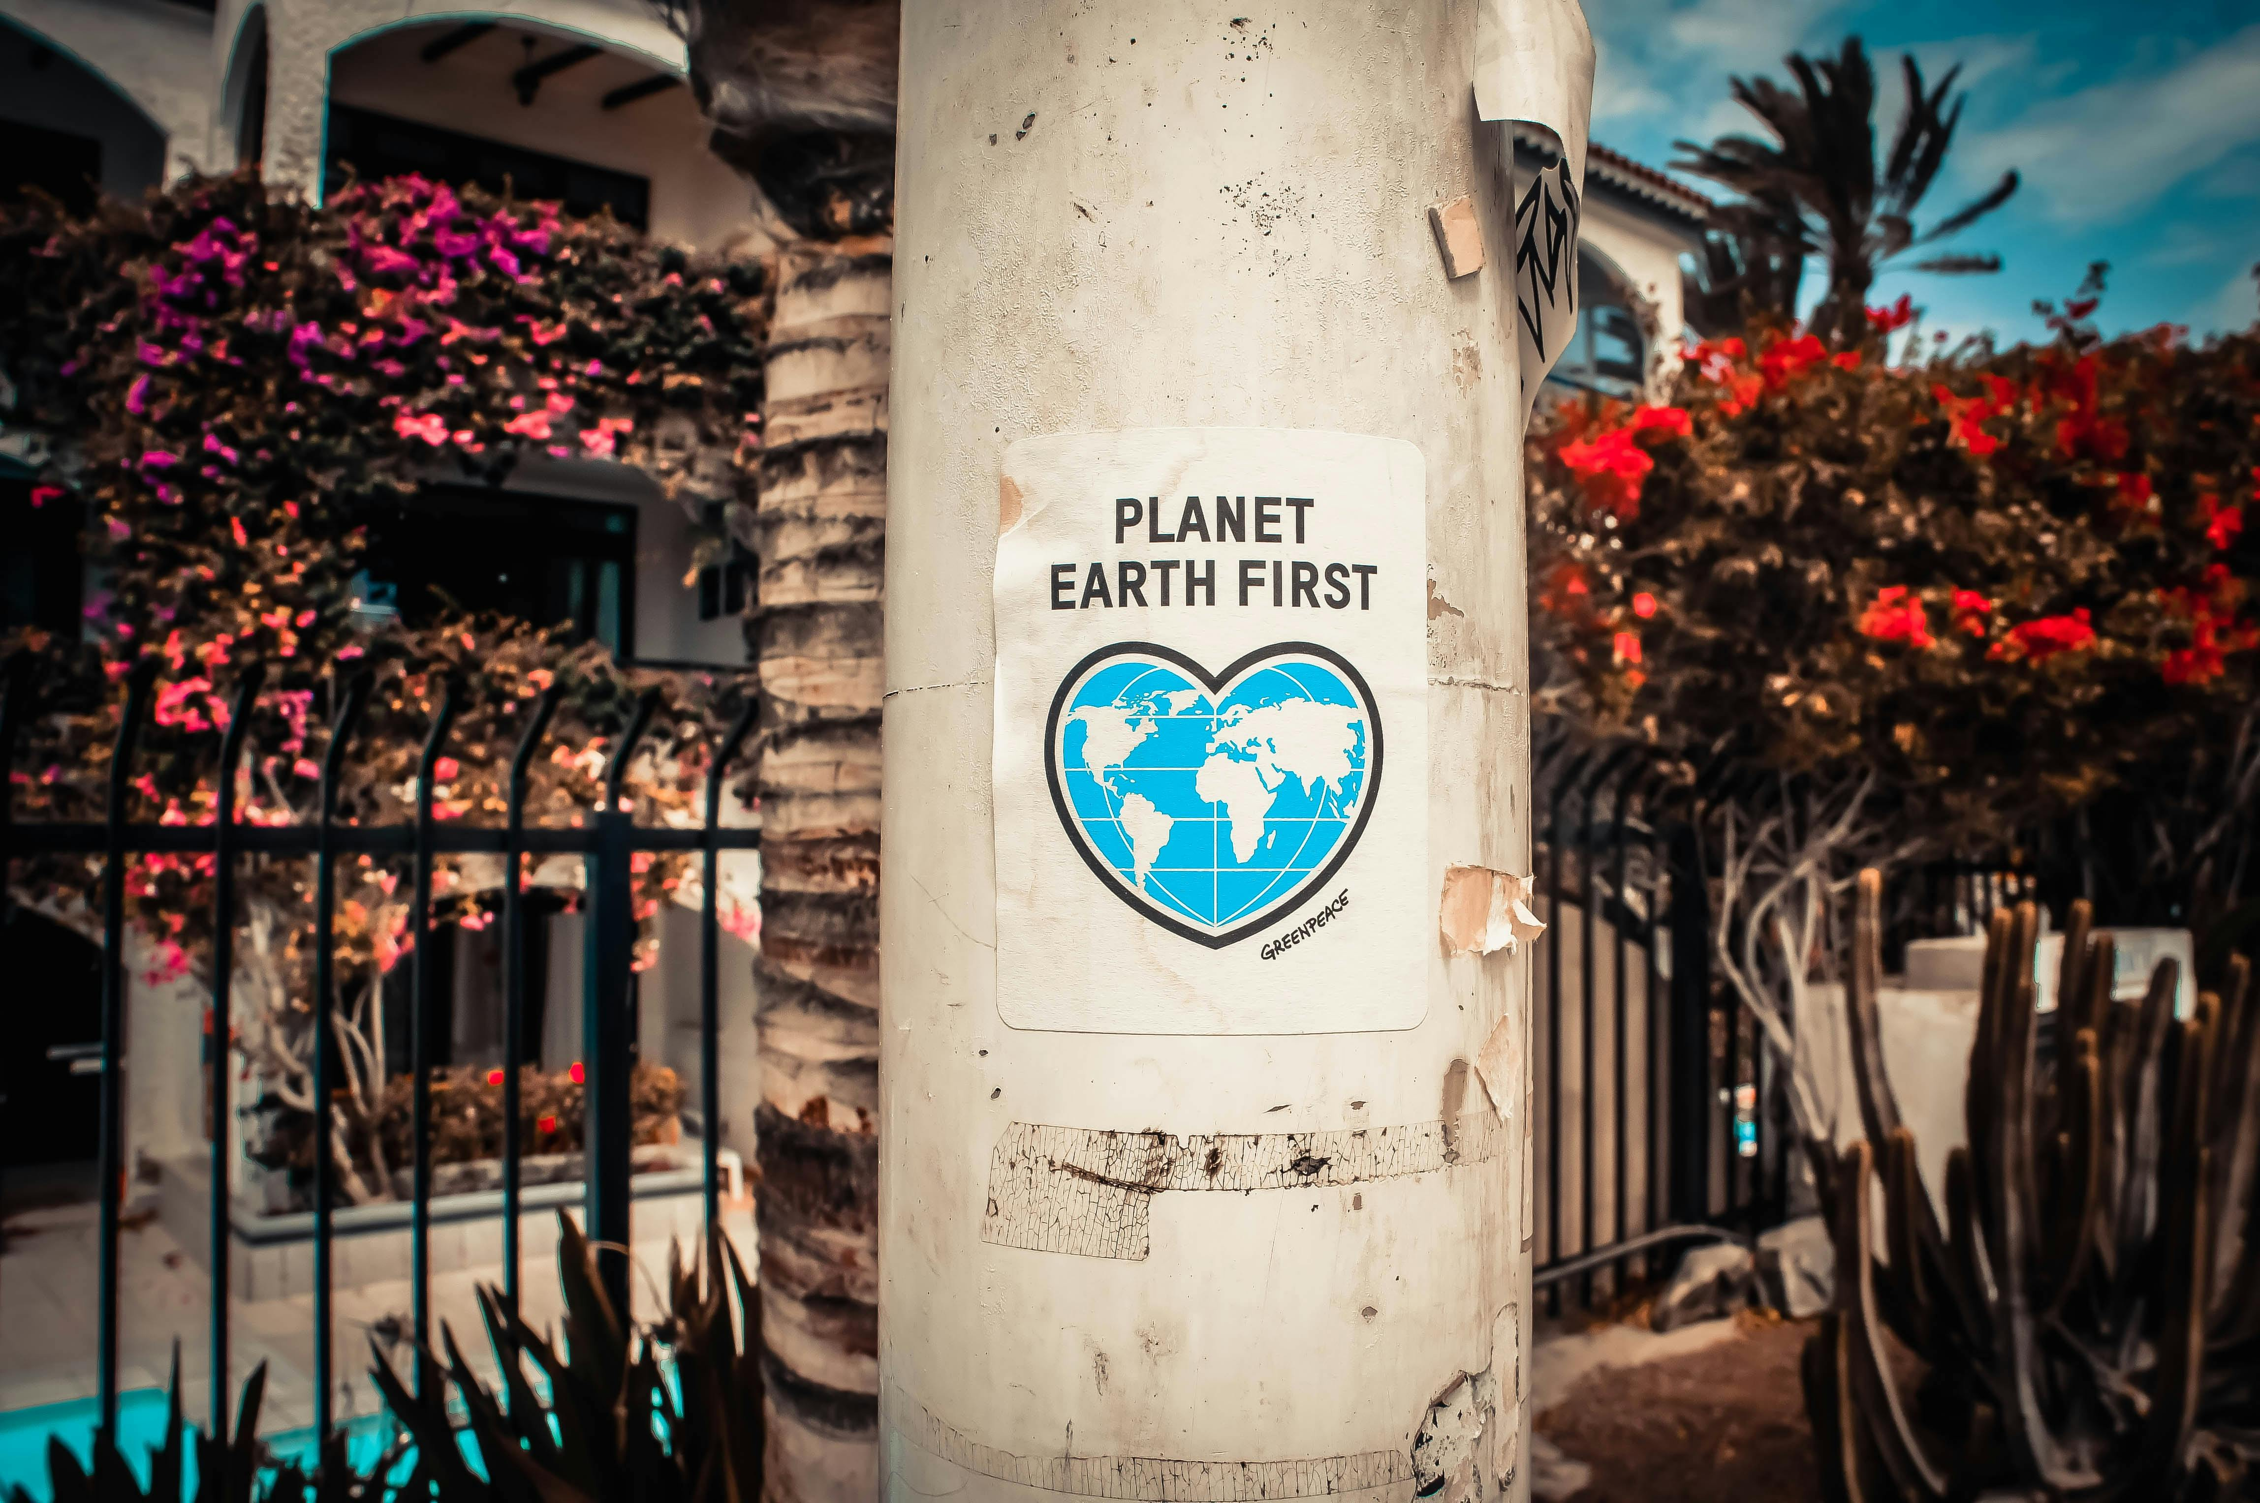
01
The Power of We:
Strengthening Emotional Resilience

Slide 7
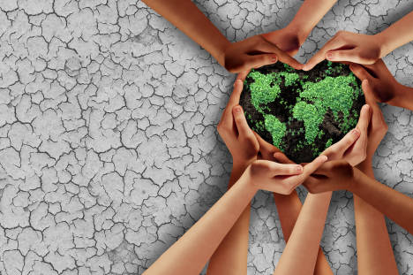

Collective emotional strength vs. individual isolation
What makes a community?
Understanding the emotional impact of climate change on communities:
The
Power of 'We'
is what makes a community
Empowering individuals by fostering group solidarity.

Slide 8
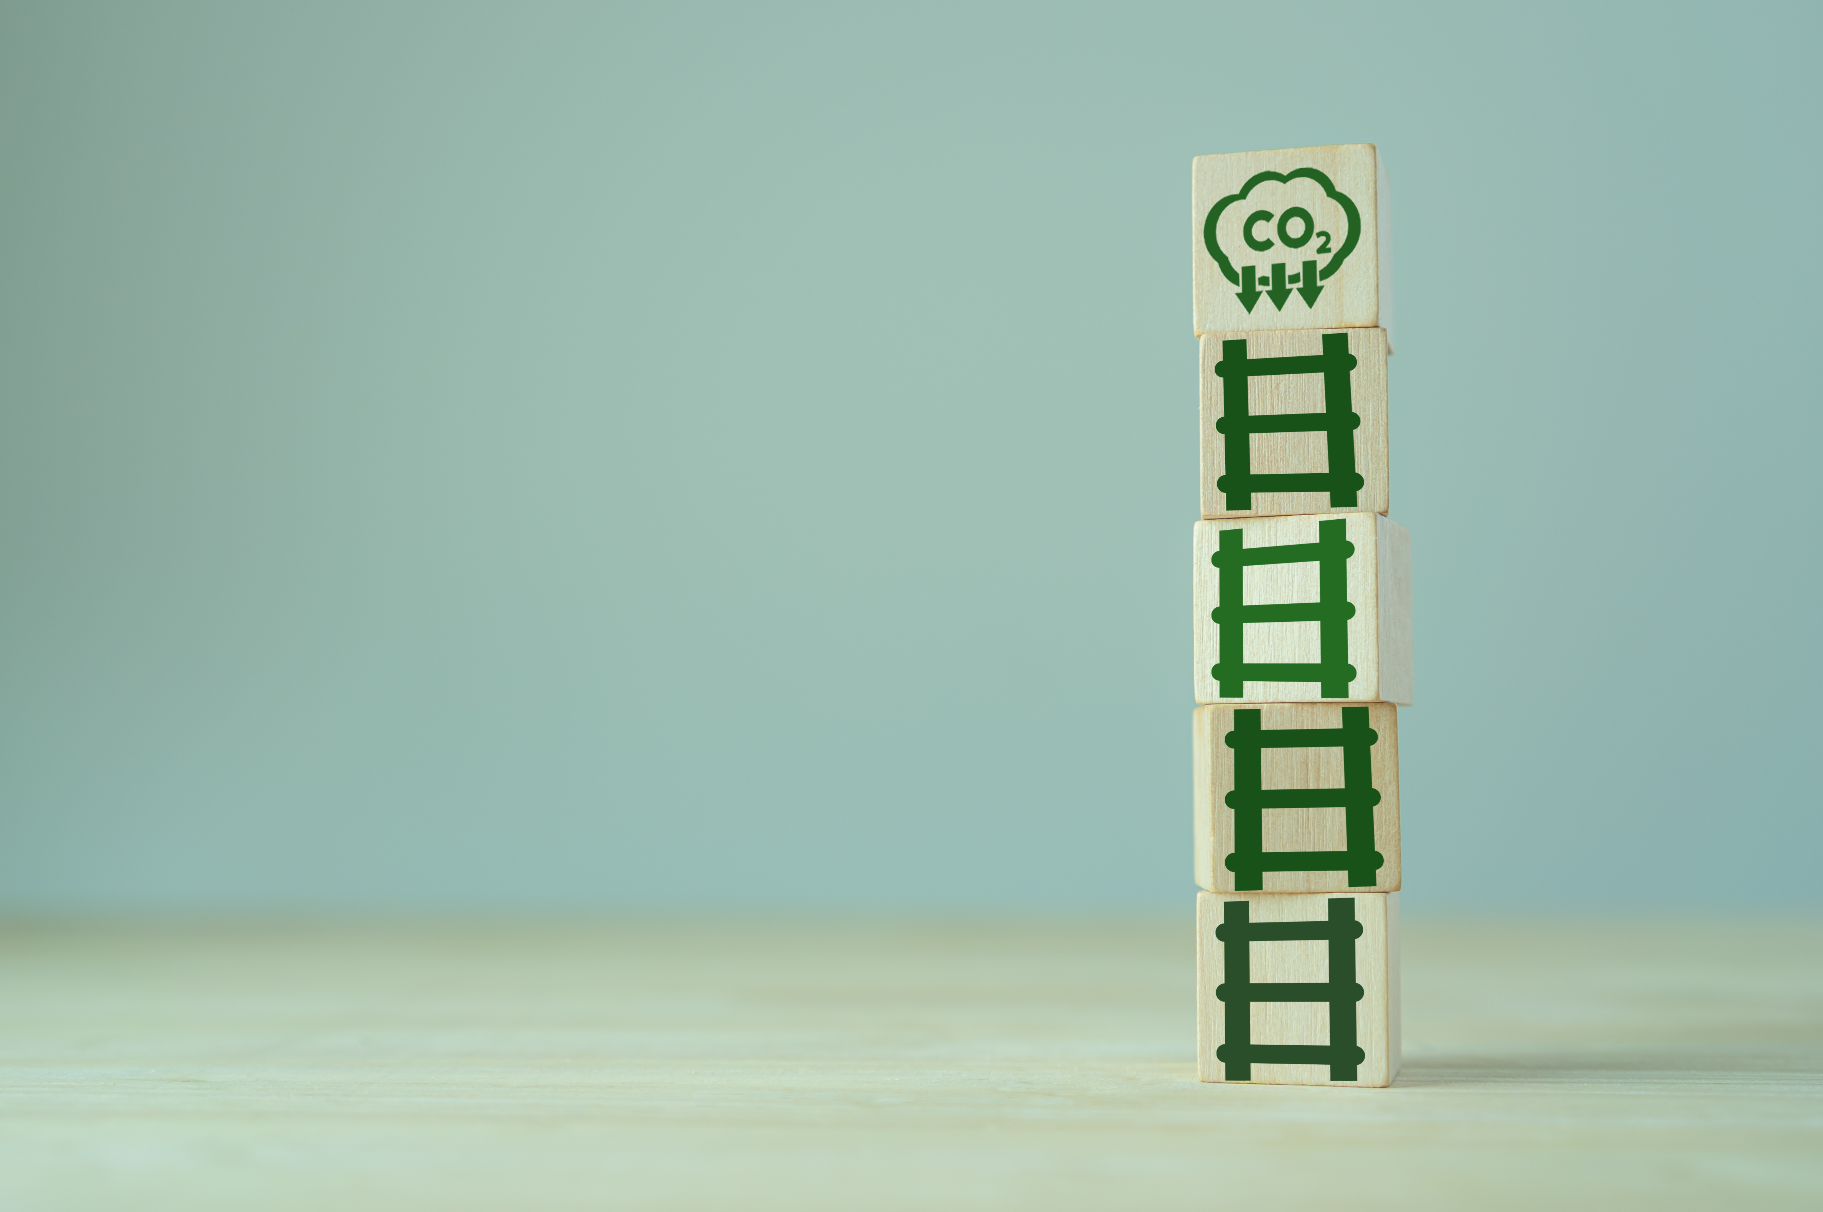
Collective Emotional Strength
vs.
Individual Isolation
Keys concepts about
‘Strengthening Emotional
Resilience’
Understanding the Emotional Impact of Climate Change on Communities
Empowering Individuals by Fostering Group Solidarity

Slide 9
While personal resilience is valuable, emotional endurance in the face of climate change often grows stronger when nurtured collectively rather than in isolation.
In shared spaces, whether in
local neighbourhood meetings
activist groups
cultural gatherings
People can voice fears, grief, and frustration without judgment.
This shared vulnerability fosters trust and connection, transforming anxiety into mutual support.
When individuals see their struggles reflected in others’ experiences, it reduces feelings of alienation and strengthens the belief that challenges can be faced together.
Over time, these supportive networks become emotional safety nets, offering both practical help and a shared sense of purpose that no single individual could generate alone.
1
Collective Emotional Strength
vs.
Individual Isolation

Slide 10

2
Understanding
the Emotional Impact of Climate Change on Communities:
The emotional footprint of climate change extends far beyond the immediate aftermath of extreme weather events.
While a flood or wildfire can cause acute trauma, the slower-moving consequences, for example;
Shifting seasons
Disappearing species
Or, the creeping threat of sea-level rise
Can create a chronic undercurrent of anxiety.
This ongoing uncertainty can weigh heavily on entire communities, particularly those whose livelihoods or cultural traditions are deeply tied to the environment.
For Indigenous peoples, small island nations, or rural agricultural communities, climate change is not an abstract threat but an unfolding reality.
Recognizing this collective emotional burden is essential for developing mental health resources and climate communication strategies that are culturally sensitive, trauma-informed, and long-term in scope.

Slide 11
When people unite under a shared goal, a transformation often occurs:
Fear becomes Fuel
Despair becomes Determination.
Solidarity doesn’t just provide comfort, it creates momentum.
In climate action, this means individuals who might feel powerless on their own can become energized contributors when part of a group.
Participating in community gardening projects, renewable energy cooperatives, or local policy advocacy campaigns offers more than tangible results; it nurtures a sense of agency and hope.
This hope is contagious, inspiring further engagement and reinforcing the idea that collective action can bend the trajectory of climate outcomes. The emotional shift from isolation to empowerment can be just as critical as the physical measures taken to adapt or mitigate.
3
Empowering Individuals by Fostering Group Solidarity!

Slide 12


Heading
Actionable Ideas for:
Community workshops focused on emotional resilience practices, such as mindfulness, group therapy, or storytelling.
Peer support networks for sharing coping strategies.
‘Strengthening Emotional
Resilience’
Click to type..
Community support events where people can share their climate-related fears and support each other.

Slide 13
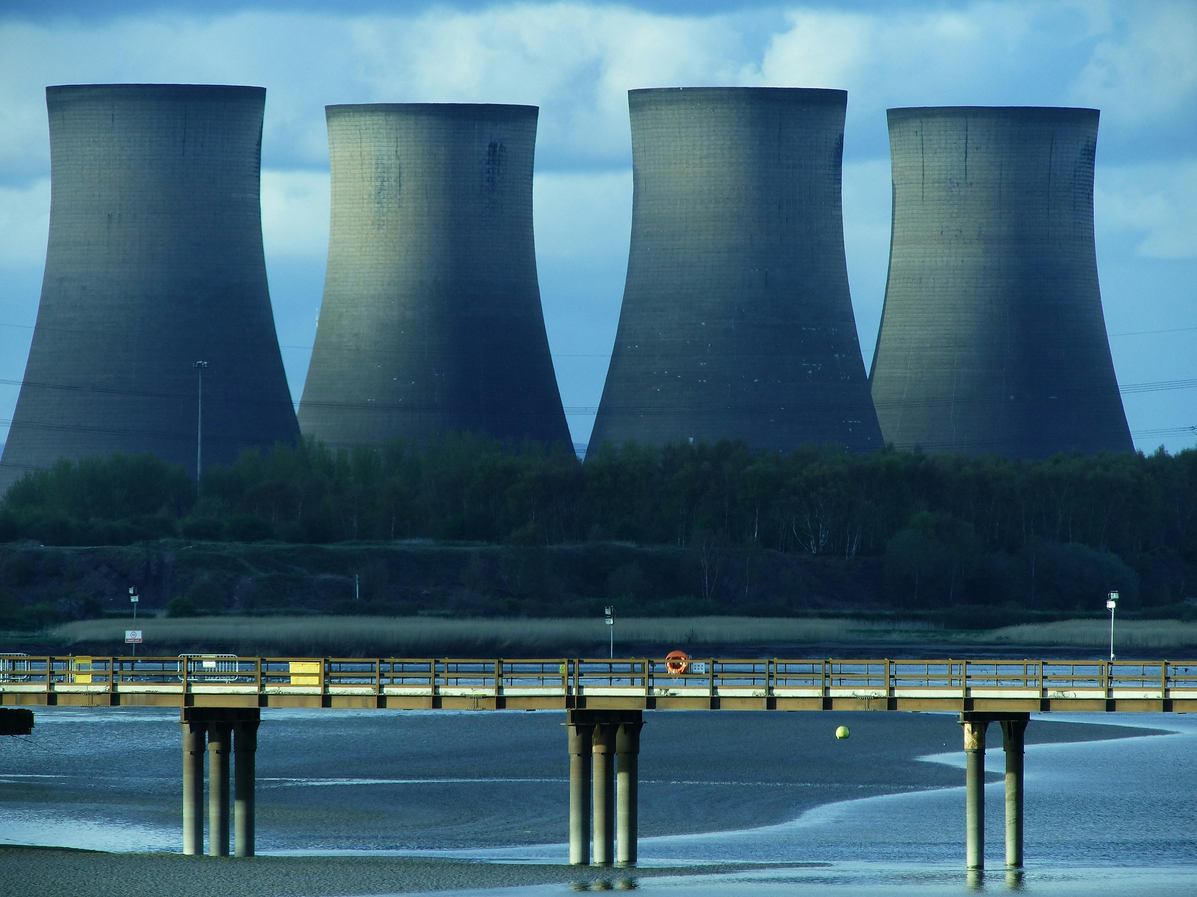
02
Turning Climate Anxiety into Change

Slide 14

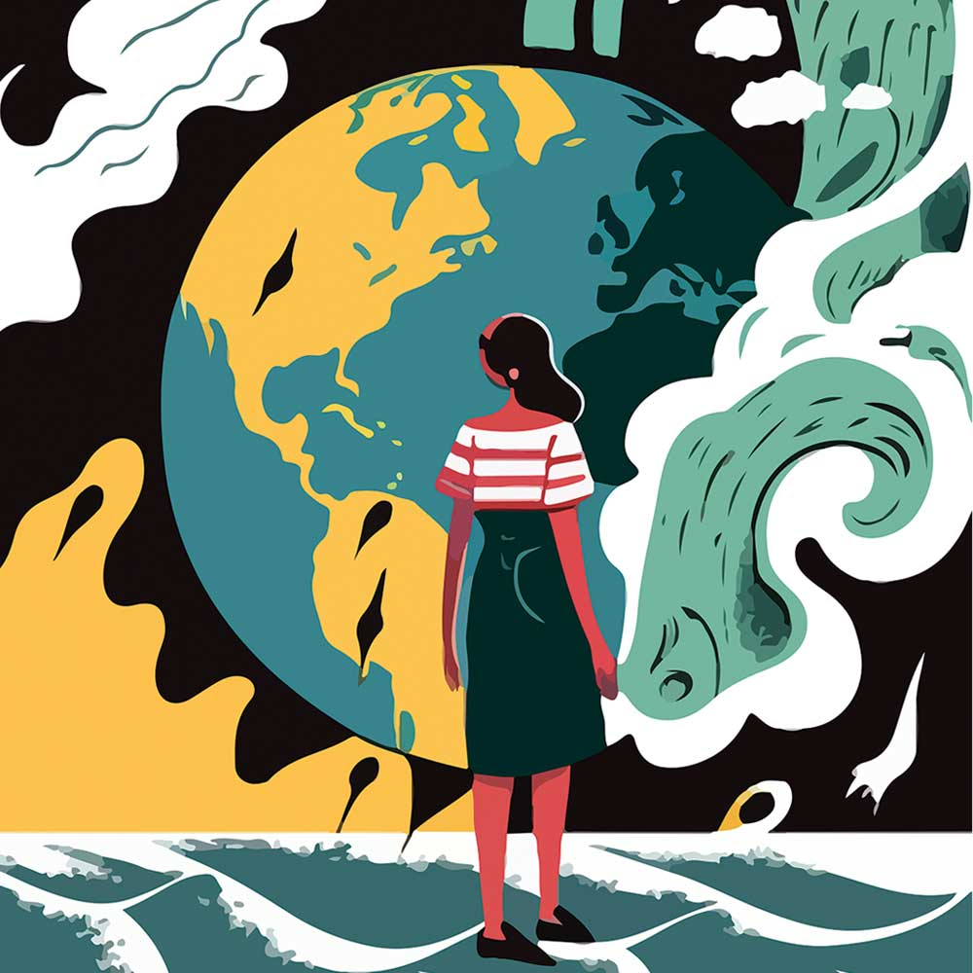
KEYS CONCEPTS ABOUT:
‘Turning Climate Anxiety into Change’
The link between
Climate Anxiety
and Inaction
Strategies for transforming fear and helplessness
into positive
community-driven actions
Examples of small, manageable actions
that can have a
significant impact.

Slide 15

The link between Climate Anxiety and Inaction:
Big problems can feel so overwhelming that people freeze.
Climate anxiety can make us tune out, avoid the news, or
think “nothing I do will matter.”
Knowing this is normal is the first step to moving forward!
1
Turning
Climate Anxiety
into
Change

Slide 16
Turning Fear into Community Action:
Fear can push us to act --> if we have clear, doable steps.
Start small, work with others, and celebrate each win.
(Try out some of the action ideas the next time you feel lost or fear.
Just like the Tesco saying goes, 'Every little helps')
Change feels possible when we share the load and see progress.
2
Turning
Climate Anxiety
into
Change

Slide 17
Small Actions, Big Ripple Effects:
Remember: Little steps add up.
You could take the next step by;
Planting a tree with friends
Setting up a repair café
Swapping clothes instead of buying new
Joining a local (or online!) climate group.
Every action helps the planet and reminds you that
you can make a difference.
3
Turning
Climate Anxiety
into
Change

Slide 18
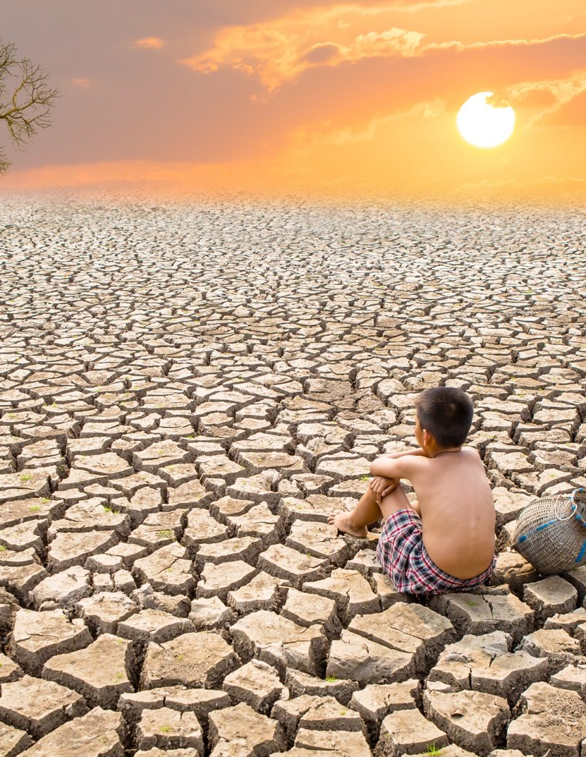

Actionable Ideas for:
Turning Climate Anxiety into Change
Action plans for local communities, like organizing tree planting events,
reducing waste initiatives, or
advocating for local green policies.
CLIMATE ANXIETY
Storytelling sessions where
community members share examples of
how they transformed their anxiety into positive change.
Climate action groups focused on
youth and adults collaborating on
eco-friendly projects.

Slide 19


03​
Cultivating Climate-Ready Communities

Slide 20
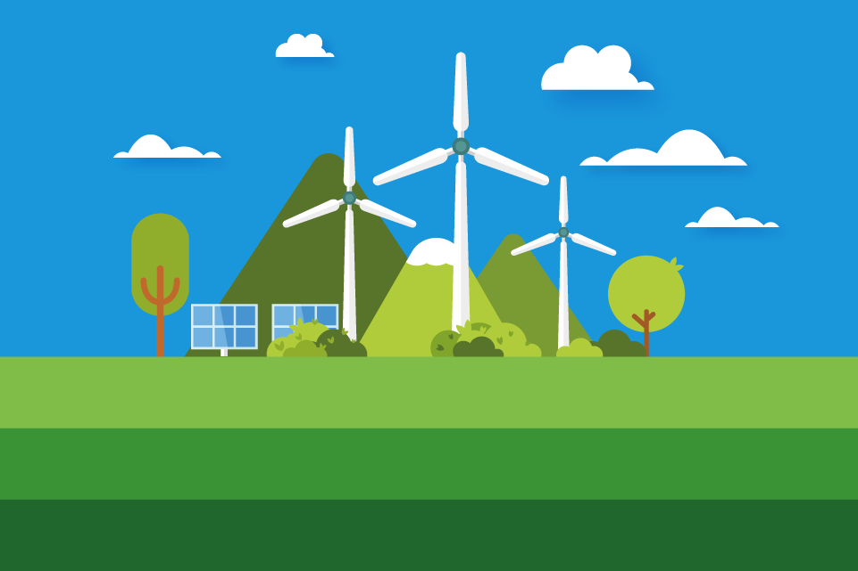

Keys concepts about:
Peer support networks for sharing coping strategies.
Cultivating
Climate-Ready Communities
Click to type..
Community support events where people can share their climate-related fears and support each other.
The importance of community preparedness in the face of climate events
How to build climate-resilient infrastructure and social systems that support sustainability
The role of education in cultivating
long-term community resilience

Slide 21
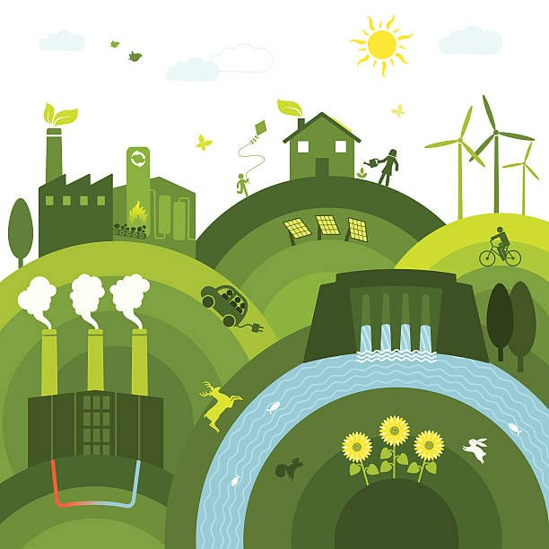
Actionable Ideas for:
‘Cultivating Climate-Ready Communities’
Workshops on Sustainable Living
For example;
- Rainwater harvesting
- Home energy audits
Building local resilience teams that focus on preparing for
- Natural disasters
- Energy-saving initiatives, or
- Sustainable local food production
Educational campaigns
to inform communities about the impacts of climate change and
ways they can mitigate them

Slide 22
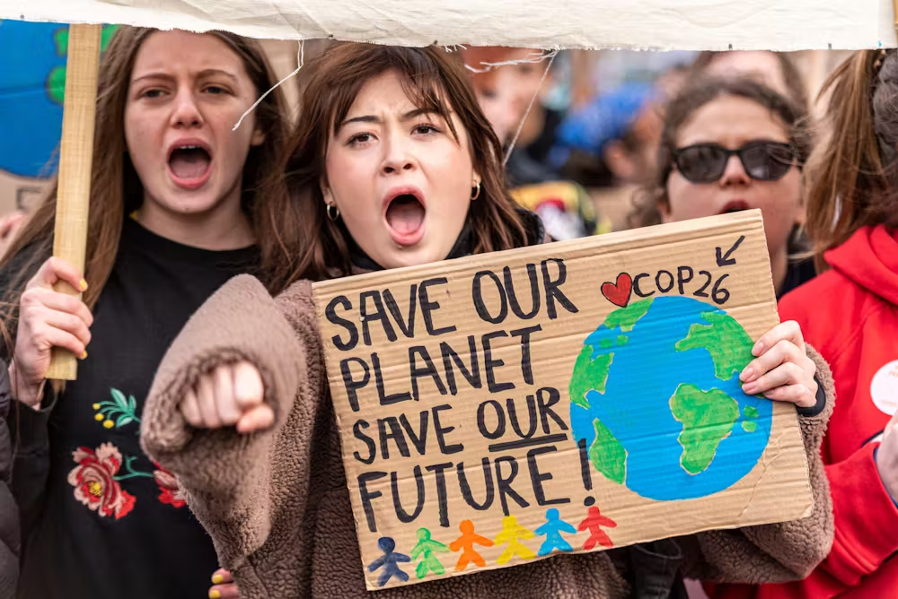
04​
The Emotional Compass:
Navigating Climate Anxiety Collectively

Slide 23
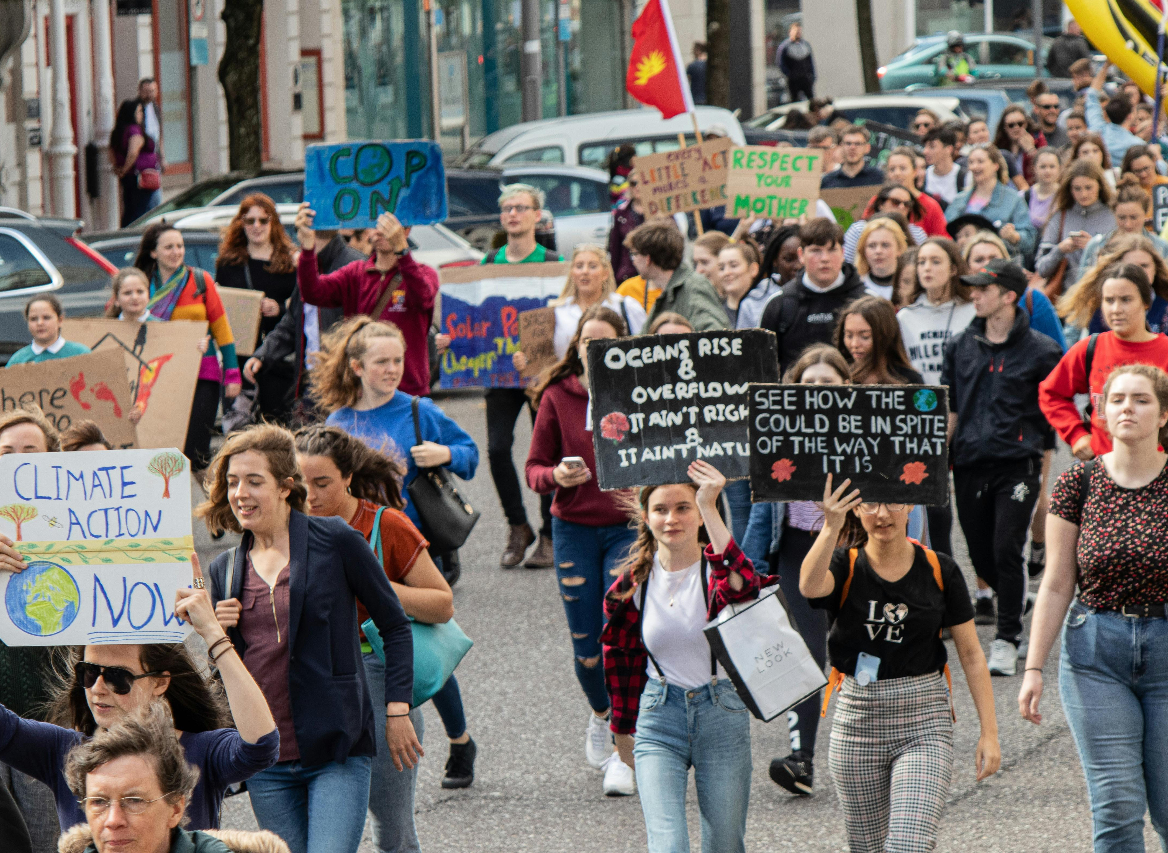
Developing emotional literacy within communities to deal with climate-related stress and grief.
Group-based approaches to managing climate anxiety and fostering solidarity.
Emotional resilience as a collective asset.
Keys Concepts about: Navigating Climate Anxiety Collectively

Slide 24
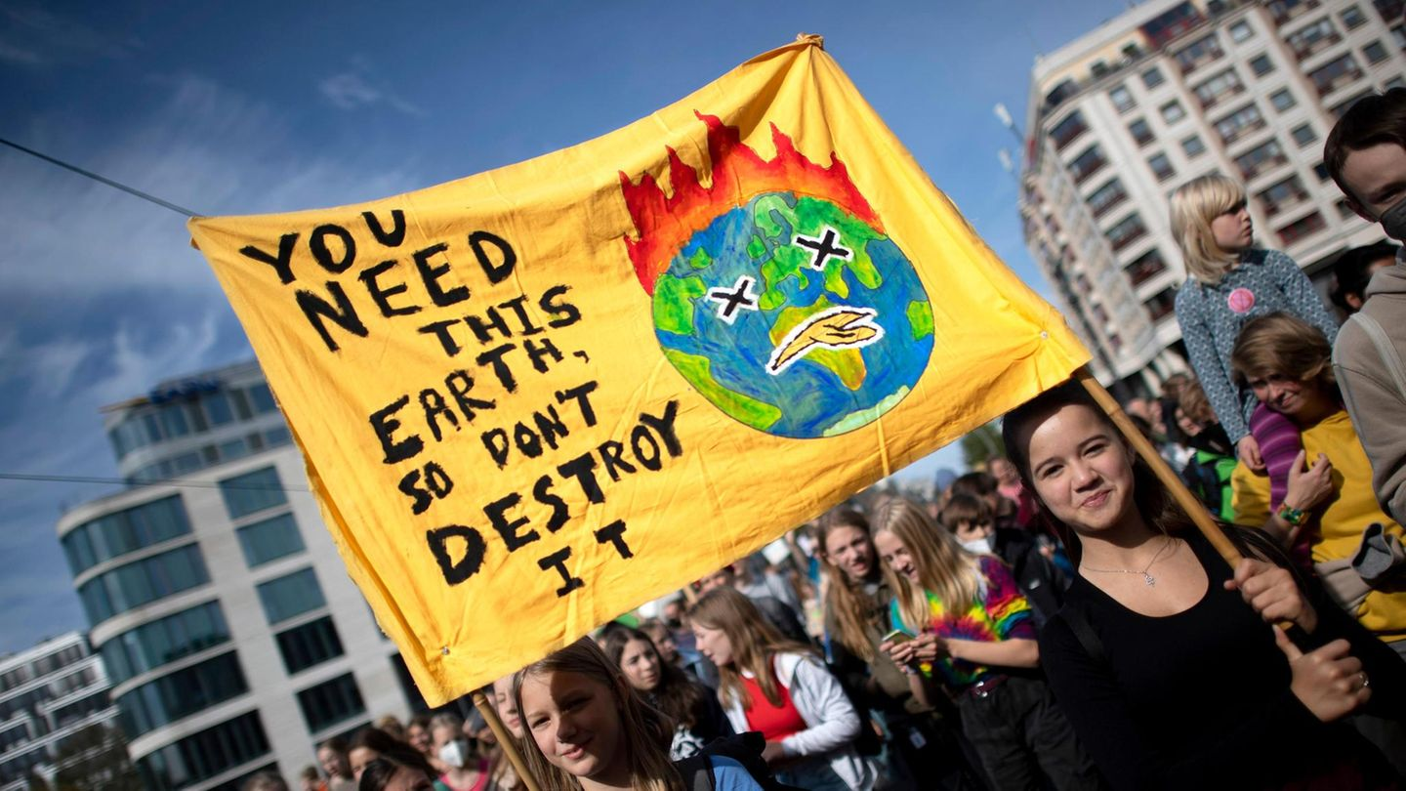
Actionable Ideas for:
Navigating Climate Anxiety Collectively
Community emotional check-ins during climate-focused events.
Creating emotional resilience hubs where people can come together to process emotions surrounding climate change.
Promoting mental health resources for those experiencing climate grief or anxiety.

Slide 25
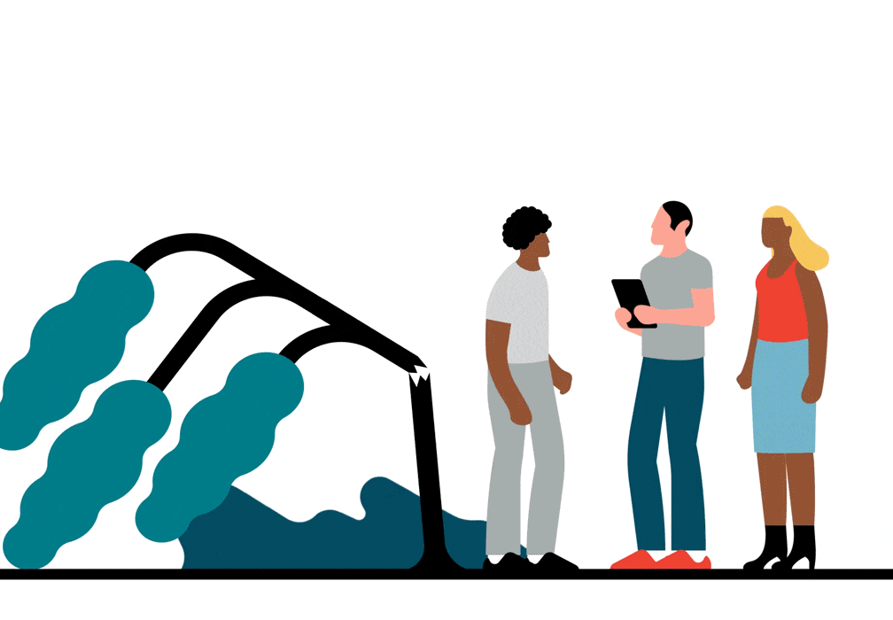
05
The Resilience Blueprint:
How Communities Adapt & Thrive

Slide 26
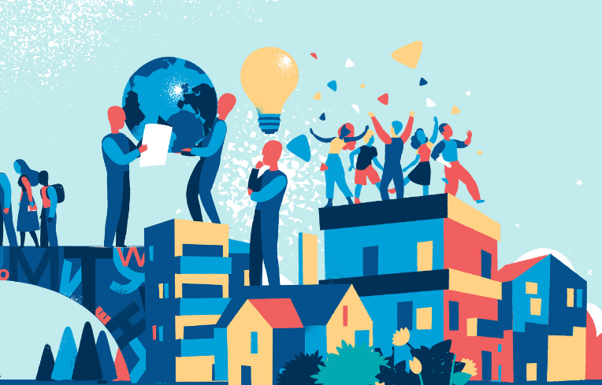
Keys Concepts about: The Resilience Blueprint
How Communities Adapt and Thrive
The importance of proactive planning and long-term thinking.
Case studies of communities that have successfully adapted to climate impacts.
Understanding the blueprint for building a resilient community in response to climate challenges.

Slide 27
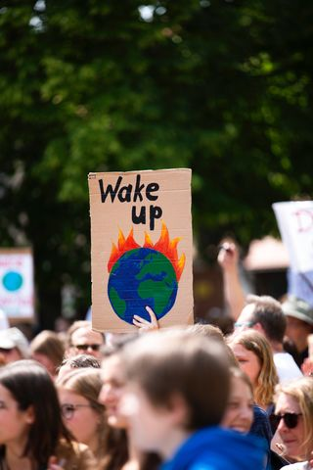
Actionable Ideas for:
‘The Resilience Blueprint':
How Communities Adapt and Thrive!
Building community resilience maps that identify key vulnerabilities and strategies for adaptation (e.g., flood risks, food security).
Collaborative projects that involve the community in designing resilience strategies.
Peer-to-peer learning opportunities where successful case studies are shared and implemented in new areas.

Slide 28
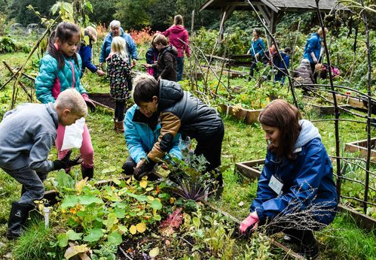

06
Re-Planet-ing
Our Communities

Slide 29
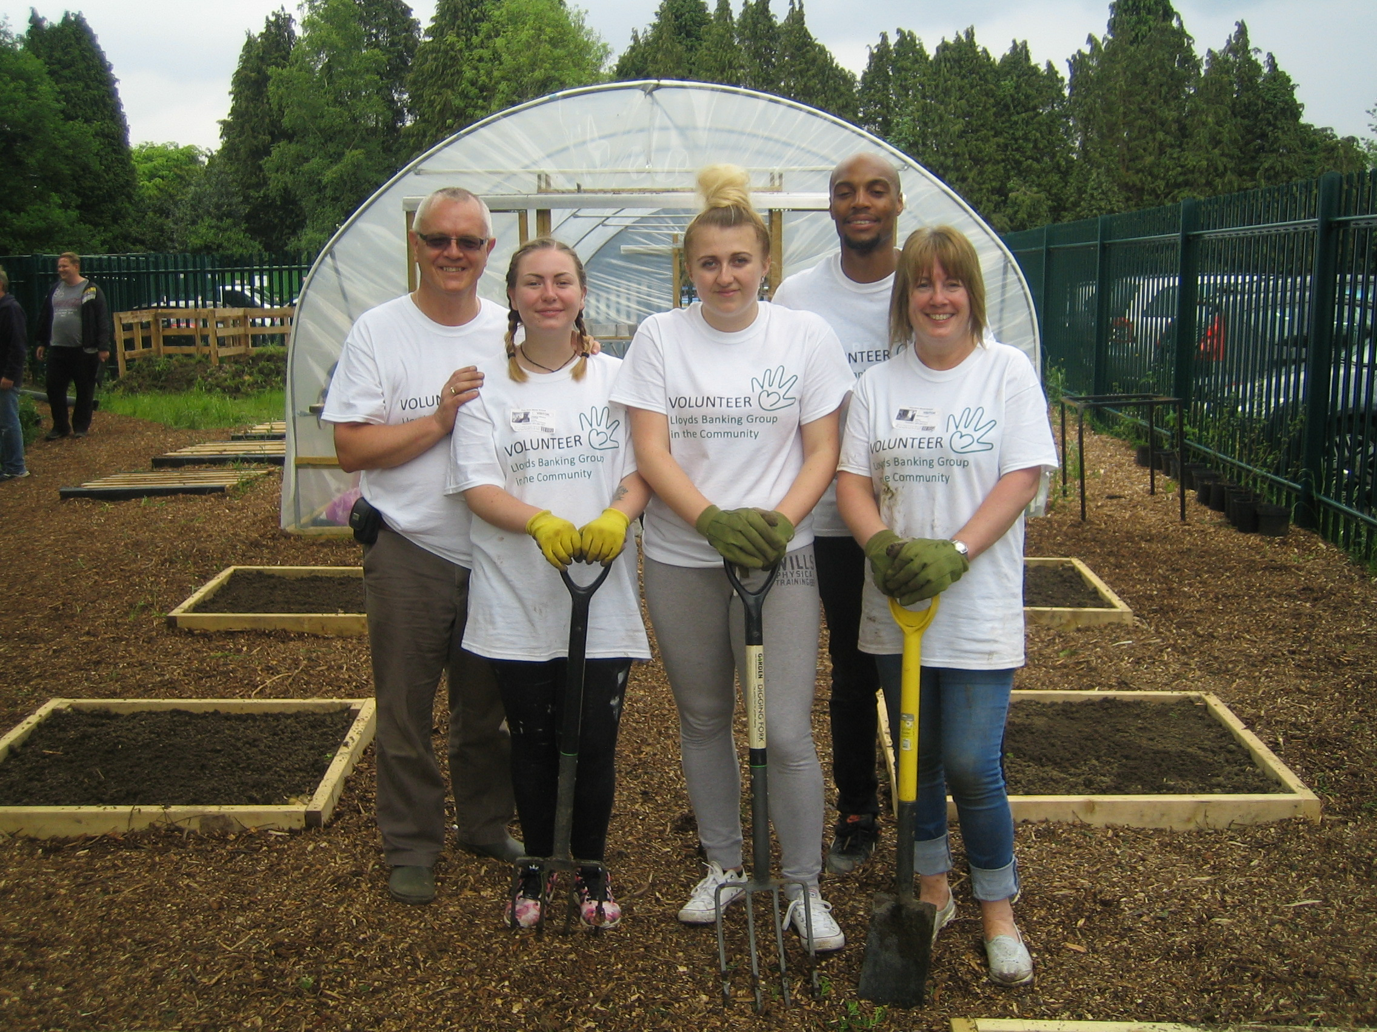
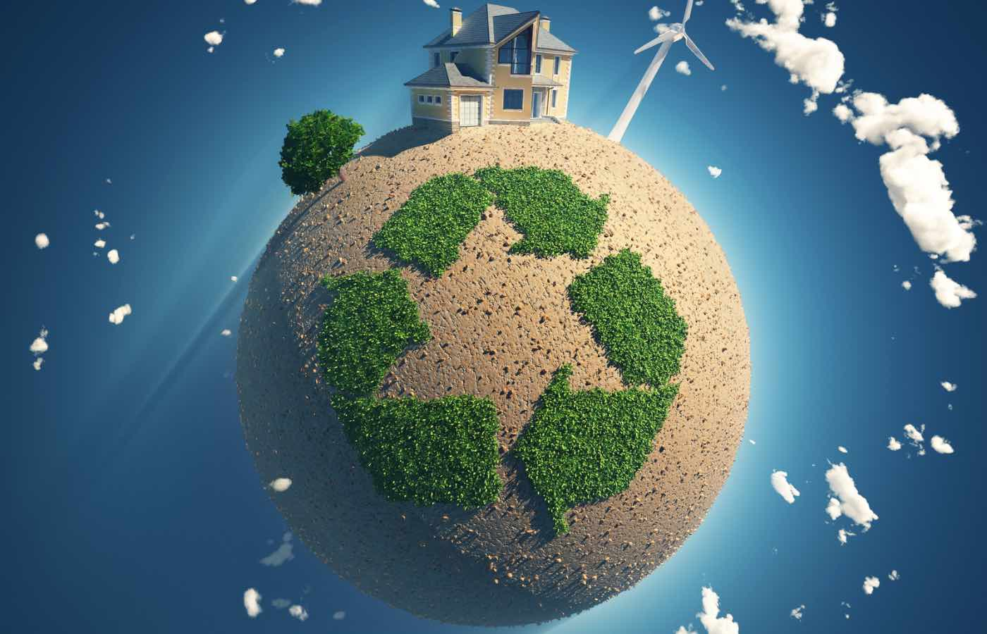
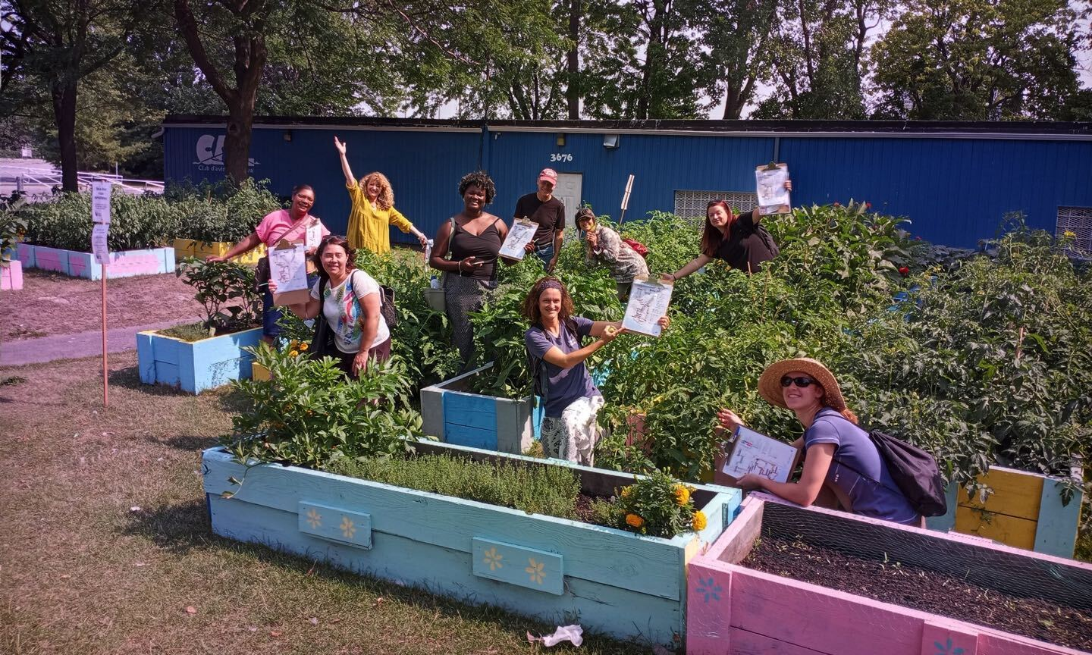
Keys Concepts about: ‘Re-Planet-ing Our Communities’
Rebuilding our relationship with the planet on a community level.
Shifting toward a "regenerative" mindset. Restoring, rather than merely sustaining, the environment.
How communities can take steps to reduce their ecological footprint through sustainable practices.

Slide 30
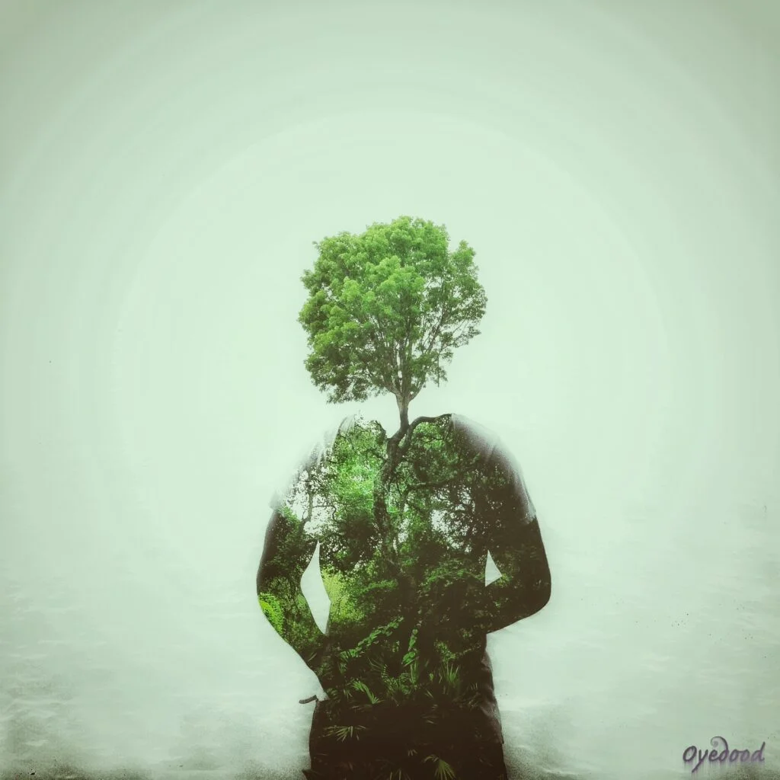

Green infrastructure projects like community gardens, urban farming, and green roofs.
Actionable Ideas for:
‘Re-Planet-ing Our Communities’
Local sustainability festivals that
teach and showcase sustainable
living practices.
Rewilding initiatives.
Communities coming together to restore ecosystems and
natural habitats.

Slide 31
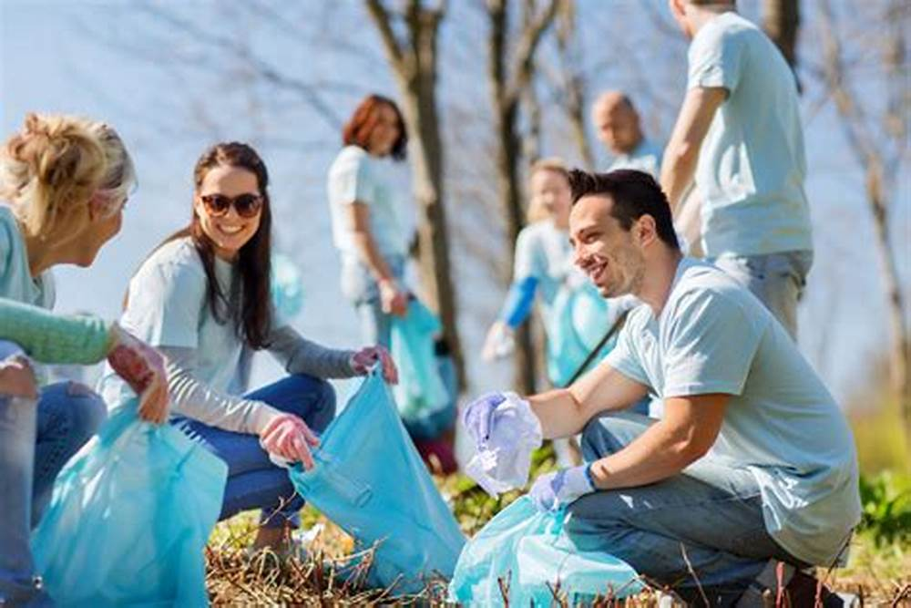

07
A Pulse for Every Community

Slide 32
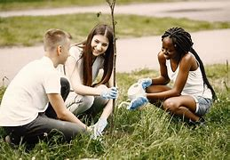

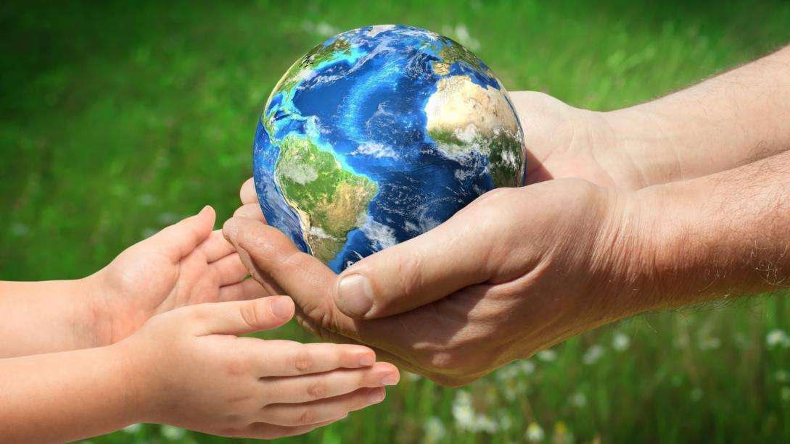
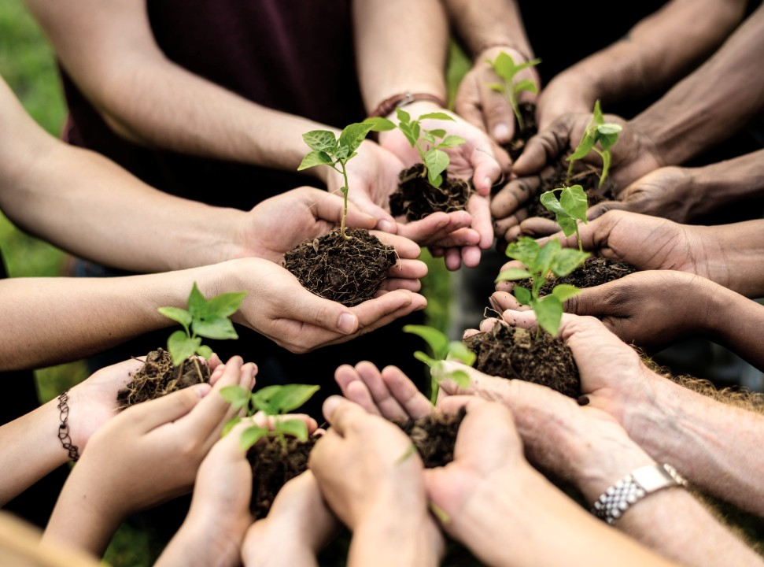
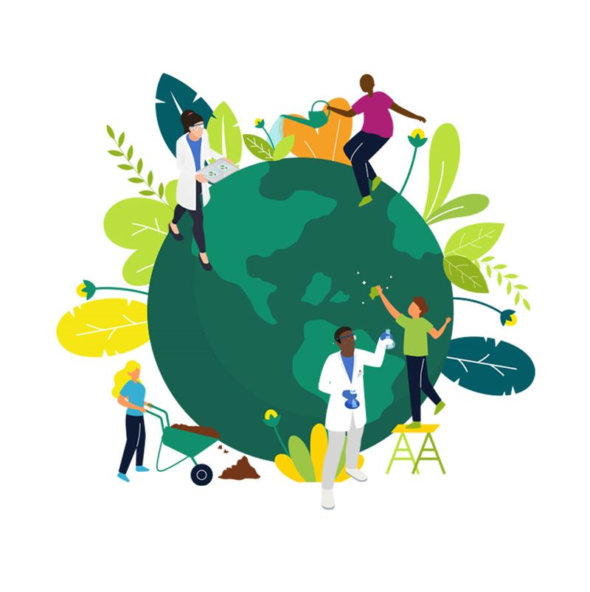
Keys Concepts about: ‘A Pulse for Every Community’
Harnessing
local culture,
values, and energy
for effective action.
Understanding the diverse needs and capacities of different communities.
The idea that every community has its own unique “pulse” and energy that can drive climate action

Slide 33
A Pulse for Every Community
A community’s pulse is its emotional, cultural, and social energy.
It’s how people come together, what they care about, and what makes them act.
Remember that no two communities are the same
One community might beat with the rhythm of street parades and protest chants.
Another community might hum quietly through shared discussions, nature cleanups, or raising awareness virtually.

Slide 34
A Pulse for Every Community
A community’s pulse is its emotional, cultural, and social energy.
It’s how people come together, what they care about, and what makes them act.
Remember that no two communities are the same
Different types of communities
Physical
(In-person) Communities
Online Communities
Intergenerational Communities
Global Advocacy Network Communities
Youth & Student Communities

Slide 35

Case Study Examples of how various communities can act and support on the same matter
in their own ways
During the Australian bushfires, the local fire brigades and neighbors offered on-the-ground support (physical community at its best)
At the same time, global Instagram accounts raised millions in aid and awareness (the power of online networks)
Both were needed and valuable.
Some more examples:
In rural Romania, where internet access can be limited, climate awareness has grown through community theatre and local radio storytelling, especially among older people.
In Copenhagen, an online ‘Green City Discord’ connects students, architects and activists across Europe, collaborating on sustainable design challenges.
Combining virtual friendships to plan actions locally.
It is possible to achieve lots
as part of a community

Slide 36

Collective emotional strength vs. individual isolation
Actionable Ideas for: ‘A Pulse for Every Community’
Community pulse surveys to gauge local concerns, interests, and capacity for action.
Celebrating local culture in climate action efforts (e.g., incorporating traditional knowledge and practices).
Understanding the emotional impact of climate change on communities:
Creating personalized action plans based on community-specific strengths.
Empowering individuals by fostering group solidarity.

Slide 37
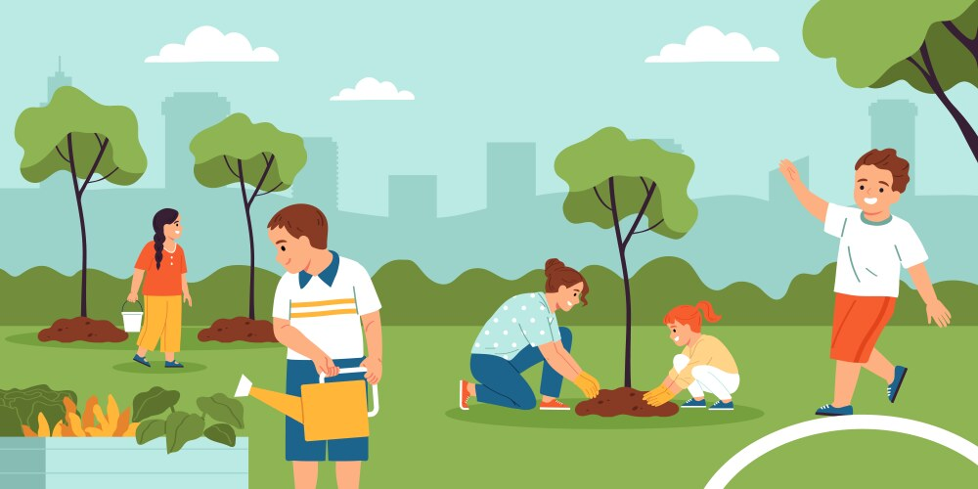
08
Planet Pulse, Community Pulse

Slide 38
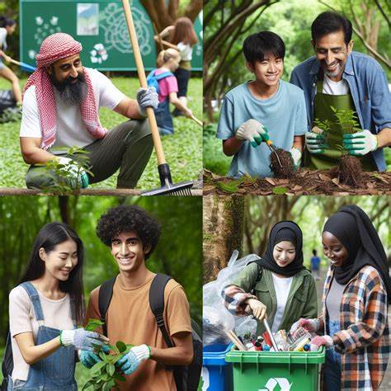
Keys Concepts about:
‘Planet Pulse, Community Pulse’
The interconnectedness between the well-being of the planet and the well-being of its communities.
The concept that the health of our communities directly impacts the health of the Earth.
Reinforcing that global change begins at the local level, with communities aligning their actions to planetary health.

Slide 39
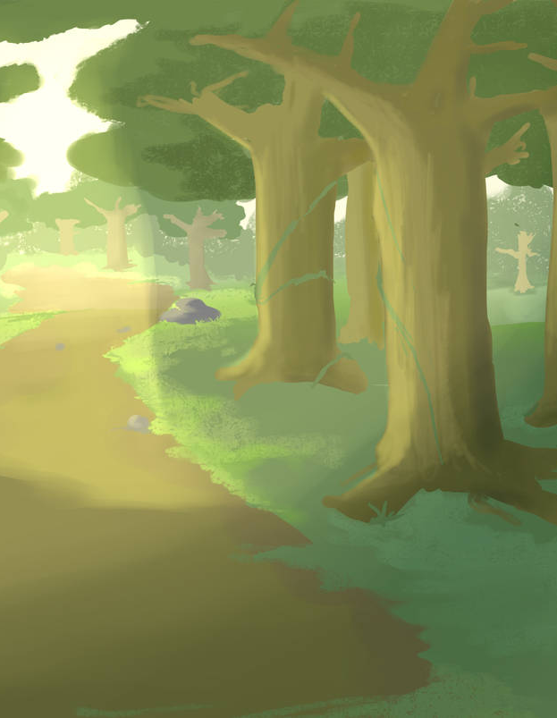
Actionable Ideas for:
‘Planet Pulse, Community Pulse’
Community-wide sustainability pledges where people commit to environmental goals.
Global-local action connections, such as linking local sustainability projects with global environmental initiatives (e.g., tree planting initiatives contributing to global carbon offset goals).
Creating “pulse” events where communities unite to focus on a specific environmental cause, like World Environment Day.
Posted just now by @PlanetUser100
#WorldEnvironmentDay #CleanUp
Let's do this together, as a community!
#PlanetPulse #CommunityPulse

Slide 40
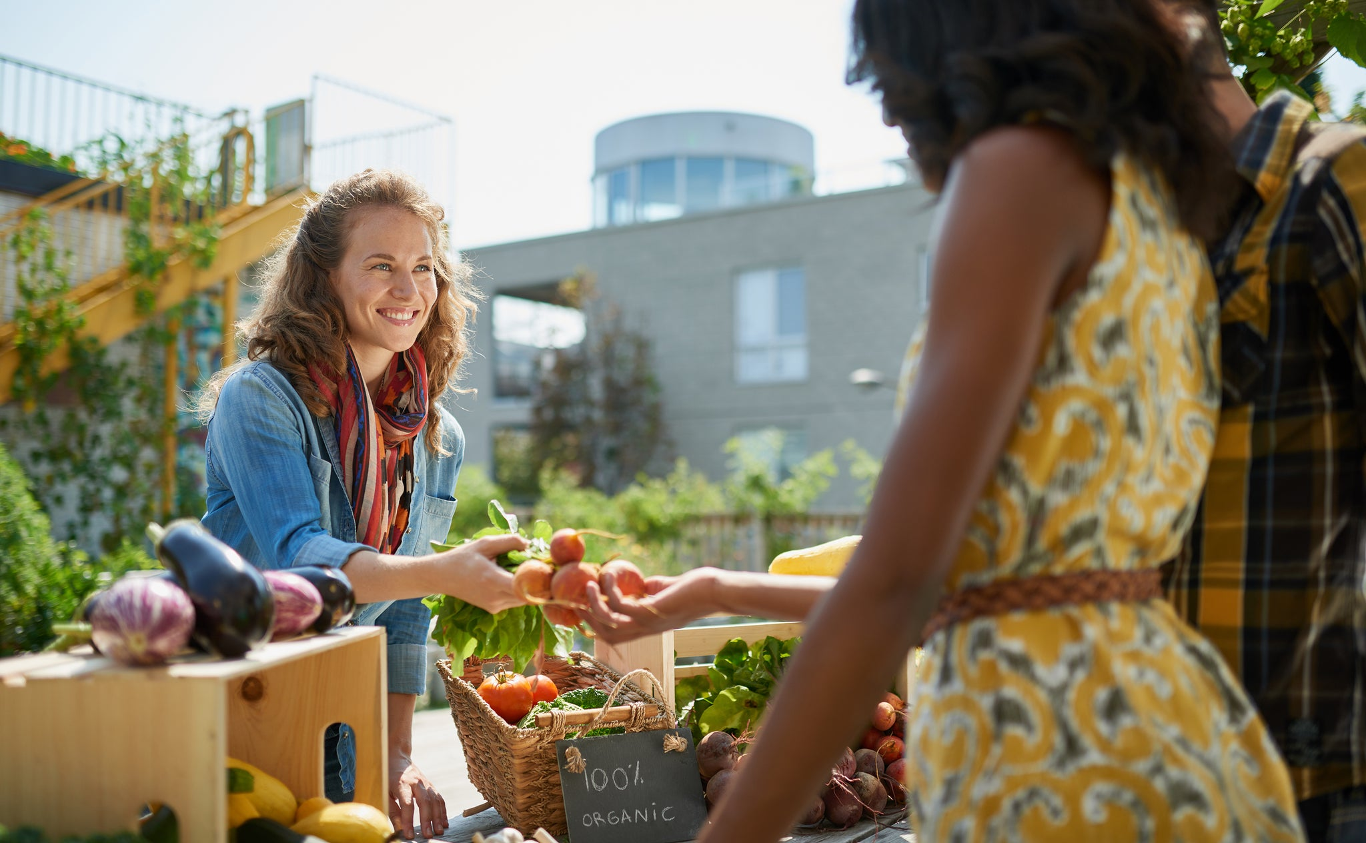
09
Examples of Communities and Organizations Successfully Implementing Sustainable Actions

Slide 41
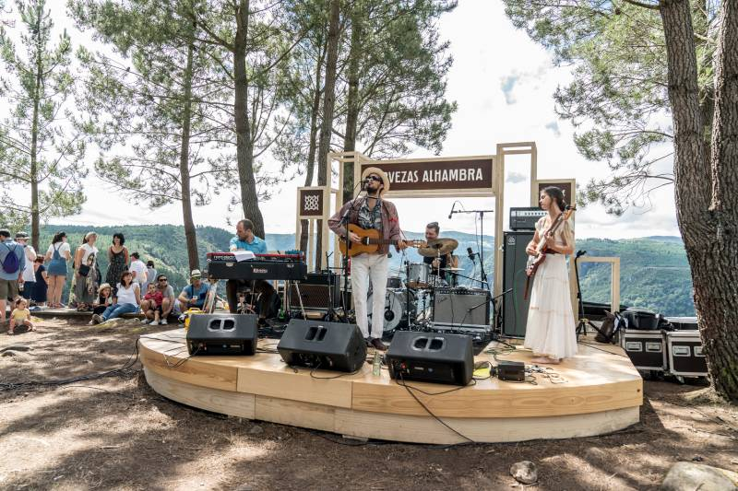
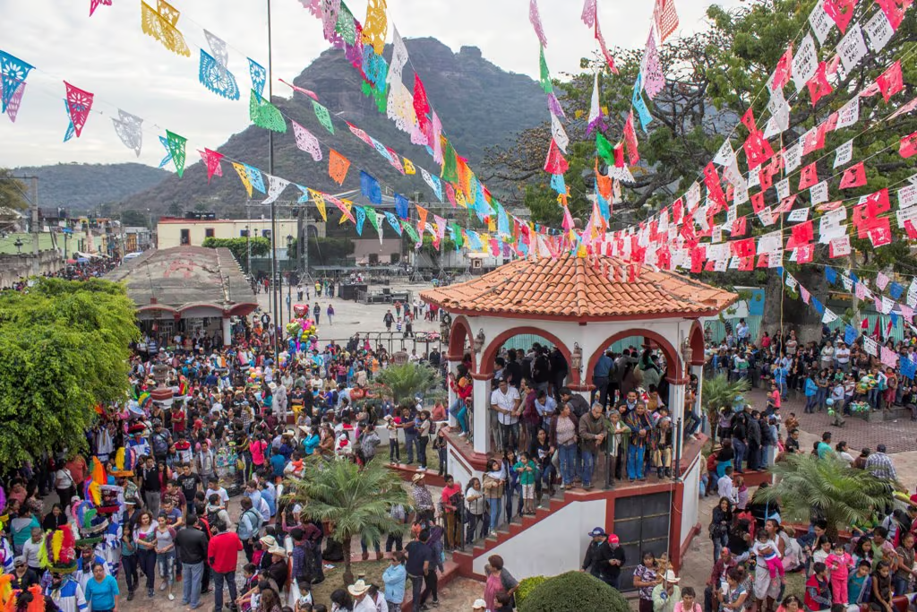
Examples of Communities and Organizations successfully implementing Sustainable Actions
17º Ribeira Sacra Festival (Galicia, España)
Sustainable Festivals in Mazamitla, Mexico
It implements practices such as using biodegradable materials, promoting local and seasonal products, and offering bus transportation to reduce attendees’ carbon footprint.
During the Craft Beer Festival, recycling systems allowed up to 70% of generated waste to be reused or recycled. Additionally, the Gastronomy Fair promotes the use of organic ingredients sourced from community gardens, supporting the local economy and reducing the carbon footprint.

Slide 42
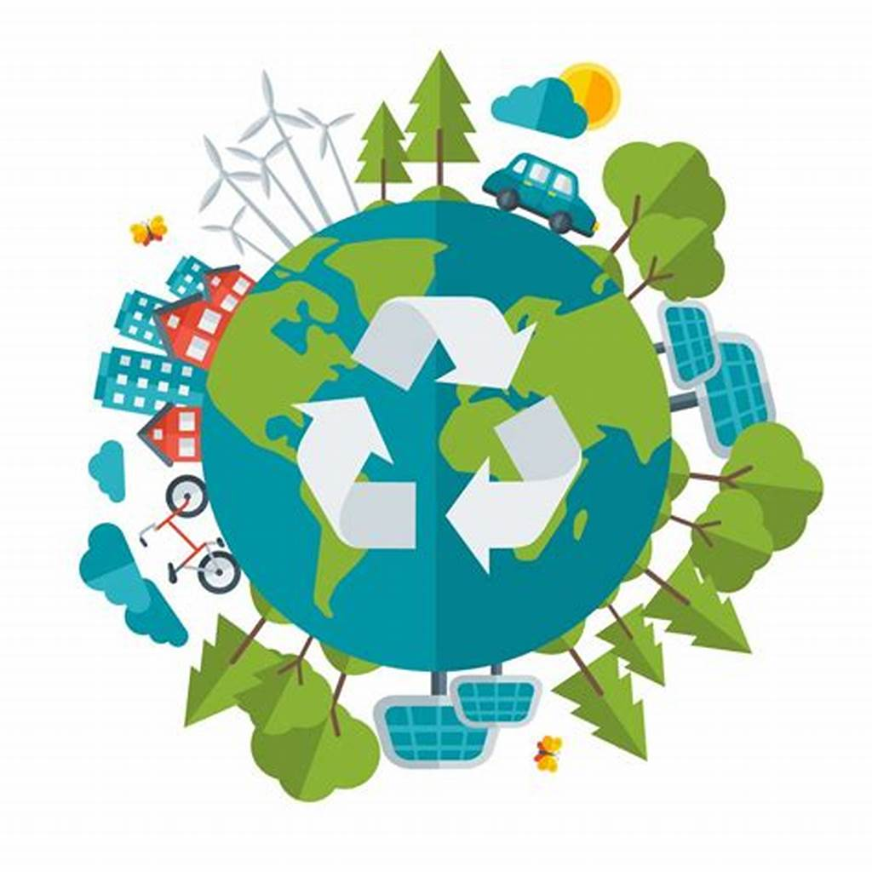

10
Measures taken by European Union communities to reduce their ecological footprint through sustainable practices

Slide 43
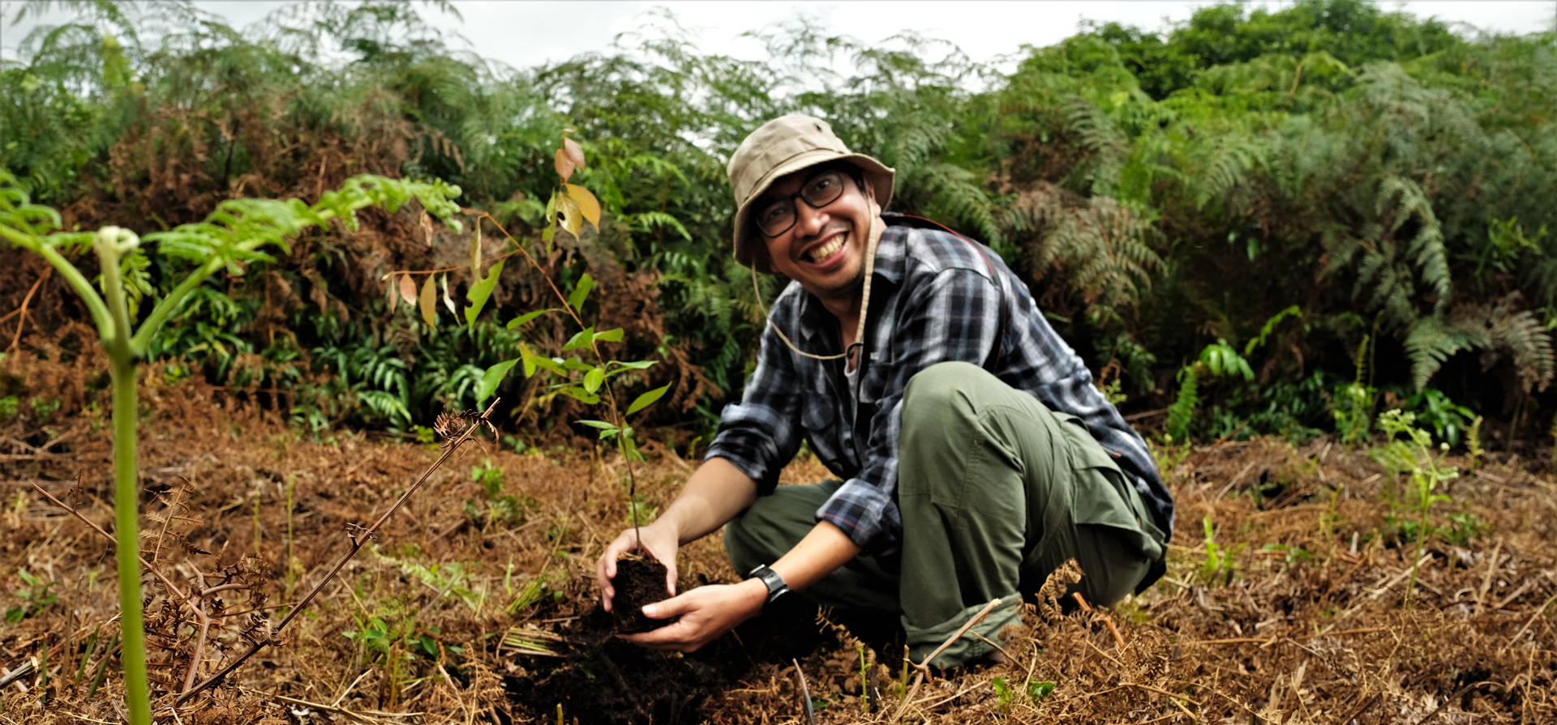
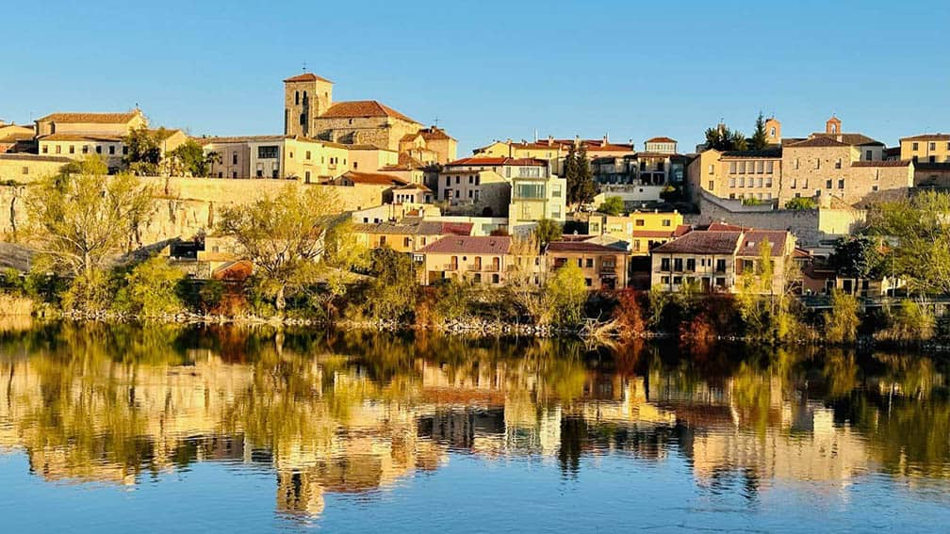
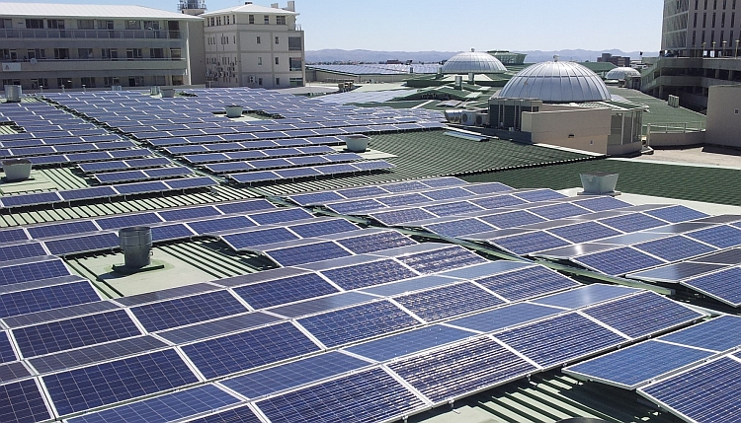
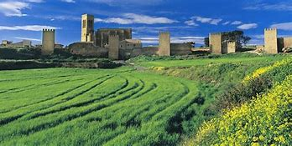
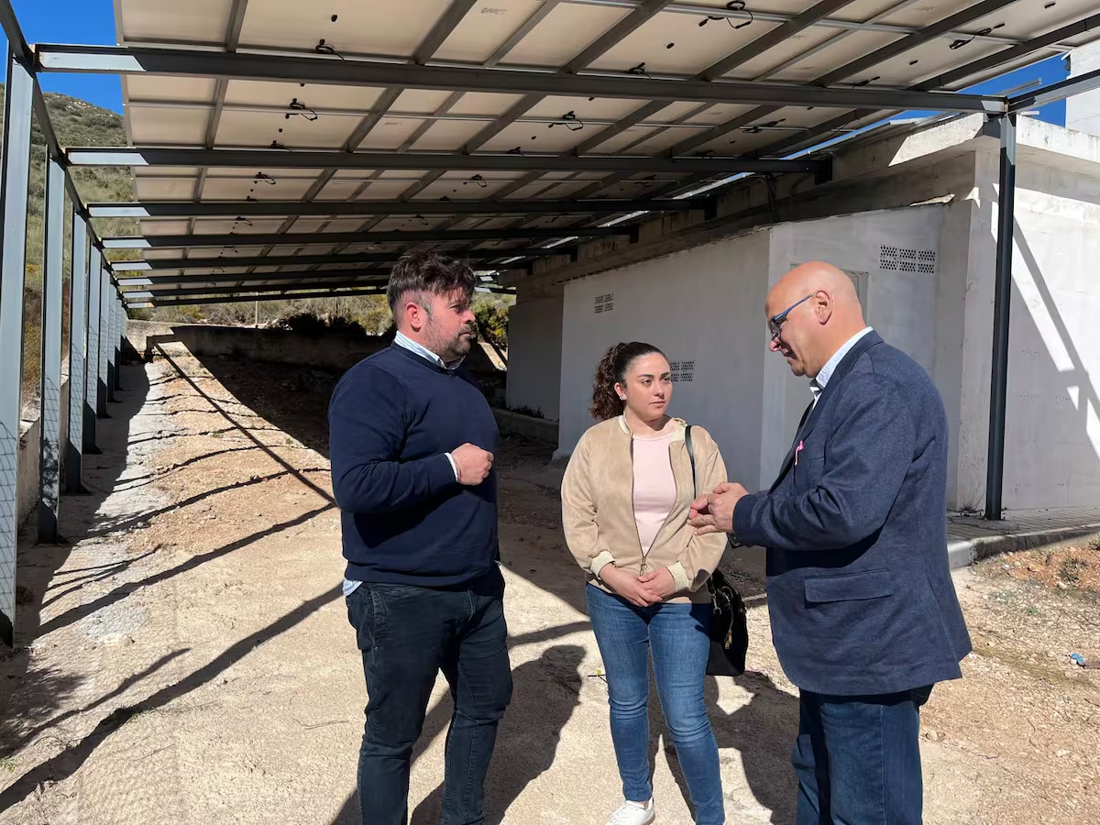
Creation of Food Forests in Artajona
Urban Rewilding in Zamora, Spain
Energy Efficiency Improvements in Cabra de Santo Cristo
Measures taken by European Union communities to reduce their ecological footprint through sustainable practices.
Artajona transforming a 23,000-square-meter plot into a food forest using permaculture techniques to promote biodiversity and sustainable food production.
the RenaturaliZA project aims to rewild 16 hectares and 7 km of urban roads by planting 400 trees and installing 150 nest boxes for various species.
New photovoltaic installations for self-consumption were inaugurated in municipal buildings . These installations will enable approximately 84% of the energy consumed to be generated from renewable sources.

Slide 44
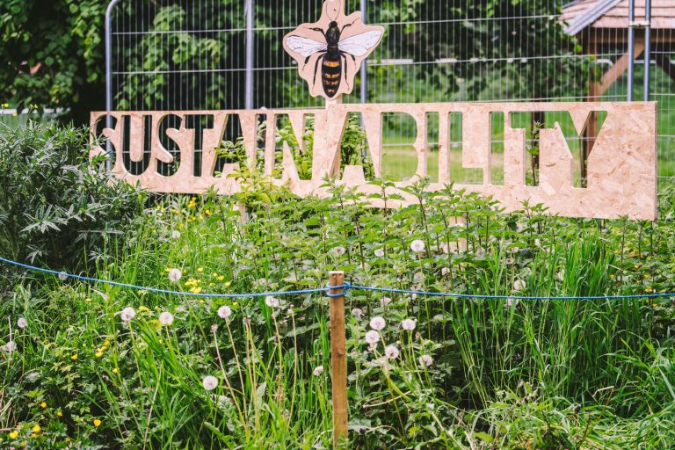
11
Local Sustainability Festivals in Ireland

Slide 45

Climate Inspirations Festival in Galway, Ireland
This festival aims to change the narrative around climate action towards a more positive perspective.
It includes activities such as "Playful Streets", which transforms streets with games, street theatre, art, and music to foster climate conversations.
Additionally, talks and panel discussions on various sustainability and climate change topics are held.
https://galwayclimatefestival.ie/

Slide 46


Junk Kouture Festival in Dublin and across Ireland
and the World
As 'The Global Sport For Creatives', Junk Kouture is open to 12-19 year olds
Evolving educational resources on creativity, innovation, and circularity to inspire students and educators to apply their learning beyond Junk Kouture.
Showcasing their design & representing their school on stages across the world
Challenges young people to design & create high-end Kouture from upcycled Junk
https://junkkouture.com/
Junk Kouture Irish 'STEM' Category Winner 2024 from Roscommon, Ireland

Slide 47


12
Green infrastructure projects in the European Union

Slide 48

The city of Hamburg has implemented a comprehensive strategy to promote green roofs, combining financial incentives, dialogue, regulations, and scientific support.
The goal is to green at least 70% of new buildings and flat or slightly sloped roofs undergoing renovation
Green Roof Strategy in Hamburg, Germany
Which translates to planting a total of
100 hectares of
green rooftops in the metropolitan area.
(Green infrastructure projects in the European Union)

Slide 49




This project received €45,000 in funding to introduce vertical growing spaces, green roof structures, and a rainwater filtration system.
It also includes a community chicken-feeding area and an elevated pond
Foster urban agriculture and environmental education within the community.
"Top of the City"
Community Garden
in Waterford, Ireland:
(Green infrastructure projects in the European Union)

Slide 50
Well Done! & Thank you!
You have now completed Module 4 of the Planet Pulse Learning Course
'Community'
Continue your learning with Module 5
'Empowerment'
www.planetpulse.eu

