Slide 1



MODULE 3
Hope
www.planet-pulse.eu
Module 3 by Planet Pulse is licensed under CC BY 4.0

Slide 2
Module Overview
This module explores the powerful role of hope in response to climate adversity. We examine how hope helps build personal resilience and empowers action, how to recognize hope in a light of optimism and pessimism, how to sustain its meaningful purpose, nurture it and divert into collective action where hope becomes a source for shared strength and
inspiration.
01
The Role of Hope in Times of Crises
02
Optimism versus Pessimism: What is the Light in the End of the Tunnel?
03
Positivity and its Toxic Aspects: Where Do You Flash Your Light?
04
Meaningful Hope: How to Keep the Flame Burning?
05
Hope and Climate Action
06
Collective Hope and Climate Storytelling

Slide 3
Learning Objectives of Module 3
By the end of this module, you should be able to…
Understand the critical role of hope in times of crises.
Reflect on how mindset of optimism, pessimism or hope may influence the climate action.
Recognize the concept of “toxic positivity” and how to nurture rather grounded and authentic approach to staying hopeful.
Explore a concept of meaningful hope.
Learn how to nurture hope.
Discover how hope grows through community and fuels engagement for climate justice and advocacy.

Slide 4

Welcome to Module 3 - HOPE
Welcome to Module 3 of the Planet Pulse course, where we explore the powerful role of hope in responding to the climate crisis. At times when the future looks grim – there are many reasons to lose hope. But in such times, it is exactly hope that we need the most.
Why? Because hope fuels imagination, courage, and the motivation to act. It is not a passive feeling, but an active force that drives engagement, innovation, and resilience. Hope helps us envision a better future—and gives us the energy to work toward making that future a reality.
Rather than being a substitute for action, hope is the foundation of action. It is the spark that turns despair into determination and anxiety into advocacy.
In this module we will explore the concept of hope and its meaning. We will explore the mindset of pessimism and optimism by questioning “Is it better to look on the bright side, or prepare for the worst?” At the end of the module, we will learn how to nurture meaningful hope and to share that hope within your community to fuel climate action.

Slide 5
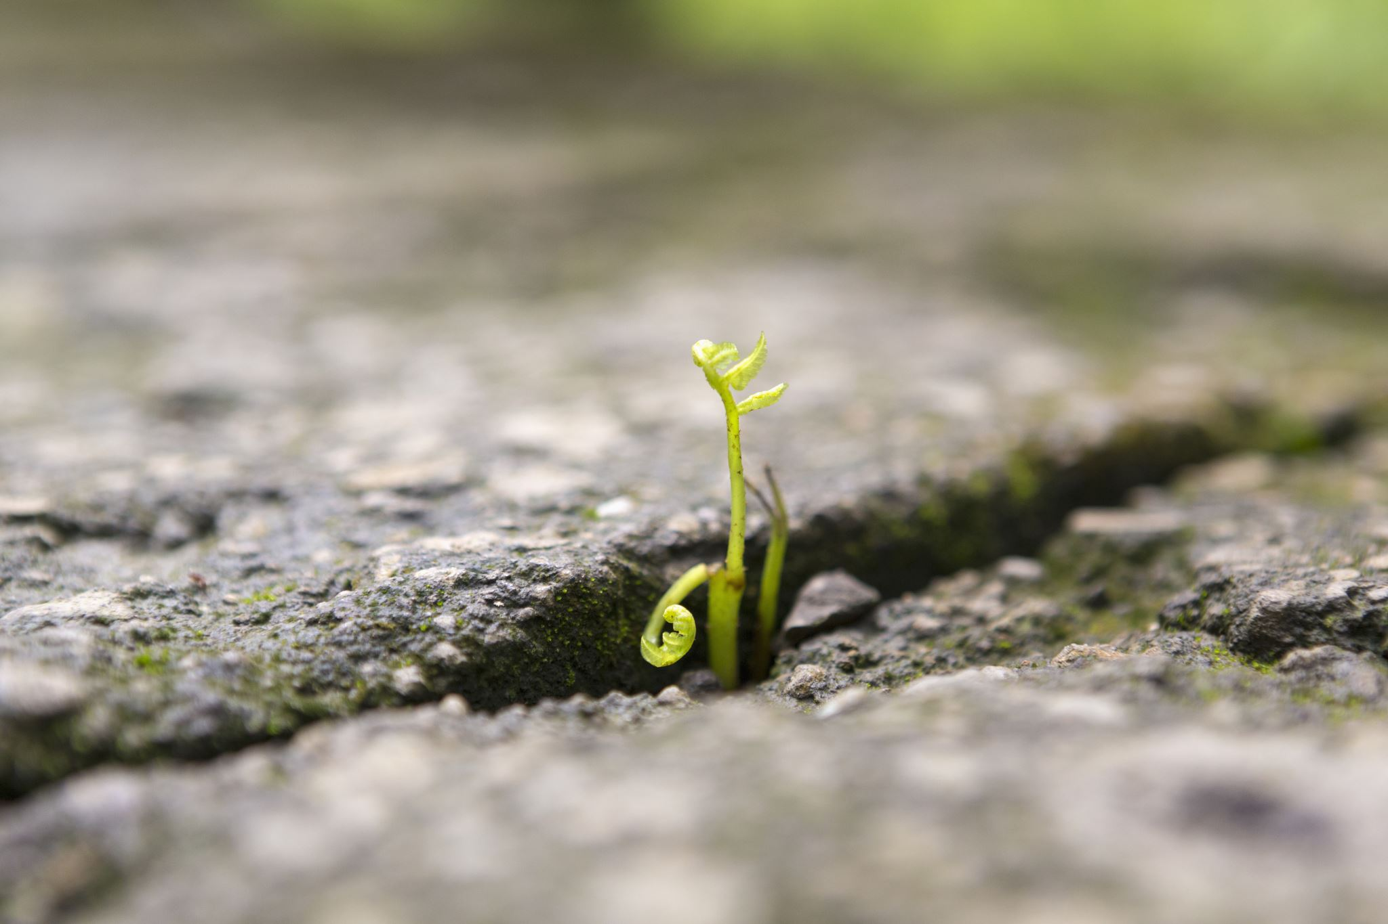
01
The role of hope in times of crises

Slide 6

1.1
Climate change and the need for hope
"The capacity for hope is the most significant fact of life. It provides human beings with a sense of destination, and the energy to get started."– Norman Cousins, American journalist.

Slide 7

Are we doomed or is there still hope?
The reality of the climate crisis is alarming. As you have learned in previous Modules, feeling anxiety about the uncertain future, is normal. It is a core human emotion when witnessing something wrong and upsetting. On top of that there is no clarity who is responsible to fix it, and - if there is time to fix anything at all? You may even have experienced a feeling or questioned “does anyone cares?” That’s one of the most pressing and emotional questions of our time: Are we doomed, or is there still hope?
Feeling like nothing we can do matters, can feel realistic but it does not lead anywhere.
This is exactly where hope becomes essential—not as a denial of reality, but as a force to help us keep going in the face of it.
Activity: Can you remember a personal experience when something was important for you but seemed at first impossible or really hard to achieve, yet hope helped you move forward or face the challenge?
Share your story!

Slide 8
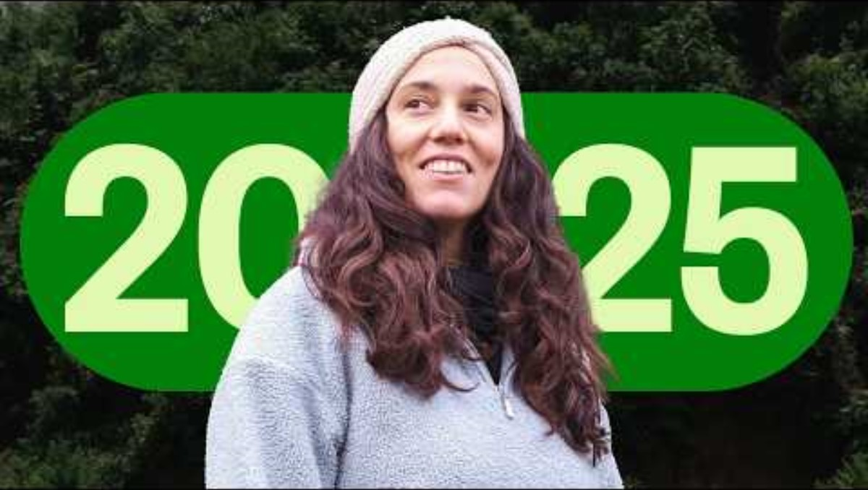
Climate change and the need for hope
Watch this short video from Ecosia organization about hope in climate reality
Hope can give a direction. Not to sit and wait, but to take an initiative, take an action (Ojala, 2017a, Ojala, 2017b). It is such hope, that grows when we come together, speak up, and support each other.
None of us can fix the world alone. But each small step — a conversation, a protest, a change in habits — adds up.
We are the generation that cares. And that is powerful.
Why? Because when our hope is grounded in truth, justice, and shared responsibility, it becomes more than just a feeling — it becomes ethical hope: the kind that sustains meaningful action and collective change.

Slide 9

1.2
The ethics of hope during the climate crisis
"Hope is a discipline. "— Mariame Kaba, American activist

Slide 10
What is ethical hope?
Activist Mariame Kaba says, “Hope is a discipline”, but what does it mean?
It is a powerful and often misunderstood idea. It means that hope is not just a feeling—it's a practice, a commitment, and often, a deliberate choice in the face of hardship. “Hope is a discipline” - means that ethical hope requires consistency, effort, and care, not just emotion.
  Emotional hope says, “I feel hopeful today because good news happened.”
  Discipline-based hope says, “Even when everything looks grim, I choose to act like change is possible.“
Activity: Activist Mariame Kaba says, “Hope is a discipline”, but what does it mean?
Share your thoughts in a class!

Slide 11

What is ethical hope?
Hope becomes ethical when it is something you work at, not something you wait for. Even when you’re tired, afraid or unsure it will “work”, you stay committed regardless the outcome.
And here it lights up your power – being brave.

Slide 12

02
Optimism and Pessimism

Slide 13

2.1
Optimism vs pessimism
“When asked if I am pessimistic or optimistic about the future, my answer is always the same: if you look at the science about what is happening on earth and aren't pessimistic, you don't understand the data. But if you meet the people who are working to restore this earth and the lives of the poor, and you aren't optimistic, you haven't got a pulse.”
— Martin Keogh, Hope Beneath Our Feet: Restoring Our Place in the Natural World

Slide 14
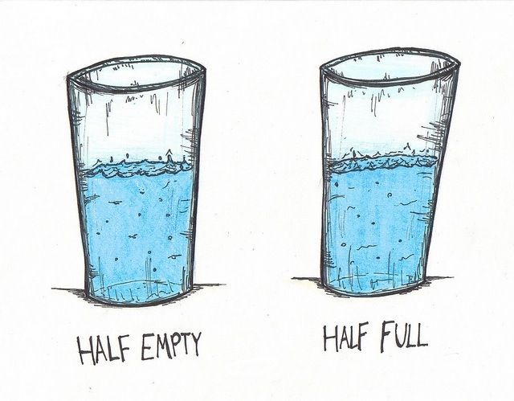
Optimism and pessimism
We often hear that life is a matter of perspective — whether we see the cup as half full or half empty. We all know the difference. But in practice, adopting either mindset - is both chalenging and not easy.
It is not easy to be an optimist when we talk about climate crises. Optimism can feel dishonest - even disconnected from reality. How can one be an optimist, when the world is overwhelmed by mounting facts about the global warming, ecosystem collapse, and the failure of political leaders to act? Optimist can be perceived being naive, irresponsible or even «toxic».
But pessimism offers no productive path forward either. It paralyzes with inaction.
Activity: Which part of the quote resonates with you?

Slide 15
Optimism and pessimism
For today’s youth, growing up in times of social, political , environmental and economical uncertainty, is not anymore about choosing optimism or pessimism.
It's about navigating emotional survival in a world of uncertain future with hope.
HOPE is a feeling only humans have – a mindset that acknowledges the severity of the crisis, yet believes in opportunity or collective capacity to respond, adapt, and create meaningful change.
For young people especially, hope is not naive — it is a vital emotional and psychological resource.
Hope fuels engagement, activism, innovation, and resilience. It gives direction in the face of uncertainty and helps transform fear into action.
It is not passive or blind belief that everything will turn out fine. It is a belief that our actions matter. Hope is not the absence of fear, but a commitment to act despite it.

Slide 16
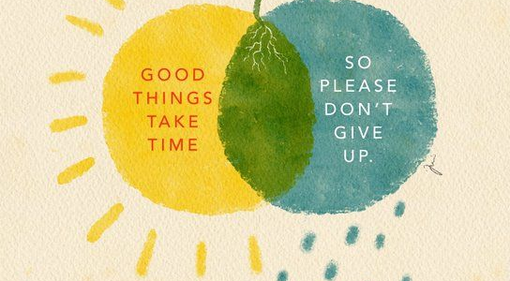
2.2
Meaningful hope
Hope, unlike optimism or pessimism, is a choice you practice.

Slide 17
2.2 The role of hope looking at the future
Hope becomes more grounded when it’s based on relationships and action, not just optimism.
Moreover, hope provides emotional resilience. It helps cope with loss and reminds that while new generation may not be responsible for causing the climate crisis, they are instrumental in shaping the future. Movements led by youth, such as Fridays for Future, show that when hope is combined with collective action, it becomes a powerful force for systemic change.
We must move beyond the binary of optimism vs. pessimism. The climate crisis demands something more nuanced — an active, grounded, and informed hope. A hope that acknowledges pain but refuses to give up. A hope that empowers young people to imagine and build a better world, even when the path is uncertain.

Slide 18
2.2 The role of hope looking at the future
Moving beyond optimistic and pessimistic future scenarious, hope can help us imagine a shared vision of an alternative future that catalyzes a regeneration.
Sometimes a great movement can start form one initivite of a single person or a small number of committed individuals, that can influence the majority of population and shift a paradigm.
Seemingly small things in nature can generate powerful ripple effects that impact the world around them.
Most environmental victories look like nothing happened; when in fact those are triumphs of those who dared to act.
As African proverb says it «If you believe you're too small to make a difference, try spending a night alone in the dark with a mosquito”.

Slide 19


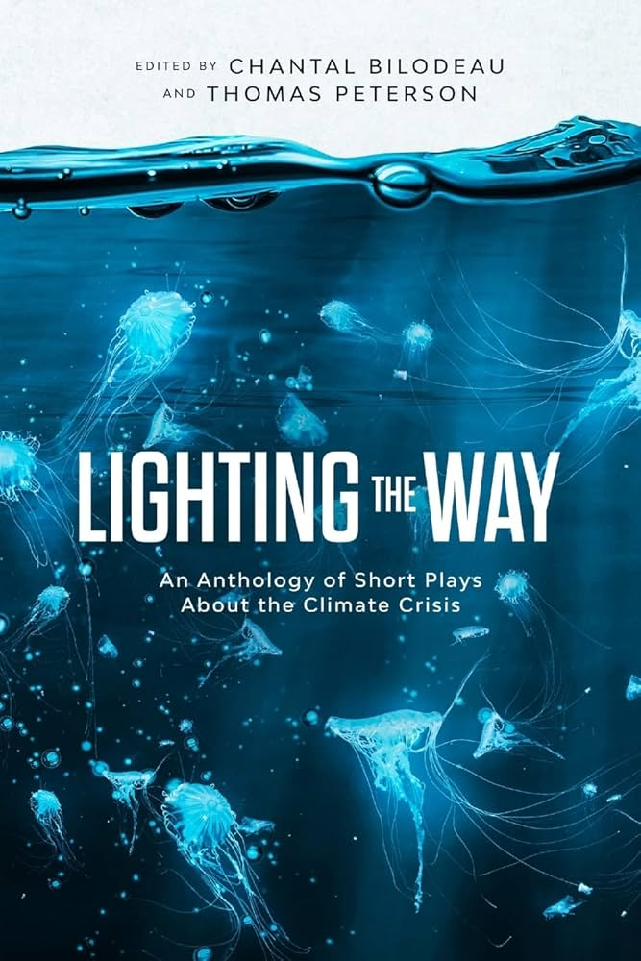


Online magainze orionmagazine.org
Resources on hope
A book
A podcast

Slide 20
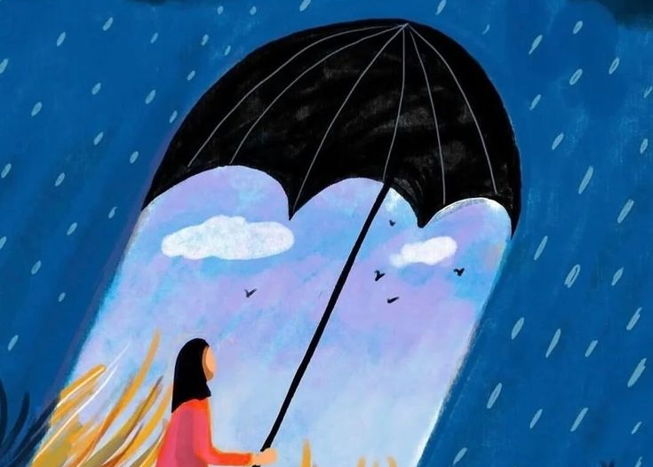
03
Meaningful Hope and climate action

Slide 21

3.1
Finding joy in climate action
Hope, unlike optimism or pessimism, is a choice you practice.

Slide 22
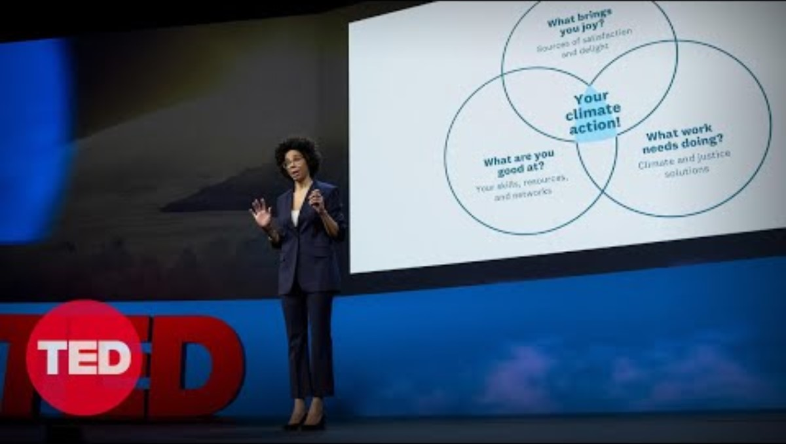
Finding joy in climate action
Watch this short video by Ayana Elizabeth Johnson about How to find joy in climate action
There is real joy and purpose in being part of the solution — in creating, collaborating, and believing in the possibility of change. Whether it's through innovation, activism, education, or community action, every step taken toward a sustainable future matters. Even if progress is slow, the act of working for a better world brings meaning, connection, and hope. And that hope is powerful — it fuels resilience, sparks creativity, and inspires others to join in.

Slide 23
3.2 Activity
Print here the worksheet for the exercise

Slide 24
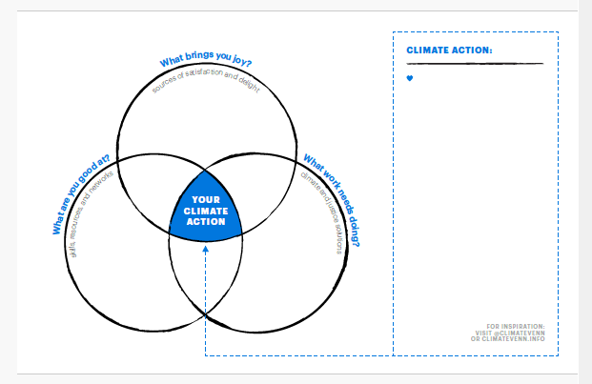

Slide 25
3.4 Self-Assessment (understanding your climate emotions)
Everyone experiences climate anxiety differently.
Some people feel a constant low-level worry, while others feel sudden waves of sadness, frustration, or anger when they hear about certain events.
This activity helps you explore your own emotional patterns, without judgement.
Using a simple "Climate Emotion Tracker," you’ll monitor how you feel over a few days when exposed to climate-related content.
News Audit
How did these make you feel? Download it https://static1.squarespace.com/static/5b5a301e0dbda385e213c811/t/6678629f938c4164441735df/1719165600841/VENN_WORKSHEET.pdf
Notes:
Reference article:
Source: Frontiers
Author: Panu Pihkala
Date: 14th January 202

Slide 26

06
Collective hope

Slide 27
Thank you
Any Questions?
www.planet-pulse.eu

Slide 28
Passive and Active hope
Scholars often make a separation between (1) passive hope, which is usually called wishful thinking and (2) active hope, which is often called constructive hope (Ojala, 2017a, Ojala, 2017b).
Scholars argue that hope is especially meaningful as a motivator when the odds of success are low, which seems to be the case with the climate crisis.
Hope can assist to withstand difficult situations as well as work actively for a better-rated future (Oettingen & Chromik, 2017).

