Slide 1
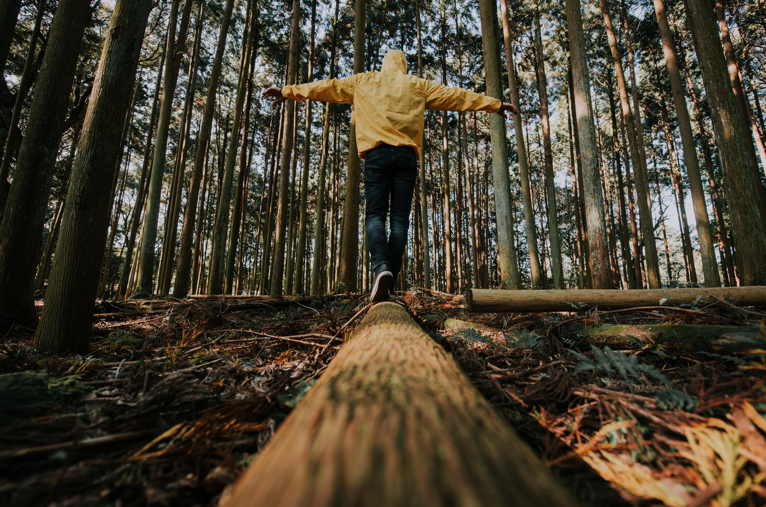


MODULE 2
Resilience
www.planet-pulse.eu
Module 2 by Planet Pulse is licensed under CC BY 4.0

Slide 2
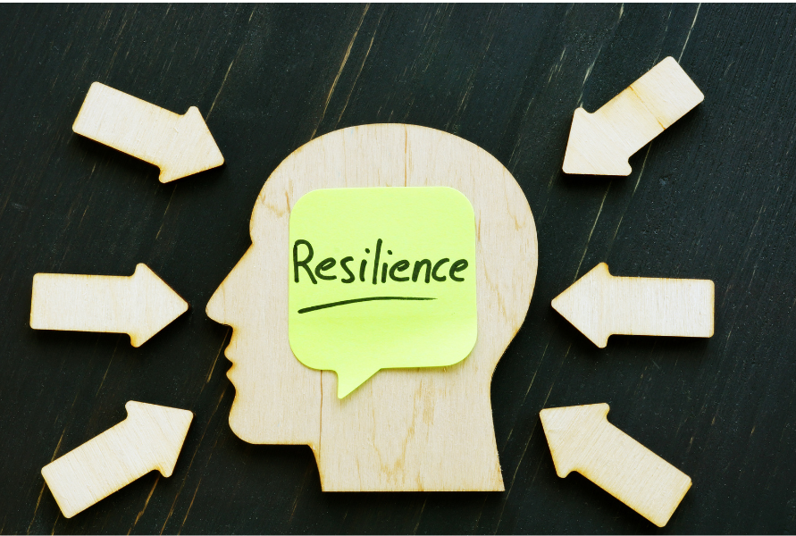

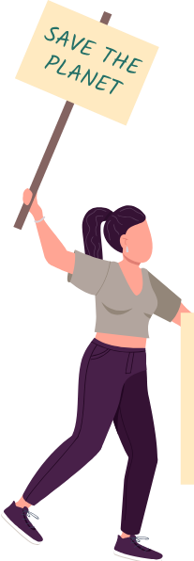
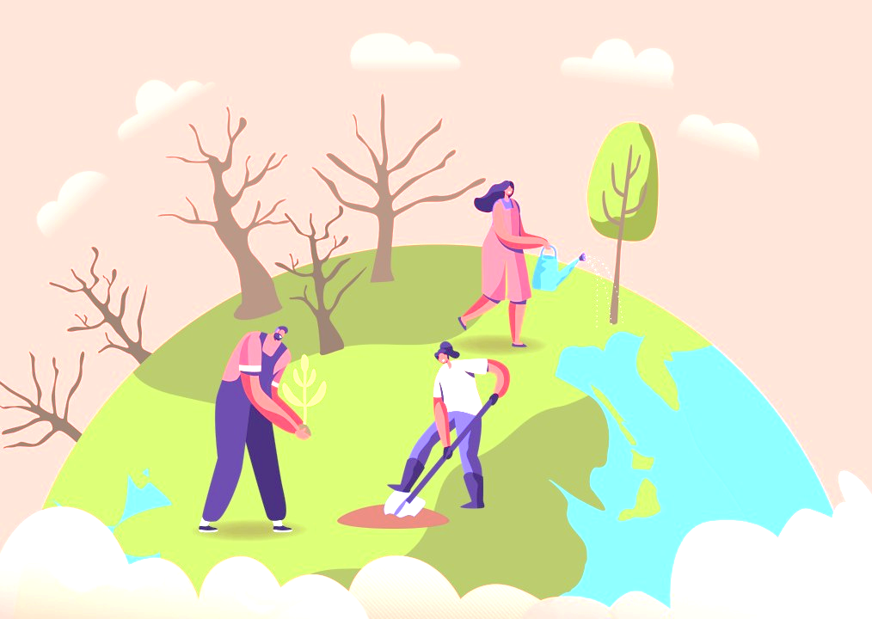
02
Page 11
WHY RESILIENCE MATTERS
CONTENTS
01
03
Page 4
Page 22
DEFINING RESILIENCE
WHAT MAKES US RESILIENT?

Slide 3
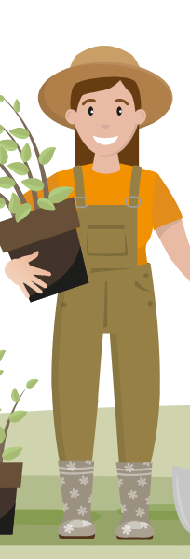
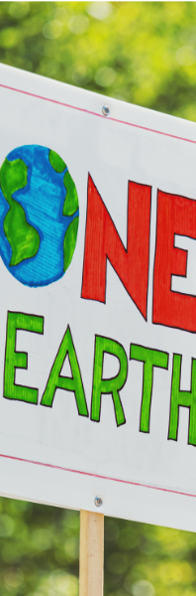
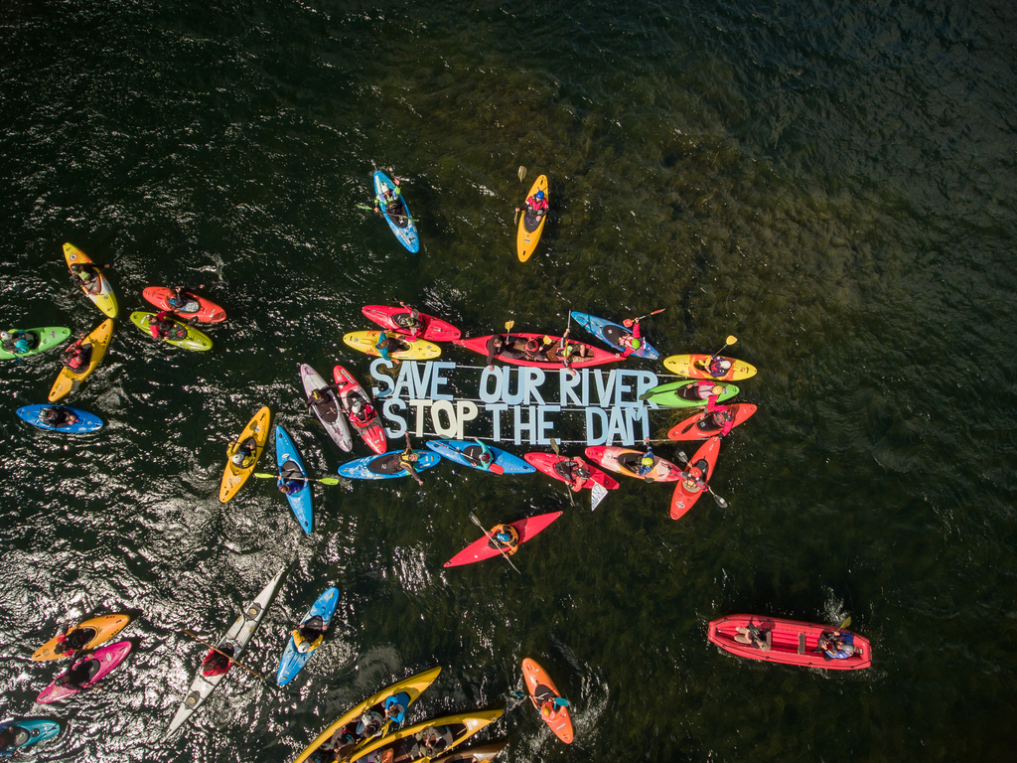
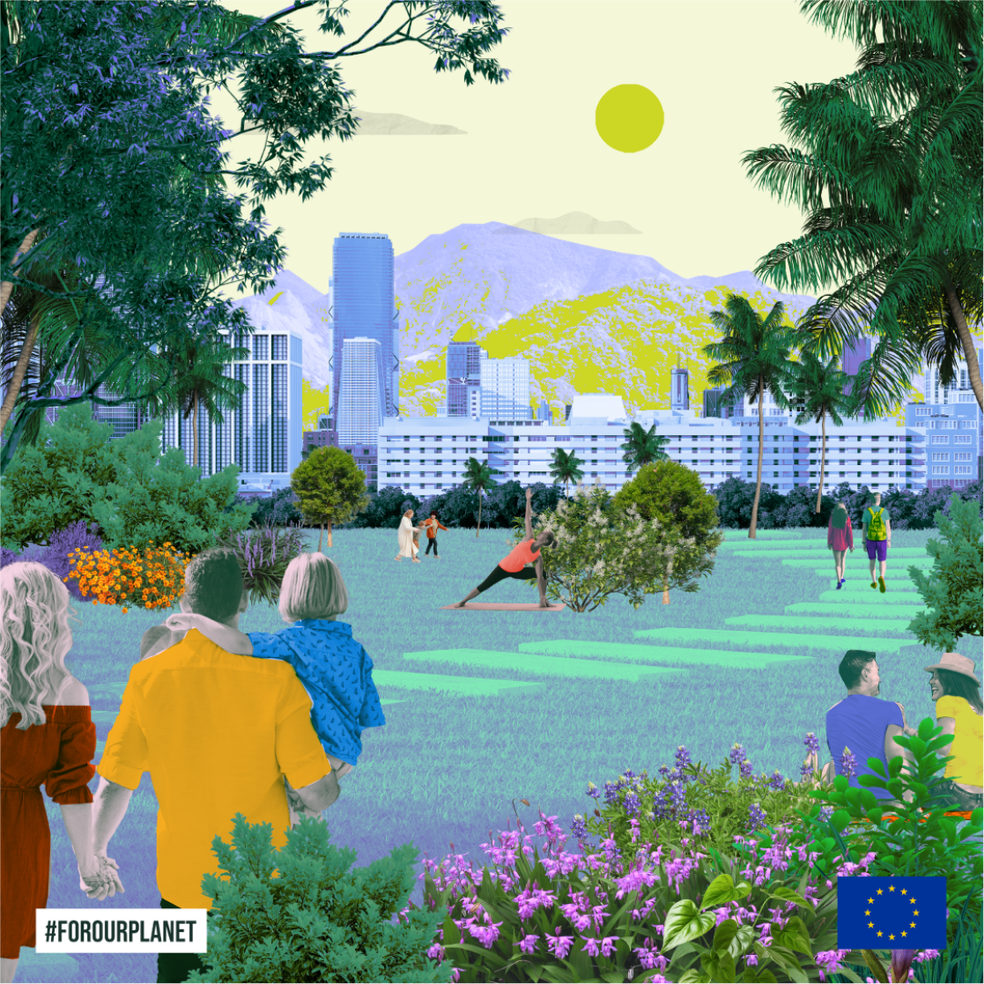
04
Page 37
PRACTICAL TOOLS
05
Page 51
RESILIENCE IN ACTION

Slide 4
01
DEFINING RESILIENCE

Slide 5

In its basic form, resilience is the ability to not only withstand stress and adversity, but to adapt, grow, and even thrive facing life's challenges.
.
1.1
Key aspects of climate resilience:
Applies to communities, ecosystems, and political beliefs
Goes beyond survival – includes growth and transformation
Involves adapting to stress and disruption
Developing tools, both internal and collective — to respond effectively to climate impacts
Defining resilience in the context of climate change

Slide 6
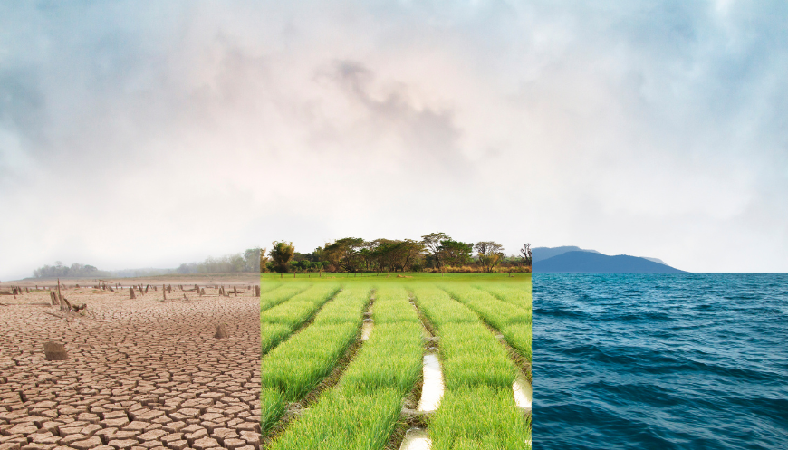
We're facing uncertainty – extreme weather, social shifts, eco-anxiety.
Climate turbulence is the new normal. Heat-waves, storms, and slow-burn shifts (like biodiversity loss) disrupt our daily lives, economies, and mental health.
Resilience helps us cope, adapt, and support each other in the long run.
1.2
Climate resilience

Slide 7
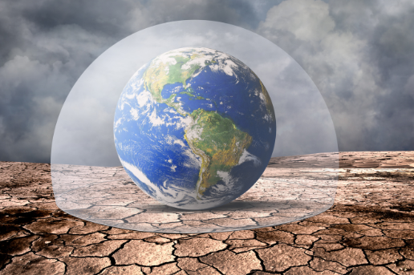
Which climate impact have you personally felt?
Extreme heat, storms, supply-chain issues, eco-anxiety or any other?

Slide 8
Climate change can trigger emotions like:
Deep sense of grief
Anxiety
Overwhelm
Developing mental resilience can help us:
Acknowledge these feelings — without being consumed by them
Stay engaged
Maintain hope
Continue to take meaningful action — even when the path ahead feels unclear
1.3
Mental resilience
The psychological and emotional strength that allows us to stay grounded in the face of uncertainty, loss, and change.

Slide 9
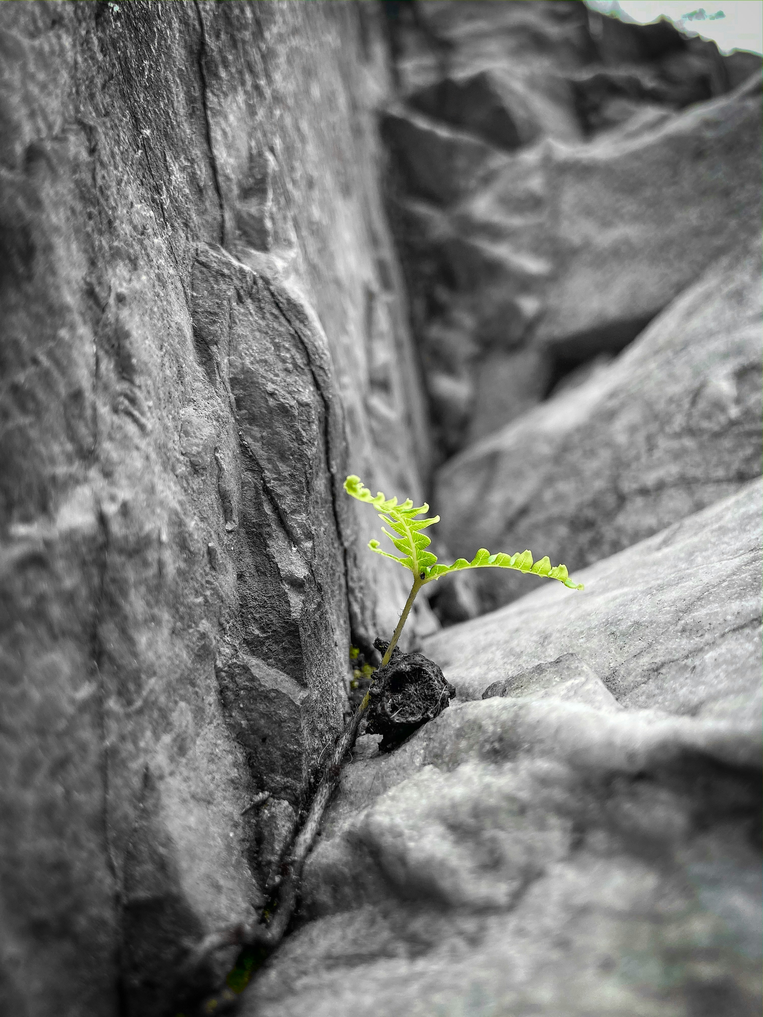
Resilience does not mean avoiding stress altogether, and as climate change brings unavoidable stressors that are happening on a global scale, it is in fact very hard to avoid them.
What matters most is how we respond - meeting these challenges without being overwhelmed or paralyzed.
Being exposed to stressors for a long time without resilience to them, can cause things such as:
Burnout
Depression
Poorer cognitive function
Photo by Rawan Ahmed on Unsplash

Slide 10

“Climate change can bring both external stressors — like extreme weather and displacement — and internal ones, such as fear, guilt, and helplessness.”
Photo by nikko macaspac on Unsplash

Slide 11
02
WHY RESILIENCE MATTERS

Slide 12
It‘s important to know what triggers us
In the next two sub-chapters, you‘ll first learn:
What Disrupts Us? Recognising the stressors
Types of changes that occur in the environment around us, how they materialise and affect us.
Spotting climate stressors, identifying fast and slow disruptions in your own region and how they affect mental, social, and cultural well-being.

Slide 13
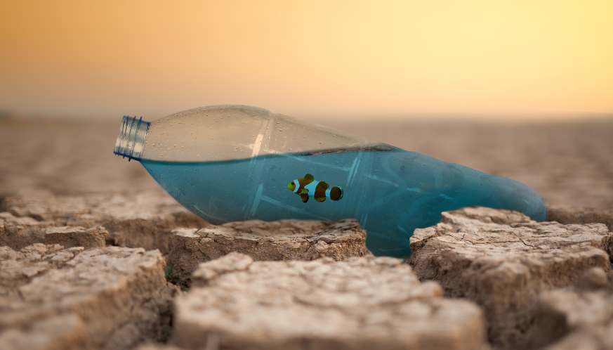
Sudden shocks: floods, fires, heatwaves
Slow-Onset Changes: drought, biodiversity loss, rising costs
Ripple Effects: Loss of homes, water, crops, damage to culture
(e.g. local food, crafts), emotional and social strain
2.1
What Disrupts Us?
“Have you, or someone you know, experienced a 'climate disruption’?
What changed afterwards?”

Slide 14
Climate change brings both external stressors — like extreme weather and displacement — and internal ones, such as fear, guilt, and helplessness.
2.2 Recognising the stressors
Recognizing and naming these feelings is the first step toward resilience. When we acknowledge what we’re experiencing instead of suppressing it, we create space to respond thoughtfully.
This helps us understand:
What we CAN control
What we CAN NOT
Where our actions can have the GREATEST IMPACT

Slide 15

“Climate change is a collective issue, and while no single person can carry the entire weight, each of us has a role to play."
But by identifying our personal and professional roles, we can:
Align our efforts with purpose
Avoid becoming overwhelmed by the
scale of the crisis.
Photo by Jens Johnsson

Slide 16
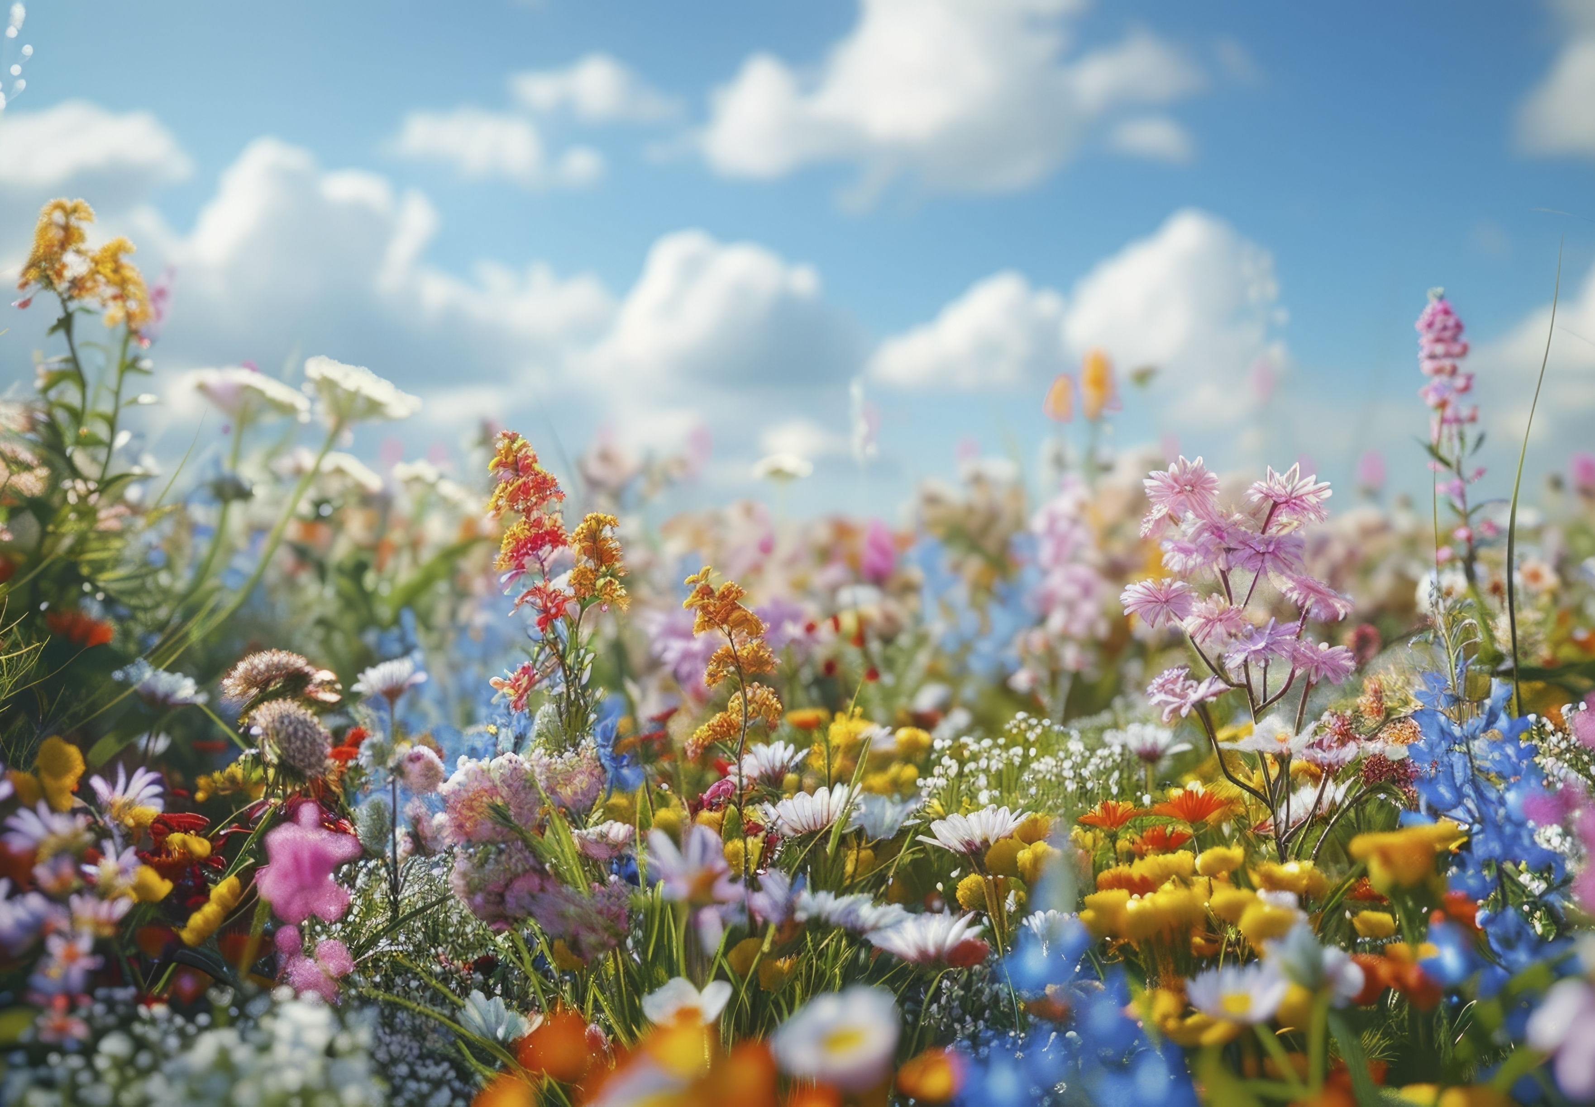
“In the end, surviving is not the same as thriving.
Resilience is what helps us move beyond survival, toward meaningful action and well-being.”
Source

Slide 17
Take action!
Once you‘re aware, you can start to adjust your life. The next two sub-chapter explain:
Resilience building Dimensions of resilience
Step-by-step actions to building resilience.
Learn what resilience is, what different dimensions it holds and how you can benefit from each aspect.

Slide 18
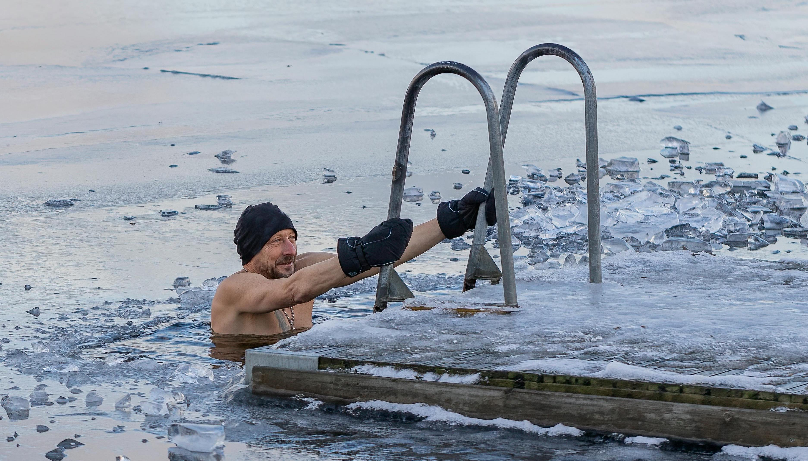
1. You cannot build resilience by trying to suppress what you are experiencing.
2. If someone tells you not to think about something, that thought often becomes even more present in your mind.
3. This is especially true when it comes to daily realities like the visible impacts of climate change.
2.3
Resilience building

Slide 19
4. Whether it's extreme weather, rising sea levels, or changes in local ecosystems — these events are part of everyday life for many people.
6. Psychologically, the effort to block out difficult thoughts often makes them more intrusive.
5. Ignoring them only increases stress and awareness, rather than helping to cope.
“Resilience comes from facing these realities, processing them, and finding ways to adapt and respond.”

Slide 20
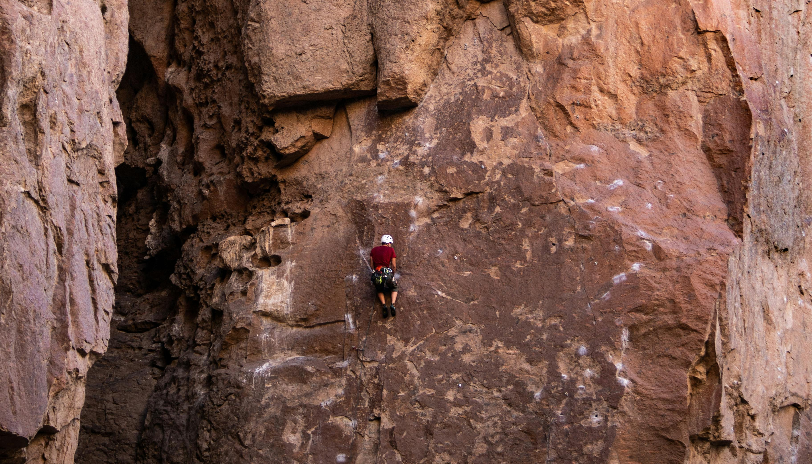
There are different sides to resilience:
Emotional Resilience: Handling fear, grief, uncertainty
Physical Resilience: Being ready (food skills, first aid, basic tools)
Cultural Resilience: Keeping traditions alive, sharing knowledge
Social Resilience: Strong networks, solidarity, community care
2.4 Dimensions of resilience
Photo by Nicolas Diaz

Slide 21
Activity (2 minutes)
Reflect:
Think of a time when you faced a personal challenge.
What helped you get through it?

Slide 22
03
WHAT MAKES US RESILIENT?

Slide 23
Two Types of Resilience:
Individual Resilience Collective Resilience
• Your mental and emotional strength to face change
• Ability to cope with stress, adapt to new conditions, and care for your wellbeing
• Includes practices like mindfulness, rest, healthy routines, and emotional expression
• Collective capacity to prepare, respond, and recover from crisis
• Built on trust, shared values, local knowledge, and cooperation
• Examples: community gardens, mutual aid groups, traditional rebuilding after disasters

Slide 24
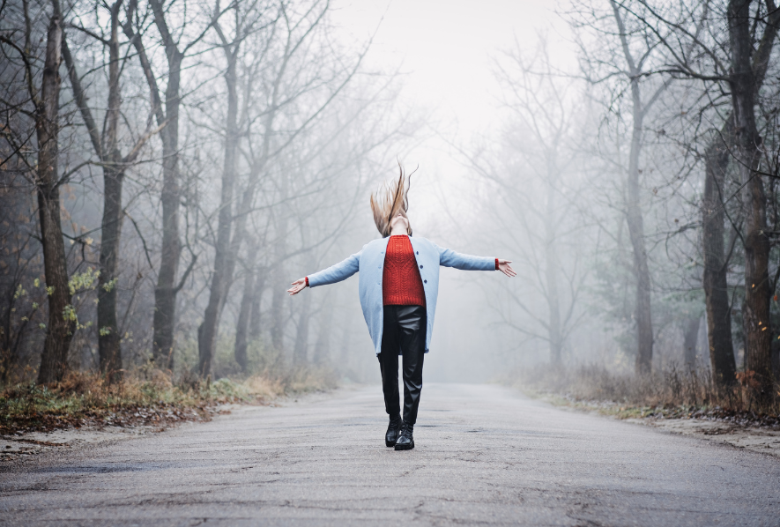
What is individual resilience?
A resilient person is someone who:
Is less likely to experience overwhelming negative emotions
Embraces challenges
Maintains strong social connections
However, it's harder to stay resilient when facing global-scale challenges (e.g. climate change, pandemics, war).
3.1 Individual resilience

Slide 25
So how can we build personal resilience?
It depends on the individual. There is no one-size-fits-all approach.
Find what works for you—and practice it regularly.
Mind-based strategies:
Meditation
Breathing exercises
Journaling
Action-based strategies:
Physical activity (sports, walking, dance)
Hands-on tasks (crafts, gardening, repairing things)

Slide 26
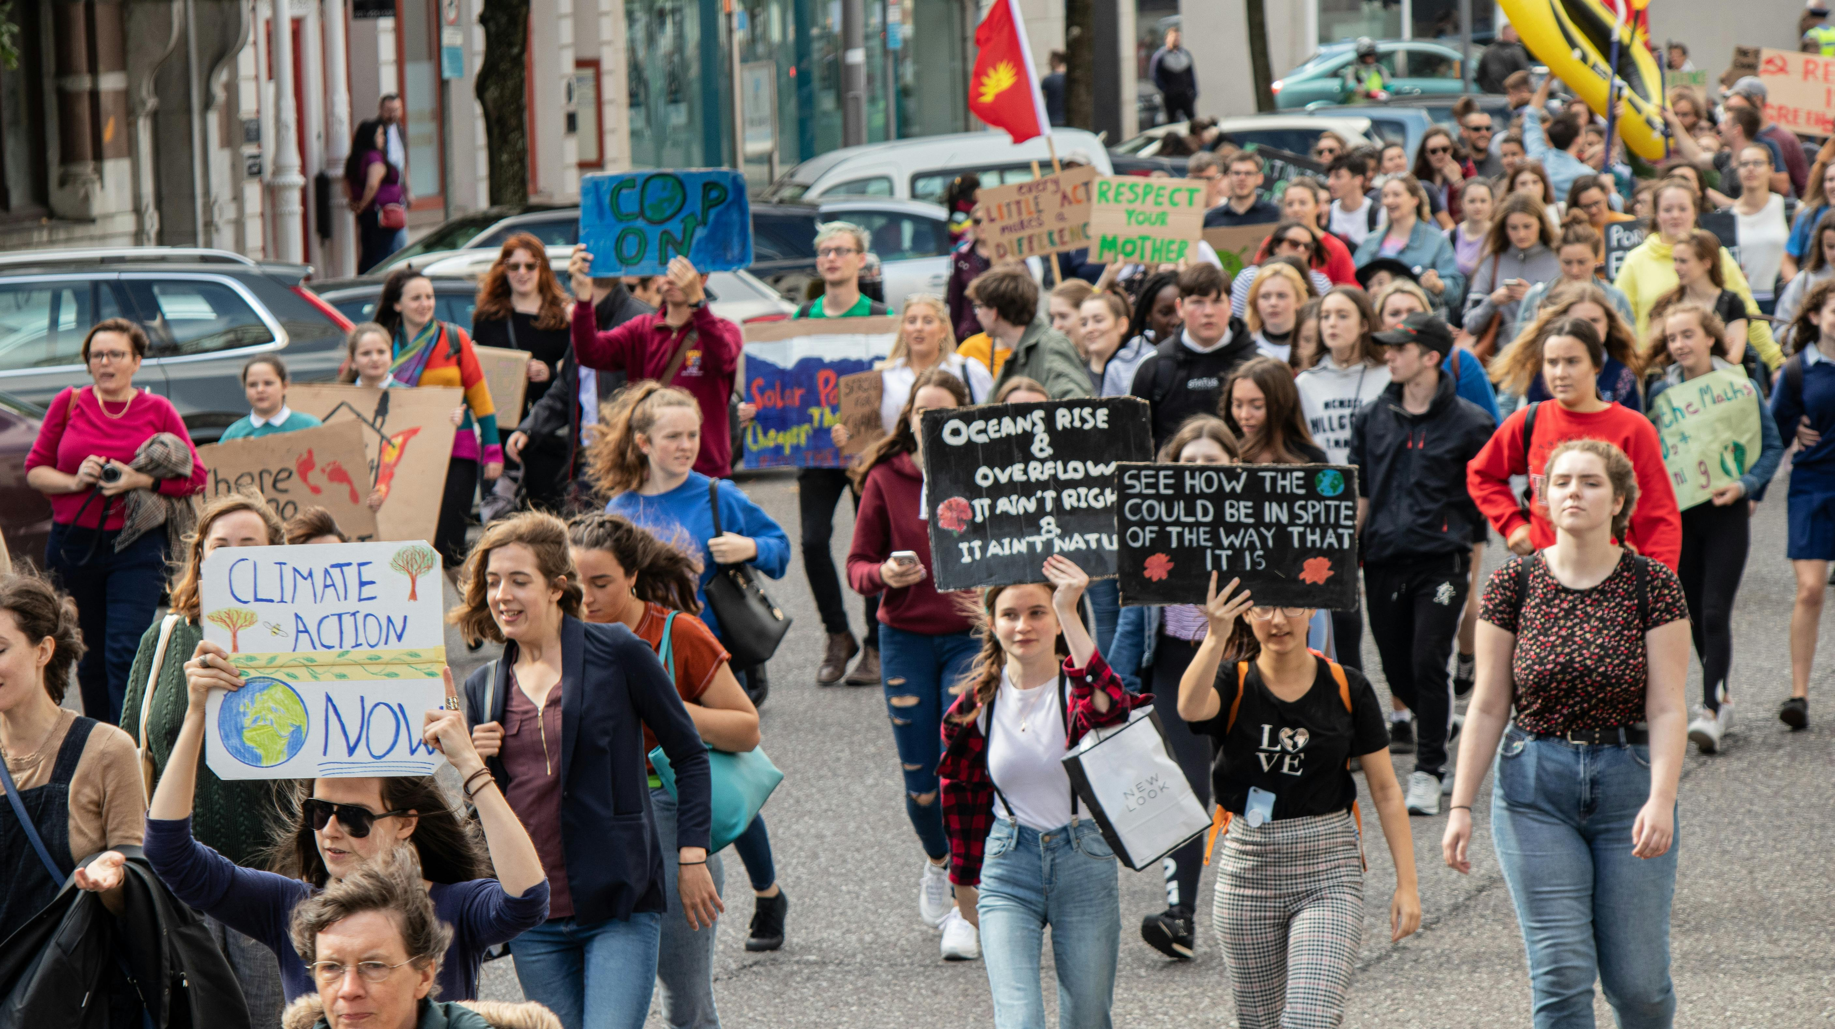
3.2 Collective Resilience
Why is community important?
We are not meant to face challenges alone.

Slide 27
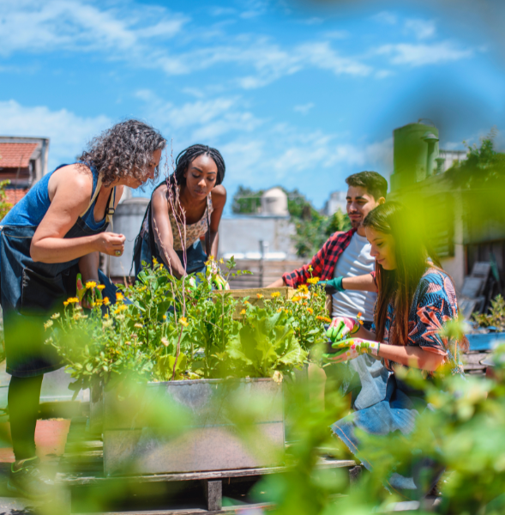
The role of community in resilience-building
Collective resilience is the ability of a group to adapt and recover together.
It’s built through:
Trust
Cooperation
Shared purpose
Communities that are connected—through relationships, shared spaces, or common goals—are better able to support one another during crises.

Slide 28
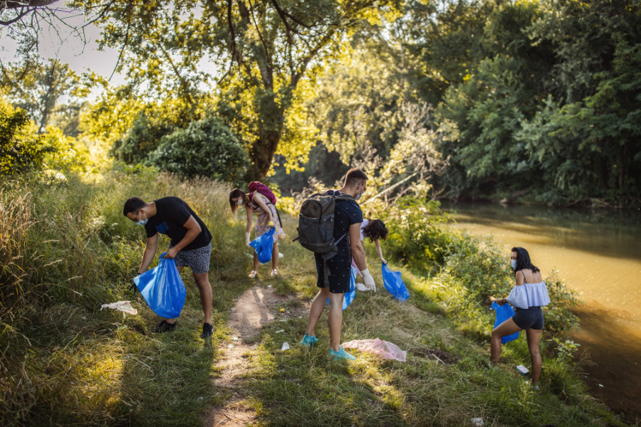
What does it look like in everyday life?
Neighbours helping during a flood
A local group offering mental health support
Babysitting a friend’s child
Feeding a neighbour’s cat while they’re away
Cultural events that create a sense of identity
Source

Slide 29
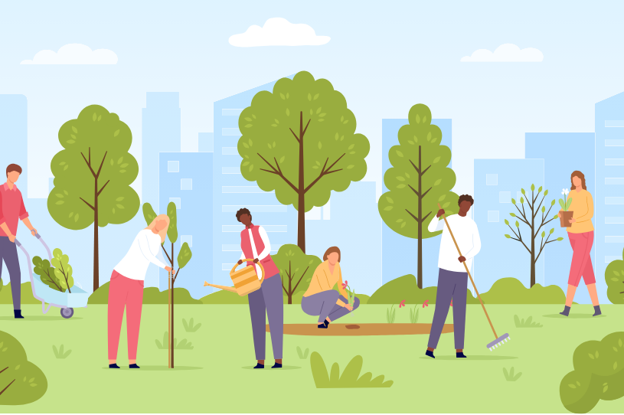
Together we are stronger.
When people feel seen, supported, and connected, they recover better from crisis and stress.

Slide 30
Activity (2 min)
Think of 2–3 communities you are part of:
(e.g. local neighbourhood, youth group, club, church, online group…)
Creating spaces where people can connect, share experiences, and offer support helps build emotional and practical safety nets that benefit everyone.
Resilience isn't just about “me”—it's also about “we.”

Slide 31
Ecosystems go through cycles of:
Growth
Disruption
Recovery
Transformation
3.3
Nature’s cycles and lessons
Examples:
Forests regrow after wildfires
Rivers shift course to adapt to terrain
Animals evolve to survive in changing environments
Nature = The Ultimate Teacher of Resilience

Slide 32
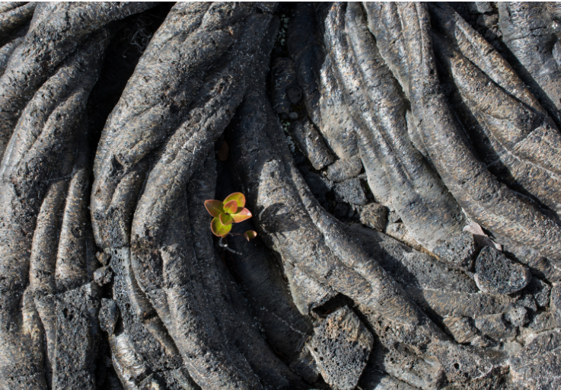
Nature’s message to us:
Don’t resist change.
Respond to it.
Flexibility is strength
Let yourself change, adapt, and evolve.

Slide 33
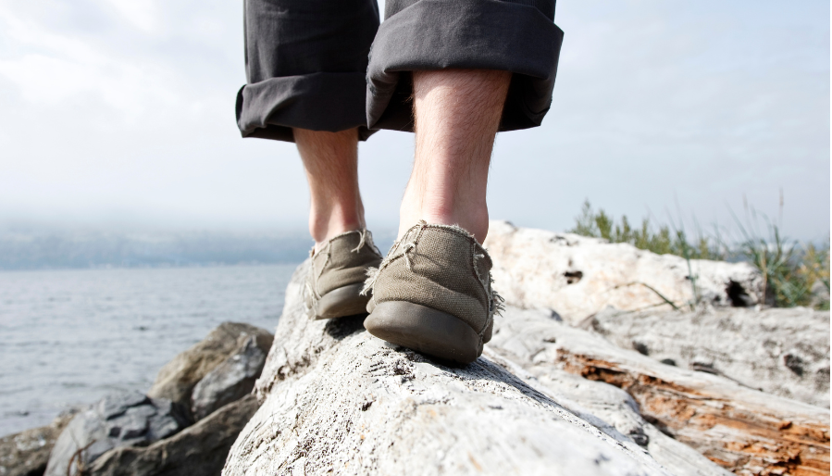
Resilience begins in your mindset.
Shift from fear-based to possibility-based thinking.
Instead of:
“What if I fail?”
Try:
“What if I learn something?”
“What if this turns out well?”
3.4 Training to Be More Resilient

Slide 34

Small Actions, Big Change
Resilience is built by:
Facing setbacks and learning from them
Pursuing meaningful goals
Starting small
Being consistent
Don’t aim for overnight transformation.
Take small steps that align with your values.

Slide 35

Be Kind to Yourself
Be kind to yourself when progress isn’t perfect—progress rarely is.
Show yourself compassion, not criticism, when things don’t go perfectly
Resilience ≠ never failing
Resilience = bouncing back when you do

Slide 36
Activity (2 min)
Write down 3 challenges you’re facing.
Now write the best possible outcome for each one.
Key Takeaways
Start small
Focus on purpose
Learn from setbacks
Be kind to yourself
Resilience is not one big moment—it’s many small, intentional choices.

Slide 37
04
PRACTICAL TOOLS

Slide 38
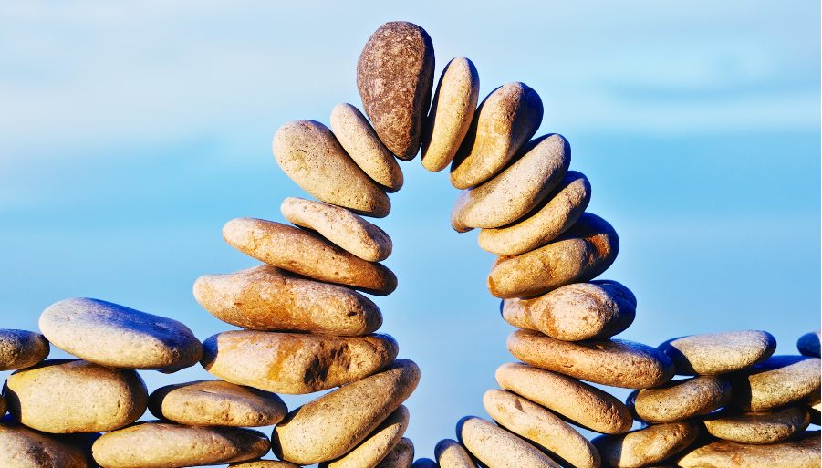
Understanding hyperarousal & hypoarousal
In a world of overlapping crises, our nervous systems are under constant stress. This can push us outside our “window of tolerance”.
Window of tolerance is the state where we can think, feel, and act effectively.
When we tip into hyperarousal, we may feel emotionally overwhelmed and unable to calm down.
In hypoarousal, we may shut down, becoming numb or unmotivated.
4.1
The Resilience Window

Slide 39
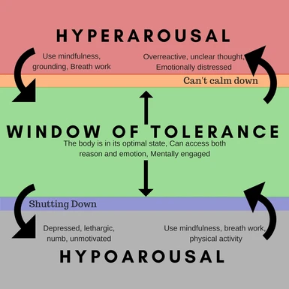
Balancing between hyperarousal and hypoarousal
Signs you’re outside the window:
Resilience = noticing the signs + coming back to balance..
HYPERAROUSAL
HYPOAROUSAL
Overwhelmed
Anxious
Can’t calm down
Numb
Withdrawn
Unmotivated

Slide 40

Tools to return to your window:
Breathwork
Movement or sports
Mindfulness
Creativity
Engaging with nature
The key isn’t to avoid difficult emotions but to work with them, embracing discomfort as part of growth.
Resilience means responding with flexibility and care, using imagination, connection, and creative expression to thrive even in uncertain times.

Slide 41
Small acts = big emotional shifts
4.2
Turning Physical into Mental Resilience
For some people, preparing for life's uncertainties through tangible actions can significantly bolster their emotional well-being.
Physical actions can calm the nervous system and boost your sense of agency.
Proactive, hands-on engagement with our environment can bring profound emotional benefits, helping us better navigate life’s challenges.

Slide 42
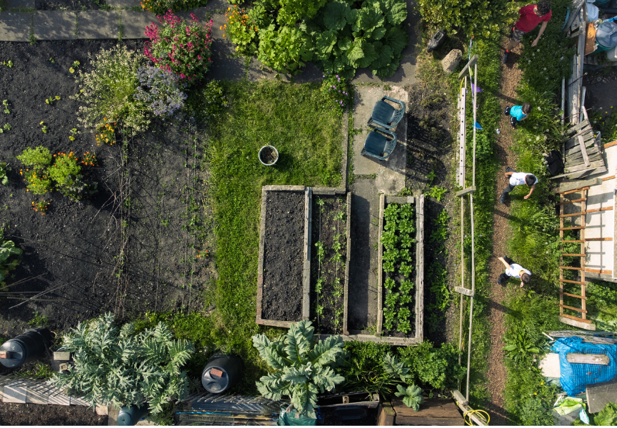
Example: Community Gardening
Why gardening works:
Builds routine and presence
Creates connection to life cycles
Offers tangible progress and control
Research shows*:
Improved mental health
Increased self-esteem and optimism
Boosted resilience in community gardening settings
*International Journal of Environmental Research and Public Health

Slide 43
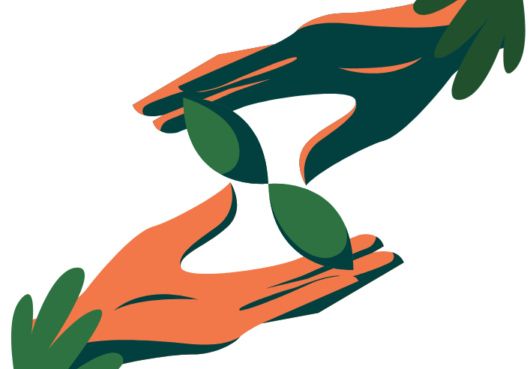
“Growing something small can help grow your strength inside.”

Slide 44

Building resilience through connection with self, creativity, and nature
Calm activities help release stress and process emotions:
Drawing, painting, writing, journaling
Listening to music or creating art
Sitting quietly in nature
4.3
Creative & Natural Pathways to Resilience

Slide 45
Calm activities:
Exploring how creative expression fosters emotional processing and stress relief:
Drawing, writing, painting, or crafting can help you express feelings you might not have words for. These calm, personal activities help release stress and bring clarity during difficult times.
Engaging with nature for grounding, mindfulness, and perspective-shifting:
Spending quiet time in nature can reduce anxiety and help you feel more present. Nature reminds us of life’s rhythms and our connection to something bigger.
Ideas for activities in nature: walks in the park, observing trees or sky, listening to natural sounds, noticing seasonal changes

Slide 46
Calm activities:
Movement-based expression as pathways to resilience:
Playing music, dancing, or even gentle stretching can shift your mood, release tension, and reconnect you with your body. These creative outlets can restore energy, boost confidence, build inner strength and emotional regulation.
Active time spent in nature can be a tool to build resilience:
Not all nature time has to be calm. Hiking, climbing, swimming, biking, or even helping in a community garden are great ways to build physical and emotional resilience. Moving outdoors challenges your body, clears your mind, and boosts confidence—especially when done regularly or with others.

Slide 47
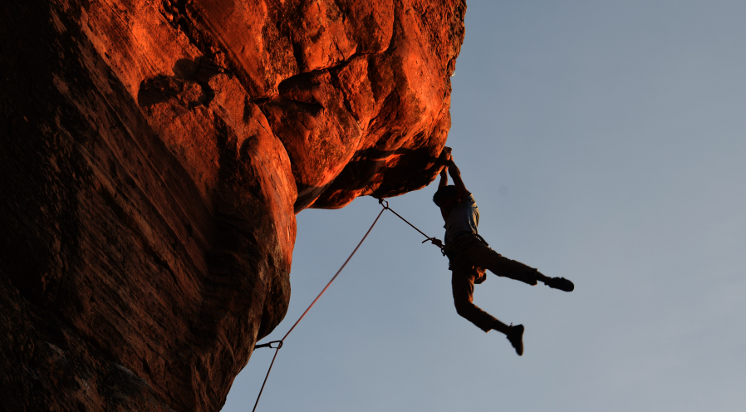
4.4 Flow State: Deep Focus as a Pathway to Resilience
Beyond calm reflection and nature-based grounding, resilience also grows through deep, focused engagement.
What is flow?
A state of deep focus where time disappears, distractions fade, you’re completely in the zone and you're fully immersed in an activity that challenges and excites you.

Slide 48

Flow = active attention
In flow, the usual noise of the mind—self-doubt, stress, hunger—quietly drops away. What’s left is pure focus and purpose.
Moments of full engagement help us build:
a deeper connection to ourselves, confidence, purpose, joy, fulfillment, mental strength.
Moments of flow are often the most meaningful parts of our lives.
Recognised by psychologists Mihaly Csikszentmihalyi and Jeanne Nakamura, flow sate is a kind of moving meditation.

Slide 49
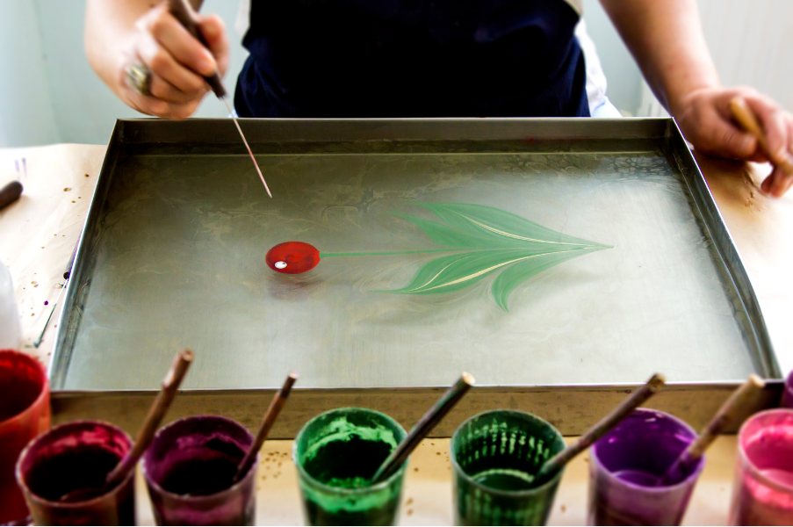
Flow = active attention
While calm activities like meditation and mindfulness help train our attention, flow is where that focused attention becomes active.
By regularly engaging in challenging and enjoyable we create the perfect conditions for flow to arise.
Examples of actvities:
dancing
climbing
painting,
coding
playing an instrument
hiking up a trail
rehearsing a dance routine
writing music

Slide 50

“There’s this focus that, once it becomes intense, leads to a sense of ecstasy, a sense of clarity: you know exactly what you want to do from one moment to the other; you get immediate feedback.”
Mihaly Csikszentmihalyi

Slide 51
05
RESILIENCE IN ACTION
Click to type..
Foto: Rožle Bergant

Slide 52
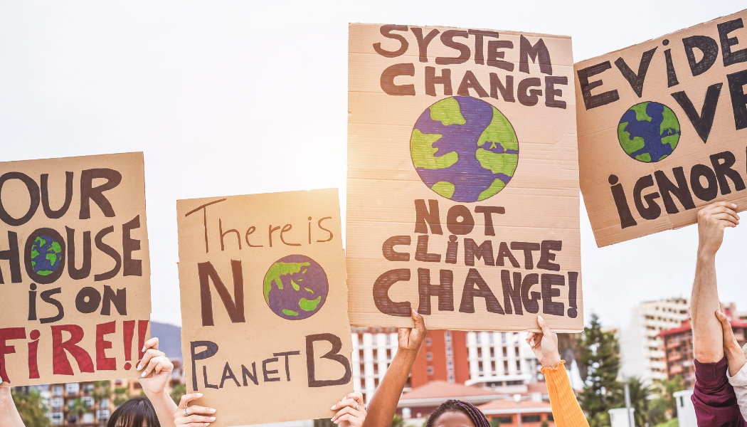
From worry to courage
Young people today are growing up in the shadow of climate change—heatwaves, wildfires, floods, and political inaction.
It’s normal to feel overwhelmed. That feeling has a name: climate anxiety.
Feelings of urgency and overload are common—but so are innovation, solidarity, and care
But anxiety doesn't have to lead to helplessness.
Taking action—even small steps—can turn fear into empowerment.
5.1
Turning climate anxiety into constructive action

Slide 53
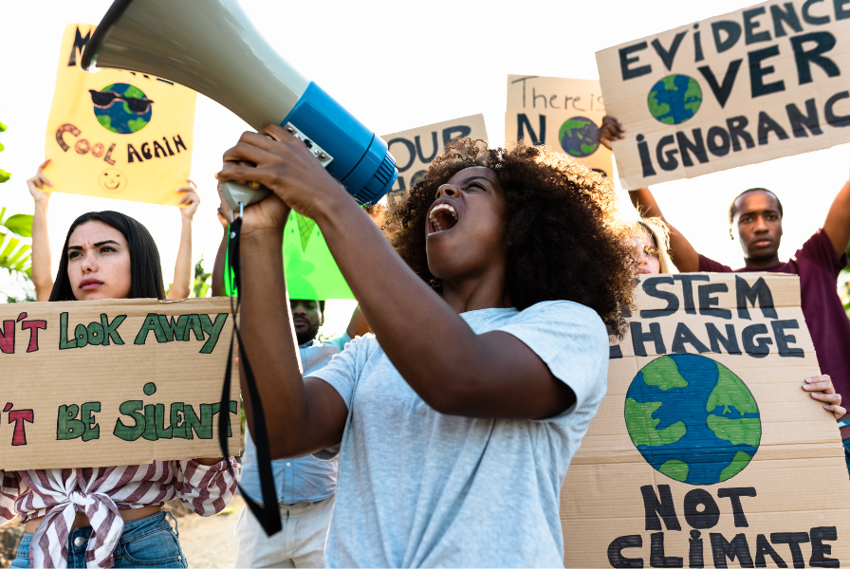
“We are not too young to lead. We are not too young to build a better world.” – youth climate activist

Slide 54
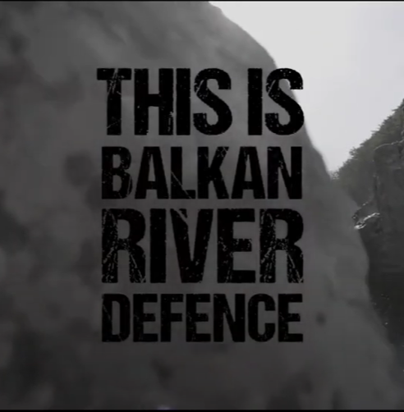
Example: Balkan River Defence
Began with kayakers who loved wild rivers
Concerned by plans for hydropower dams
Started paddling, documenting, sharing
Grew into a movement defending Europe’s last free rivers
Resilience = noticing the signs + coming back to balance..
“You don’t need to be an expert or a professional activist to make a difference. Just bring together your passions with a cause you care about, you can build real momentum for change.”

Slide 55
Activity – Watch: Balkan River Defence video
The founders of Balkan River Defence were not famous activists or scientists—they were regular people who loved kayaking. But they used that passion to protect the rivers they cared about, inspiring thousands of others in the process.
Now it’s your turn to reflect:
What do you love doing? (Biking? Cooking? Filmmaking?)
How could that help a cause you care about?
What’s one small action you could take?

Slide 56
Activity - Your Passion, Your Power
Write a short paragraph or make a visual (like a poster or mind map) showing how your personal hobby or skill could help protect the planet, support your community, or raise awareness about something important to you.
Show how your hobby could:
Protect the planet
Support your community
Raise awareness

Slide 57
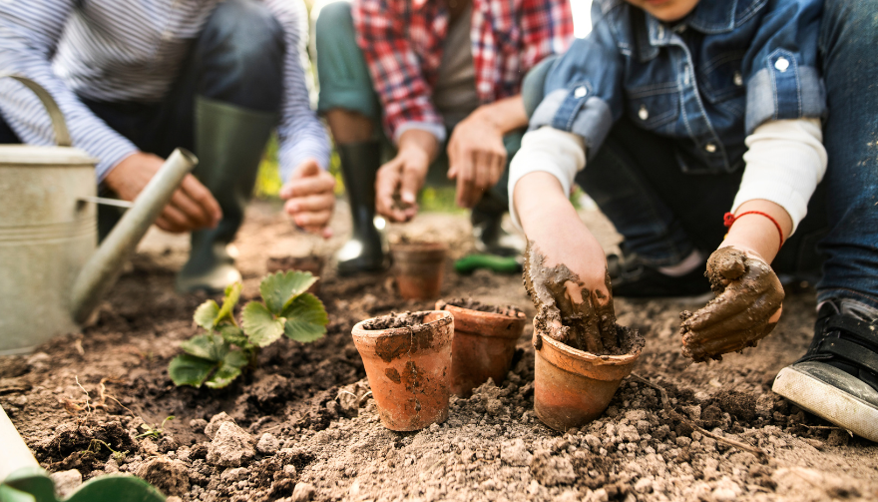
You don’t have to do it alone
Joining a supportive network makes climate action feel less overwhelming and more hopeful.
Supportive networks:
youth climate organizations (e.g., Fridays for Future),
school eco-clubs,
community garden groups,
online forums for youth action
5.2
Finding Strength in Community

Slide 58

Resilient Spaces: Where we gather shapes how we cope
Shared motivation
Tools and resources
Emotional support
A chance to make friends and allies
Talking with others who share your concerns, learning from experts, or collaborating on local projects can make the work feel lighter and more hopeful.

Slide 59
Local action matters!
You also don’t need to launch a global campaign to make a difference. Most of the time small, local efforts matter just as much if not more.
For example, if you're in a hiking or climbing group, you can:
Share how to respect nature while outdoors
Help newcomers understand local ethics
Pick up trash or organize clean-ups
Talk about wildlife and habitat care
Set a good example for others
These acts build:
Environmental responsibility
Social connection
Community care
By encouraging others around you, you’re creating a ripple effect that spreads beyond yourself.

Slide 60
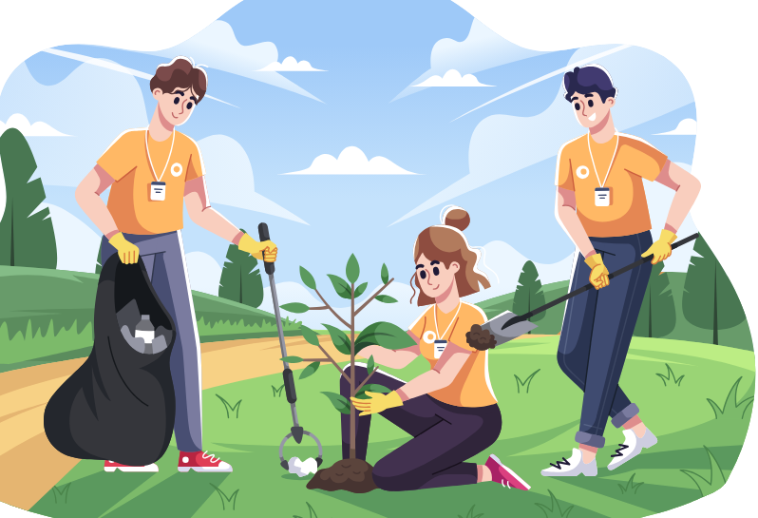
“Working together makes climate challenges feel more manageable, and it strengthens your sense of belonging and purpose.”

Slide 61
Activity – Watch: Stone Locals
Watch parts of this film about a family of climbers creating a more sustainable outdoor culture:
🔗 Climbing, community, and resilience
Watch:
Intro: 08:30–13:00
Climbing community: 25:15–27:10
Responsibility & action: 37:25–39:45
Reflect:
What values do they show?
How do they connect passion with care for others and the planet?

Slide 62
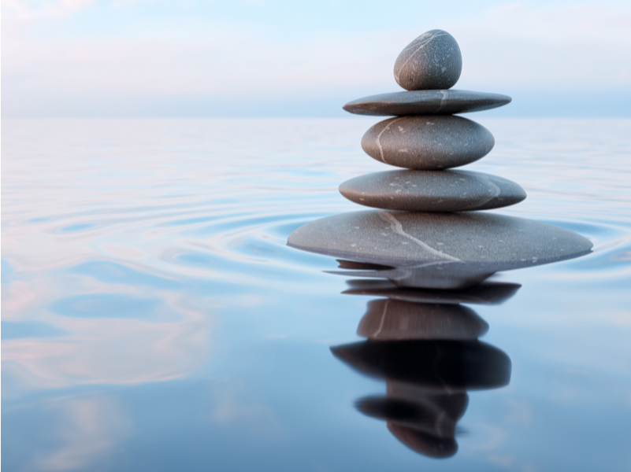
„We build resilience by showing up for ourselves—and each other—one small step at a time.“

Slide 63
Thank you
Any Questions?
www.planetpulse.eu

