Slide 1
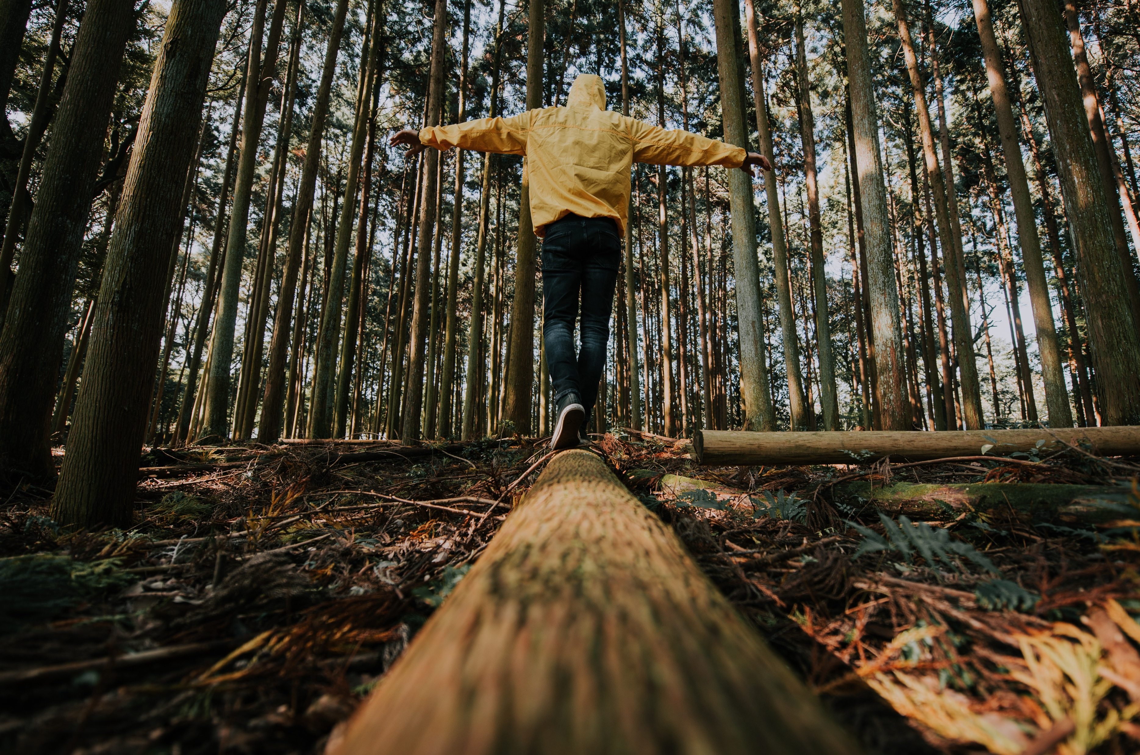

Module 1
Climate Anxiety
www.planet-pulse.eu

Slide 2
Module Overview
Module 1 helps young people understand climate anxiety as a natural response to the climate crisis. It explores the emotional, social, and political roots of these feelings and offers practical strategies to manage them. Through reflection, activities, and real examples, learners are supported to move from anxiety to action, recognising their own power to contribute to change and shape hopeful climate narratives.
01
What is Climate Anxiety?
02
The Science Behind Climate Anxiety
03
Building Climate Resilience
04
The Power of Community Support
05
From Anxiety to Empowerment
06
Shaping the Narrative on Climate Anxiety

Slide 3
Learning Objectives of Module 1
By the end of this module, you should be able to…
Understand what climate anxiety is and why it is a normal emotional response.
Explore how media, personal experiences, and global inaction shape your emotions.
Identify healthy coping strategies to manage anxiety and build emotional resilience.
Recognise the importance of peer support and collective action in reducing climate stress.
Discover your personal role in contributing to climate solutions, big or small.
Communicate about climate issues in ways that inspire hope, not panic
Use your voice to help shape a more honest and empowering climate narrative.

Slide 4
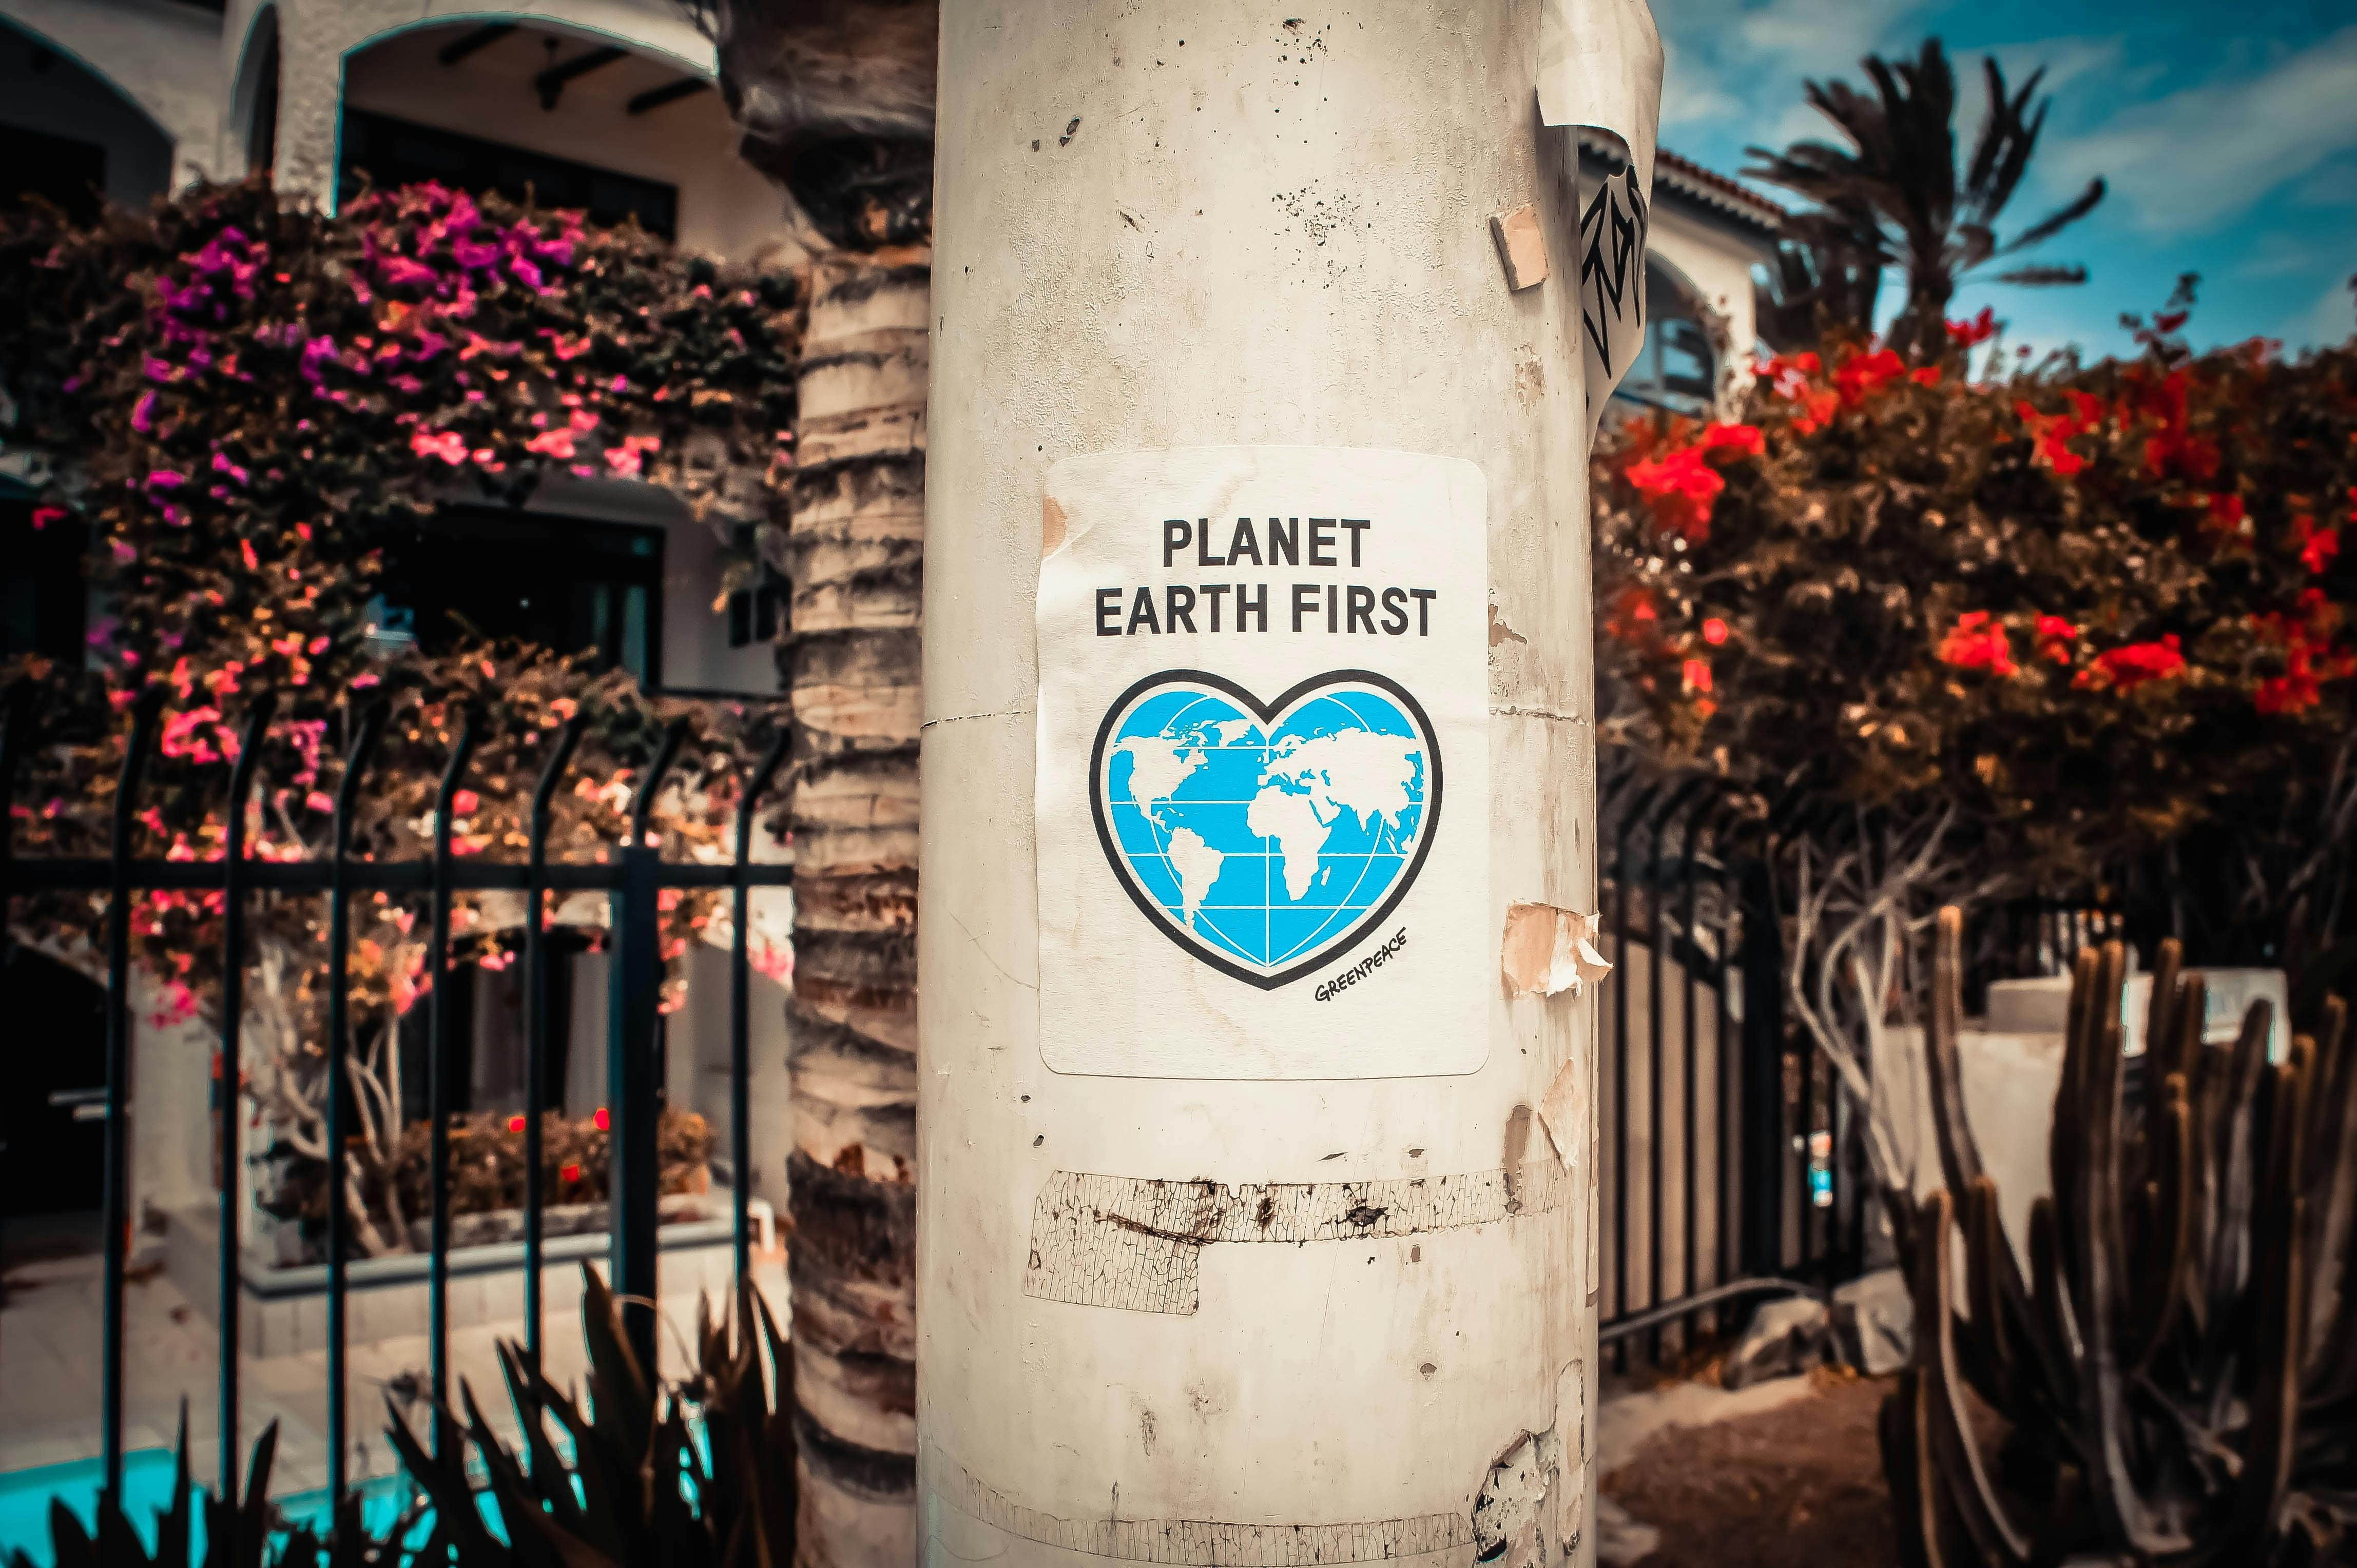
01
Unit 1
What is Climate Anxiety? Understanding the Emotional Landscape

Slide 5

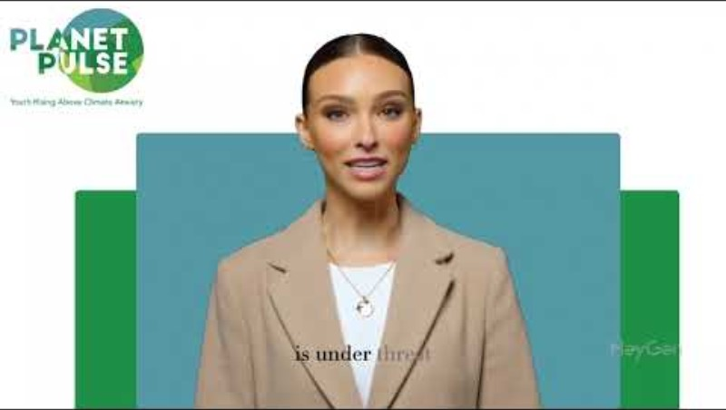
Welcome to Module 1 Climate Anxiety
Click here to watch Module 1 Introduction video

Slide 6

1.1
What is Climate Anxiety?
Climate anxiety, sometimes also called eco-anxiety, refers to the emotional, cognitive, and behavioural responses connected to concerns about climate change. It is important to understand that this is a rational and healthy response to the reality of environmental threats, not a mental illness or disorder.

Slide 7

1.1 What is Climate Anxiety?
Watch this short video on What is 'climate anxiety' and what to do about it
Psychologists Clayton and Karazsia (2020) define climate anxiety as "negative cognitive, emotional, and behavioural responses associated with concerns about climate change.“
When young people learn about deforestation, rising sea levels, or species extinction, it is natural to experience emotions like sadness, worry, or fear.
Feeling climate anxiety means you care deeply about the planet and its future. It is not something that should be suppressed, it is something that can drive positive change.

Slide 8
How Climate Change Affects Mental Health Globally
1.2
The effects of climate change go far beyond physical destruction. According to the World Health Organization (2022), climate change is one of the greatest health threats facing humanity, particularly for young people.
Young people are living with the knowledge that the future may be filled with more frequent natural disasters, food insecurity, displacement, and social disruption.
Even those who have not directly experienced these impacts can be affected emotionally through constant exposure to news reports, social media, and environmental campaigns.
Watching wildfires destroy forests in Australia, or floods displacing communities in Pakistan, can lead to a deep sense of helplessness and sadness, even from thousands of kilometres away. Understanding that these emotions are a normal global reaction can help you realise you are not alone

Slide 9
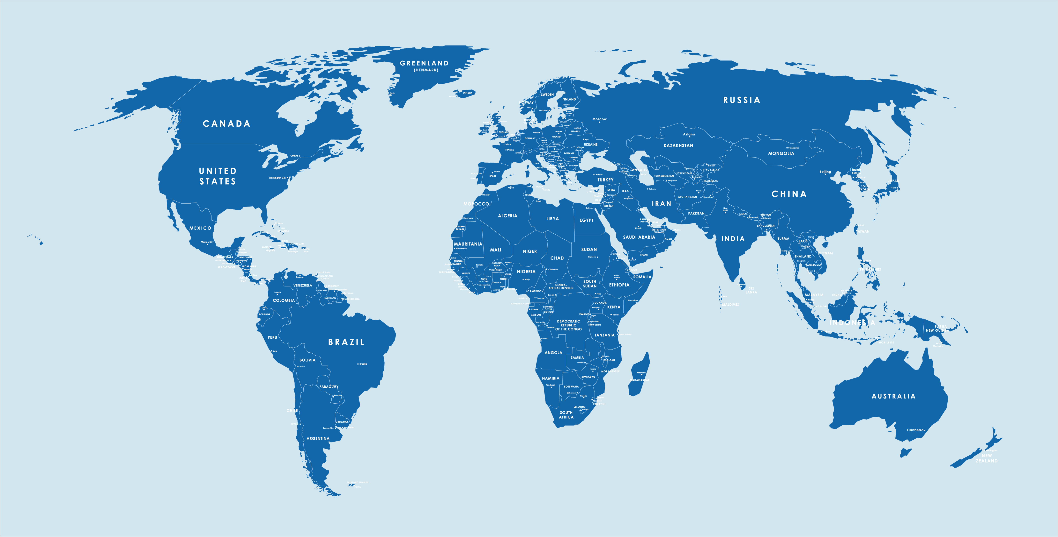
How Climate Change Affects Mental Health Globally
1.2
Activity!
Map Task – Pin two countries that have faced major climate impacts recently and discuss how you felt seeing those events
Click HERE to take part in the activity

Slide 10

1.3 What emotions are behind climate anxiety?
Climate anxiety is not one single feeling. It is a mix of many powerful emotions.
Common emotions linked to climate anxiety include fear, guilt, anger, grief, hopelessness, and even hope.
You might feel fear when thinking about extreme weather events, guilt over your personal carbon footprint, or anger at older generations or governments for failing to act.
Grief, known as solastalgia, is another powerful emotion — the deep sadness we feel when familiar natural environments are damaged or lost (Albrecht, 2005).

Slide 11
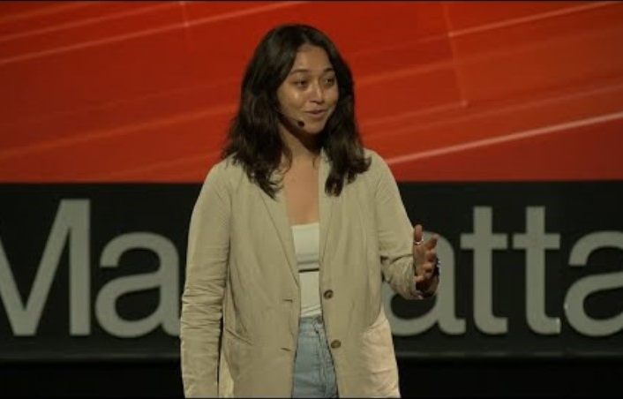
1.3 What Emotions Are Behind Climate Anxiety?
Watch this short video on Eco-anxiety to Climate Optimism | Lyn Stoler | TEDxManhattanBeach
At the same time, feeling hope is also part of the emotional landscape — hope that change is possible, hope that action is being taken, and hope that a better future can still be created.
Hickman et al. (2021) found that nearly 60% of young people globally are extremely worried about climate change, showing how widespread these feelings are.

Slide 12
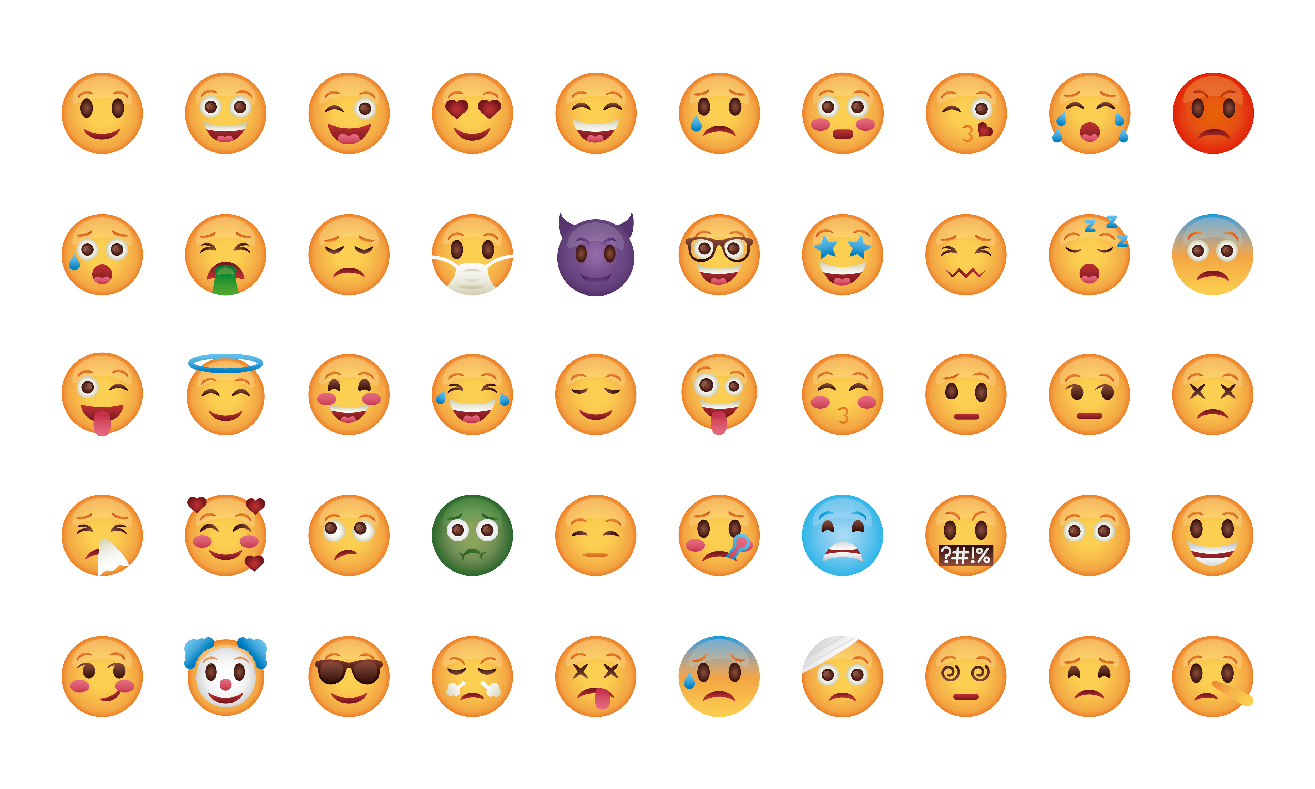
1.4 Activity - Emoji Wall
Choose an emoji that describes your climate feelings today and explain your choice.

Slide 13
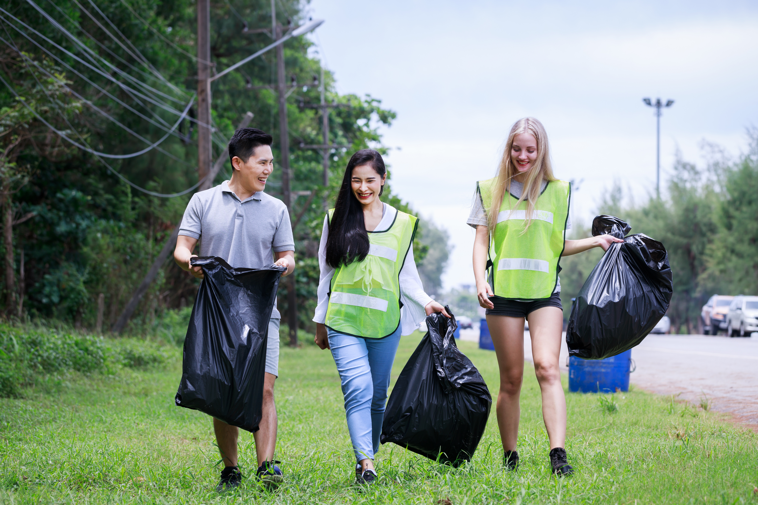
1.5 Healthy Concern vs. Paralysing Distress
It is important to understand the difference between healthy concern and paralysing distress.
Healthy concern pushes us to learn more, join discussions, support change, and find solutions. It keeps us alert and connected to what matters.
On the other hand, paralysing distress can lead to feeling stuck, helpless, and unable to act. It can cause withdrawal from conversations or create a sense of fatalism — the belief that nothing can be done to help.
Both reactions are normal. What matters is recognising when anxiety begins to block us, and learning how to gently guide ourselves back into constructive action. The goal is not to ignore fear, but to use it as a signal to focus our energy where it can make a difference.
1.5

Slide 14
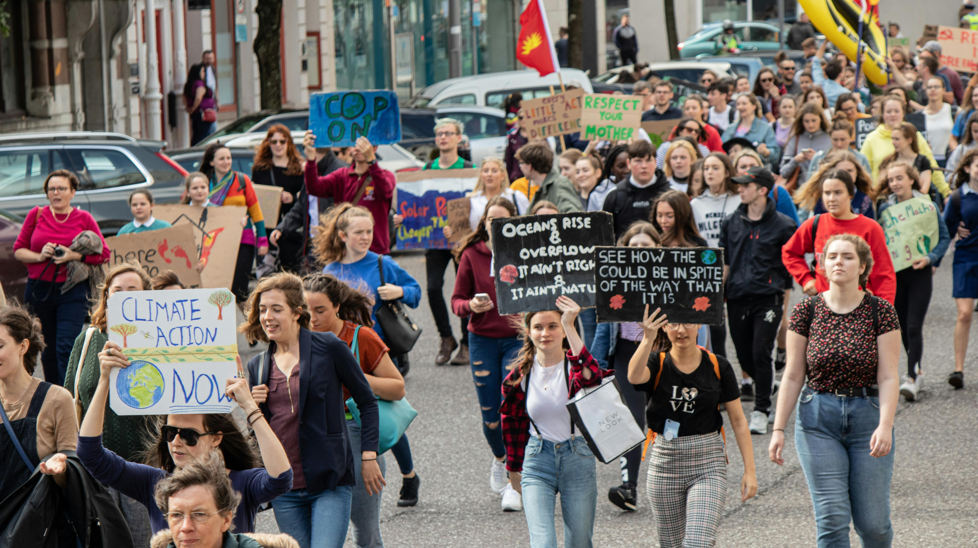
1.5 Activity - Reflection
With a partner discuss, or write in your journal, about a time when fear or worry helped you make a positive change in your life

Slide 15
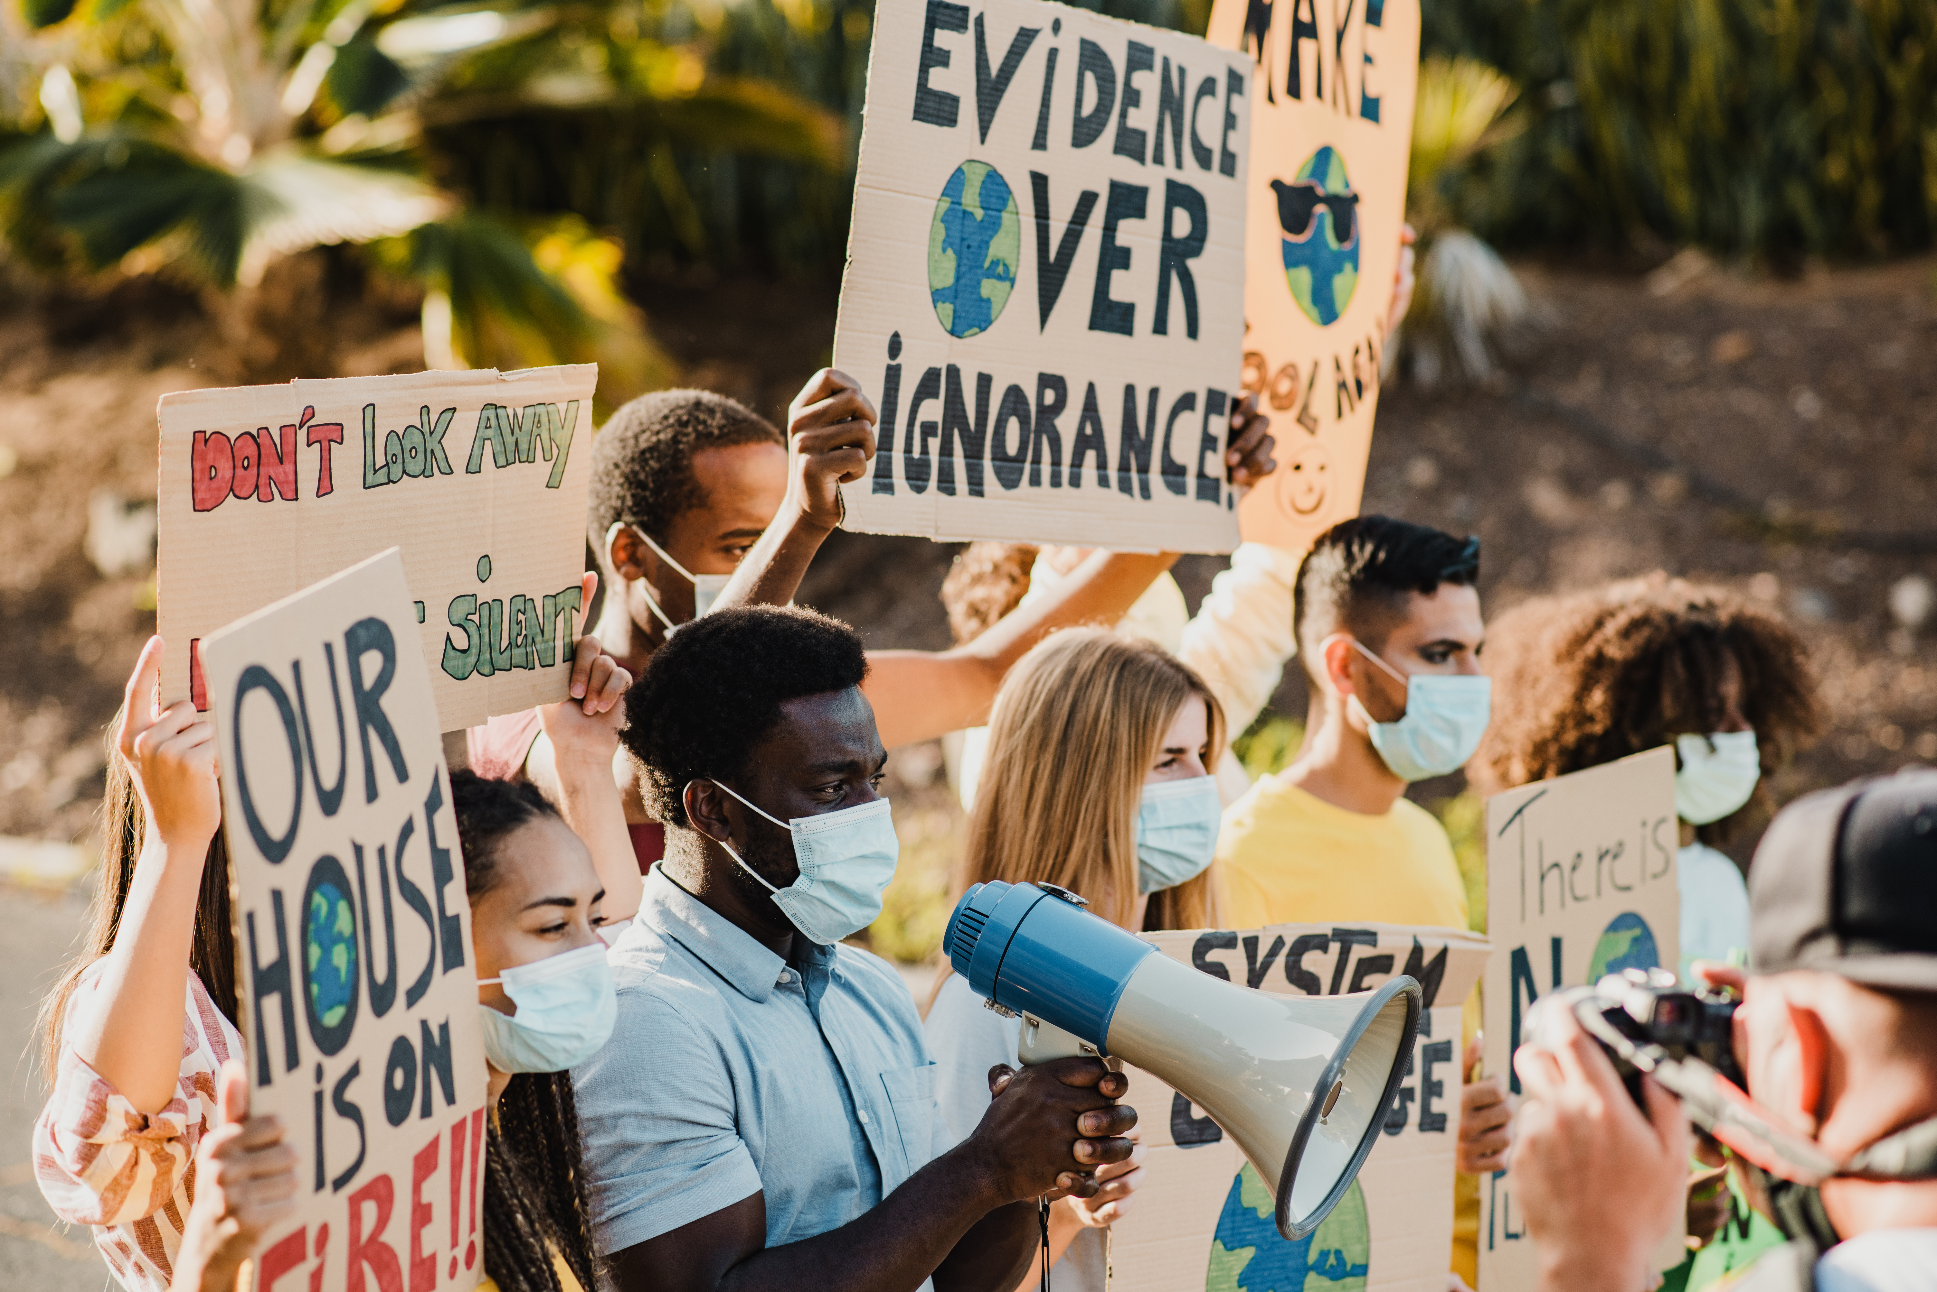
02
Unit 2
Why Do We Feel This Way? The Science Behind Climate Anxiety

Slide 16
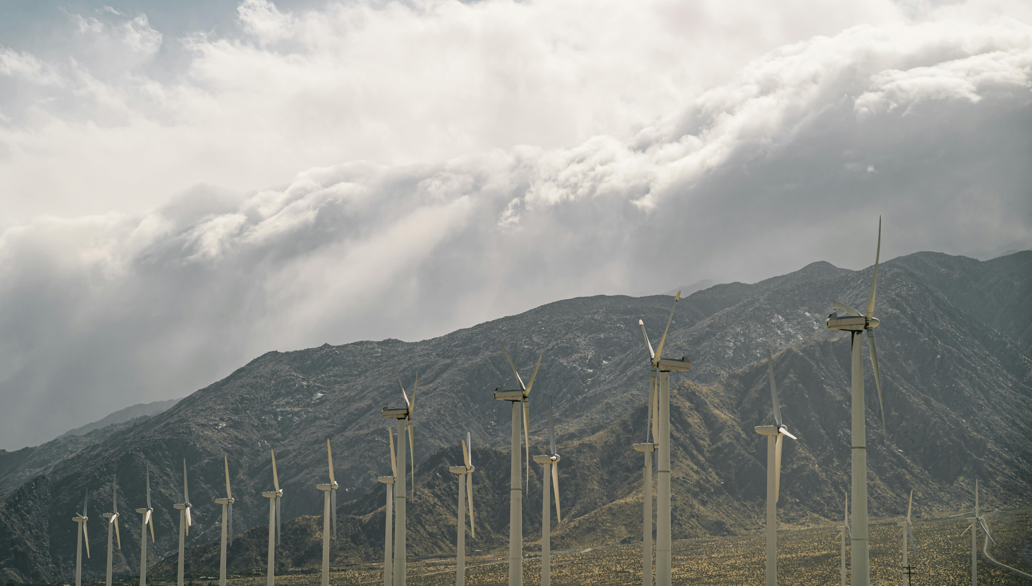
2.1 The role of media and social Networks
Today, we are surrounded by a 24/7 news cycle.
Every time we open our phones, watch television, or scroll through social media, we are likely to see stories about floods, fires, droughts, and other disasters linked to climate change.
While staying informed is important, constant exposure to frightening news can create what psychologists call "media-induced anxiety.“
This means that even if we are not directly experiencing a climate event ourselves, we can still feel stressed, overwhelmed, and helpless just from seeing and hearing about them repeatedly. Research (Clayton & Karazsia, 2020) shows that frequent negative news increases feelings of fear and powerlessness — two major ingredients of climate anxiety. It is important to balance being informed with protecting our emotional wellbeing.
2.1

Slide 17
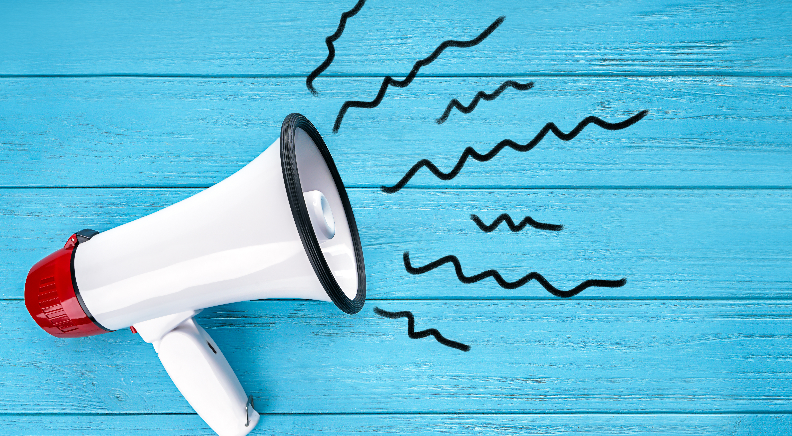
2.1 Activity
News Audit
Track how many climate-related news pieces you encounter in one day via TikTok, Instagram, Online news, News on radio/tv?
How did these make you feel?

Slide 18
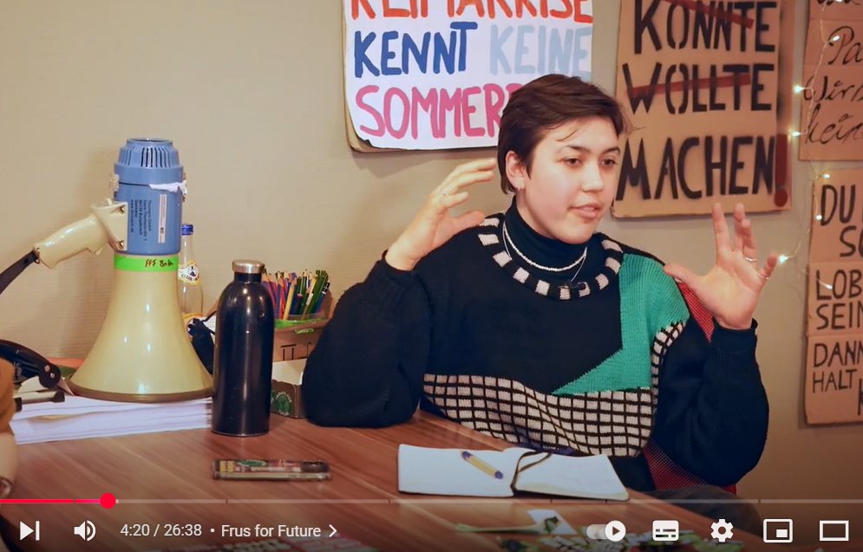
2.2 How personal and collective experiences shape climate emotions
Watch this short video Climate activist Helena Marschall, 20, takes us into a youth-led movement in Germany to get political leaders to act. And they are listening.
Our feelings about climate change are also shaped by our direct and indirect experiences.
A personal experience, like living through a heatwave or seeing a local river dry up, can trigger strong emotions like grief, anger, or fear.
Even if you have not directly experienced environmental changes, seeing your community or a place you love change can have a deep emotional impact.

Slide 19
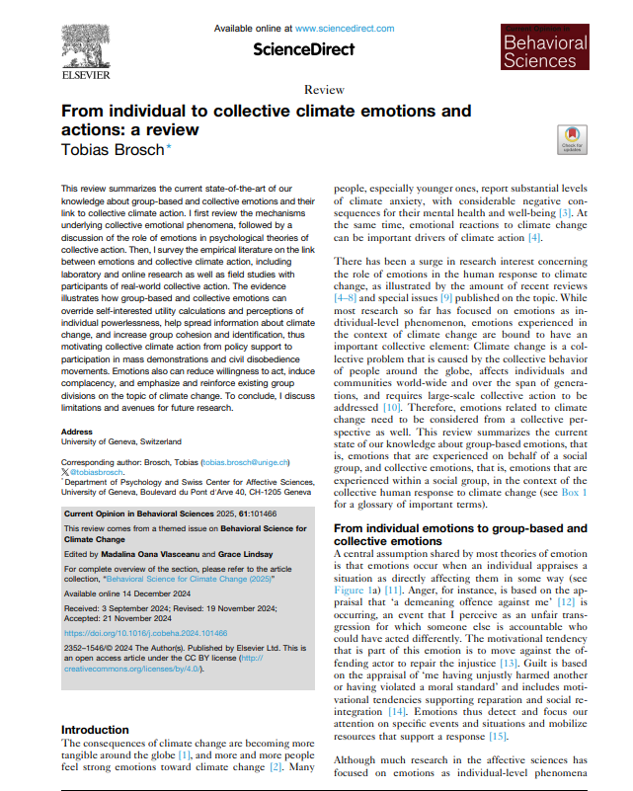
2.2 How personal and collective experiences shape climate emotions
Collective experiences, such as witnessing global movements like Fridays for Future or seeing climate protests on the news, can also create strong emotions, including solidarity, frustration, or hope.
Psychologists call this "vicarious experience" feeling emotionally connected to events even when we are not physically there.
Both personal and collective experiences help to explain why climate anxiety is so widespread among young people today.
“From individual to collective climate emotions and actions”
Tobias Brosch

Slide 20
2.2 Activity
Create a short video or blog about a time when nature or the environment made you feel emotional

Slide 21
Understanding Eco-Anxiety vs. Eco-Paralysis
Not all emotional responses to climate change are the same.
Eco-anxiety is when fear and concern motivate you to care, learn, and act.
It is a mobilising force, it pushes people to join environmental movements, change behaviours, and raise awareness.
2.3

Slide 22
Understanding Eco-Anxiety vs. Eco-Paralysis
Eco-paralysis, on the other hand, is when fear becomes so overwhelming that it stops action.
Someone experiencing eco-paralysis may feel that the situation is hopeless, that nothing they do will matter, or that change is impossible.
The difference between eco-anxiety and eco-paralysis is important because while both start with similar emotions, they lead to very different outcomes.
Recognising the early signs of paralysis (e.g., withdrawing from conversations, feeling frozen or numb) helps us to seek support and reconnect with hope and action.
2.3

Slide 23
03
Unit 3
Building Climate Resilience- Coping Without Avoidance

Slide 24
3.1 From Overwhelm to Resilience
Feeling anxious about climate change can sometimes become too much.
When fear takes over, it’s easy to feel overwhelmed, to shut down emotionally, or to stop engaging altogether.
But there are strategies that can help- not to ignore those emotions, but to work with them.
In this unit, we’ll explore how to build resilience- your ability to stay grounded and motivated, even in the face of a challenge like climate change.
Resilience is not about being unaffected. It’s about learning how to feel, cope, and keep going.

Slide 25
Emotions are not something to get rid of, they are signals, telling us what matters.
One of the first steps in managing climate anxiety is to understand that you do not need to silence or "fix" your feelings.
Instead, you can learn ways to manage them so that they don’t take over.
Healthy strategies include recognising your emotions, accepting them without judgement, and then deciding how you want to respond…
3.2
Healthy Strategies to Manage Emotions and Take Control

Slide 26
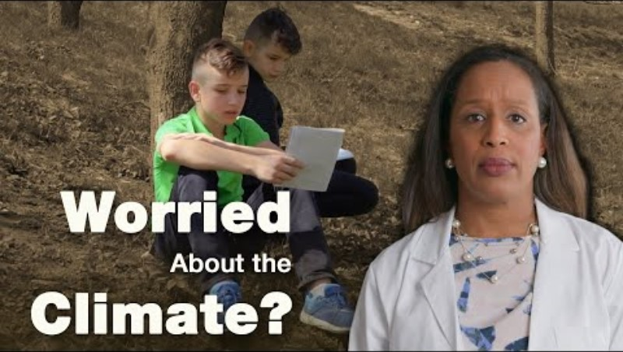
This might involve talking to someone you trust, journalling your thoughts, or taking a break from overwhelming media content.
It could also mean spending time in nature, listening to music, or finding creative ways to express what you're feeling.
These small steps give you back a sense of control, and that’s what anxiety often takes away.
Watch this 4 minute video on coping mechanisms

Slide 27
3.2 Activity
Breathe & Move
Lead learners in a short guided breathing or stretching exercise to recentre and relax.

Slide 28
How to turn anxiety into motivation for action
3.3
Not all anxiety is negative.
When understood and channelled well, anxiety can actually help us focus, plan, and act.
Think of it like this…anxiety is a signal that something matters to you.
If climate change didn’t matter, you wouldn’t be feeling anxious about it.
So instead of trying to get rid of the feeling, ask yourself, “What is this feeling asking me to do?”…..

Slide 29
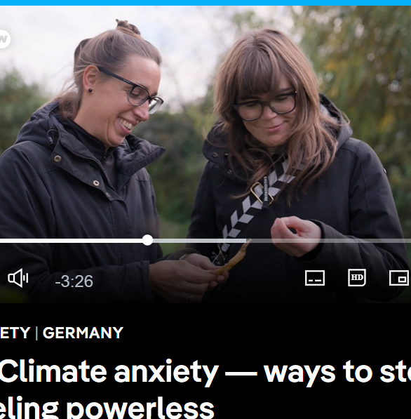
This could be as simple as learning more about a topic that concerns you, sharing your feelings with a friend, or taking a small step to reduce waste or support a campaign.
Research (Sanson et al., 2019) shows that when young people take action, even small actions, their anxiety reduces and their sense of empowerment grows.
Action gives anxiety a purpose.
Watch this 3 minute video on ways to stop feeling powerless about climate anxiety

Slide 30
3.3 Activity
Journal Prompt
What does your climate anxiety tell you that you care about most?
What’s one small action you could take related to that concern?

Slide 31
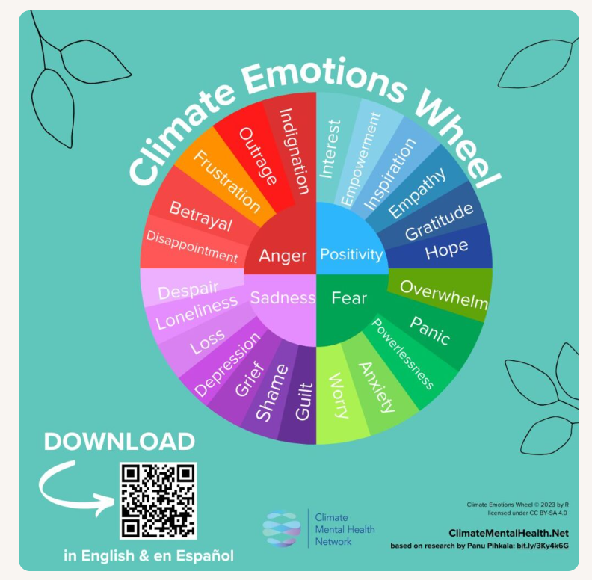
3.4 Self-Assessment (understanding your climate emotions)
Everyone experiences climate anxiety differently.
Some people feel a constant low-level worry, while others feel sudden waves of sadness, frustration, or anger when they hear about certain events.
This activity helps you explore your own emotional patterns, without judgement.
Using a simple "Climate Emotion Tracker," you’ll monitor how you feel over a few days when exposed to climate-related content.
Notes:
Reference article:
Source: Frontiers
Author: Panu Pihkala
Date: 14th January 202

Slide 32

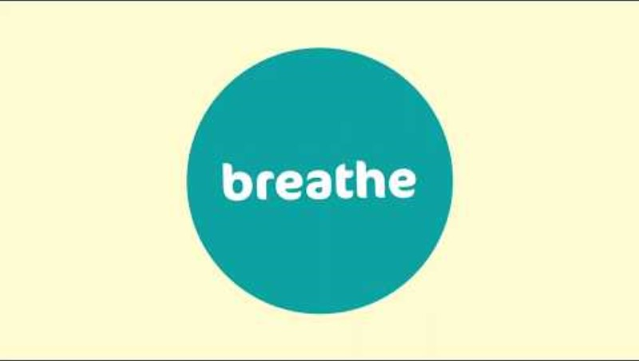
3.5 Mindfulness and avoiding burnout
When we care deeply about something, like the environment, we can sometimes push ourselves too hard.
If you’re constantly thinking, acting, and worrying, it’s easy to fall into burnout, a state of exhaustion that makes it hard to keep going.
This is why taking care of your mind is just as important as taking action.
Mindfulness is a powerful technique that helps you focus on the present moment, reduce stress, and reconnect with your sense of calm. Even just five minutes of mindful breathing a day can help regulate your emotions and lower anxiety.
Mindful Breathing Exercise
https://youtu.be/wfDTp2GogaQ?si=5y9u7wSdjXYrhLym
Notes:
Reference article:
Source: Frontiers
Author: Panu Pihkala
Date: 14th January 202

Slide 33

04
Unit 4
You Are Not Alone…the power of community support

Slide 34

When facing something as big as climate change, it’s easy to feel like you're dealing with it alone. But the truth is, millions of people around the world share your concerns, your questions, and even your fear.
In fact, building supportive communities and taking action with others is one of the most powerful ways to manage climate anxiety. When we come together to share, listen, and act, we remember we are part of something bigger than ourselves.
4.1
Connection is a climate solution

Slide 35
4.2 How collective action reduces climate anxiety
Studies have shown that being part of a group that shares your climate concerns can reduce anxiety and increase motivation. This is because collective action gives us a sense of belonging, purpose, and shared strength. When you act alone, change can feel impossible. But when you act with others, every effort feels more powerful.
Psychologist Susan Clayton (2020) explains that community engagement helps people feel more hopeful and less isolated, which is key for emotional resilience. Movements like Fridays for Future have shown that joining others in visible, supportive, and empowering actions can reduce feelings of helplessness and transform anxiety into momentum. Even if you don’t join a protest, being part of a conversation, a club, or a local project can have the same effect.

Slide 36
4.1 Activity
Group Brainstorm
What kinds of group actions have you seen or taken part in?
How did they make you feel?

Slide 37
Stories of Youth-Led climate initiatives
4.3
Young people are not just feeling climate anxiety, they’re leading the global response.
Across every continent, youth-led groups are raising awareness, holding leaders accountable, planting trees, designing apps, running workshops, and educating their communities.
These actions don’t just help the planet — they give young people a sense of pride, control, and connection. Here are just a few examples to inspire you…

Slide 38
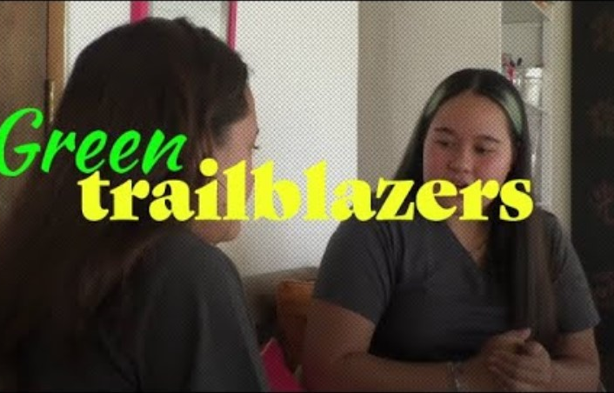
4.3 Stories of Youth-Led climate initiatives
Bye Bye Plastic Bags (Bali)
Started by two sisters, now a global movement to end plastic waste.
https://byebyeplasticbags.org/
Watch video

Slide 39
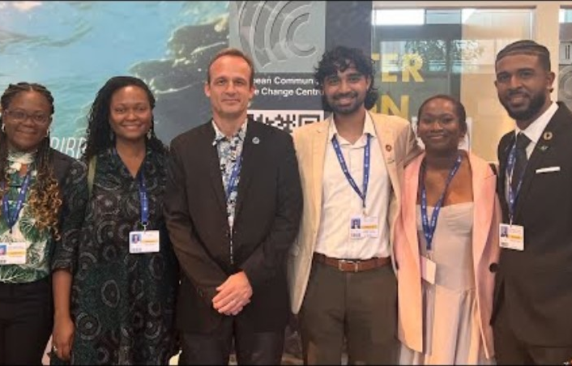
4.3 Stories of Youth-Led climate initiatives
Green Generation (Eastern Europe)
Youth workshops on sustainable living in rural areas.
https://www.yha.org.uk/generationgreen
Watch video

Slide 40
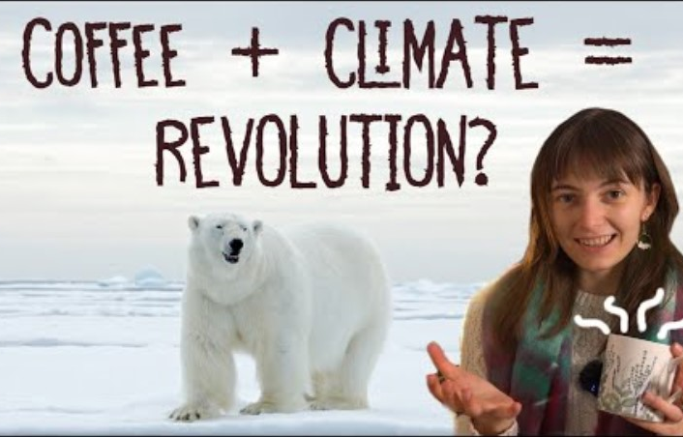
4.3 Stories of Youth-Led climate initiatives
Climate Cafés (Europe/Online)
Peer-led safe spaces to share feelings and ideas about climate anxiety.
https://www.climate.cafe/
Watch video

Slide 41

Why climate change is a social justice issue
Climate change doesn’t affect everyone equally.
People living in wealthier countries often have more resources to adapt, while people in the Global South, Indigenous communities, and marginalised groups are more vulnerable.
Young women and girls, especially in low-income areas, often face greater challenges after environmental disasters due to unequal access to education, healthcare, or decision-making.
4.4

Slide 42
Why climate change is a social justice issue
Understanding this is part of climate justice, the idea that climate action must also address inequality, fairness, and human rights.
When we talk about community support, it’s not just emotional, it’s about standing in solidarity with those whose voices are often ignored or silenced.
Feeling anxious about climate change is not just about the science, it's also about feeling the weight of injustice.
But working together for justice can be a powerful way to reduce that burden.
4.4

Slide 43
4.4 Activity
Discussion Prompt
What does justice mean to you in the context of climate change?
How can we make sure everyone’s voice is heard?

Slide 44
One of the most effective things you can do is to build a small, meaningful climate support circle, a group of people you can share your feelings with, learn from, and take action with.
This could be as simple as a group chat, a school club, a monthly meet-up, or an online forum.
Your group doesn’t need to be big. What matters is that it’s safe, inclusive, and encouraging.
4.5
Group Challenge Create a Climate Support Network
Here’s how to start…
Invite 2–5 people who care about the climate (or are willing to learn).
Set a shared purpose- support, learning, action, creativity.
Decide how often to meet (in person or online).
Plan simple, meaningful activities (watch a documentary, organise a clean-up, write letters to decision-makers).
Keep it flexible, fun, and welcoming

Slide 45
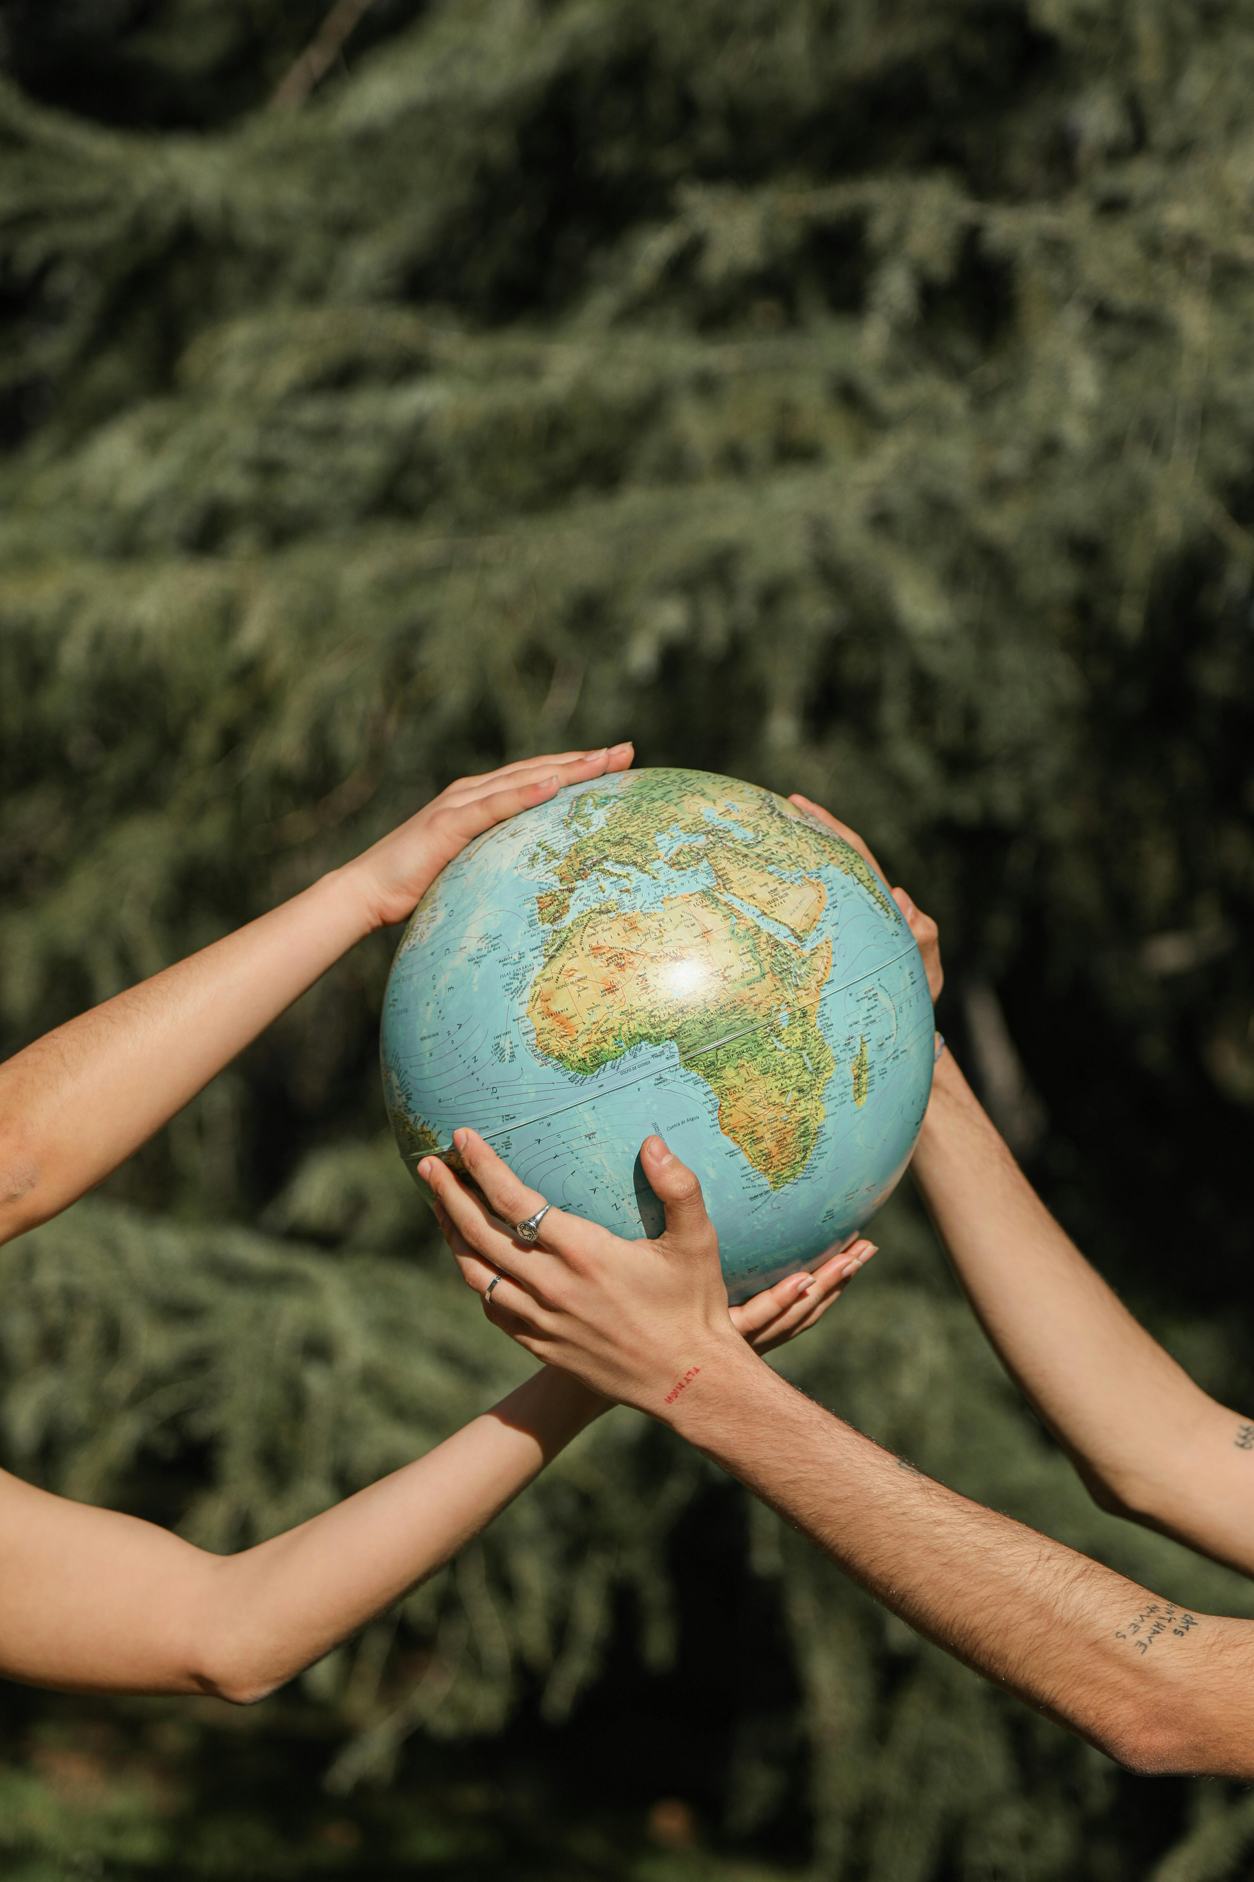
05
Unit 5
From Anxiety to Empowerment

Slide 46
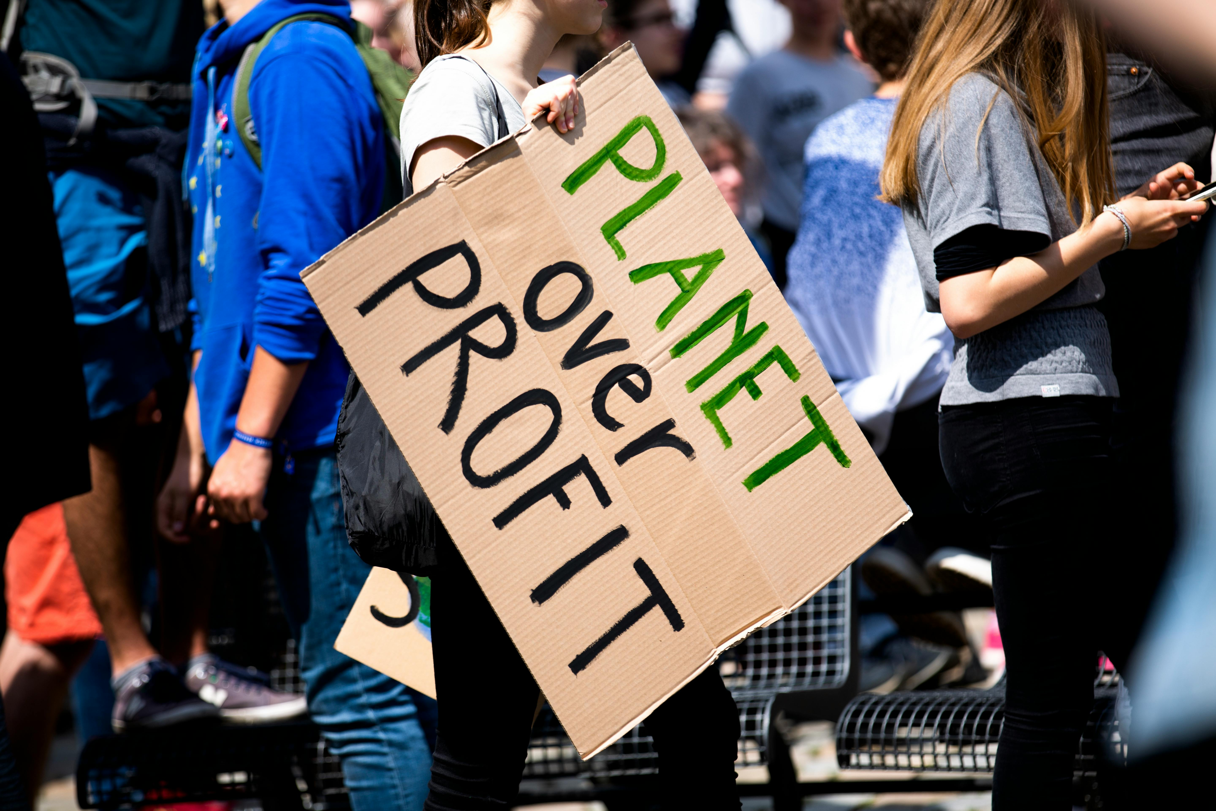
5.1
Introduction to the power of the first step
By this stage, you’ve explored the emotions behind climate anxiety, how to manage them, and how to connect with others. Now it’s time to shift the focus from understanding to doing.
When facing a crisis as big as climate change, it’s easy to believe that our actions are too small to matter. But research shows the opposite, taking action, especially when it aligns with your values, can significantly reduce feelings of anxiety and helplessness. This unit is all about helping you take your first step. It doesn’t need to be dramatic or perfect, it just needs to be yours.

Slide 47
One of the biggest barriers to action is the feeling that change is impossible without huge resources, expert knowledge, or a big audience.
But in psychology, there’s a principle called “behavioural activation,” which means that taking even a small action can boost motivation, energy, and hope. In fact, action often comes before motivation.
When you take a step, even a tiny one, your brain responds with a sense of progress and control. This reduces anxiety and makes it more likely that you’ll keep going.
You don’t need to solve the whole crisis. But you can do something today, this week, or this month that contributes to a more sustainable future.
And that’s enough to start building momentum.
5.2
The psychology of taking the first step

Slide 48
5.2 Activity
Brainstorm Prompt
What’s one small climate-related action you’ve taken recently (even unintentionally)?
Share responses as a list of “small but real” actions.)

Slide 49
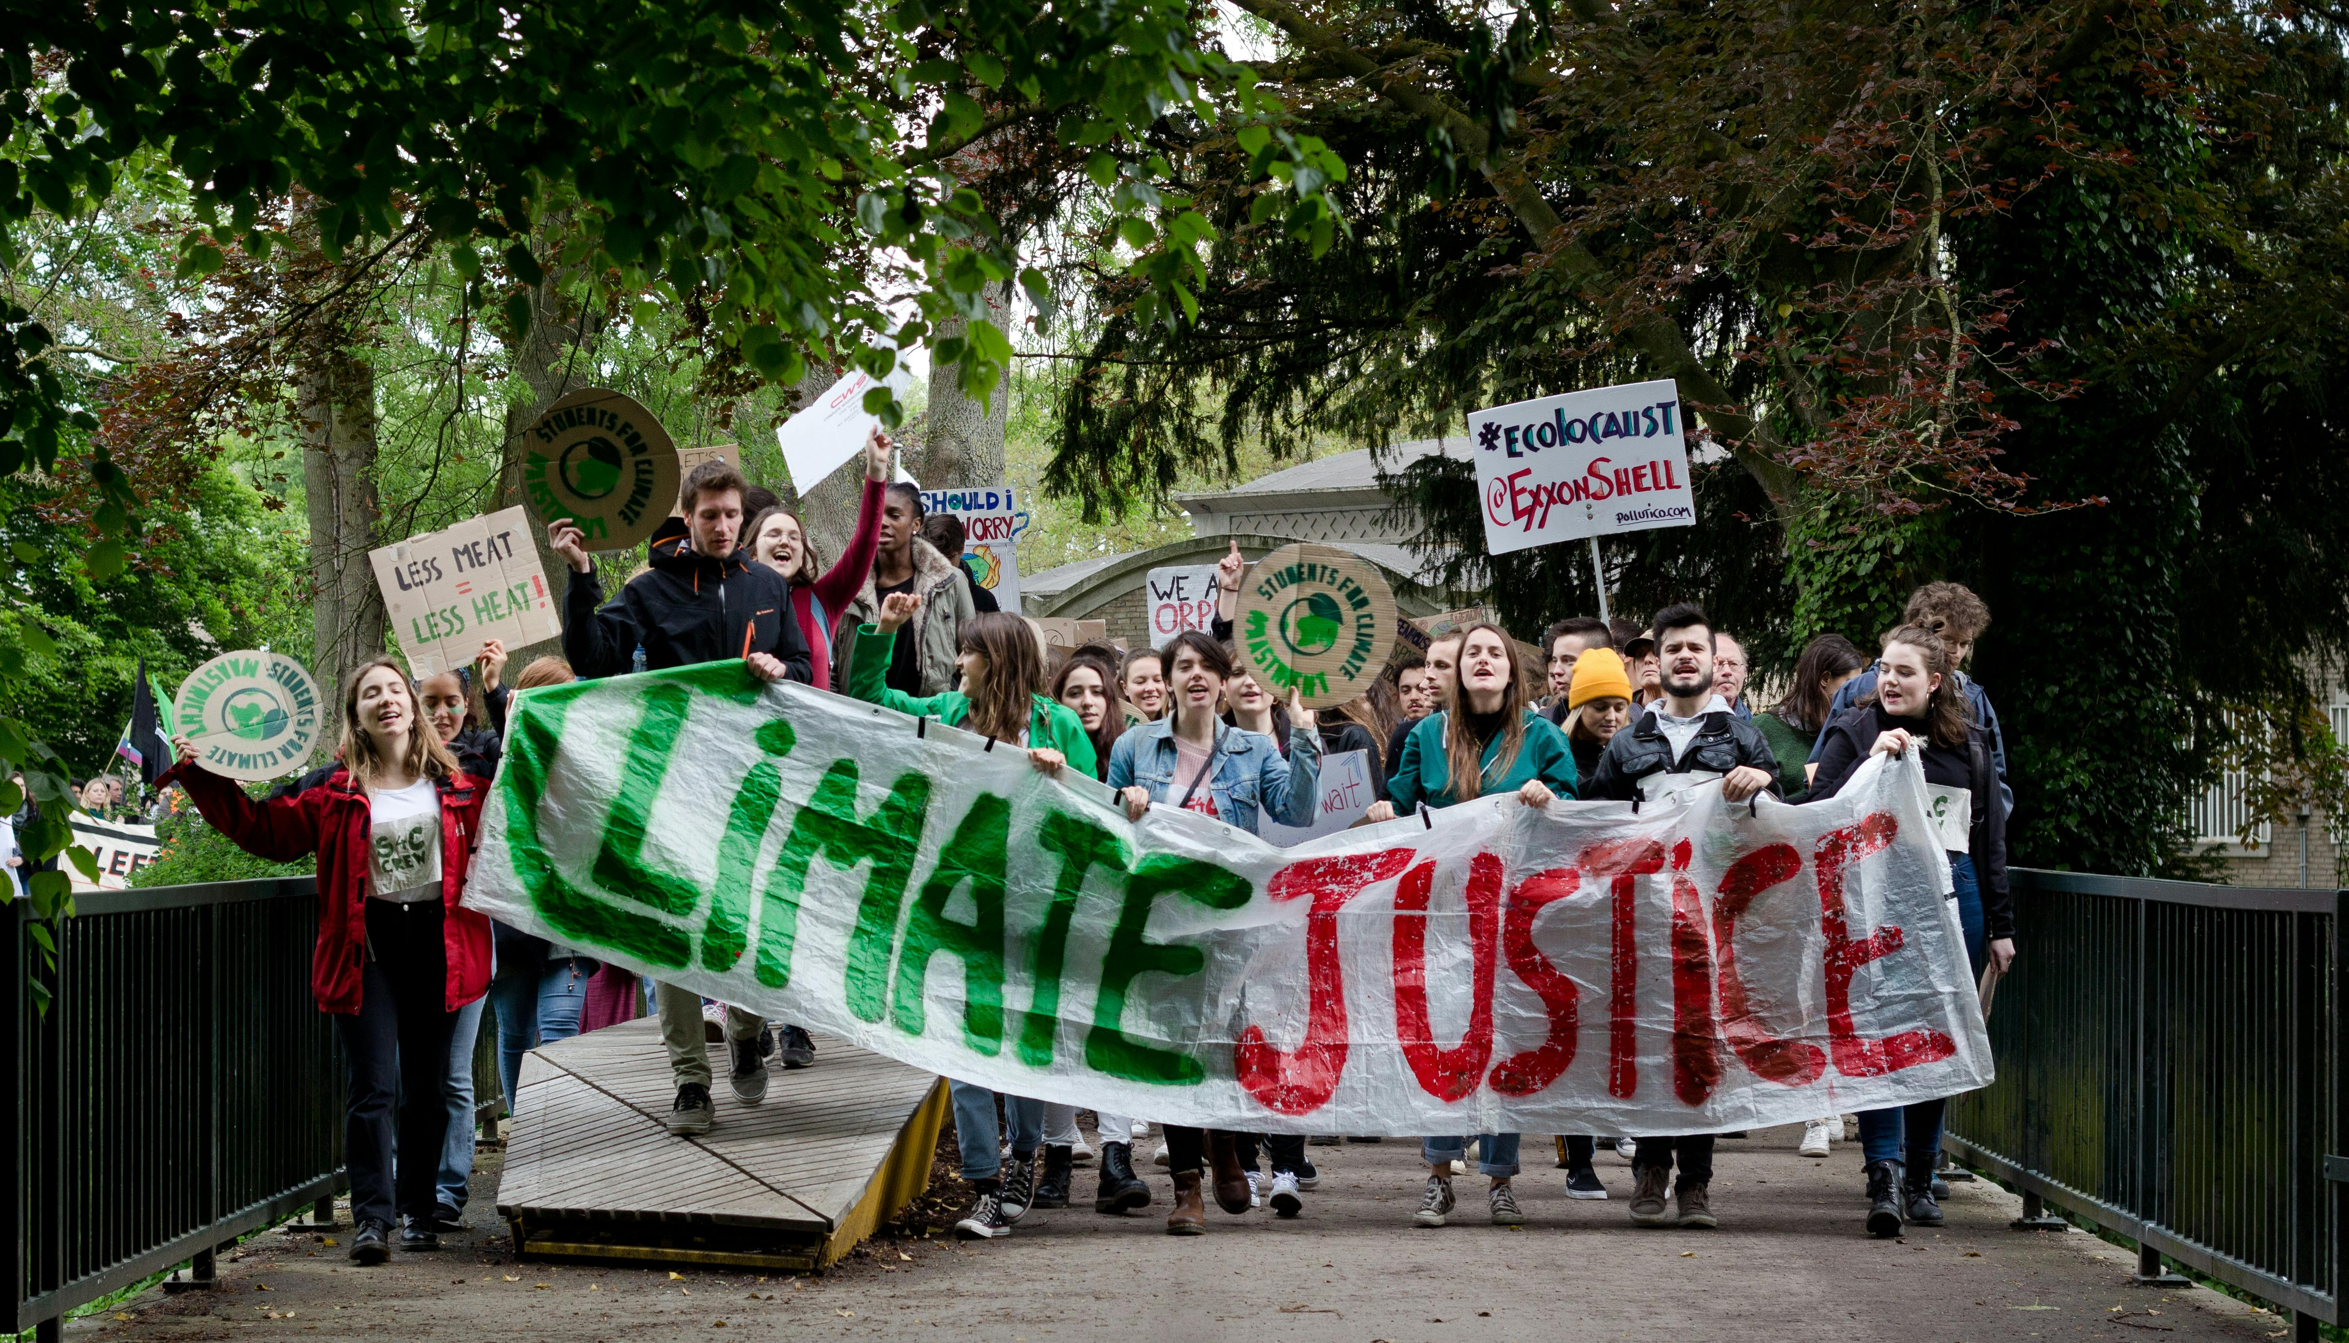
Not everyone is an activist. And that’s okay.
There are many different ways to contribute to climate solutions. What matters is finding the path that suits your interests, skills, and personality.
Here are four common roles in climate action…
5.3
What Kind of Changemaker Are You?

Slide 50




The Advocate
You speak up, raise awareness, or challenge systems through protest, policy, or storytelling.
The Educator
You enjoy learning and helping others understand complex topics, whether in class, online, or informally.
The Innovator
You love solving problems and might be drawn to design, technology, or creative thinking.
The Local Actor
You prefer practical, hands-on work that supports your community or environment directly.
5.3
What Kind of Changemaker Are You?
You might fit one role more than the others, or a mix of several. Understanding your role can help you choose actions that feel meaningful and sustainable, rather than overwhelming.

Slide 51
5.3 Activity
Quick Quiz
What’s your climate action style?
Learners complete a short reflection to identify the roles that match them best.

Slide 52
It’s very common for young people who care about the climate to feel like whatever they do, it’s never enough.
This feeling of guilt or inadequacy can stop people from taking action altogether.
This is called “climate guilt” the sense that because you’re not perfect, your efforts don’t count.
A single action won’t fix the climate crisis, but neither will blaming yourself into inaction.
Instead, focus on what you can do, and recognise that collective impact grows when many people take small steps together.
Progress is not about being flawless. It’s about showing up, again and again, in a way that you can sustain.
5.4
Tackling the “I’m Not Doing Enough” Feeling

Slide 53
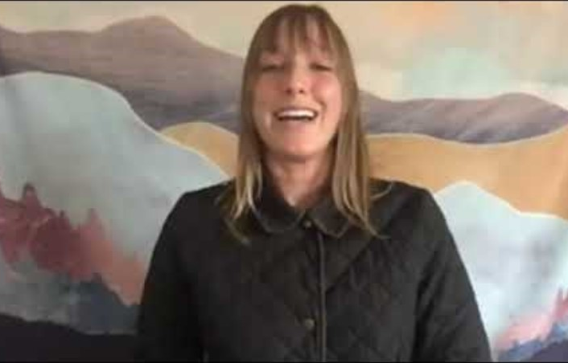
5.4 Tackling the “I’m Not Doing Enough” Feeling
Overwhelmed, sad and guilty are some of the emotions young people say they feel when they think of climate change and their concerns world leaders will fail to tackle it. It's a term broadly referred to as climate anxiety.
Watch video

Slide 54
5.4 Activity
Reflection Prompt
Write down three things you’ve done that have helped the planet, big or small.
Then, write one thing you’d like to try next.

Slide 55
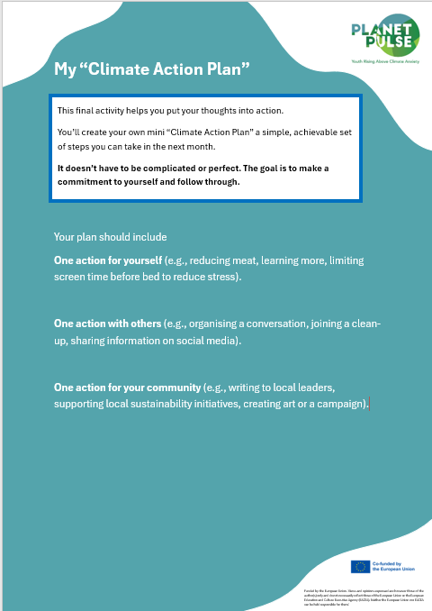
5.5 Activity
Action Plan Task
Provide a downloadable or printable template for learners to fill in their plan (There is one available for download from Planet Pulse website). Invite volunteers to share theirs if comfortable.

Slide 56
06
Unit 6
Shaping the Narrative on Climate Anxiety

Slide 57
Every day, we are surrounded by stories about the climate, on the news, on social media, in films, and in conversations.
These stories are powerful. They shape how we think, feel, and act. They can make us feel hopeful, or hopeless.
In this unit, we will explore how climate narratives influence emotions and behaviour, and why it’s so important to tell stories that are honest and hopeful.
You’ll learn how to talk about climate change in ways that reduce panic and inspire others, and how to use your own voice to change the conversation.
6.1
Introduction Why Stories Matter

Slide 58
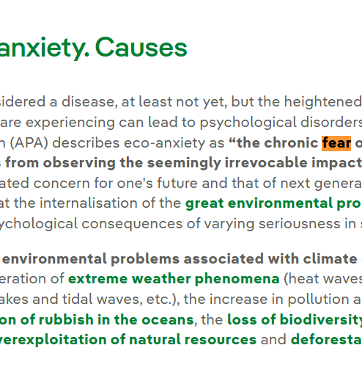
6.2 Why “fear-based” messaging isn’t enough
Fear is a common strategy in climate communication. You’ve probably seen headlines like “Time is Running Out” or “The Planet is Dying.” These messages are meant to shock us into action, but often, they have the opposite effect.
While fear can grab attention, it can also overwhelm us. When people feel scared and powerless, they tend to shut down. This is called “fear fatigue”, and it contributes to eco-paralysis and burnout.

Slide 59
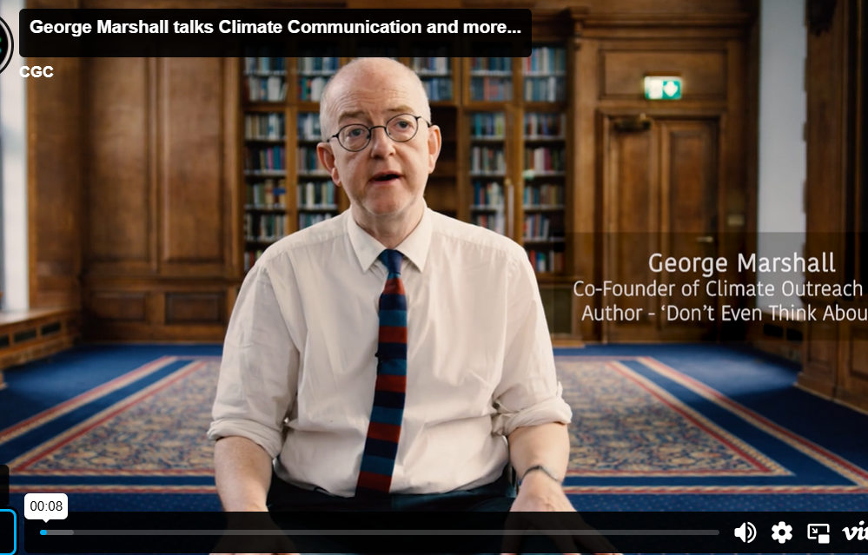
6.2 Why “fear-based” messaging isn’t enough
Instead of only showing what’s going wrong, research shows that we need to balance truth with possibility — pairing warnings with solutions, urgency with agency.
As climate communicator George Marshall puts it, “We need a narrative of hope grounded in reality, not sugar-coating, but signposting.” Young people especially respond to messages that include possibility, progress, and action.
WATCH GEORGE MARSHALL ON CLIMATE CHANGE COMMUNICATION

Slide 60
6.2 Activity
Rewrite the Message
Show a dramatic, fear-based climate headline and ask learners to rewrite it in a more constructive, still truthful tone

Slide 61
6.3 How to talk about climate change without spreading panic
Start with feeling! Share how the issue makes you feel, not just facts.
Find common ground! Use examples that relate to everyday life (weather, food, energy).
Talking about the climate crisis can be difficult. You might worry about saying the wrong thing, making someone anxious, or being ignored. But when done well, conversations about the climate can help people feel connected and motivated, not overwhelmed. Here are some tips….
Use the “Yes, and…” approach! Acknowledge the problem, then offer a way forward.
Speak from your role! You don’t need to be a scientist. Speak as a friend, a student, a young person who cares.

Slide 62
6.3 Activity
Role Play
In pairs, practice responding to a friend who says, “I don’t want to talk about climate change, it’s too depressing.” Use empathy, facts, and a hopeful tone.

Slide 63
It’s easy to believe nothing is improving when bad news dominates headlines. But there are wins worth celebrating, and they matter.
Celebrating progress boosts morale, keeps movements alive, and gives people reasons to keep going. Here are just a few examples…
The ozone layer is healing due to a global ban on harmful chemicals.
Renewable energy is now the cheapest source of electricity in many regions.
Youth-led campaigns have influenced real policy changes in cities and schools.
Major brands and governments are responding to public pressure to reduce emissions.
6.4
Celebrating climate progress and why it’s important

Slide 64
This progress doesn’t mean the crisis is over, but it proves that change is possible when people act together.
Focusing only on problems can drain us. Balancing that with evidence of solutions can re-energise us.
6.4
Celebrating climate progress and why it’s important

Slide 65
6.4 Activity
“Good News Gallery”
Invite learners to find and share 1 recent story of climate progress from anywhere in the world. Collect and display as a shared wall or digital board (you can use Padlet or Miro for this).

Slide 66
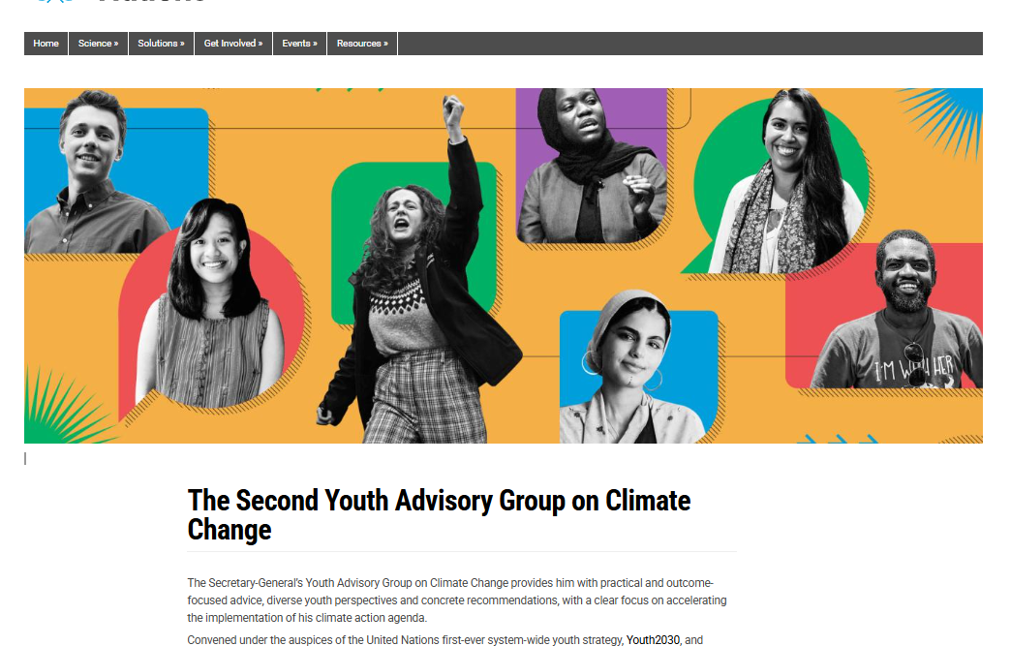
6.5 The role of youth voices in changing the narrative
Young people are not just part of the climate story, they are shaping it.
From community organisers to TikTok creators, from school clubs to UN speakers, youth voices are changing how the climate crisis is understood and addressed. Young people bring new ideas, emotional honesty, creativity, and a deep sense of urgency. Your voice, whether written, spoken, artistic, or onlinecan help shift the story from fear to agency.
Notes:
When more young people speak up, the narrative begins to reflect hope, fairness, and action.
That’s how change happens: not just through science or policy, but through storytelling, shared values, and human connection.

Slide 67
6.5 Activity
Climate Message Challenge
Write a message, slogan, or short script to inspire others. Think of it as a caption, short video, or artwork idea. Optional: Share it on your own platform

Slide 68
Thank you
Any Questions?
www.planet-pulse.eu

