Slide 1

Module 6 - Collective Action
Let's come together and get the work done!
www.planet-pulse.eu

Slide 2

Module 6 - Collective Action
01
Introduction 3
02
Examples of Collective Action 12
03
Journal Activities 18
04
Resources for further exploration 21
This project has been funded with support from the European Commission. The author is solely responsible for this publication (communication) and the Commission accepts no responsibility for any use may be made of the information contained therein. In compliance of the new GDPR framework, please note that the Partnership will only process your personal data in the sole interest and purpose of the project and without any prejudice to your rights

Slide 3

01
Introduction

Slide 4

”No revolution happens within one lifetime so we work to capacity, we believe in what we are doing knowing full well we don’t see the fruits of our labour. It is a hard place to hold. I believe my work is important.”
Audre Lorde

Slide 5
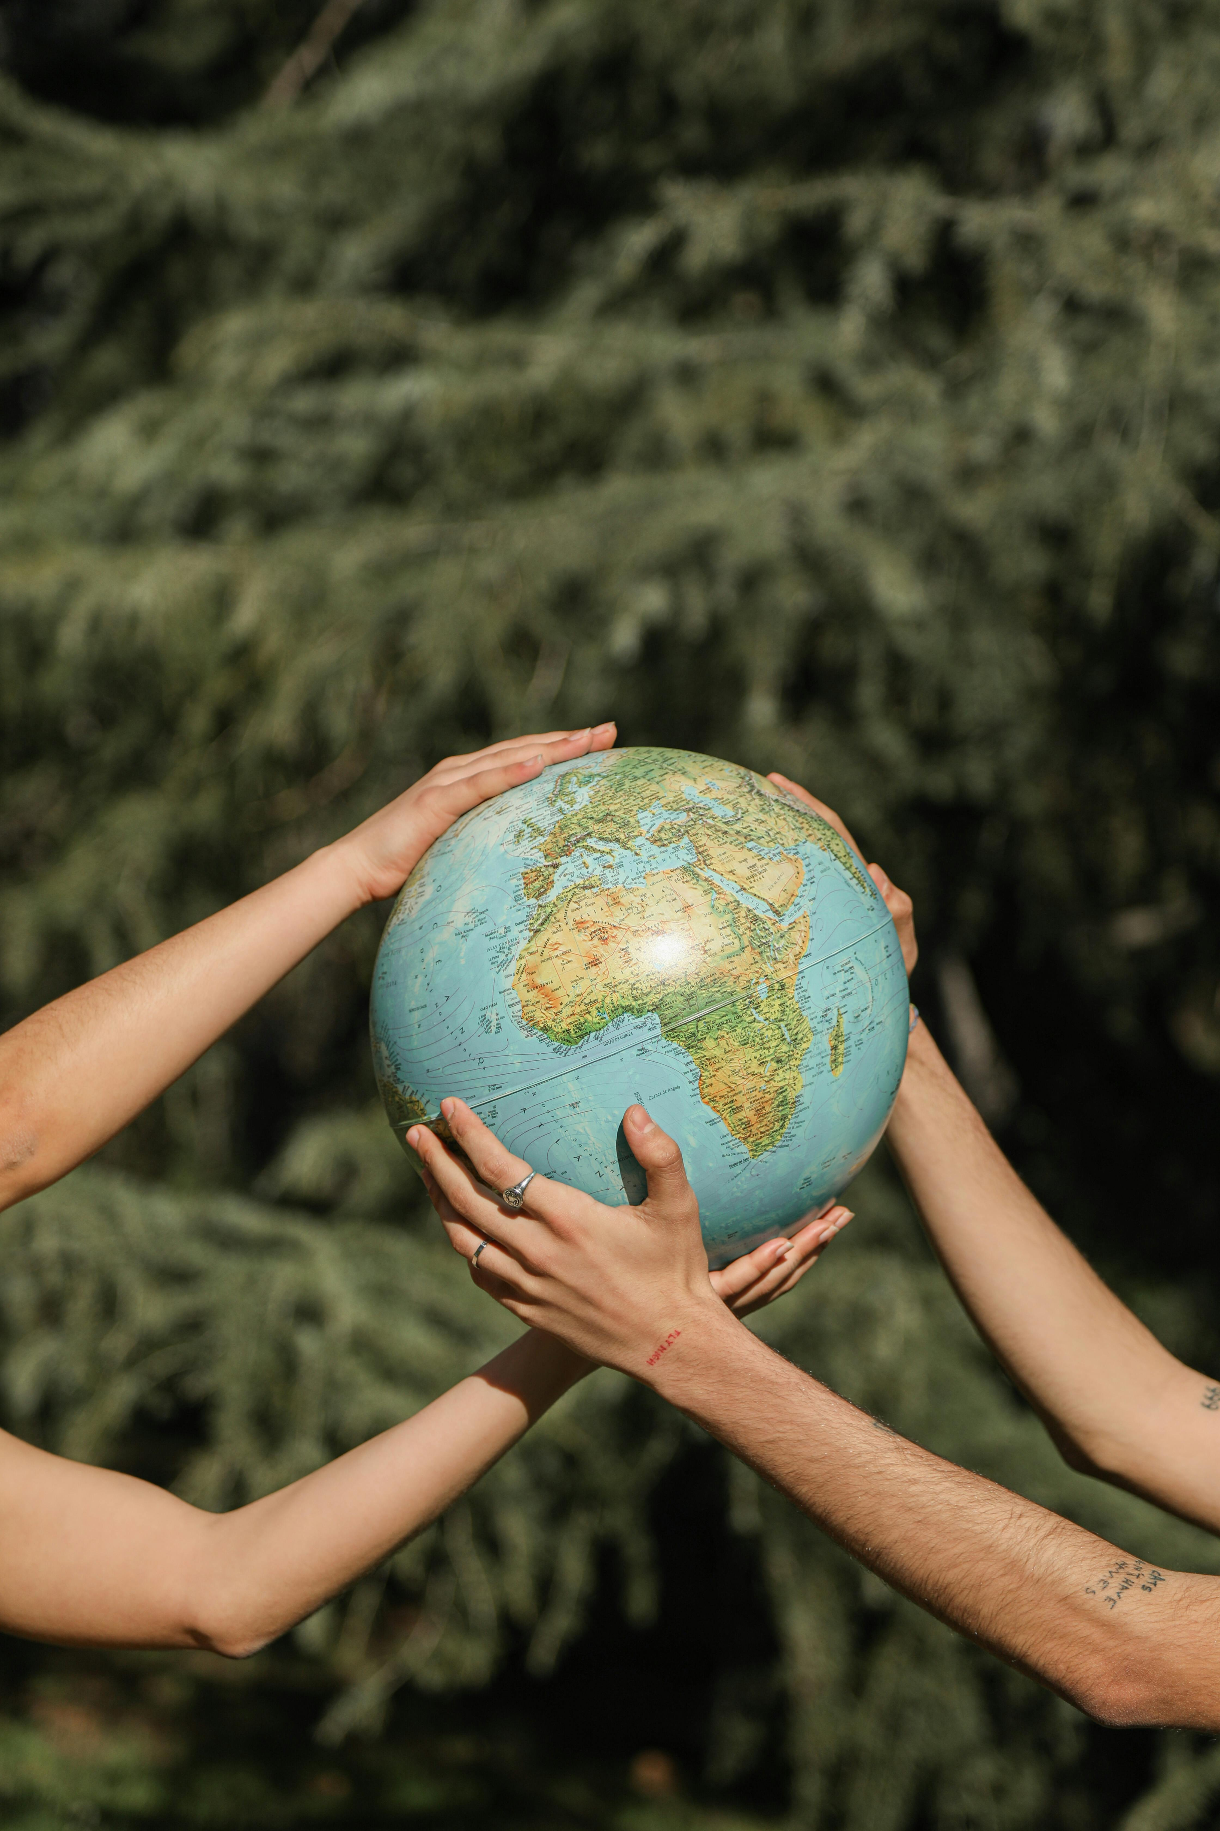
Most of us have heard the phrase:
“Many hands make light work.” Similarly, as our old neighbour used to say: “When you are two people, you get three times as much done.”
This old neighbour was a farmer and, if you have ever tried doing anything alone as a farmer, you know how tiring and downright impossible it can be on your own.
Despite the forces that separate us there are at least as many – if not more – forces that bind us. No one is truly alone and, consequently, we can choose to work together for a brighter future.

Slide 6
There are countless examples of people coming together to enable change over the course of history. Some include:
In the late 1970s through the early 80s, the indigenous Sámi community and the Norwegian environmental movement joined hands to save Norway’s Alta River. While in the end the dam they sought to prevent was built, the powerful protests led to significant changes for the Sámi people: a constitutional clause on Sámi language, culture, and society was added in 1988, and the Sámi Parliament began in 1989. In 2023, this movement mobilized again to defend the rights of Sámi reindeer herders at Fosen. Although the government did not remove the windmills that caused the human rights violation in the first place, Norway’s Prime minster apologized for the violation and agreed on mitigating measures. This example demonstrates how resistance is never futile. Even when there is loss, gains can also be won.

Slide 7
There are countless examples of people coming together to enable change over the course of history. Some include:
Modern society is full of climate activist grandmas who advocate for change by “leading with love.” For example, in 2023, a group of over 2,000 Swiss women (whose age averages in the low 70s) have sued the Swiss Government, arguing their climate inaction has violated their human rights. As a European Court has taken up the case, the Association of Swiss Senior Women for Climate Protection, gathered outside of the courthouse, waving flowers, blowing bubbles, and ringing cowbells. Similarly, a U.S. group called Guardians of the Aquifer formed in 2010 against a pipeline which was eventually cancelled in 2021. Most members are older women. One approach they have taken is calling news conferences to present cheddar crust apple pies to legislators who have made good environmental decisions. The message being – when a cause is just, we can take joy in knowing such and in knowing we are all here to create that better, more joy-filled world from now into the future. While there are tremendous forces to oppose, there are also many to applaud and drawing attention to this can have a great impact, too.

Slide 8
There are countless examples of people coming together to enable change over the course of history. Some include:
In 2018, a group of Colombian youth successfully sued their government for failing to stop illegal deforestation in the Colombian Amazon, arguing their failure to act violates their future rights to life and a liveable environment, because deforestation is known to cause climate change as well as other significant issues impacting their right to life.
While the Court’s decision was in their favour, groups continue to collectively organize for change and end deforestation in the region.

Slide 9
There are countless examples of people coming together to enable change over the course of history. Some include:
Balkan River Defense began when an enthusiastic river defender drew a sloppy red line on Google Earth map of the Balkans and told the room of scientists and conservationists that, together with his friends, they were going to kayak all these rivers in the spring, to show the Balkans–and the world–what is at stake if these rivers get dammed.
They would paddle to defend the rivers. The Balkan Rivers Tour was born as a rebellious promise given to both locals and the global river conservation community. River conservation should first be about fun and enjoyment of rivers and second about saving and conserving them. Kayakers were followed by videographers and photographers who captured the moment. But also, kayaking presented a big opportunity to collect data to show how the dams impact local wildlife.

Slide 10
Knowing that movements often respond to an existing or impending crisis, we can see new words emerging that can help us understand collectivism as a response.
Disaster capitalism¹ describes how many private industries exist to profit from crises like climate change – think the increased cost of bottled water and greenwashing that allow fossil fuels to continue. By contrast, disaster collectivism² describes how the “rupture in everyday life” can lead to “solidarity with others.” Decades of research found that people are most caring in the wake of disaster and, while disasters are terrible and unwanted, abnormal times can encourage new forms of collective action and public life.
In other words, collectivism is the antidote to the social-ecological degradation occurring around us — and stories of collective action offer a counter narrative to those that simply portray those in crises as victims. Both can be true, and both exist among us. The more stories of collective action we hear, the more we can be reminded of our innate power to bring about transformation.
¹ Term coined by Naomi Klein in her 2007 book “Shock Doctrine”
² Term coined by Rebecca Solnit in her 2010 book “Paradise Built in Hell”

Slide 11
Knowing that movements often respond to an existing or impending crisis, we can see new words emerging that can help us understand collectivism as a response. It’s worth emphasizing that aims like justice, freedom, equality, and a better world are intergenerational struggles; not all organized movements bring about the desired changes, and we personally may not see and enjoy the fruits of our own labour. Those who have come before us remind us of this. In honouring this truth, they also invite us to trust in the strength of collective action, today and every day.
This module seeks to praise the movements that show us the way collective action can bring about the future we want and deserve

Slide 12
02
Examples of
Collective Action

Slide 13
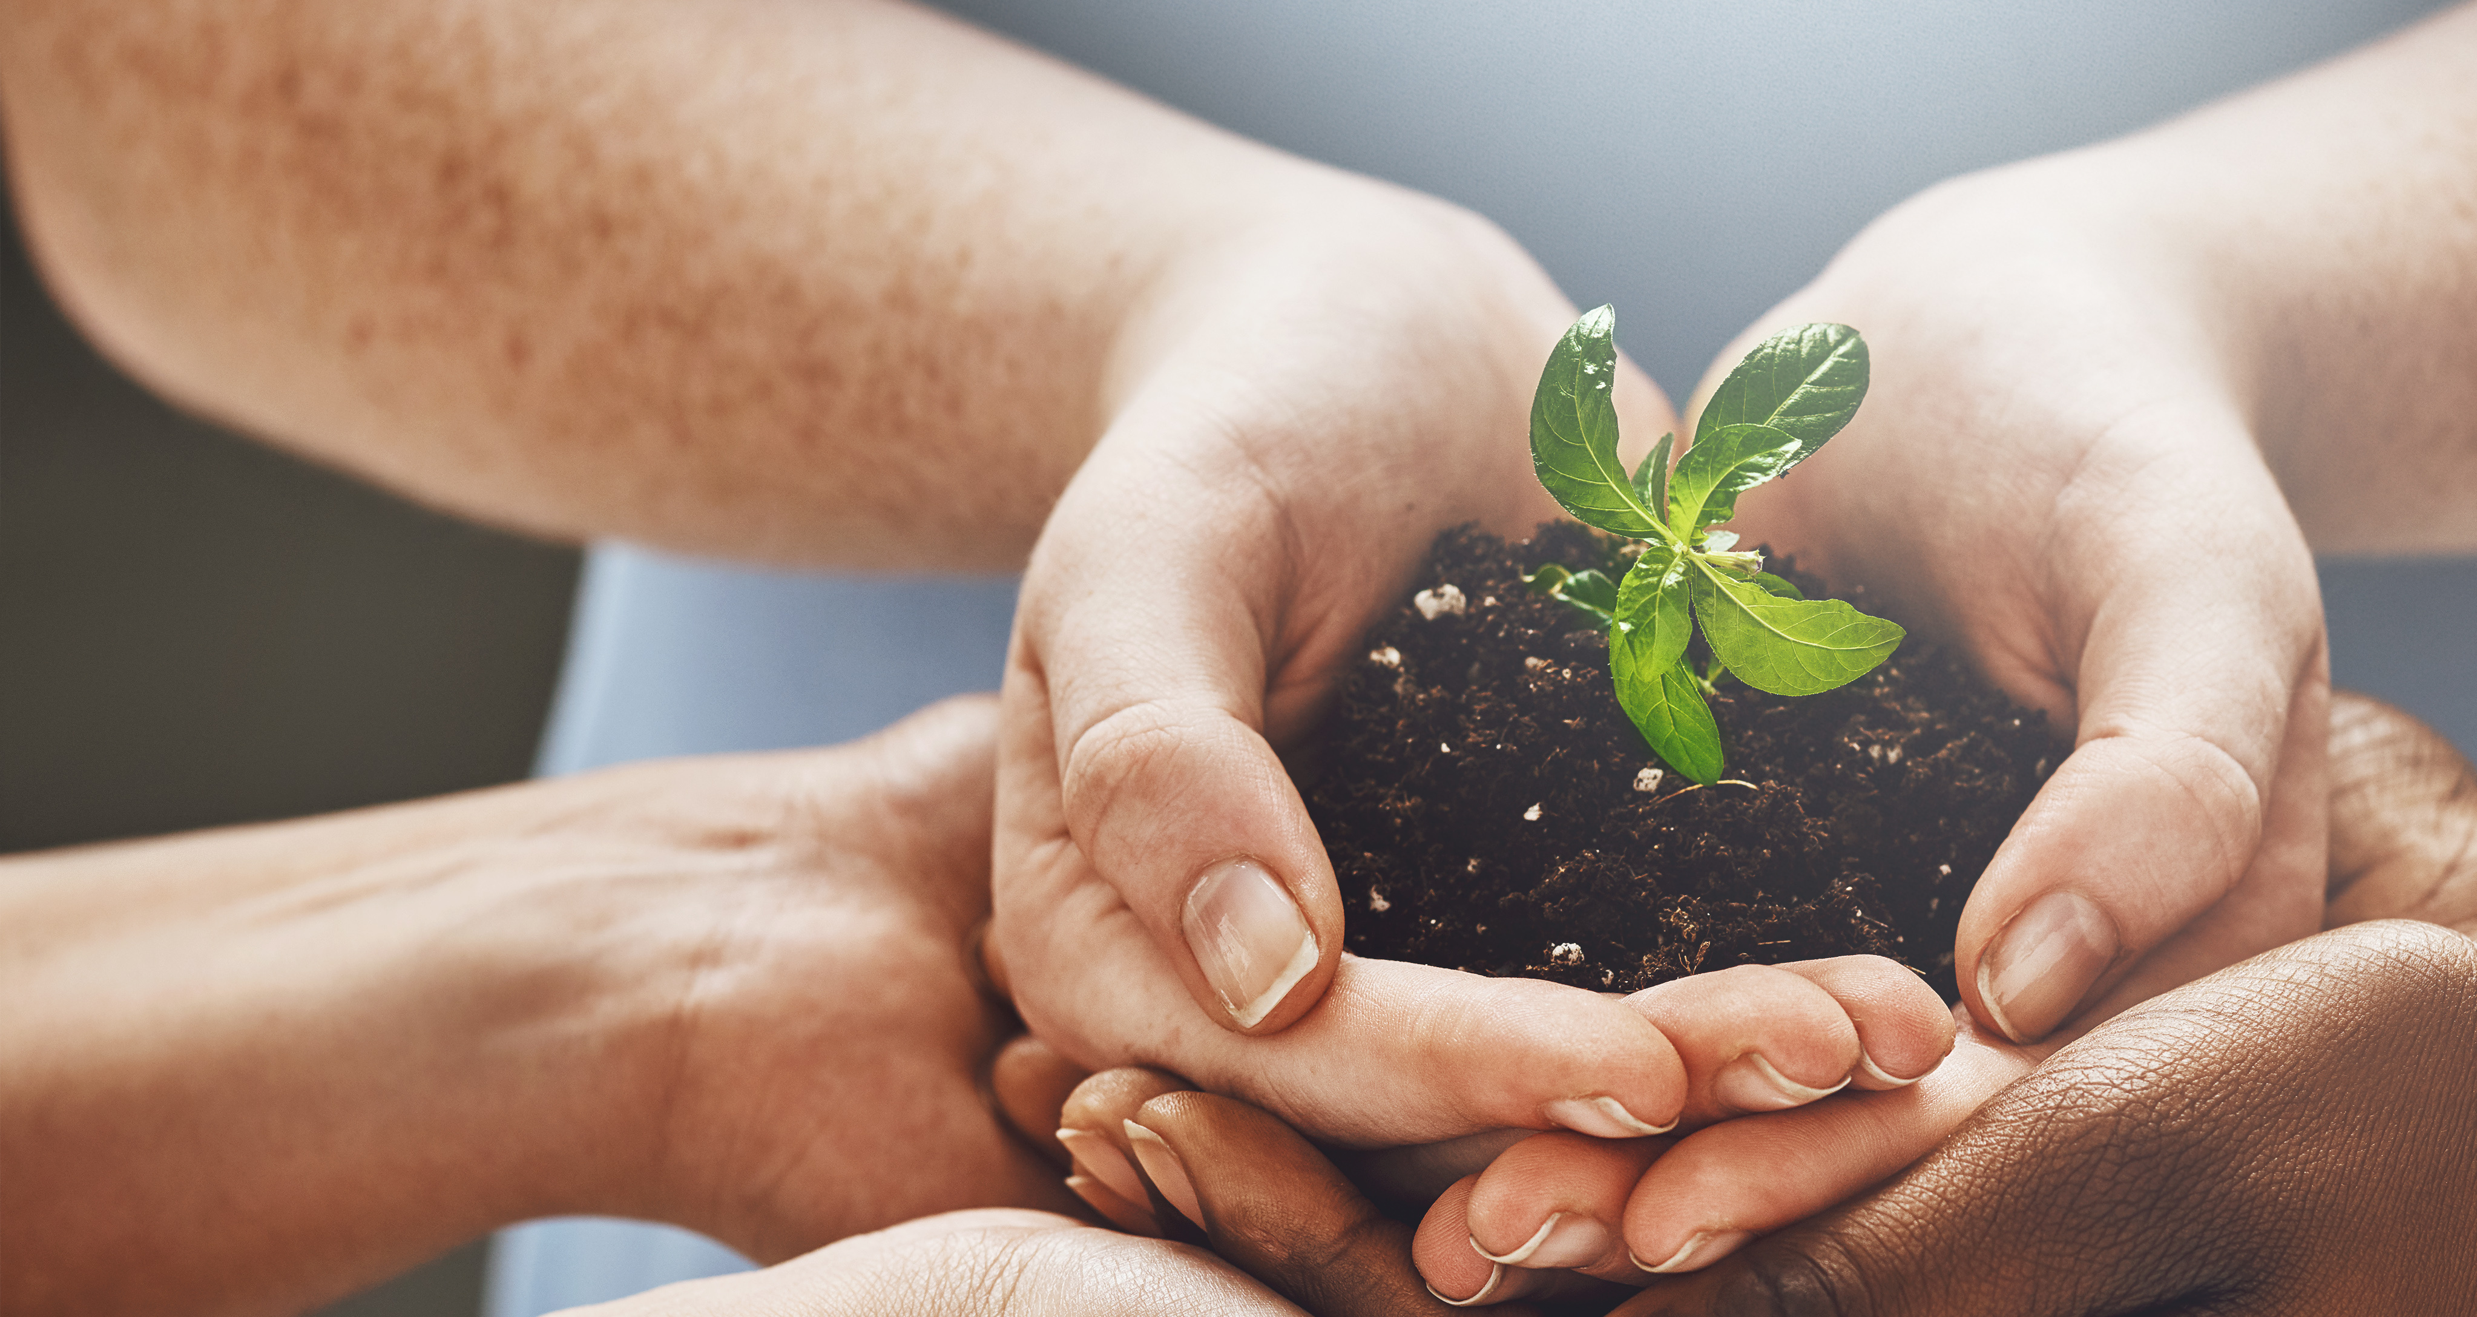
When we’re told to address climate change by taking small individual actions, anxiety can build up. The responsibility can feel too big.
The actions seem like too little too late. At the same time, witnessing the inaction of others can induce the feeling that you need to compensate for climate inaction. It becomes too much for one person to bear alone.
Throughout this guide, collective action runs like a refreshing river. You can jump in and immerse yourself in ideas of how we can meet the climate crisis together. When you go for a walk with your mother in the forest; spend time with your friends snowboarding in the mountains; or swim with the fishes underwater, you are strengthening the connections with other beings that are essential for collective action.

Slide 14
Many storytellers in this guide are fuelled by the energy of fellow students, activists, and friends who join in the cause: organizing conferences, campaigns, protests – even co-founding new organizations.
Collective action can offer hope and inspiration, providing much needed motivation. But if our hope is dependent on others becoming engaged or other big results in the outside world, hope can easily dwindle when the realities of the ongoing climate crisis remain.
Remember: any action that replenishes your inner source of hope–no matter how fruitless it might appear in the moment–is meaningful.

Slide 15
Collective climate action goes beyond traditional protests and campaigning. Together we can build the sustainable lives we want for ourselves and others
Around the world, young people are reviving traditions and inventing new ways of living: A circus artist sails the world, living on a boat that is also her stage, and performing to inspire climate action.
Young farmers combine sustainable farming practices with climate education. A young woman starts an eco-village and goes to live there. These approaches to living can be contagious and inspire further collectivism. They involve living and working across generations, guided by core values.

Slide 16
When you add creativity and compassion into the mix, collective action has no limits.
A young activist moves her listeners with a song from the future, and her performance causes the activists to be arrested by the police in London. When youth are arrested for singing about climate change, and the oil companies are rewarded for ignoring their cries, it shows the absurdity of how our systems respond to the climate crisis. Through dialog and community support, young people are co-creating a more compassionate world: starting new dialogs, amplifying underrepresented voices through storytelling and art; visiting climate-affected communities to help with disaster relief and organizing.
Collective climate action is as rewarding as it is needed. You don’t need to know what to do or how to do it, to join in. Start by telling a friend you want to do something about climate change, and together you’ll create your way.

Slide 17
The following activity may prove useful to get you on your way.

Slide 18
03
Journal Activities

Slide 19
Journal activity #1:
Spend 20 minutes reflecting on the following questions:
Name some movements you are familiar with — whether current or historic. What was their aim? What was their method? Include any other details useful to describe them.
Roles of individuals in movements: What roles do you imagine various people play in these movements? What kind of support do you think they could use to achieve all of their goals?
Effective movement-building: What do you think effective movement building looks like? What kind of outreach or approach would inspire you to take action?

Slide 20
Journal activity #1:
Spend 20 minutes reflecting on the following questions:
Forms of and tools for activism: Some tools for and forms of group activism include: culture and coalition-building, direct organizing, popular education, direct action, communications campaigns, electoral organizing, issue campaigns, boycott and divestment campaigns. Are any of these familiar to you? If so, which ones? Can you give some examples? Look up the ones you are not familiar with. Add any forms of and tools for activism you can think of that are not mentioned above.
Who inspires you? Who are the people that inspire you to take action? Name any of your climate “heroes”, mentors, guides, and partners in crime here. How can their example inspire your own contributions?

Slide 21
04
Resources
for further
exploration

Slide 22
Read (however long it takes to read): Practical Radicals: 7 Strategies to Change the World is a book that offers an inspiring guide to social change based on case studies of grassroots movements that won.
Listen (30-60 min): The Force of Nature podcast - A podcast series hosted by Clover Hogan features young climate activists from around the world, showing many different ways to be a climate activist.
Watch (44 min): The Fight for Europe’s Last Wild Rivers - A film that documents the battle over the largest undammed river in Europe, Albania’s Vjosa; the effort to save Macedonia’s endangered Balkan lynx; and the women of Kruščica, Bosnia, and Herzegovina, spearheading a months-long, 24/7 protest to protect their community’s only source of drinking water. It showcases that our voices matter and that positive change at the highest political levels can happen as a result of grassroot mobilization.

Slide 23
PLAY
The Range of Opinion game is used to reveal the diversity of viewpoints within a group without the need for extensive discussion or debate. It allows participants to visually express their opinions on a spectrum of agreement or disagreement, making it an effective tool for highlighting differences and commonalities within a collective on complex issues.
This game can serve as a method to explore and recognize the range of opinions on how to tackle the climate crisis. This is particularly useful when trying to motivate a group to work together toward a shared goal, despite potentially differing viewpoints. The game helps participants understand that collective action doesn’t always mean total agreement on every issue but can be built on a shared commitment to the broader goal of climate action.

Slide 24
The Range of Opinion Game
Reveals Diversity of Thought: The game allows participants to see the variety of perspectives in the group, making it clear that everyone may have different approaches to climate action while still working toward the same goal.
Encourages Inclusivity: By visualizing differences without requiring verbal debate, the game ensures that quieter or less vocal participants can still express their opinions, fostering a more inclusive environment.
Promotes Understanding: Participants can reflect on the reasons behind differing opinions, promoting empathy and mutual respect for others’ views on collective action.
Facilitates Dialogue Without Debate: It opens the door for future discussion but avoids the immediate pressure of defending opinions, making it a safe space for participants to express their views.

Slide 25
Step-by-Step Guide for the Range of Opinion Game:
Time:
20-30 minutes
Number of Participants:
10-20 people
Materials:
Tape or rope to mark a line on the floor (or you can use an open space), topic cards with statements, and a prepared space for participants to position themselves.

Slide 26
Step-by-Step Process:
Introduce the Topic of Collective Action:
Begin by discussing the importance of collective action in addressing the climate crisis. Emphasize that people may have different approaches, ideas, and priorities when it comes to taking action, but that it’s important to acknowledge and appreciate this diversity as part of the process of working together.
01

Slide 27
Explain the Game’s Objective:
Introduce the Range of Opinion game by explaining that it’s a way to express views on various topics or statements without engaging in verbal debate. Participants will position themselves along a spectrum based on how much they agree or disagree with a statement related to climate action.
02
Create a Physical Spectrum:
In the room or space where the game is taking place, use tape, rope, or even an imaginary line to mark a spectrum on the floor. One end represents “Strongly Agree” and the opposite end represents “Strongly Disagree.” The middle represents a neutral or uncertain stance.
03

Slide 28
Present a Series of Statements:
Read out a series of statements related to climate action and collective approaches.
For example:
“Individual actions, such as reducing personal carbon footprints, are enough to solve the climate crisis.”
“Governments should take the lead in addressing climate change through policy changes and regulations.”
“Community-based solutions are more effective than global initiatives for fighting climate change.”
“Climate activism should prioritize direct action, such as protests and civil disobedience.”
You can have members of the group add their own statements and have other members respond, as well. If you choose to do this, perhaps allow all group members to review the existing statements and anonymously write down additional statements to be read by someone at this stage.
04

Slide 29
After reading each statement:
After reading each statement, ask participants to move to the point on the spectrum that best represents their opinion. Allow participants to stand anywhere along the line—from strongly agree to strongly disagree.
05
Observe and Reflect:
Once everyone has positioned themselves on the spectrum, ask participants to observe the distribution of the group.
Ask questions like:
What do you notice about where people are standing?
Were you surprised by how many people stood in a particular spot?
Why do you think there is a diversity of views on this issue?
06

Slide 30
Reflect on how collective action:
Encourage participants to reflect on how collective action can still move forward, even when there are differing perspectives on the best approaches.
07
Optional Discussion:
Depending on the group dynamic, you may choose to invite a brief discussion where individuals can share why they chose their position on the spectrum. However, the value of the game lies in visually representing opinions without requiring debate, so this step can be kept minimal.
08

Slide 31
Repeat for Multiple Statements:
Continue presenting statements and having participants position themselves along the spectrum. Each time, encourage them to reflect on how different viewpoints can coexist within a group working toward the same goal - collective action against climate change.
09
Conclusion:
After several rounds, conclude by highlighting that collective action does not require everyone to have identical views. Instead, it’s about finding common ground and acknowledging that diverse perspectives can lead to more innovative, well-rounded solutions. Emphasize that recognizing and respecting differing opinions strengthens the group’s ability to act collectively.
10

Slide 32
Thank you
Any Questions?
www.planet-pulse.eu

