Slide 1
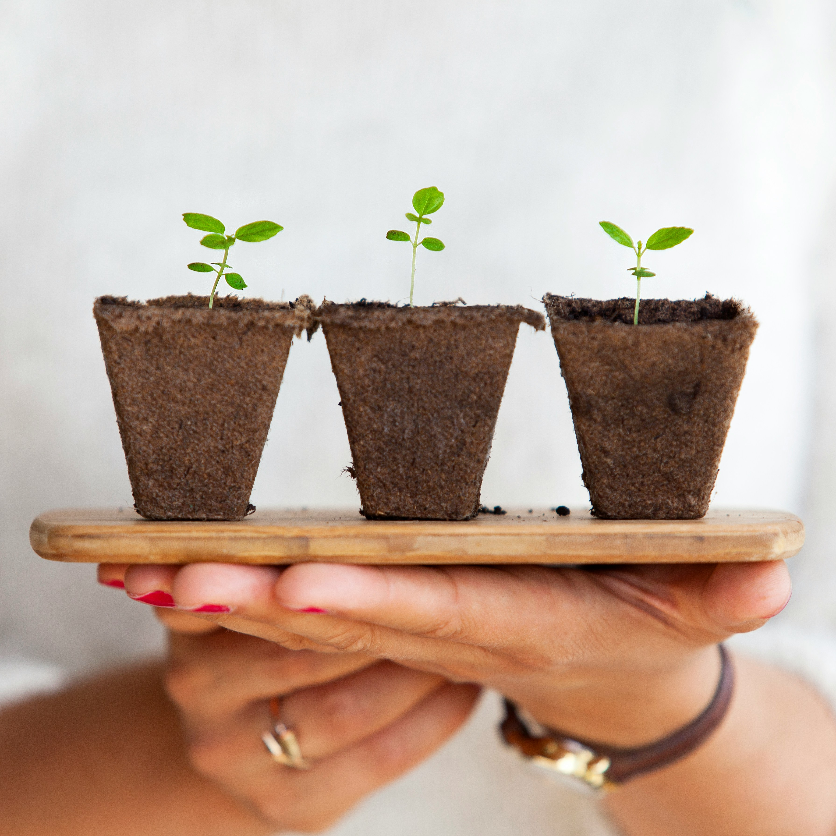

Module 3 - Hope
How to replenish our source of hope?
www.planet-pulse.eu

Slide 2

Module 3 - Hope
01
Introduction 3
02
Hopeful Nature Practices 8
03
Journal Activities 25
04
Resources for further exploration 30
05
Step-by-Step Guide for Educators 33
This project has been funded with support from the European Commission. The author is solely responsible for this publication (communication) and the Commission accepts no responsibility for any use may be made of the information contained therein. In compliance of the new GDPR framework, please note that the Partnership will only process your personal data in the sole interest and purpose of the project and without any prejudice to your rights

Slide 3

01
Introduction

Slide 4

“For me, hope is not a metaphor; it’s a lived practice. It isn’t a thing I possess. Rather, I have to remake it daily. I don’t have hope, I do hope.”
Mariame Kaba

Slide 5

I often find myself feeling hopeless. Scientifically, we know that, if we do not limit greenhouse gas emissions on the scale and in the time required, climate change will create unlivable conditions for humanity across much of the Earth’s surface.
And, while many around the world have worked tirelessly to limit climate change, global emissions continue to rise. Oil companies continue drilling, and new so-called “green” initiatives pop-up in the form of battery factories replacing old forests, windmills occupying indigenous lands, and mining operations polluting prestine lakes. Inaction on climate change used to frustrate me. Now, the escalating loss of nature, community, and safe climate conditions makes me sad and afraid. For years, I met this systematic inaction with an extreme personal commitment to climate action. My hopefulness was fuelled by the belief that we can make a difference, combined with the contagious enthusiasm expressed by fellow colleagues and activists. But years of work on climate change has left me feeling exhausted. I have no energy for activism, so others’ enthusiasm often makes me feel ashamed of my moral inaction.

Slide 6
What are the sources of hope? Social scientists working on climate change have suggested that trust is the basis of hope.
Therefore, when we lose trust in our social systems and political leaders to address climate change, or in our own capacity for action due to exhaustion or lack of results, we can find ourselves feeling hopeless. In these circumstances, we might need to go deeper in our search for hope, to our trust in life itself. Hope is more than a feeling. Hope is a practice. So, what if, by adding to the abundance of life, we can grow not just food and biodiversity, but trust, while filling our hearts with hope?
Observing growth in nature can help our brain envision a future of natural abundance, nurturing our sense of hope. In this way hope becomes a tool for cultivating resilience and flourishing. In this module, we’ll explore replenishing practices that can restore both hope and energy, such as traditional, nurturing ourselves and the natural world around us.

Slide 7
These are practices that require us to be fully present in the here and now, while trusting that the future will come in spite of us. Paying attention – to the pollinators visiting flowers in the field, to the process of flowers turning into seeds and fruits, to the slow growth of an oak tree - these evolving realities illustrate the relationship between mindfulness and hope.
One of my favourite poems speaks of active hope in a way that decouple hope from the future entirely. In his book
The Rain in the Trees, W.S. Merwin writes:
“On the last day of the world
I would want to plant a tree.”

Slide 8
02
Hopeful
Nature Practices

Slide 9
Make hope a daily practice by cultivating life in your everyday. Growing a garden is one way to do that, and below you can learn about traditional growing practices.
However, there are many ways to cultivate and care for life, so feel free to consider come up with your own hopeful practices.
Learning about
Traditional Growing 10
Collecting, planting
and growing seeds 13
Companion Planting 16
Composting 20
Preserving Food 0
01
02
03
04
05

Slide 10
01. Learning about Traditional Growing
In a world where rapid industrialization has transformed the way we produce and consume food, there’s a growing movement that seeks to revive traditional methods of cultivation.
These ancient practices have sustained civilizations for centuries, offering a connection to our heritage but also a beacon of hope in the face of modern-day challenges like climate change, food insecurity, and the erosion of biodiversity.
Traditional food growing techniques vary across cultures, but they share core principles rooted in sustainability, harmony with nature, and respect for the land. From Indigenous permaculture practices in the Americas to terraced farming in Southeast Asia, these methods have evolved over generations to adapt to local environments and climates.

Slide 11
01. Learning about Traditional Growing
The revival of traditional food growing represents more than a nostalgic return to the past - it embodies hope.
Hope that by embracing sustainable, time-honored methods, we can create a future where communities are more resilient, food systems are more equitable, and the land is nourished rather than depleted. Did you know that the Netherlands is one of the biggest food exporters, because they are experts in utilising vertical growing techniques? You can grow plants vertically, too, like cucumbers, courgettes (eggplants), beans, melons and other plants that would otherwise require a lot of ground space.
You don’t need a large piece of land to begin. Even a small garden bed or a few containers on a balcony can be enough to start practicing traditional methods. Focus on planting heirloom or native seeds that are suited to your local environment. Saving your own seeds and companion planting, and composting are important aspects of traditional growing. Keep reading to learn more about it.

Slide 12
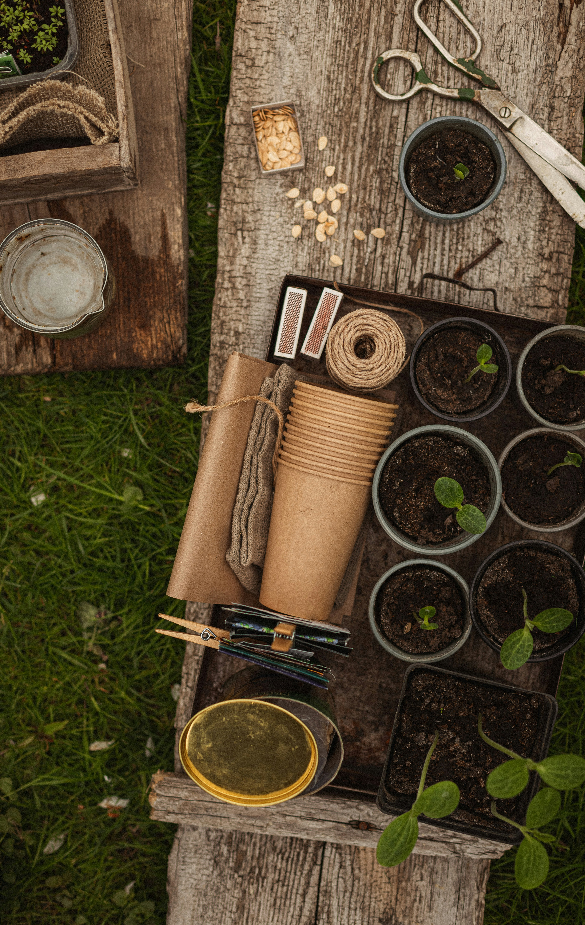
02. Collecting, planting and growing seeds
Kale starts off small and then blooms into a beautiful spectacle of yellow flowers loved by pollinators. One plant can produce hundreds of seeds.
The small black seeds grow in small containers and are super easy to collect in fall. When you collect your own seeds, you increase your level of self-sufficiency, you allow the plants to evolve in place, and you get to experience just how abundant nature is.
If you are stuck in a scarcity mindset, always feeling like you have too little time, money, or energy, seed collection could be the boost your mind needs. Kale, rocket (arugula), tomato, and chili peppers are easy food plants to grow from seed, and collect seeds from.

Slide 13
02. Collecting, planting and growing seeds
While many seeds can be bought in stores, it can be hard or impossible to buy seeds from native plants and flowers in your local area.
Collecting seeds from native flowers is a wonderful way to learn about and support your local ecosystems. Seeing a monoculture, like a lawn, transform from a green desert to a diverse flower field can serve as a needed reminder that change is not just possible, but it’s also beautiful and contagious.
On certain fall days, if the wind is right, the air above a native meadow can be so thick with drifting seeds it looks like snow, feels like magic - witnessing hope filling the air.

Slide 14
Tips & Tricks for collecting seeds:
Do no harm: Be careful with collecting seeds from foods bought at the supermarket as these seeds can bring with them harmful substances or disease.
Pay attention: Familiarise yourself with the local plants in your area by observing what grows where and when they bloom and go into seeds.
Research: When you locate an interesting plant in your area, check the origin of the plant using books, apps or by searching the internet to identify native and invasive species.
Ask for help: If you have a family or community member who are familiar with local plants, go to them with your questions and ask for help to get started.

Slide 15
Tips & Tricks for collecting seeds:
If you decide to buy seeds: Look for local, small seed companies that don’t treat the seeds with fungicides or herbicides. Search for terms like “heirloom” and “open-source pollinated” plus your region when you look for companies. Some examples of great seed companies include:
In Germany: https://www.bingenheimersaatgut.de/en/?srsltid=AfmBOopDsk4A6sPnRxIRiynIor6LyiW8IcKAFrKZc08r5sVKR6NinNEH
In the U.S.: https://www.rareseeds.com/store/plants-seeds/herbs

Slide 16
Growing up in "Oak Harbor" - a mini story by Marte
I’m from a place called Eigersund, meaning “oak harbor.” A few years ago, I planted four tiny oaks that were given to me by an old relative to plant in my grandmother’s garden on my family’s farm. Two oaks died, but two still grow larger as you read this. Closeby is an old oak, and below this tree I found tree nuts just a few days ago. I brought two acorns inside, as a reminder of how wonderful the natural world is, and the third I planted in the garden.
I had thought of the perfect place to plant it, but when I got there, I discovered that a tiny oak was already growing here. It must have self-planted and sprouted in the spring. What joy I felt. I planted the third acorn next to it. An act of joy and hope with no result in mind. When it sprouts is of no importance to me. I know it’s there.
To me, hope is knowing the potential, and trusting this will grow when the time is right.

Slide 17
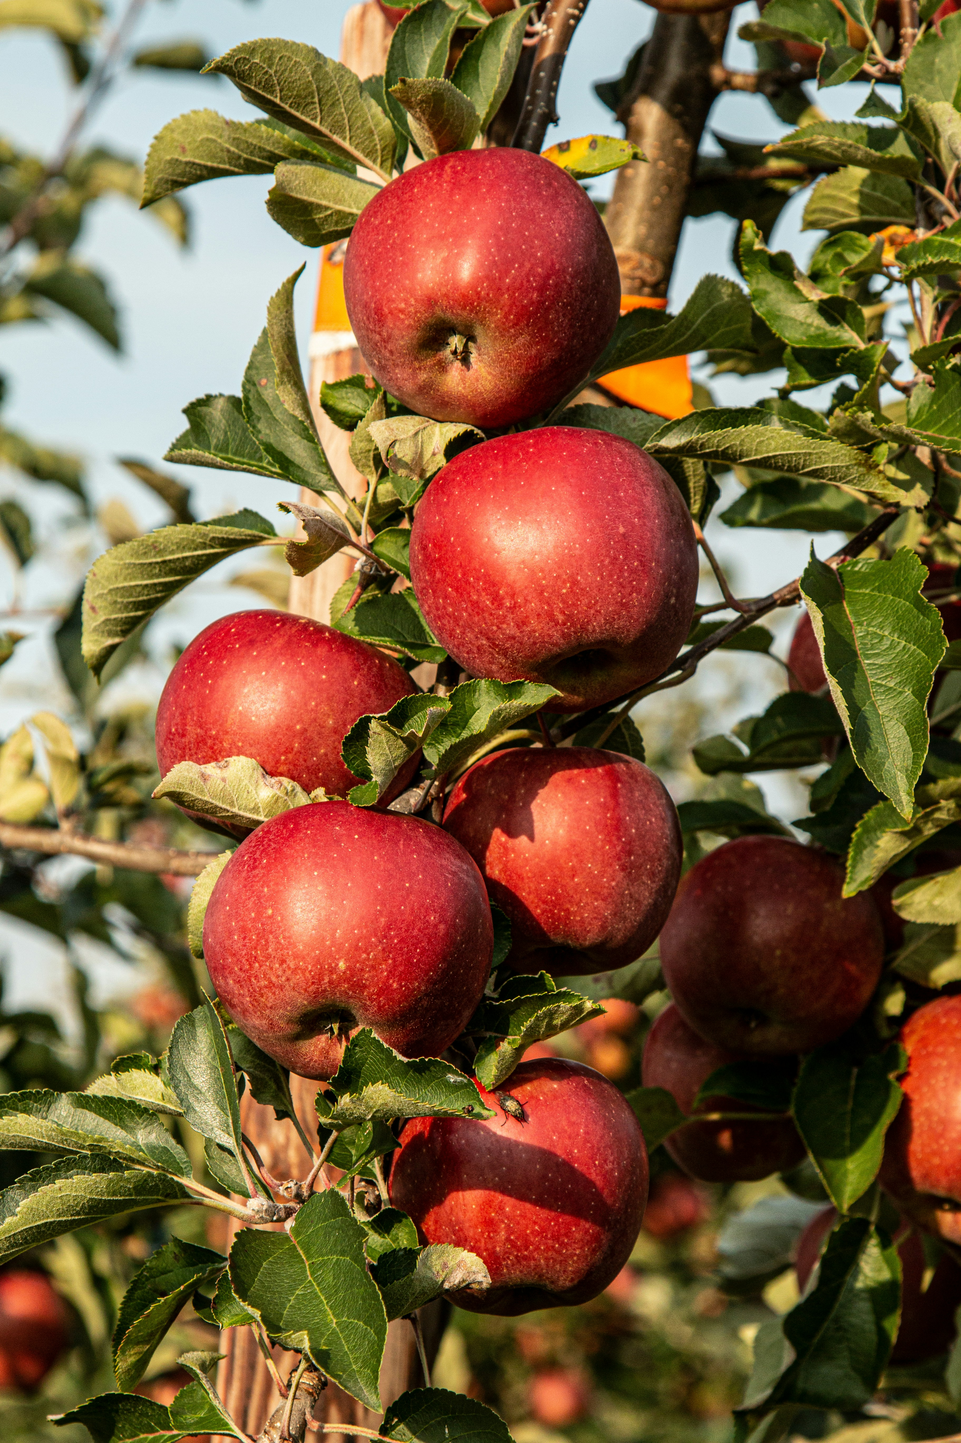
03. Companion Planting
Companion planting is a gardening technique where certain plants are grown together because they enhance each other’s growth.
Some plants provide shade, others deter pests, and some even enrich the soil with nutrients that benefit their neighbours. It’s a way of mimicking nature’s balance and working with the ecosystem rather than against it.
In the face of climate anxiety, companion planting is a practice that encourages mindfulness and connection with the earth.
By carefully choosing plant combinations, you not only promote growth but also create a small, thriving ecosystem in your own space. The act of planting with intention, knowing that each plant supports the other, can be a deeply satisfying way to feel engaged with the environment.

Slide 18
03. Companion Planting
There’s something about companion planting that reminds me of how communities work best when everyone brings their strengths to the table. Just as certain plants protect others, we can find hope in the idea that by working together, we’re stronger.
In times of climate uncertainty, it’s a reminder that we don’t have to face things alone, we can support one another and thrive in harmony, just like a well-planned garden.

Slide 19
Tips & Tricks for Companion Planting:
Research Pairings: Some plants naturally benefit each other (e.g., planting marigolds with tomatoes to deter pests). Learn about companion plants that thrive in your climate and garden.
Consider Space: Taller plants can provide shade for shorter ones that need protection from the sun.
Plant for Soil Health: Beans and peas, for example, enrich the soil with nitrogen, which can help other plants grow.
Rotate Plants: Practice rotating plant pairings each season to maintain soil health and keep pests at bay.
Observe Your Garden: Pay attention to how different plants interact over time. Companion planting can help you see the ways nature works together and adapt your practices to your specific environment.

Slide 20
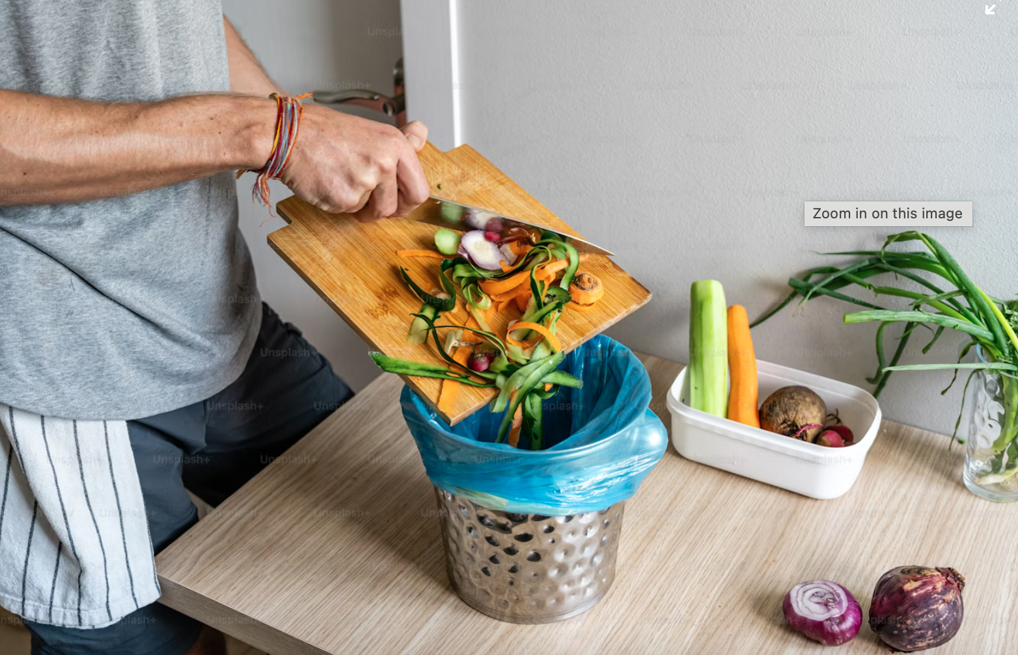
04. Composting
Composting is the process of recycling organic material, like kitchen scraps and garden waste, into nutrient-rich soil.
This practice not only reduces waste but also improves soil health and supports the life cycle of plants.
In a time when climate change can make us feel disconnected and powerless, composting offers a way to take an active role in regenerating the earth. Through composting, we become part of the natural process of decomposition, where death and decay are transformed into new life.
This cycle mirrors the process of grief and resilience, facing and processing challenges, transforming them into opportunities for growth. Composting is about seeing potential where others see waste, and it can help us build a deeper connection to the earth and create hope for renewal.

Slide 21
04. Composting
Composting can be a deeply hopeful practice.
When we throw our vegetable scraps into the compost bin, we are reminded that nothing is wasted, and that what seems like an ending is really just part of the cycle of renewal.
There’s something comforting about knowing that even when things break down, they can still contribute to new growth. Composting is a quiet, patient process, just like building hope and resilience, and it reminds me that we can start again.

Slide 22
Tips & Tricks for Composting:
Balance Greens and Browns: For healthy compost, you need a balance of green materials (like fruit and vegetable scraps) and brown materials (like dry leaves or newspaper). The greens provide nitrogen, and the browns provide carbon.
Turn the Pile: Regularly turning your compost helps to aerate it, speeding up the decomposition process.
Avoid Certain Materials: Don’t compost meat, dairy, or oils, as they can attract pests and slow the composting process.
Compost in Layers: Start with a layer of browns, then add greens, and alternate layers to keep your compost healthy and decomposing evenly.
Use Your Compost: Once your compost is ready, mix it into your garden soil to improve its nutrient content. This will help your plants grow stronger and healthier, just as nurturing hope helps build inner strength.

Slide 23
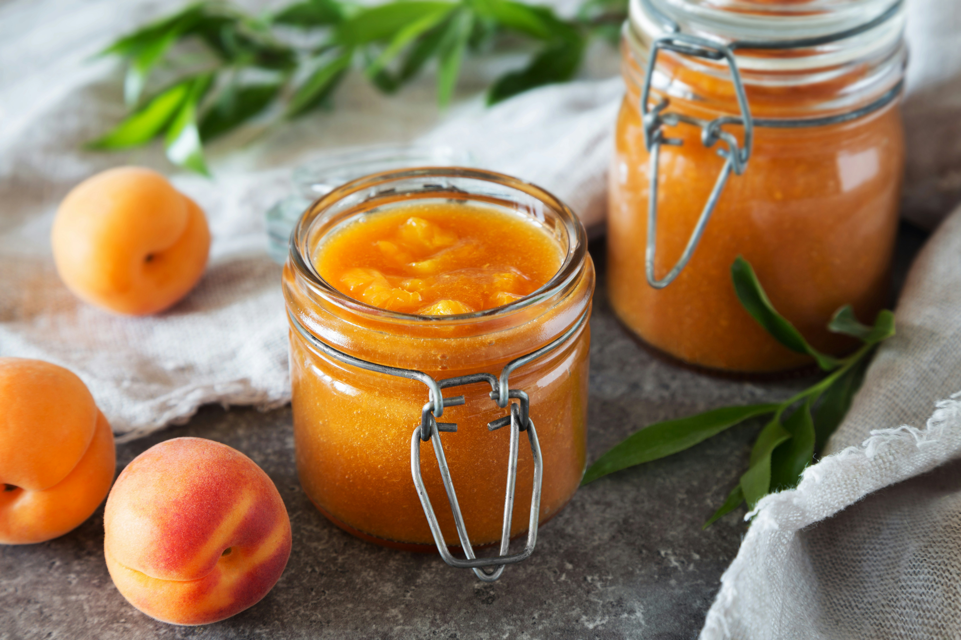
05. Preserving Food
Preserving food is a time-honored practice that celebrates nature’s abundance and strengthens our connection to seasonal cycles.
Preserving food is a time-honored practice that celebrates nature’s abundance and strengthens our connection to seasonal cycles. By learning techniques like canning, drying, fermenting, and pickling, we are able to extend the vibrant flavors and nutrients of each season, enjoying them year-round in creative ways. Preserving not only reduces food waste but also gives us the chance to engage directly with the produce we grow or select, instilling a deep appreciation for every ingredient. Imagine savoring sun-ripened tomatoes, crisp pickled cucumbers, or dried herbs in the cooler months - a reminder of summer’s warmth and the Earth’s generosity.
.

Slide 24
05. Preserving Food
Moreover, food preservation offers a rewarding sense of self-sufficiency, allowing us to fill our pantries with wholesome, homemade foods free from artificial preservatives. Each container becomes a symbol of care and respect for the food we consume. By embracing these practices, we cultivate a resilient, sustainable lifestyle that aligns with the rhythms of the natural world.
Food preservation is more than a skill; it’s a joyful and meaningful way to foster a sense of gratitude, nourish our well-being, and sustain hope for a future where we live harmoniously with nature. Through these simple, fulfilling acts, we learn to cherish what the Earth provides and to share that abundance with those around us

Slide 25
03
Journal Activities

Slide 26
Journal Activities
Becoming hopeful is a deeply personal process. Incorporating journaling into your practice of hope can help you reflect on your personal growth, and process your emotions and dreams along the way.

Slide 27
Journal activity #1:
Write a love letter (20 min)
Draw a mind map responding to the questions below with words and/or drawings. Spend 5 minutes on this activity.
What are your favorite things/places/people in the world?
What do you love about them?
When did you first discover them?
If they are no long with you, when did you lose them?
How can you show them that you care?
Write a love letter to someone or some place or something you mapped. Tell them thank you. Spend 15 minutes on this part.

Slide 28
Journal activity #2:
Dream World (15 mins)
Create an image of a world you dream of. Who is there? Where are you? What is possible here?
You can use words, too. If you completed the safe place exercise in the previous module, this may differ because it may incorporate many more places, people, things, and practices than you accounted for when creating your safe place.

Slide 29
Journal activity #3:
Hope as feeling and practice (15 min)
What does hope feel like in your body? Where do you feel it? Describe it! (5 min)
What kind of skills and practices help you cultivate a sense of hope? Make a list of 3 skills, as well as 3 practices that help you grow those skills. (10 min)

Slide 30
04
Resources
for further
exploration

Slide 31
Read (5 min): What if climate change meant not doom — but abundance? - an opinion article by writer and historian Rebecca Solnit.
Listen (5 min): Lean dás (I am always here) - a musical collaboration between artists and activists Mari Boine and Ella Marie Hætta Isaksen. About the song, Mari says, “It can be difficult to maintain hope in these dark times, but to surrender hope is to lose our will to (take) action, to render ourselves powerless.” She says the track “shines with hope” as “we joik (summon) the Universal Mother, Divine Source, Giver of Life, and Creative Force.”
Watch (30 min): Reservation Dogs - Comedy-drama television series created by Sterlin Harjo and Taika Waititi. It follows the lives of four Indigenous teenagers in rural Oklahoma as they are dealing with loss and grief while pursuing their dreams.

Slide 32
PLAY
The "Turn It Around" game can serve as a transformative tool to shift participants' perspectives and help them understand the power of hope as an active (rather than passive) force.
This module aims to emphasize that while the climate crisis presents unprecedented challenges, hope can inspire action and change, rather than paralyze us in fear or despair.

Slide 33
05
Step-by-Step
Guide for
Educators

Slide 34
Step-by-Step Guide for Educators:
Objective:
The goal is to help participants build a sense of active hope - hope that motivates them to take action in the face of climate change. This type of hope is rooted in the belief that while the challenges ahead are significant, solutions are possible when individuals and communities are committed to acting together.
Time:
30-45 minutes
Number of Participants:
Small groups (6-10)
or an entire class

Slide 35
STEPS:
Introduction to the Concept of Hope
in Climate Action:
Begin by discussing how hope can either empower or hinder action depending on how we view a situation. Explain the difference between passive hope ("I hope things will get better") and active hope ("I will find ways to care for the world"). Frame hope not as wishful thinking, but as something that inspires action.
01

Slide 36
Setting up the "Turn It Around" Game:
Present participants with a real-world scenario related to climate change that can be viewed from different perspectives.
For instance:
Despairing Vie: Rising temperatures, deforestation, loss of biodiversity, and the slow pace of governmental action lead to a sense of helplessness and despair.
Hopeful View: Communities are increasingly coming together to develop innovative solutions, such as renewable energy projects, forest protection and reforestation efforts, and global youth-led climate movements, and such efforts again and again lead to positive change..
02

Slide 37
Game Execution:
NDivide participants into two groups. One group will analyze the situation from a despairing viewpoint (focusing on overwhelming challenges), while the other group will focus on reasons for hope and action (highlighting community and solutions).
After a few minutes of discussion, swap perspectives: the group that focused on the desparing view will now highlight hopeful aspects, while the hope-oriented group will turn to discuss the challenges.
This reversal shows participants how their perspectives can shift by consciously choosing to focus on different aspects of climate change For some, this game can transform despair into action-oriented hope. For others, such a transformation might require more time and sustained practices, involving grief, care and community. This is OK.
03

Slide 38
Group Reflection:
NAfter the exercise, bring the groups together to reflect on how shifting perspectives changed their emotional response to climate change. Discuss the psychological and social benefits of maintaining an active sense of hope, particularly in tackling complex issues like the climate crisis.
Ask participants: What did you feel when focusing on despair? How did that change when you “switched” to hope? Encourage them to identify actions that can be taken to support hope in the face of challenges, with a focus on care.
04

Slide 39
Why This Game is Effective in the Hope Module:
Empowers action: Participants learn that they have agency over how they address the climate crisis, which can be a powerful motivator for taking action rather than feeling defeated.
Shifts mindset: The game demonstrates that while it’s easy to feel overwhelmed by the scale of the climate crisis, changing one’s perspective can lead to seeing possibilities for solutions and resilience.
Fosters collective understanding: By engaging in group discussions, participants learn that collective hope and action are more effective in creating meaningful change.

Slide 40
Thank you
Any Questions?
www.planet-pulse.eu

